Slide 1

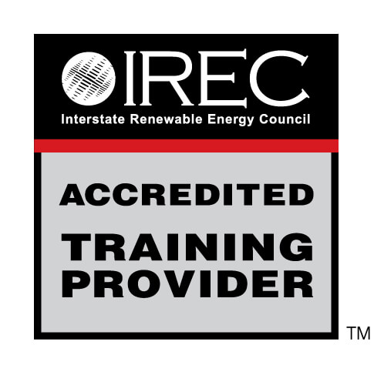


WEATHERIZATION INSTALLER/TECHNICAN FUNDAMENTALS
Combustion Safety
1
1
GJA 2025 Version III
GJA 2025 Version III
Notes:
July 2012
<number>

Slide 2
Learning Objectives
By attending this session, participants will be able to:
  Explain the health and safety issues related to combustion equipment.
  State the basics of combustion equipment inspection.
  Explain why different vent pipe materials are required for different appliances.
  Describe worst case combustion appliance zone (CAZ) testing.
  Demonstrate how to conduct a duct inspection.
2
2
GJA 2025 Version III
GJA 2025 Version III
Notes:
By attending this session, participants will be able to:
Explain the health and safety issues related to combustion equipment.
State the basics of combustion equipment inspection.
Explain why different vent pipe materials are required for different appliances.
Describe worst case combustion appliance zone (CAZ) testing.
Demonstrate how to conduct a duct inspection.
Present this slide as an interactive discussion, soliciting personal examples from the trainees. Add your own personal examples and knowledge to supplement.
July 2012
<number>

Slide 3
House as a System
COMBUSTION SAFETY
The House is a System
When we air seal and insulate,
we change how the house operates.
We need to inspect and test to make sure
the house is safe when we leave.
3
3
GJA 2025 Version III
GJA 2025 Version III
Notes:
The house is a system. Changes to one aspect of the house, like the air barrier, cause changes in other aspects of the house, like indoor air quality (IAQ) and moisture movement.
When we air seal and insulate, we change how the house operates.
Our biggest responsibility as weatherization technicians is to ensure the safety of our clients. Every home should be tested and inspected for safety before heading home every evening in case there are potentially lethal conditions. Dangerous conditions can arise quickly when a home with combustion appliances is air sealed before pressure imbalances have been addressed.
Air sealing and insulating a home reduces the heating and cooling load. A replacement furnace in a sealed and insulated home can be smaller than the existing furnace. The initial price of the smaller unit is lower and the long-term operating costs will be less.
July 2012
<number>

Slide 4
House as a System
COMBUSTION SAFETY
Making the house tighter could:
  Make existing problems worse.
  Create new problems.
  These existing and new problems could be lethal.
  Gas leaks
  Carbon monoxide
  Backdrafting
  Moisture and mold
  Most of the potentially lethal problems involve combustion appliances, like the furnace or water heater.
4
4
GJA 2025 Version III
GJA 2025 Version III
Notes:
Making the house tighter could:
Make existing problems worse.
Create new problems – Moisture and gas leaks that might not have been problems when the home was leaky will become new problems if those issues aren’t addressed before sealing the home.
These existing and new problems could be lethal.
Gas leaks
Carbon monoxide (CO)
Backdrafting
Moisture and mold
Most of the potentially lethal problems involve combustion appliances like the furnace or water heater.
Q: What do you think happens to the indoor air quality if there’s no exhaust fan in the bathroom and we seal the house up super tight?
A: We probably cause moisture issues in that house.
Q: Given the dangers to IAQ, is it possible to seal a house up too tight? Should installers leave the house leaky for fresh air and indoor air quality?
A: Leaving a home leaky does not ensure adequate ventilation all the time. There may be forces that prohibit airflow, and the source of that incoming air may be a musty attic or crawl space. The air might not be so fresh. Seal tight, ventilate right.
July 2012
<number>

Slide 5
What to Inspect
COMBUSTION SAFETY
What do we inspect on combustion appliances?
  Chimney
  Vent pipe
  Fuel leaks
  Wiring
  Heat exchanger
  Distribution (fan and ducts, if applicable)
5
5
GJA 2025 Version III
GJA 2025 Version III
Notes:
What do we inspect on combustion appliances?
Chimney
Vent pipe
Fuel leaks
Wiring
Heat exchanger
Distribution (fan and ducts, if applicable)
Combustion appliances can quickly create deadly IAQ. Most of the visual inspection focuses on elements that can let CO or other toxic combustion gases into the living areas: the chimney, vent pipe, heat exchanger, and distribution system.
July 2012
<number>

Slide 6
What to Test
COMBUSTION SAFETY
What do we test for on combustion appliances?
  Fuel leaks
  Correct operation of safety devices
  Fuel input rate
  Proper combustion air
  Worst-case draft
  Carbon monoxide
  Combustion efficiency
6
6
GJA 2025 Version III
GJA 2025 Version III
Notes:
What do we test for on combustion appliances?
Fuel leaks – Use a gas leak detector, then soap bubbles to pinpoint the leak. Soap bubbles will set off the gas leak detector.
Correct operation of safety devices – In appliances with a pilot light, blowing out the pilot should trip the safety shutoff, turning off gas to the pilot.
Fuel input rate – Turn off all gas appliances except the one you are measuring, and monitor the gas meter.
Proper combustion air – Measure CO levels in undiluted flue gases. If less than or equal to 25 parts per million (ppm), there is enough combustion air. We can also do volume calculations.
Worst-case draft – The worst-case draft CAZ testing reveals if unsafe conditions could be created within the home with the home’s existing appliances, vents, fans, etc.
With combustion appliances off or on the pilot setting, produce the worst-case depressurization that can be created in the combustion appliance zones with exhaust fans and doors/windows. Then, starting with the lowest BTU appliance first, fire the appliances and test for spillage and CO. If spillage continues for more than one minute under these conditions, test again under normal conditions. If the maximum depressurization is smaller than 5 Pa, most natural draft appliances (those that take their combustion air from inside the home, also often referred to as atmospherically vented combustion appliances) will vent safely.
Water heaters are the exception. If the CAZ is depressurized to a mere 2 Pa, something must be done to ensure proper drafting.
Carbon monoxide – A gas sniffer is used to measure CO in undiluted flue gases.
Combustion efficiency – This is a function of the composition of the flue gases and flue gas temperature.
Ask students how to test for each item on the list.
July 2012
<number>

Slide 7
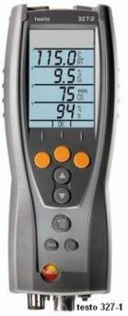
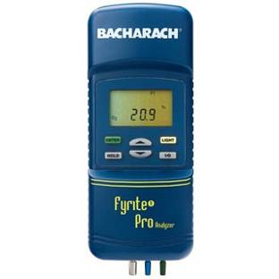
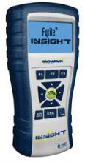
Combustion Analyzers
COMBUSTION SAFETY
Bacharach
Fyrite Pro
Bacharach
Fyrite Insight
Testo 327-1
Images courtesy of Bacharach and Testo
7
7
GJA 2025 Version III
GJA 2025 Version III
Notes:
A wide range of combustion analyzers are available. Combustion analyzers must read:
Flue temperature.
Free oxygen.
Carbon monoxide (CO).
July 2012
<number>

Slide 8
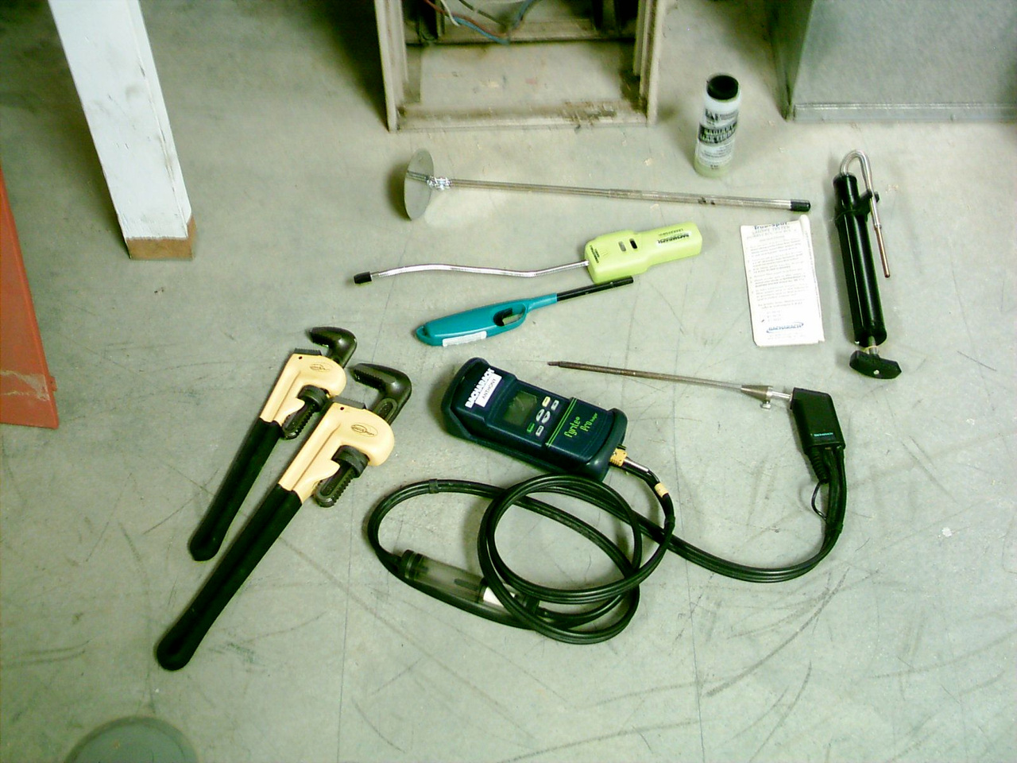
Combustion Safety Equipment
COMBUSTION SAFETY
Photos courtesy of the US Department of Energy
8
8
GJA 2025 Version III
GJA 2025 Version III
Notes:
Combustion appliance inspection tools:
Mirror
Gas leak detector
Long lighter
Pipe wrenches
Combustion analyzer
Flue gas analyzer
Soap solution
July 2012
<number>

Slide 9
Inspection – Chimney & Vent Pipe
COMBUSTION SAFETY
Inspection – Chimney and Vent Pipe
  Is it rusty? Are there holes? Is it falling apart?
  Is the chimney blocked?
  Is it too short?
  Are the correct materials used? Is it the right kind of vent pipe?
  Is it too small or too large for the appliances connected to it?
  Does it need a chimney liner?
9
9
GJA 2025 Version III
GJA 2025 Version III
Notes:
Chimney and vent pipe inspection
Is it rusty? Are there holes? Is it falling apart?
Is the chimney blocked?
Is it too short?
Are the correct materials used? The right kind of vent pipe?
Is it too small or too large for the appliances connected to it?
Does it need a chimney liner?
A visual inspection can answer all of these questions. Inspect to ensure the chimney is:
Made of the proper material for the appliance.
In sound condition.
Properly sized.
July 2012
<number>

Slide 10
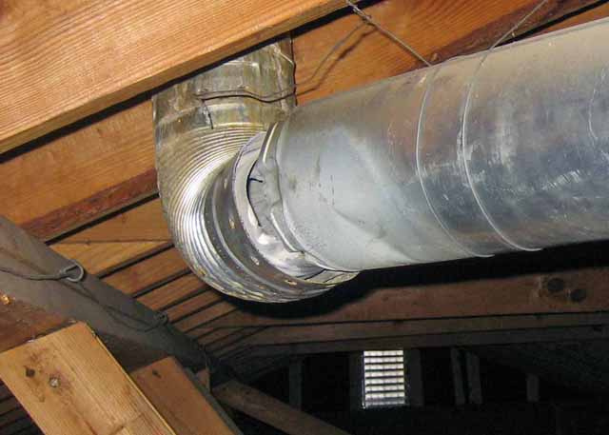
COMBUSTION SAFETY
Photo courtesy of NRCERT
Notes:
Is it rusty? Are there holes? Is it falling apart?
It’s clear where we want the air to go, but air follows the path of least resistance. The whitish residue on the pipe shows where flue gases have been escaping into the attic.
Q: What problems might this leak cause, besides wasting energy?
A: CO could build up in the living space. Escaping heat could also melt snow on the roof and cause ice dams or create condensation on the roof deck and cause mold or mildew.
July 2012
<number>

Slide 11
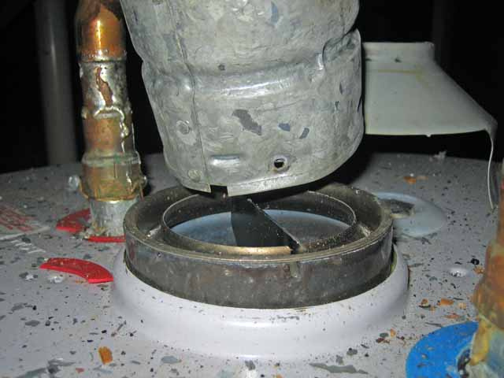
COMBUSTION SAFETY
Photo courtesy of NRCERT
Notes:
Is it rusty? Are there holes? Is it falling apart?
Again, it’s clear where we want the air to go, but the air doesn’t know that.
July 2012
<number>

Slide 12

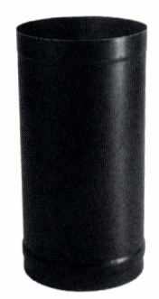
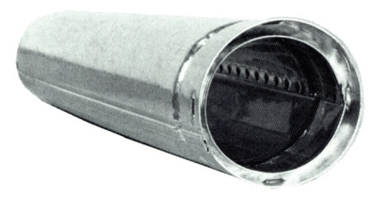
Vent Pipe
COMBUSTION SAFETY
B-vent
L-vent
Single-wall
black pipe
Photos courtesy of various manufacturers
12
12
GJA 2025 Version III
GJA 2025 Version III
Notes:
The vent pipe materials required for the job vary based on the type of equipment and location.
Q: What type of vent is appropriate for a wood stove?
A: Single-wall 24-gauge black steel, or shielded single-wall (e.g., Duravent) if it’s in conditioned space; double-wall stainless with insulation between walls if it’s in unconditioned space.
Q: Where do we use an L-vent?
A: In oil-burning appliances.
July 2012
<number>

Slide 13
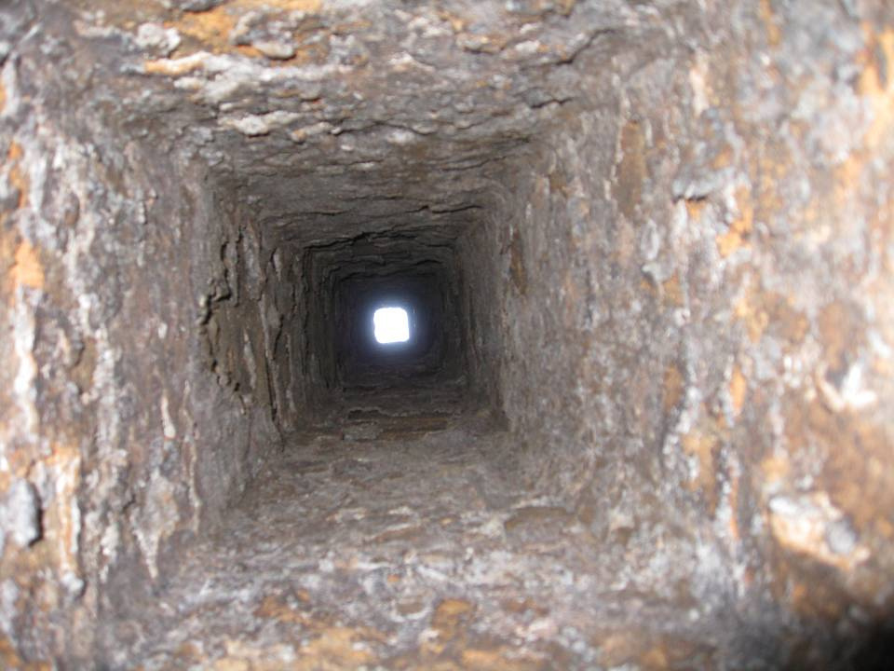
COMBUSTION SAFETY
Photo courtesy of NRCERT
Notes:
Is the chimney blocked?
Upon visual inspection, you should see daylight at the top of the chimney.
Q: What’s missing in this chimney?
A: A chimney liner.
Q: Why is a liner sometimes necessary?
A: For a degraded chimney.
A: The chimney is too large to adequately match the venting design criteria of an appliance (orphaned hot water tank, gas tank, etc.)
July 2012
<number>

Slide 14
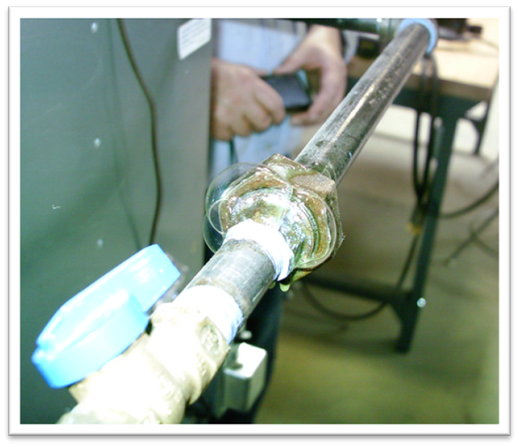
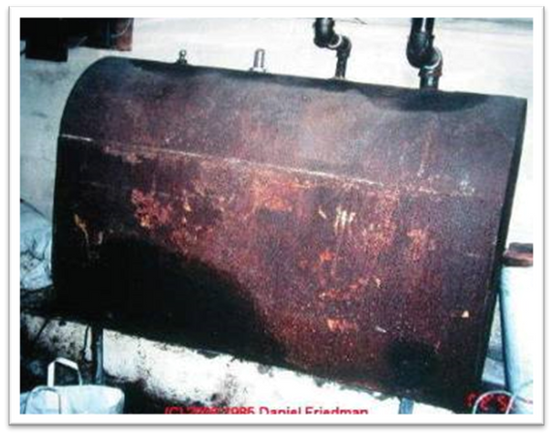
Inspection – Fuel Leaks
Photo courtesy of the US Department of Energy
Photo courtesy of NRCERT
Gas leak detector for
gas and propane
Visual inspection and the personal sniff test for fuel oil
14
14
GJA 2025 Version III
GJA 2025 Version III
Notes:
We inspect differently for the different fuel types.
Gas leak detector and soap bubbles for gas and propane (industry accepted measures)
Visual inspection and the personal sniff test for fuel oil
July 2012
<number>

Slide 15
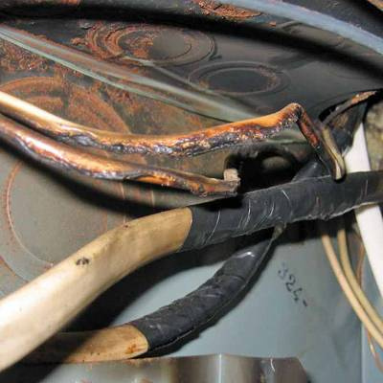
Inspection – Wiring
COMBUSTION SAFETY
  Is wiring burnt?
  Is insulation on
  wiring missing or deteriorated?
  Is heating system
  on its own circuit?
  Is thermostat the correct type?
  Is thermostat installed in a suitable location?
Photo courtesy of NRCERT
15
15
GJA 2025 Version III
GJA 2025 Version III
Notes:
Is wiring burnt?
Is insulation on wiring missing or deteriorated?
Is the heating system on its own circuit?
Is the thermostat the correct type?
Is the thermostat installed in a suitable location?
The discolored and melted plastic on this wiring indicates something isn’t working quite as it should. Do not work on unsafe appliances.
July 2012
<number>

Slide 16
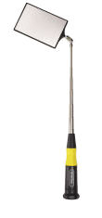
Inspection – Heat Exchanger
COMBUSTION SAFETY
  Use a strong light and an inspection mirror.
  Is the heat exchanger rusty?
  Are there cracks?
Image courtesy of generaltools.com
16
16
GJA 2025 Version III
GJA 2025 Version III
Notes:
Use a strong light and an inspection mirror.
Is the heat exchanger rusty?
Are there cracks?
A strong flashlight and adjustable mirror are crucial to getting a good look at the heat exchanger.
July 2012
<number>

Slide 17
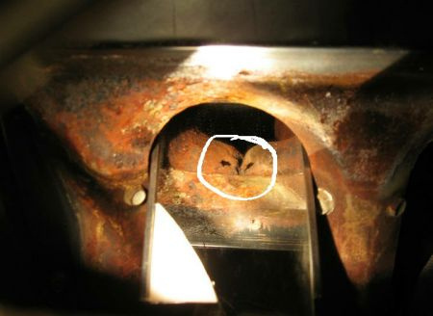
COMBUSTION SAFETY
Photo courtesy of NRCERT
Notes:
Corroded heat exchangers leak carbon monoxide.
If the integrity of the heat exchanger is compromised by a crack or hole, combustion by-products will leak into the air distribution system and enter the living space.
July 2012
<number>

Slide 18
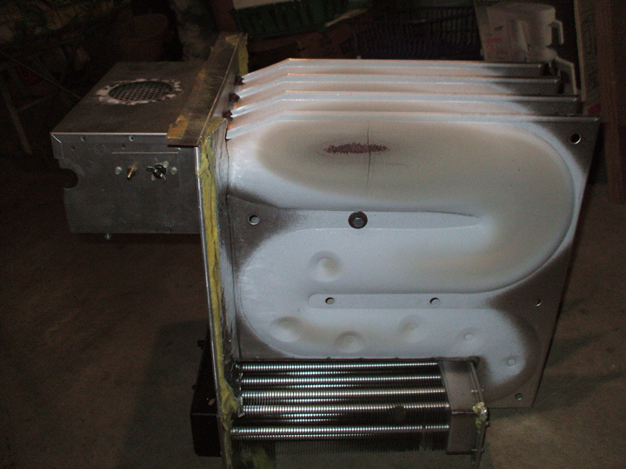
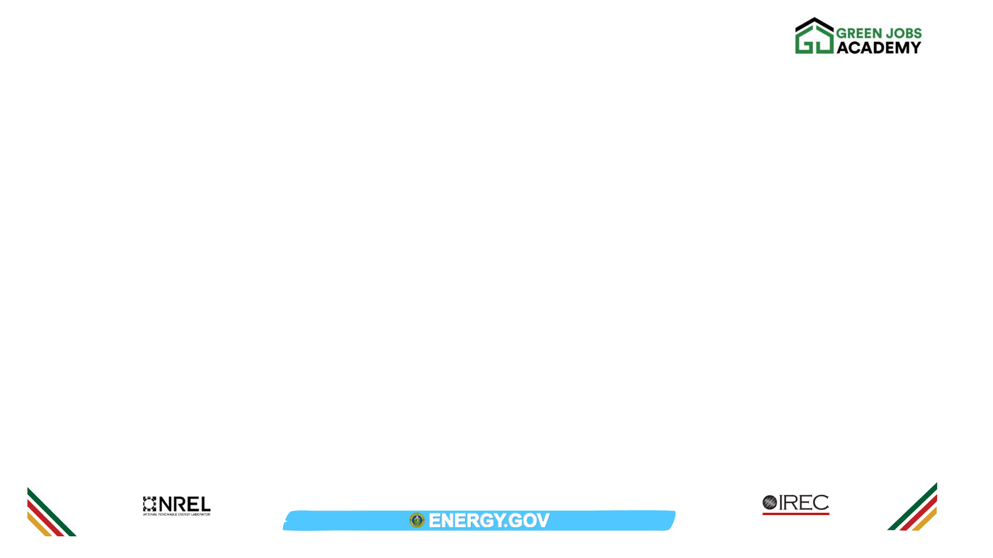
Cracks will cause problems
Photo courtesy of NRCERT
Notes:
Carbon monoxide will leak from that crack and taint the indoor air.
July 2012
<number>

Slide 19
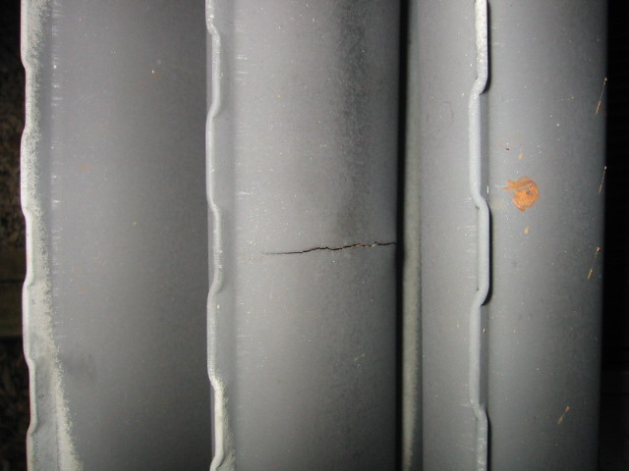
COMBUSTION SAFETY
Crack
Photo courtesy of NRCERT
Notes:
If the heat exchanger is cracked, the best option is to replace the furnace with a 90+ version. These direct-vented appliances are safer since they take combustion air directly from the outside.
July 2012
<number>

Slide 20
Inspection – Distribution (Ducts)
  Is there a return in the combustion appliance zone?
  Is the filter slot too big and uncovered?
  Is the filter present? Is the filter dirty?
  Is the air handler fan clean?
20
20
GJA 2025 Version III
GJA 2025 Version III
Notes:
Is there a return in the combustion appliance zone? During duct inspection, get an idea of how the entire system works by noting the locations and sizes of returns and supplies.
Is the filter slot too big and uncovered? The filter won’t be effective if there are gaps for air to bypass the filter.
Is the filter present? Is the filter dirty?
Is the air handler fan clean? If the air handler fan is dirty, the filters aren’t working and the fan can’t work as efficiently as it should.
July 2012
<number>

Slide 21
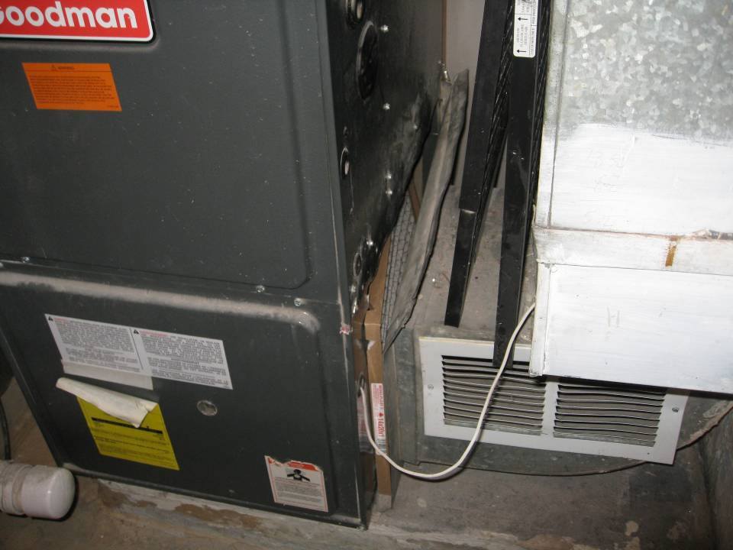
COMBUSTION SAFETY
Photo courtesy of NRCERT
Notes:
This is a photo of a furnace filter.
The black soot on the appliance indicates that this filter is not effective.
July 2012
<number>

Slide 22
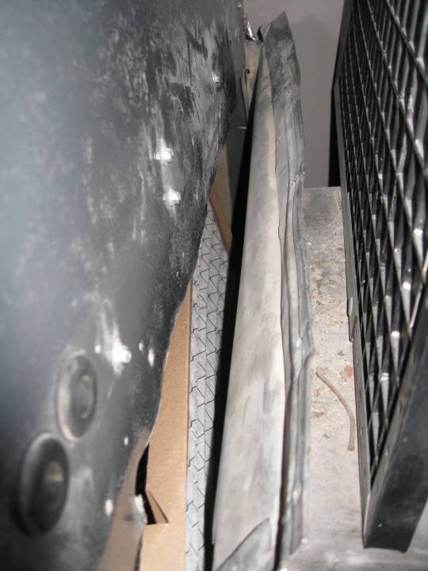
22
22
Photo courtesy of NRCERT
GJA 2025 Version III
GJA 2025 Version III
Notes:
This is a closer look at a photo of a furnace filter.
Air will take the path of least resistance, which in this case is not through the filter.
July 2012
<number>

Slide 23
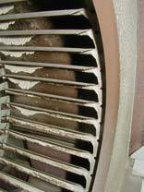
COMBUSTION SAFETY
Photo courtesy of NRCERT
Notes:
This photo shows a dirty air-handler fan.
The dust build-up on this fan indicates an ineffective filter. Clean the fan and replace the filter.
Q: Will this fan move as much air as a clean fan?
A: No. Think of fan blades like shovels. A clean shovel can move material effectively. Shoveling sticky snow, or wet, clayey soil is less effective, because material sticks to the shovel, making it heavier and reducing capacity. Fans work the same way.
Ask students if they clean fans in their programs.
July 2012
<number>

Slide 24
Summary
COMBUSTION SAFETY
  For combustion safety, visual and diagnostic inspection of combustion appliances is critical to protecting clients and workers.
  Negative home pressure, chimney obstructions, or insufficient combustion air can cause unsafe levels of CO.
  CAZ worst-case draft testing reveals potentially dangerous conditions.
  Filters, ducts, and air handling units are part of combustion safety.
24
GJA 2025 Version III
Notes:
For combustion safety, visual and diagnostic inspection of combustion appliances is critical to protecting clients and workers.
Negative home pressure, chimney obstructions, or insufficient combustion air can cause unsafe levels of CO.
CAZ worst-case draft testing reveals potentially dangerous conditions.
Filters, ducts, and air-handling units are part of combustion safety.
Present this slide as an interactive discussion, soliciting personal examples from the trainees. Add your own personal examples and knowledge to supplement.
July 2012
<number>

