Slide 1




Moisture Barriers
WEATHERIZATION INSTALLER/TECHNICIAN FUNDAMENTALS
1
GJA 2025 Version III

Slide 2
Learning Objectives
Moisture BARRIERS
By attending this session, participants will be able to:
Identify symptoms of moisture problems in houses.
Name sources of moisture.
State moisture terms and concepts.
List moisture tools and their functions.
Demonstrate moisture barrier installation.
Describe roof repair techniques.
(Continued on next slide)
2
GJA 2025 Version III
Notes:
By attending this session, participants will be able to:
Identify symptoms of moisture problems in houses.
Name sources of moisture.
State moisture terms and concepts.
List moisture tools and their functions.
Demonstrate moisture barrier installation.
Describe roof repair techniques.
Present this slide as an interactive discussion, soliciting personal examples from the trainees. Add your own personal examples and knowledge to supplement.

Slide 3
Learning Objectives
Moisture BARRIERS
By attending this session, participants will be able to:
Identify flashing locations.
State basement and crawl space retrofit options as related to moisture issues.
Identify techniques for basement and crawl space retrofits.
Demonstrate moisture assessment logic, and list various moisture control strategies.
3
GJA 2025 Version III
Notes:
Participants will also be able to:
Identify flashing locations.
State basement and crawl space retrofit options as related to moisture issues.
Identify techniques for basement and crawl space retrofits.
Demonstrate moisture assessment logic, and list various moisture control strategies.

Slide 4
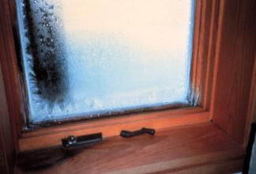
Symptom #1
Excessive window condensation
4
Photo courtesy of PA WTC
GJA 2025 Version III
Notes:
Moisture barriers and vapor retarders stop or hinder moisture movement. In this photo, the moisture source is inside the house, so we want to solve that problem before installing a barrier.
Excessive window condensation in a cold climate may be evidence of a high moisture load and windows with poor thermal characteristics. For instance, the cold surface of a single pane of glass on a cold winter day is much more susceptible to condensation than a more thermally efficient double-pane window. Window condensation in non-air conditioned houses is a seasonal occurrence. Even if there is no condensation at the time of the assessment, water staining along the window sill may indicate that condensation has occurred.
Try to avoid lengthy discussion of condensation at this point. The principles of condensation will be discussed later.

Slide 5
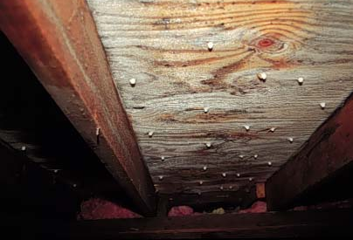
Symptom #2
Frost on underside of roof sheathing
5
Photo courtesy of PA WTC
GJA 2025 Version III
Notes:
Wet or frosted roof sheathing may indicate a high moisture load and air leaks to the attic.
Often in this situation, the homeowners think they have roof leaks, but no amount of moisture barriers on the roof will stop this. The moisture is actually coming from inside the home and condensing on the roof deck. When it drips onto the ceiling, it looks just like a roof leak.
Air sealing the attic floor prevents the moisture-laden air from leaking into the attic and condensing on the roof deck.

Slide 6
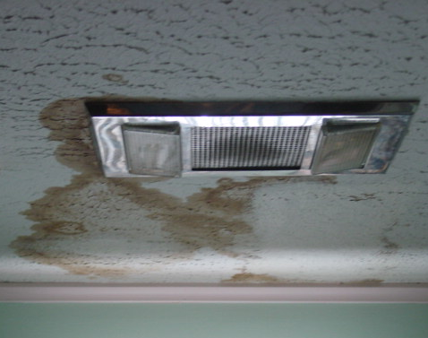
Moisture Sources
Moisture BARRIERS
  Foundations
  Unvented space heaters
  Unvented dryers
  Disconnected ventilation fans
  Drying wood indoors
  Excessive mechanical or passive humidification
Photo courtesy of PA WTC
These water stains are a result of fan venting into the attic.
6
GJA 2025 Version III
Notes:
Foundations – Leaky or cracked foundations, allowing bulk moisture intrusion, account for the majority of moisture problems. Poor grading around the foundation exacerbates the problem.
Unvented space heaters – A major byproduct of combustion is water vapor⎯1 gallon of water vapor per 100,000 BTUs.
Unvented dryers – Disconnected dryer vents allow large amounts of moisture into the house.
Disconnected ventilation fans – Attic surfaces can deteriorate if moisture from a bathroom or kitchen exhaust fan is allowed to escape into the attic. Ventilation fans must be vented to the outdoors.
Drying wood indoors – Freshly cut firewood releases a lot of moisture during the curing process and should never be stored indoors.
Excessive mechanical or passive humidification – Homeowners often choose mechanical humidification for comfort or health reasons. The problem is that elevated levels of moisture vapor may increase the moisture load in the house, resulting in mold or condensation. Passive humidification can be caused by other lifestyle choices, including plants, aquariums, and cooking without mechanical ventilation.
Q: Can you think of any others?
A: A large family in a small and tight house without ventilation. One person releases almost 5 quarts of water per day through the natural process of respiration.

Slide 7
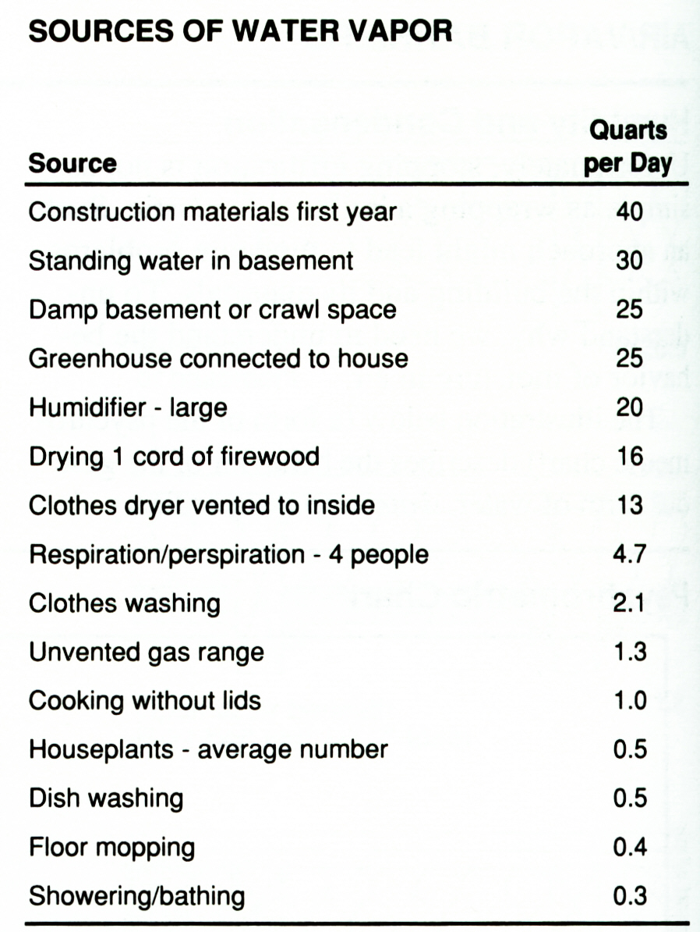
Sources of Water Vapor
Moisture BARRIERS
7
GJA 2025 Version III
Notes:
Go through the chart of water vapor sources, from largest to smallest.

Slide 8
Important Terms and Concepts
Condensation: Water vapor transformed to liquid water.
Evaporation: Liquid water transformed to water vapor.
Absolute Humidity (vapor pressure): The ratio of water vapor to a given volume of air.
Relative Humidity (RH): The ratio of the amount of moisture in the air compared to amount of moisture that the air can hold.
Dew Point: The temperature at which condensation occurs.
8
GJA 2025 Version III
Notes:
Condensation − Water vapor transformed to liquid water.
Evaporation − Liquid water transformed to water vapor.
Absolute humidity − The ratio of water vapor to a given volume of air (also known as vapor pressure).
Relative humidity − The ratio of the amount of moisture in the air to the amount of moisture that the air can hold, expressed as a percentage.
RH is influenced by temperature and vapor pressure.
Warm air can hold more moisture vapor than cold air.
At 100% RH, condensation happens on all hard surfaces.
If there is no hard surface, there is no condensation. Every raindrop has a speck of dust inside it.
Dew point − The temperature at which condensation occurs.
This is also known as saturation. If the air cannot hold any more moisture (as a function of temperature and vapor pressure), the air is saturated.
Moisture will condense on a surface whose temperature is at or below the dew point of the air next to it.
Do a simple demonstration of RH and dew point. Refer to Lesson Plan.

Slide 9
RH: Things to Remember
Warm, wet air contacting cold surfaces creates condensation instantly.
Cold winter air typically contains very little moisture and therefore has a low RH. When that air is heated, the RH drops even lower.
RH below 15% can lead to respiratory problems,
failure of furniture glue, and other problems.
9
GJA 2025 Version III
Notes:
Things to remember include:
Warm, wet air contacting cold surfaces creates condensation instantly.
Cold winter air typically contains very little moisture and therefore has a low RH. When air is brought indoors and heated, the RH drops even further.
RH below 15% can lead to respiratory problems and furniture glue failure, as well as other problems.

Slide 10
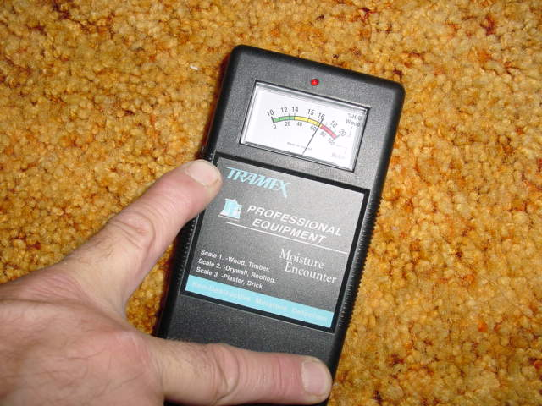
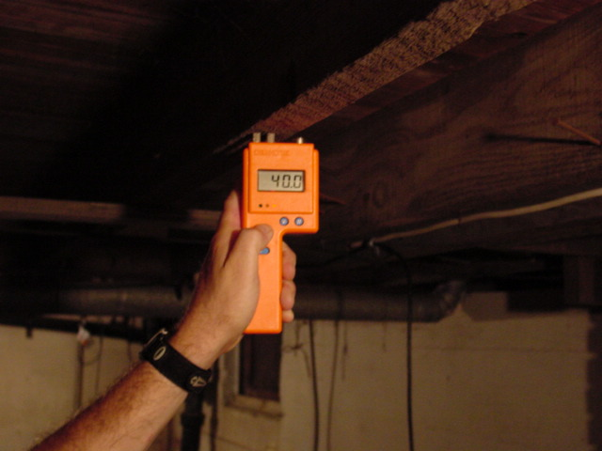
Moisture Meters
Moisture BARRIERS
10
Photos courtesy of PA WTC
GJA 2025 Version III
Notes:
Moisture meters measure the moisture level in wood and other building materials.
In these photos, readings are taken to determine the level of moisture in the floor framing and carpet directly above a waterlogged basement.
Left photo: A contact moisture meter reads the moisture content of the floor framing. Contact meters penetrate the materials to take readings from beneath what may appear to be a dry surface. The pins leave small holes in the walls or framing.
Right photo: A non-contact meter reads the moisture level of the carpet above.
A pocket knife is also useful in determining moisture levels in wood. Wet lumber is softer than dry lumber and the blade of a pocket knife will penetrate saturated wood quite easily.

Slide 11
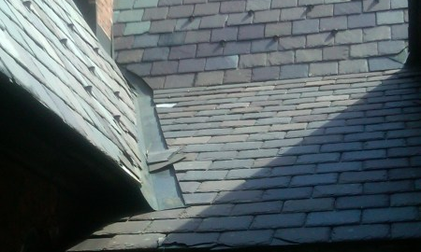
Roof Flashing Locations
Moisture BARRIERS
Valleys and roof edges are important locations for proper flashing.
Photo courtesy of www.stewartroofing.com
11
GJA 2025 Version III
Notes:
Valleys, changes in roof slope, and edges are important flashing locations. Shingles should overlap the flashing and the entire assembly should effectively shed water away from the home.

Slide 12
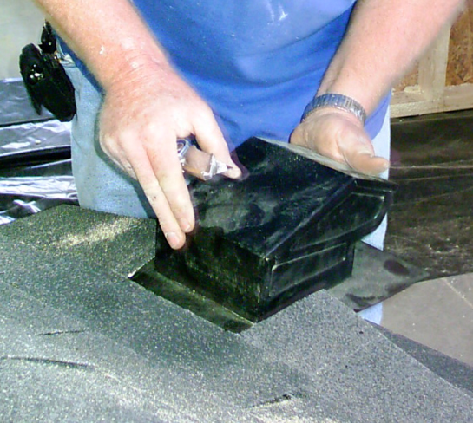
Vent Installation
Moisture BARRIERS
Cut hole to fit;
test fit vent.
Caulk edges of hole where flange will sit.
Slide vent into place under shingles.
Seal and nail.
Photo courtesy of the US Department of Energy
12
GJA 2025 Version III
Notes:
When installing roof vents, follow these guidelines to prevent later moisture leaks.
Cut the appropriately size hole and test-fit the vent. The flange is designed to slide under the roofing.
Once a proper fit is established, remove the vent and caulk a bead of roof cement under the shingles around the edges where the flange will sit.
Slide the vent into position, caulk with roof cement, and fasten through the roof deck with galvanized roofing nails.
Cover nail heads with roof cement. Nails should not be exposed.

Slide 13
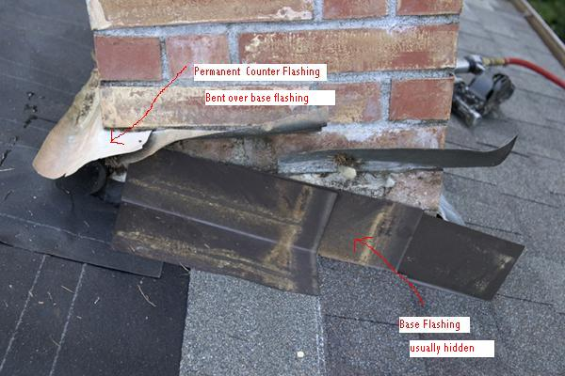
Chimney Flashing
Moisture BARRIERS
Stepped flashing, combined with effective over-flashing, protects the chimney penetration from moisture intrusion.
Photo courtesy of www.stewartroofing.com.
13
GJA 2025 Version III
Notes:
When reflashing a chimney to prevent water intrusion, use step flashing instead of continuous flashing down the slope.
Note how the individual flashing pieces are stepped.
Beginning from the lowest part of the slope adjacent to the chimney, insert flashing pieces underneath each shingle and overlapping the previous shingle.
Spread roof cement on the backside of the flashing in contact with the masonry chimney.

Slide 14
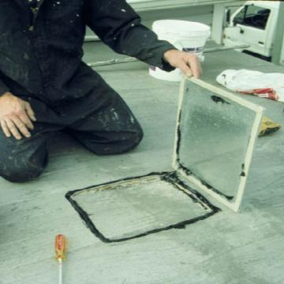
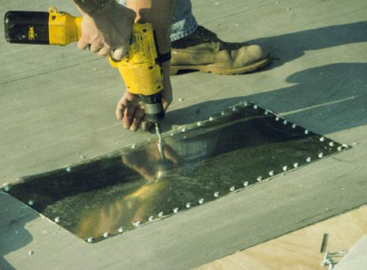
Mobile Home Roof Repair #1
Moisture BARRIERS
Photos courtesy of PA WTC
Bend the roof flap down and overlap the seams with a
precut piece of galvanized metal roofing.
Back-caulk the patch with
high-temperature silicone caulk,
and attach with hex head screws set every 2 inches.
14
GJA 2025 Version III
Notes:
When repairing a mobile home roof, follow these guidelines—whether covering holes cut for insulation installation or repairing pre-existing leaks.
Bend down the roof flap and overlap the seams with a precut piece of galvanized metal roofing.
Back-caulk the patch with high-temperature silicone caulk and attach with hex head screws set every 2 inches.
Note: For pre-existing leaks, it’s unlikely you’ll have a perfectly fitting roof flap like the one shown here. Create the best patch possible and follow the rest of the procedure. Be sure to remove any debris or rotten edges first so you’re caulking and patching onto a stable surface.

Slide 15
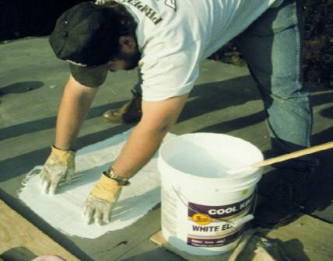
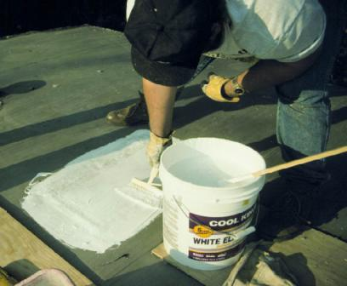
Mobile Home Roof Repair #2
Photos courtesy of PA WTC
Cover with two coats of elastomeric roof
coating over fiberglass mesh
15
GJA 2025 Version III
Notes:
Follow these instructions:
Cover with two coats of elastomeric roof coating over fiberglass mesh.
Seal seams and edges with the same elastomeric roof coating.

Slide 16
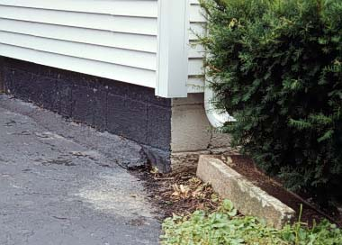
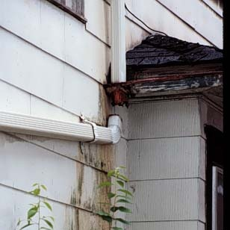
Visual Assessment – Exterior
Driveway slopes back
into foundation, carrying moisture there.
A disconnected downspout causes water to pour down walls during weather events.
Water Mismanagement
Photos courtesy of PA Weatherization Training Center
Basement moisture problems may be traced
back to poor exterior drainage.
16
GJA 2025 Version III
Notes:
These are photos of water management systems: photo on left shows the driveway sloping back into the foundation; photo on right shows a disconnected downspout.
Any basement moisture problems may be traced to a poor exterior drainage plain.
The ground should slope away from the building.
Gutters should carry water to the downspouts, which should direct the water at least five feet away from the building.

Slide 17
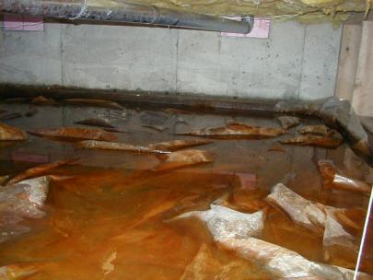
Foundation Moisture Issues
Foundation spaces account for the vast majority of moisture and indoor air quality (IAQ) issues in houses.
Standing water is often caused by poor exterior or interior drainage.
Many homes don’t have sump systems; many homes have sump systems that don’t work.
Condensation on cool surfaces during warm, humid periods can cause moisture problems.
Saturated building and cellulose-based materials lead to mold problems.
Resolve all major moisture issues before weatherizing a home.
Photo courtesy of the US Department of Energy
What’s the difference between a basement and a pond? Sometimes very little.
17
GJA 2025 Version III
Notes:
Foundation spaces account for the vast majority of moisture and indoor air quality (IAQ) issues in houses.
Standing water is often caused by poor exterior or interior drainage.
Many homes don’t have sump systems; many homes have sump systems that don’t work.
Condensation on cool surfaces during warm, humid periods can cause moisture problems.
Saturated building and cellulose-based materials lead to mold problems.
Resolve all major moisture issues before weatherizing a home.
A basement or crawl space begins with a hole in the ground. If left there, it would become a pond. What distinguishes a basement from a pond? Sometimes very little.
Air sealing work should not be performed on a home with severe moisture problems until those problems are resolved.
This applies to any work that reduces the building air leakage rate, such as:
Air sealing
Repair
Building shell insulation
The vapor barrier in the photo may actually be making the problem worse by trapping the water.

Slide 18
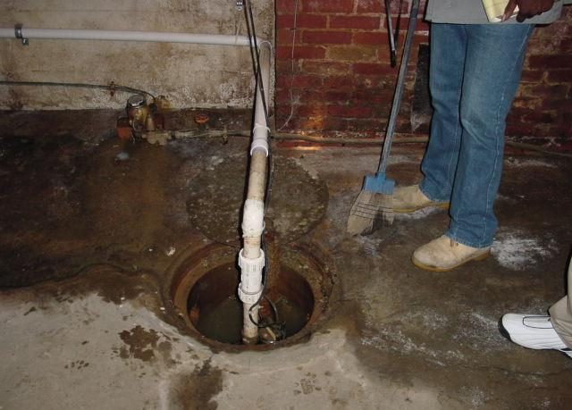
Photo courtesy of PA WTC
Notes:
Inoperable sumps should be fixed or replaced before basement or other shell measures are addressed.

Slide 19
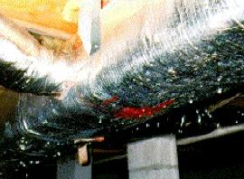
Crawl Space Condensation
Moisture BARRIERS
Symptoms
Wet wood
Condensation on foundation surfaces
Possible Reasons
High ground moisture source
Warm humid air entering vents from outside
Crawl space surfaces are below the dew point or mold threshold of the outside air
Photo courtesy of PA WTC
Water droplets of
condensation on AC ducts
19
GJA 2025 Version III
Notes:
Symptoms of condensation
Wet wood
Condensation on foundation surfaces
Possible reasons
There is a high ground moisture source.
Warm, humid air enters vents from the outside.
Crawl space surfaces are below the dew point or mold threshold of the outside air.
Condensation is a common problem in vented crawl spaces in much of the United States. Warm, humid outside air infiltrates the crawl space through vents and other openings and condenses on the underside of the floor and other cool surfaces. This can saturate building materials and cause mold.

Slide 20
Control Strategies
Moisture BARRIERS
Install a ground vapor retarder.
Control moisture sources and remove susceptible materials.
Consider converting to a conditioned crawl space.
20
GJA 2025 Version III
Notes:
Strategies include:
Install a ground vapor retarder.
Control moisture sources and remove susceptible materials. Encourage clients not to store materials prone to mold growth in the crawl space.
Consider converting to a conditioned crawl space. This prevents condensation due to the temperature difference between building materials and infiltrating air.
20

Slide 21
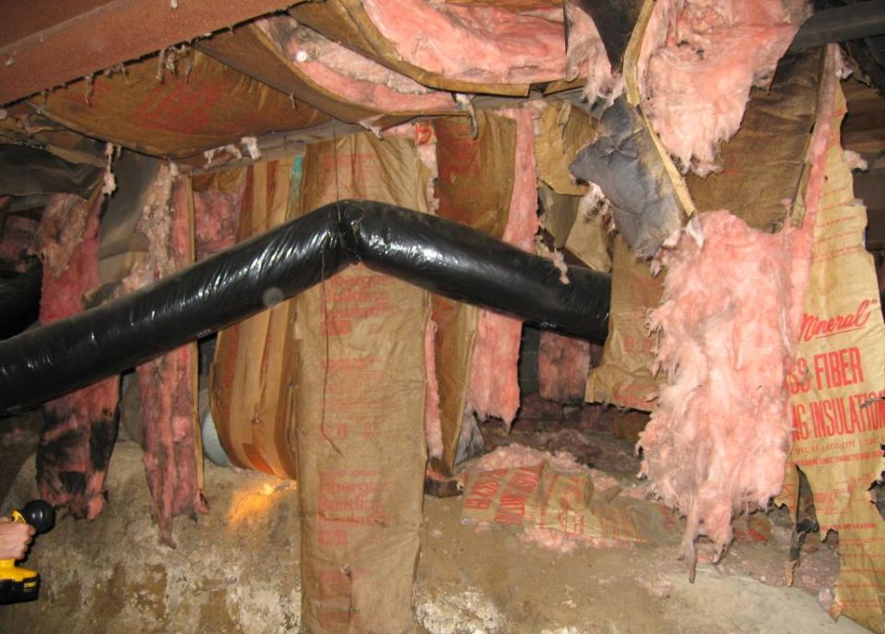
Photo courtesy of INCAP
Notes:
Wet and degraded insulation in a vented, unconditioned crawl space.
Q: Does it make sense to reinstall fiberglass batts if moisture problems are not resolved?
A: No. Consider converting to an unvented, conditioned crawl space.

Slide 22
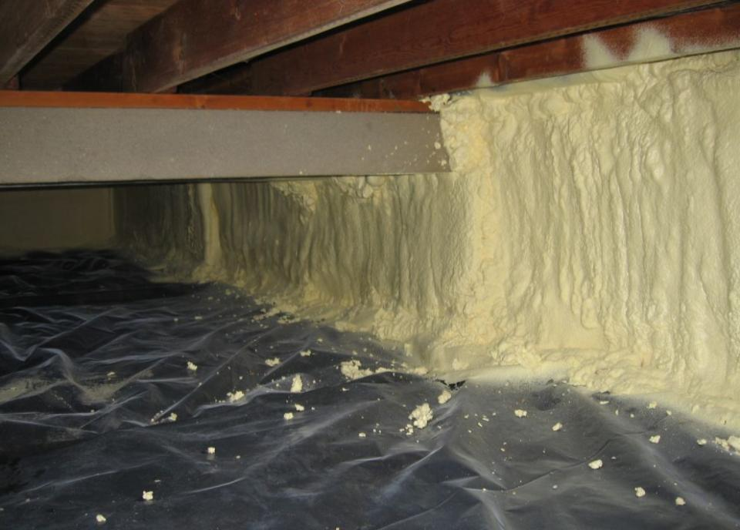
Basements and Crawlspaces
Photo courtesy of INCAP
Notes:
A two-part foam application on the foundation walls air seals and insulates.
Note the continuous vapor retarder overlapped by the foam application. The vapor retarder should be 6 mil poly. Black is preferred to prevent plant growth underneath the surface; but where there is no light, like the unvented crawl space show here, clear poly will do. Overlap seams and edges at least 6 inches and seal. In high radon areas, this can be the first step in a low-cost radon mitigation strategy. In this photo, sealing to the walls was achieved by lapping the poly up 6 inches and covering with the spray foam.
One agency reports the cost of this application at about $2 per square foot, using a truck rig for spray foam.

Slide 23
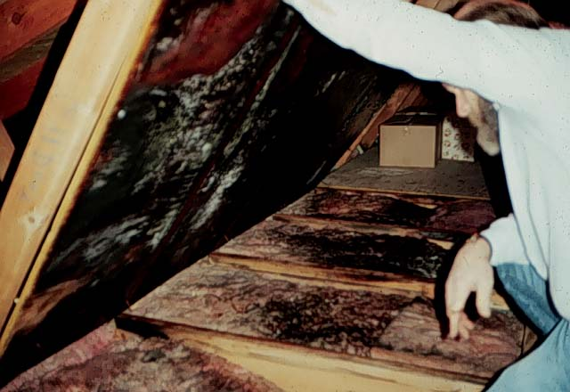
Attic Case Study #1
Moisture BARRIERS
Floored Attic and First Condensing Surface
23
Photo courtesy of PA WTC
GJA 2025 Version III
Notes:
Note the mold on the underside of the plywood flooring held up by the investigator. Mold is also visible on top of the insulation. Mold flourishes in 70-80% RH. A surface that has remained wet for 3 to 6 weeks will grow mold under the right temperature conditions. Each species has different temperature needs but anything above freezing can cause problems.

Slide 24
Attic Case Study #2
Moisture BARRIERS
Symptoms
  Condensation or mold growth on attic surfaces
  (rafters, sheathing or underside of flooring)
Possible Reasons
  Moderate to high interior moisture source
  Attic surface temps are below the dew point of the indoor air
  Air leaks to attic
Control Strategies
  Source control
  Air seal the attic
24
GJA 2025 Version III
Notes:
Symptoms:
Condensation or mold growth on attic surfaces (rafters, sheathing, or underside of flooring)
Possible reasons:
Moderate to high interior moisture source
Attic surface temperatures below the dew point of the indoor air – in this case, warm, moist air infiltrates the attic, contacts the cold surface of the plywood, and condenses.
Air leaks to attic
Control strategies:
Source control – Identify where the moisture is coming from and stop it.
Air seal the attic – One of the best means for attic moisture control is to seal all leaks to the attic.
The bottom line is that if you control the moisture problem, you solve the mold problem. No water, no mold.

Slide 25
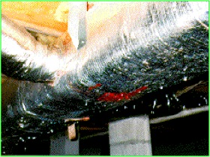
Crawl Space Case Study #1
Water Droplets of Condensation on A/C Ducts
Photo courtesy of PA WTC
25
GJA 2025 Version III
Notes:
Note the water droplets on the A/C duct running through this vented crawl space. The inspector also found wet wood and condensation on the foundation.
Condensation is a common problem in vented crawl spaces in mixed and hot, humid climates. Warm, humid outside air infiltrates the crawl space through vents and other openings and condenses on the floor joists, ductwork, and other cool surfaces. This can saturate building materials and cause mold.

Slide 26
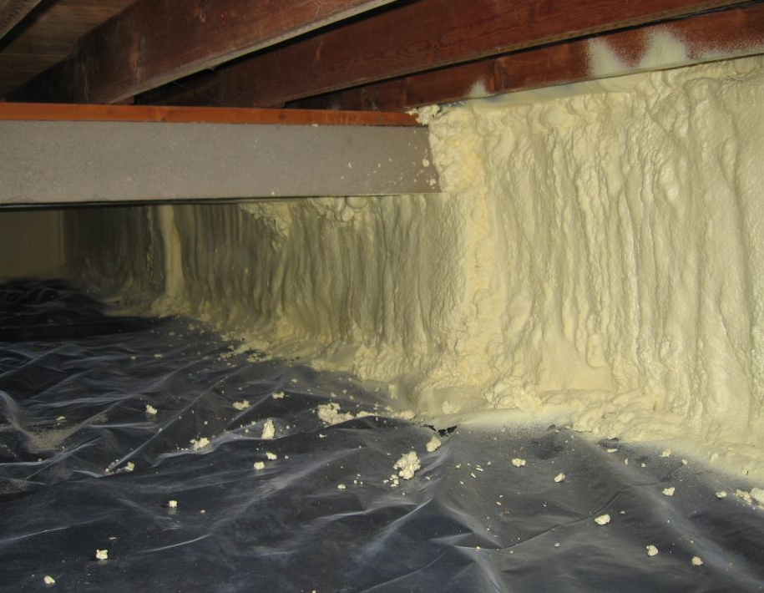
Crawl Space Case Study #2
Symptoms
Wet wood
Condensation on foundation surfaces
Possible Reasons
High ground moisture source
Warm humid air entering vents from outside
Crawl space surfaces are below the dew point of the outside air
Conditioned crawlspace with air sealed and
insulated walls
Control Strategies
Install a ground vapor retarder.
Control moisture sources and remove susceptible materials.
Consider converting to a conditioned crawl space.
Photo courtesy of INCAP
26
GJA 2025 Version III
Notes:
Symptoms:
Wet wood
Condensation on foundation surfaces
Possible reasons:
High ground moisture source
Warm, humid air entering vents from outside
Surface temperatures below dew point of outside air
Control Strategies:
Install a ground vapor retarder.
Control moisture sources and remove susceptible materials. Encourage clients not to store materials prone to mold growth in the crawl space.
Consider converting to a conditioned crawl space by sealing and insulating the foundation walls. This will raise the surface temperatures above the dew point.

Slide 27
Summary
Identifying the source of moisture should inform moisture solutions.
Understanding the effects of temperature and vapor pressure on RH can help identify solutions.
Source control, air sealing, ventilation, and thermal improvements are important moisture mitigation strategies.
Photos and diagnostic equipment help document existing conditions.
Follow proper installation guidelines for moisture barriers and roof repair.
27
GJA 2025 Version III
Notes:
Identifying the source of moisture should inform moisture solutions.
Understanding the effects of temperature and vapor pressure on RH can help identify solutions.
Source control, air sealing, ventilation, and thermal improvements are important moisture mitigation strategies.
Photos and diagnostic equipment help document existing conditions.
Follow proper installation guidelines for moisture barriers and roof repair.
Present this slide as an interactive discussion, soliciting personal examples from the trainees. Add your own personal examples and knowledge to supplement.

