Slide 1




CREW LEADER
Materials Tracking
1
WEATHERIZATION ASSISTANCE PROGRAM STANDARDIZED CURRICULUM –August 2012
GJA 2025 Version III
Notes:
1.7.2013
<number>
August 2012
‹#›

Slide 2
Learning Objectives
By attending this session, participants will be able to:
    Discuss the role of the crew leader in keeping track of materials.
    Describe how a perpetual inventory system works.
    Recognize the relationships between the crew leader and other weatherization staff in maintaining material accountability.
    Give examples of various methods for assuring material accountability.
2
WEATHERIZATION ASSISTANCE PROGRAM STANDARDIZED CURRICULUM –August 2012
GJA 2025 Version III
Notes:
1.7.2013
By attending this session, participants will be able to:
Discuss the role of the crew leader in keeping track of materials.
Describe how a perpetual inventory system works.
Recognize the relationships between the crew leader and other weatherization staff in maintaining material accountability.
Give examples of various methods for assuring material accountability.
<number>
August 2012
‹#›

Slide 3
Material Accountability
Why it’s Important:
    Program transparency is a moral obligation.
    Everyone is watching.
      State and Federal monitors
      Third-party auditors
      News media
    Severe penalties exist for misappropriation or theft.
3
WEATHERIZATION ASSISTANCE PROGRAM STANDARDIZED CURRICULUM –August 2012
GJA 2025 Version III
Notes:
1.7.2013
Why it’s important:
Program transparency is a moral obligation.
Q: What does “transparency” mean in this context?
A: In this case, it means that all aspects of the program are exposed to the public to assure that integrity and accountability can be evaluated.
Everyone is watching:
State and Federal monitors
Third-party auditors
News media
There are severe penalties for misappropriation or theft.
<number>
August 2012
‹#›

Slide 4
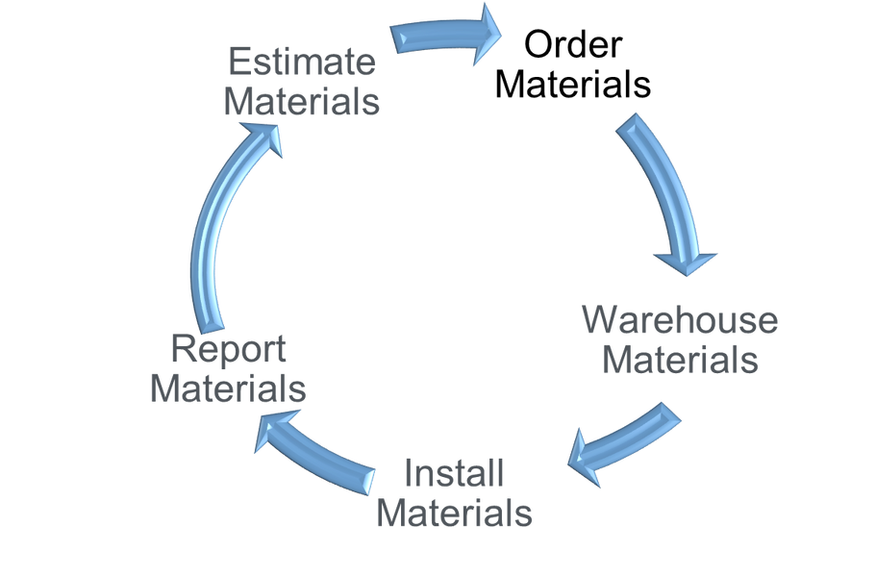
Material Life Cycle
4
WEATHERIZATION ASSISTANCE PROGRAM STANDARDIZED CURRICULUM –August 2012
GJA 2025 Version III
Notes:
1.7.2013
The weatherization program is material-intensive. The graphic shown illustrates the progress of materials from estimate to report.
Estimate – Determine material needs based on an energy audit and analysis of work orders for scheduled jobs.
Order – Perform in conjunction with the warehouse manager and/or weatherization coordinator.
Assemble – Designate and load materials for specific jobs.
Install – The primary responsibility of a crew leader.
Report – Maintain inventory control by documenting accurate counts of materials allocated for the job, installed, and returned to the warehouse.
<number>
August 2012
‹#›

Slide 5
Agency Organization
Small Agency
(100–150 jobs/year)
Single crew
    WX coordinator
    Administrative assistant
    Auditor/Post inspector
    Crew leader
    Two or three installers
Medium to Large Agency
(150+ jobs/year)
Multiple crews
    WX coordinator
    Administrative assistants
    (two or more)
    Auditor/Final inspector (one or more)
    Crew leaders (two or more)
    Installers (four or more)
    Warehouse manager
    Production manager
    Final inspectors (one or more)
5
WEATHERIZATION ASSISTANCE PROGRAM STANDARDIZED CURRICULUM –August 2012
GJA 2025 Version III
Notes:
1.7.2013
The role of the crew leader in the material life cycle is greatly influenced by the size of the subgrantee (the local agency). This depends on the size of the annual weatherization budget and completion goals required by the contract with the weatherization grantee (the state). The larger the agency, the greater the division of labor among staff.
Small agency: 100–150 jobs/year – single crew
Weatherization coordinator
Administrative assistant
Auditor/Final inspector (a.k.a. post-installation inspector)
Crew leader
Two or three installers
Medium to large agency: 150+ jobs/year – multiple crews
Weatherization coordinator
Administrative assistants (two or more)
Auditors (one or more)
Crew leaders (two or more)
Installers (four or more)
Warehouse manager
Production manager
Final inspector (a.k.a. post-installation inspector) (one or more)
Hand out “Crew Leader Responsibilities by Agency Size.” Ask students if this matches their experiences.
<number>
August 2012
‹#›

Slide 6






Weatherization Staff Functions
      Generates work order
      Calls for special order materials
      Maintains stock of bulk items
      Orders special material
      Allocates material on a daily basis
Auditor
Warehouse Manager
      Documents installed material quantities
      Maintains truck inventory
      Loads allocated material
      Purchases misc. items
      Documents installed and returned material
Final Inspector
Crew Leader
6
WEATHERIZATION ASSISTANCE PROGRAM STANDARDIZED CURRICULUM –August 2012
GJA 2025 Version III
Notes:
1.7.2013
This chart shows the relationships among staff functions in the material lifecycle.
The auditor, in generating the work order, specifies material needs.
The warehouse manager maintains stock of needed materials.
The crew leader ensures the materials are delivered to the appropriate job sites.
The final inspector documents that the materials were, in fact, installed in the home.
If one link in the chain is broken, the crew may not have adequate materials at the job site or the paper trail of materials tracking may be incomplete.
<number>
August 2012
‹#›

Slide 7
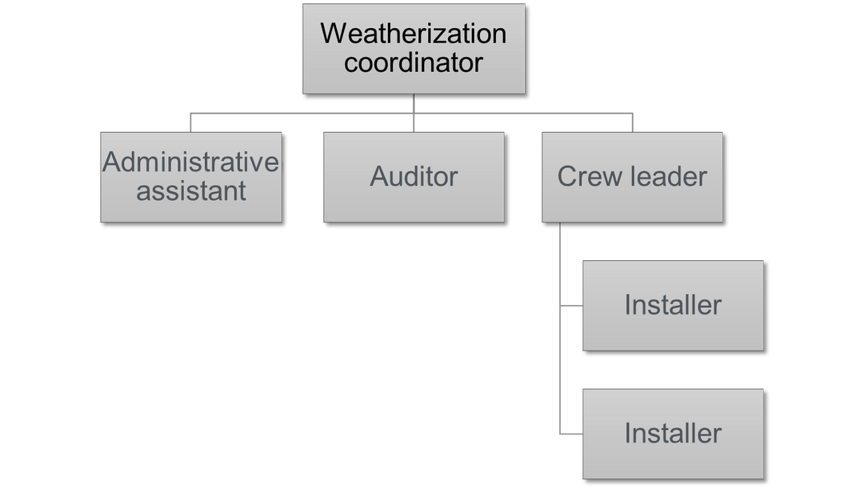
Organizational Chart - Small Agency
7
WEATHERIZATION ASSISTANCE PROGRAM STANDARDIZED CURRICULUM –August 2012
GJA 2025 Version III
Notes:
1.7.2013
In addition to the primary responsibility of completing homes, a crew leader in a small agency can be expected to have many other responsibilities, such as:
Scheduling jobs.
Ordering materials.
Maintaining and reconciling inventory.
<number>
August 2012
‹#›

Slide 8
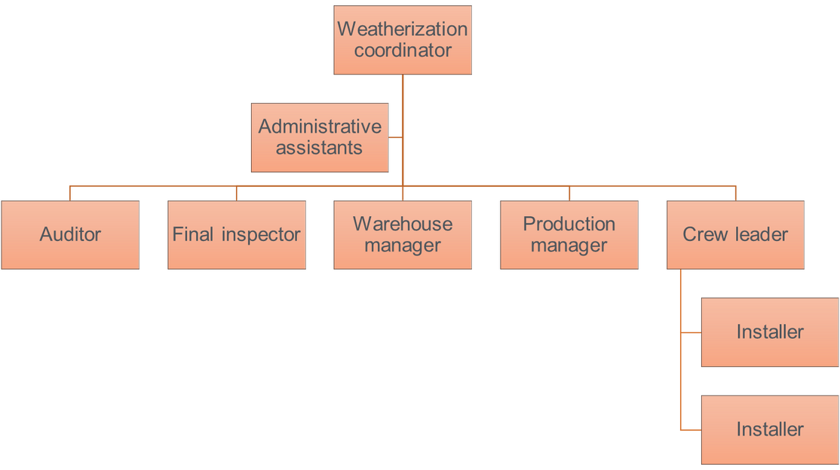
Organizational Chart - Large Agency
8
WEATHERIZATION ASSISTANCE PROGRAM STANDARDIZED CURRICULUM –August 2012
GJA 2025 Version III
Notes:
1.7.2013
In large agencies with two or more crews, job scheduling and inventory control will likely be split among the warehouse manager, production manager, and administrative assistants. The crew leader is still an important player in an agency’s system of tracking materials.
<number>
August 2012
‹#›

Slide 9
Perpetual Inventory System
What it does:
    Documents the flow of materials from purchase to installation
    Traces the purchase, storage, and final use or disposal of materials
    Accounts for all money spent for weatherization materials
9
WEATHERIZATION ASSISTANCE PROGRAM STANDARDIZED CURRICULUM –August 2012
GJA 2025 Version III
Notes:
1.7.2013
What does a perpetual inventory system do?
Documents the flow of materials from purchase to installation
Traces the purchase, storage, and final use or disposal of materials
Accounts for all money spent for weatherization materials
A perpetual inventory system means that, by design, commonly used materials are purchased when necessary to replenish the stock of those that are used.
Many weatherization materials, such as cellulose, caulk, and two-part foam, are used on a majority of jobs and are warehoused and available for use when needed.
A record of inventory is maintained on a regular basis and is updated every day something is received in the warehouse, removed from the warehouse, or used on a job.
Refer to “Inventory Management” handout.
<number>
August 2012
‹#›

Slide 10
Daily Sign-Out Sheet
The daily sign-out sheet is the source document for the weatherization program material inventory system.
This sheet makes it possible to document:
    All materials removed from the warehouse.
    All materials installed on the job.
    Material expenditures (money spent) on the job.
10
WEATHERIZATION ASSISTANCE PROGRAM STANDARDIZED CURRICULUM –August 2012
GJA 2025 Version III
Notes:
1.7.2013
The daily sign-out sheet is the source document for the weatherization program material inventory system. This sheet makes it possible to document:
All materials removed from the warehouse.
All materials installed on the job.
Material expenditures (money spent) on the job.
Normally, when materials are removed from the warehouse, they are loaded on a truck with the intention of installing them on a scheduled job.
Note all materials removed from the warehouse or installed on the job. This will allow you to keep accurate inventory records and to track expenditures.
Be sure the daily sign-out sheet is accurate.
If irreconcilable errors appear in the master inventory control sheet, it is likely the information on the daily sign-out sheet is incorrect.
If the daily sign-out sheet has incorrect information, there is no way the master inventory control sheet can be correct.
<number>
August 2012
‹#›

Slide 11
Daily Sign-Out Sheet Exercise
Daily Sign-Out Sheet Exercise
(30 minutes)
11
WEATHERIZATION ASSISTANCE PROGRAM STANDARDIZED CURRICULUM –August 2012
GJA 2025 Version III
Notes:
1.7.2013
(Refer to Lesson Plan for instructions.)
<number>
August 2012
‹#›

Slide 12
Physical Counts and Reconciliation
    Take a physical inventory once a month.
    Document date, quantity used, physical count, quantity balance, and total value.
    Reconcile discrepancies.
    Document all physical counts and the steps taken to find discrepancies.
12
WEATHERIZATION ASSISTANCE PROGRAM STANDARDIZED CURRICULUM –August 2012
GJA 2025 Version III
Notes:
1.7.2013
Take a physical inventory once a month.
Document the date, quantity used, physical count, quantity balance, and total value on a master inventory control sheet.
Reconcile the discrepancy (a.k.a., balance the books) if the quantity balance on the master inventory control sheet does not match the physical count.
Q: What are some possibilities for reconciling the discrepancy?
A: Some correct answers include: math errors on master sheet, miscounting during physical inventory check, errors on daily sign-out sheets, incomplete deliveries.
Document all physical counts and the steps taken to find discrepancies whether using a paper-based or computerized perpetual inventory system.
Take a physical count of all materials and reconcile master sheets on a regular basis. Monthly counts guarantee errors don’t multiply over time. A properly maintained perpetual inventory system also discourages theft.
<number>
August 2012
‹#›

Slide 13
Reconciling Inventory Discrepancies
Reconciling Inventory Discrepancies Exercise
(30 minutes)
13
WEATHERIZATION ASSISTANCE PROGRAM STANDARDIZED CURRICULUM –August 2012
GJA 2025 Version III
Notes:
1.7.2013
(Refer to Lesson Plan for instructions.)
<number>
August 2012
‹#›

Slide 14
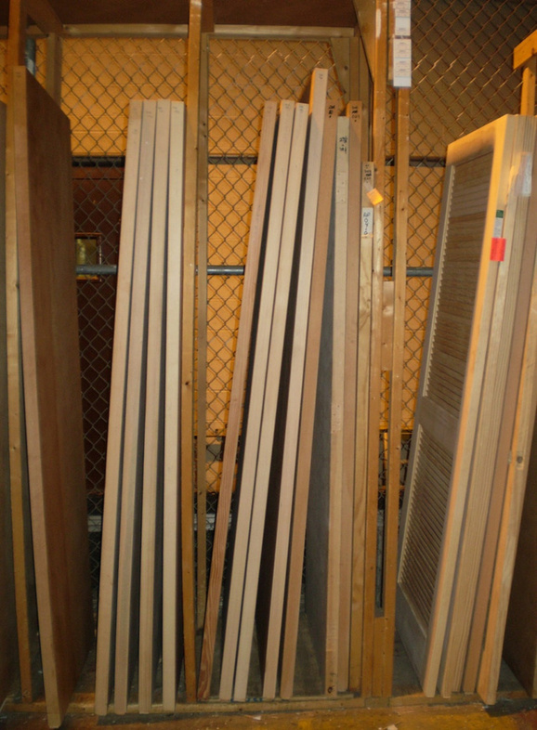
Inventory Points
    Warehoused materials
    Truck inventory
    Special order materials
    Miscellaneous purchases
Photo courtesy of Westmoreland County PA Weatherization
14
WEATHERIZATION ASSISTANCE PROGRAM STANDARDIZED CURRICULUM –August 2012
GJA 2025 Version III
Notes:
1.7.2013
Inventory points include materials stored in a warehouse or truck.
Warehoused materials
Truck inventory  The truck is considered an extension of the warehouse where all materials are accounted for as they are installed on the job and replenished after they are used.
Special order materials  Special orders, such as custom window replacements or miscellaneous materials purchased by the crew on an as-needed basis, are generally not inventoried because they come in and go out almost immediately.
Miscellaneous purchases
Both special orders and miscellaneous purchases are tracked separately by invoices, which are inserted into the client file.
Whether they are deducted from a master inventory or are special order, all materials used on the job are included in the total job cost.
Hand out “Truck Material Inventory Sample” and “Truck Inventory Sign-Out Sheet.” Review these sample forms and stress the need to track materials stored on the truck and used on the jobs. Crew leaders are responsible for making sure installers adhere to the system as well.
Ask students if they use this kind of system to track materials into and out of the work trucks. If not, what kinds of systems do they use?
Ask students how they motivate installers to help track materials.
<number>
August 2012
‹#›

Slide 15
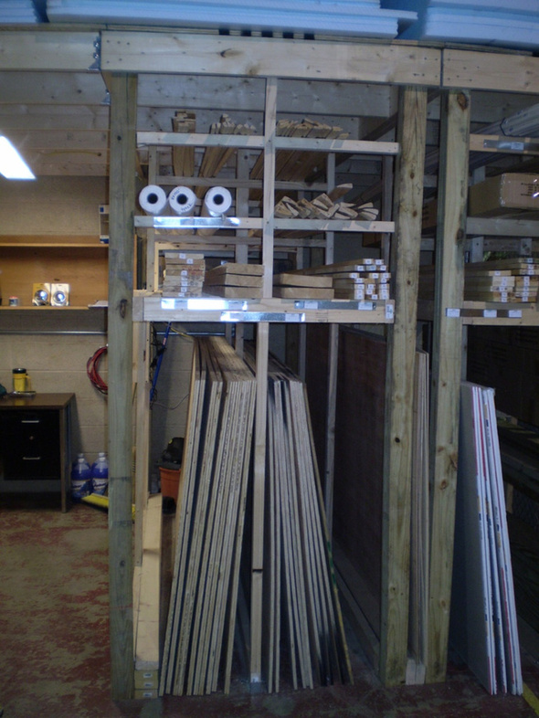
Tips for Easy Counting
    Stack materials in groups of known quantities.
    Bundle materials.
    Use shelving or cabinets for small items.
    Build tiers to organize lumber and separate long items.
Photo courtesy of Westmoreland County PA Weatherization
15
WEATHERIZATION ASSISTANCE PROGRAM STANDARDIZED CURRICULUM –August 2012
GJA 2025 Version III
Notes:
1.7.2013
Tips for easy counting include:
Stack cellulose and loose fiberglass in groups of known quantities.
Bundle materials such as weatherstrip kits.
Use shelving or cabinets for nails, caulk, glazing, paint, and other small items.
Build tiers to organize lumber and separate long items such as weatherstripping, channels, etc.
<number>
August 2012
‹#›

Slide 16
Costing Methods #1
First-In, First-Out System (FIFO):
    First items purchased are the first used for “like” items.
    Costs assigned reflect the first applicable price paid.
    Inventory stock is identified by acquisition cost.
16
WEATHERIZATION ASSISTANCE PROGRAM STANDARDIZED CURRICULUM –August 2012
GJA 2025 Version III
Notes:
1.7.2013
First-In, First-Out System (FIFO):
The first items purchased are the first used for “like” items, meaning materials used for the same purpose, regardless of specific brand.
Costs assigned to “like” items issued from the warehouse reflect the first applicable price paid for them.
Inventory stock is identified by acquisition cost.
For example, 100 tubes of Ace brand caulk are received at $2.50 per tube, as opposed to $2 per tube for the 25 tubes of this brand already in inventory.
The two cost categories of Ace caulk are established on different inventory pages.
When caulk is removed from the warehouse, the old stock will be taken first and the inventory recorder will zero out the $2/tube caulk before deducting any from the later $2.50/tube purchase.
<number>
August 2012
‹#›

Slide 17
Costing Methods #2
Cost averaging:
    Values of new purchases are averaged with the value of existing stock for “like” items.
    Divide the total value by the quantity to find the average cost.
 | Quantity | Unit Cost | Total Value
New Purchase | 100 | $2.50 | $250.00
Old Stock | 25 | $2.00 | $50.00
New Balance | 125 | ? | $300.00
17
WEATHERIZATION ASSISTANCE PROGRAM STANDARDIZED CURRICULUM –August 2012
GJA 2025 Version III
Notes:
1.7.2013
Cost averaging:
Values of new purchases are averaged with the value of existing stock for “like” items.
Quantity Unit Cost Total Value
New purchase 100 $2.50 $250.00
Old stock 25 $2.00 $50.00
New balance 125 ? $300.00
Divide the total value by the total quantity to find the average unit cost.
Example: To determine the new “average” unit cost to charge to inventory, divide the new total value ($300) by the new balance of materials (125). The new “average” unit cost would be $2.40.
<number>
August 2012
‹#›

Slide 18
Cost Averaging Exercise
Cost Averaging Exercise
(15 minutes)
18
WEATHERIZATION ASSISTANCE PROGRAM STANDARDIZED CURRICULUM –August 2012
GJA 2025 Version III
Notes:
1.7.2013
(Refer to Lesson Plan for instructions.)
<number>
August 2012
‹#›

Slide 19
Material Reporting and Interacting Relationships #1
A Case Study in Material Tracking
    Auditor submits materials estimate
    Administrative assistant types materials onto daily sign-out sheet
    Warehouse manager checks materials stock
    Warehouse manager picks materials for the job
    Crew leader verifies materials received match daily sign-out sheet
    Crew leader turns in sign-out sheet and reviews with warehouse manager
19
WEATHERIZATION ASSISTANCE PROGRAM STANDARDIZED CURRICULUM –August 2012
GJA 2025 Version III
Notes:
1.7.2013
A Case Study in Material Tracking:
The auditor submits a materials estimate as part of a work order.
The administrative assistant types the materials needed from the work order onto a daily sign-out sheet.
The warehouse manager determines which materials are in stock and which materials to order.
The warehouse manager then picks the materials for the job and enters the quantities received by the crew in the “Amount Received” column of the daily sign-out sheet.
The crew leader verifies the materials received match the entries on the daily sign-out sheet.
The crew leader turns in the daily sign-out sheet and reviews with the warehouse manager.
<number>
August 2012
‹#›

Slide 20
Material Reporting and Interacting Relationships #2
    Crew leader reviews the sign-out sheet with warehouse manager.
    Warehouse manager updates used “truck stock.”
    Warehouse manager accounts for any special order materials used.
    Crew leader turns in invoices for any miscellaneous items.
    Master inventory is updated.
    Computer lists the quantity, unit price, and total cost for all materials used on the job.
    Final inspector verifies the materials were installed on the house.
20
WEATHERIZATION ASSISTANCE PROGRAM STANDARDIZED CURRICULUM –August 2012
GJA 2025 Version III
Notes:
1.7.2013
Crew leader turns in the daily sign-out sheet and reviews with the warehouse manager.
Warehouse manager enters the items used from “truck stock” as documented by the crew lead.
Warehouse manager accounts for any special order materials used on the job.
Crew lead turns in invoices for any miscellaneous items purchased for the job.
All warehouse and “truck stock” materials used on the job are deleted from the master inventory.
The computer program creates a page listing the quantity, unit price, and total cost for all materials used on the job.
The Final inspector verifies that the materials were actually installed on the house.
Encourage students to ask questions and share their experiences or ideas for maintaining inventory control. Where are mistakes commonly made?
<number>
August 2012
‹#›

Slide 21
Summary
    The crew leader is an important player in keeping track of materials.
    The perpetual inventory system documents the material lifecycle from purchase to installation.
    Maintaining accurate records through the daily sign-out sheets, physical counts, and inventory reconciliation is important for assuring program transparency.
21
WEATHERIZATION ASSISTANCE PROGRAM STANDARDIZED CURRICULUM –August 2012
GJA 2025 Version III
Notes:
1.7.2013
The crew lead is an important player in keeping track of materials.
The perpetual inventory system documents the material lifecycle from purchase to installation.
Maintaining accurate records through the daily sign-out sheets, physical counts, and inventory reconciliation is important for assuring program transparency. The crew lead is largely responsible for this but must be assisted by the installers.
Present this slide as an interactive discussion, soliciting personal examples from the trainees. Add your own personal examples and knowledge to supplement.
<number>
August 2012
‹#›

