Slide 1




Spray Foam Insulation
WEATHERIZATION INSTALLER/TECHNICIAN FUNDAMENTALS
1
GJA 2025 Version III

Slide 2
Learning Objectives
SPRAY FOAM INSULATION
By attending this session, participants will be able to:
Describe the use of spray foam in weatherization.
Identify foam product options and uses.
Explain the advantages and limitations of
different spray foam products.
Recognize the need for proper ventilation and
personal protective equipment.
2
GJA 2025 Version III
Notes:
By attending this session, participants will be able to:
Describe the use of spray foam in weatherization.
Identify foam product options and uses.
Explain the advantages and limitations of different spray foam products.
Recognize the need for proper ventilation and personal protection equipment.
Present this slide as an interactive discussion, soliciting personal examples from the trainees. Add your own personal examples and knowledge to supplement.

Slide 3
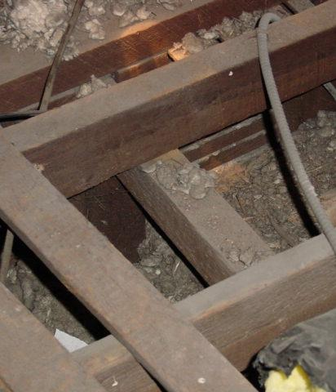
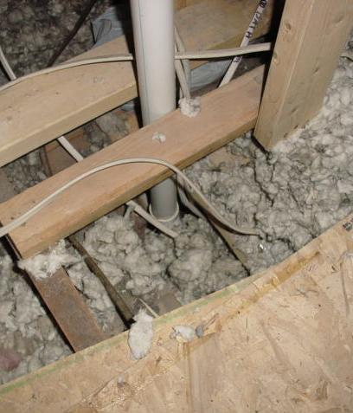

Classic Attic Air Leaks
Photo courtesy of the US Department of Energy
How do we fix them?
3
GJA 2025 Version III
Notes:
These photos show attic bypasses.
Unsealed or partially sealed bypasses due to inappropriate use or poor application of air sealing materials will allow warm moist house air to migrate into the attic and degrade the effectiveness of the insulation. In cold climates, moisture problems may result.
Q: What materials and methods can be used to seal attic bypasses such as these?
(Encourage participants to be creative with their answers. Don’t limit the options to foam alone. For each idea, ask how much time it would take.)
A: Cardboard, plywood, duct wrap, etc. are valid answers.

Slide 4
About Spray Foam
Spray foam insulation is modified polyurethane foam plastic.
It is used primarily to seal air leaks in building cavities.
It may be used to insulate vertical or horizontal surfaces.
  Knee walls
  Under floors
  Attic hatches
Due to fire rating, it may not be left exposed in living areas.
4
GJA 2025 Version III
Notes:
Spray foam insulation is modified polyurethane foam plastic.
It is used primarily to seal air leaks in building cavities.
It may be used to insulate vertical or horizontal surfaces:
Knee walls
Under floors
Attic hatches
Due to fire rating, it may not be left exposed in living areas.
Polyurethane foams have gained widespread acceptance among energy retrofitters as a very effective air-sealing product.
Before foam, common air sealing materials included fiberglass batts in plastic bags stuffed into bypasses, cardboard, and even plywood.

Slide 5
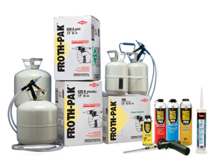
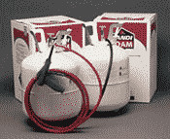
Product Options
SPRAY FOAM INSULATION
Available in a variety of shapes, sizes and uses
Froth-Pak, Dow Chemicals
5
GJA 2025 Version III
Notes:
Also known as liquid plastic foam or simply “spray foam,” polyurethane foam is an air sealing and insulating product. It comes in a variety of canisters or kits and is available in expanding or non-expanding formulations.
Expanding foams should not be used in constricted spaces such as window or door jambs. The expansion of foam may cause distortion of the jambs and affect operation.
Spray foam is better than caulking for sealing leaks in unconditioned spaces, such as attics and basements where temperature fluctuations stress traditional caulking materials.

Slide 6
Product Options
SPRAY FOAM INSULATION
Available in one-part and two-part formulas
One-part:
Spray cans
(e.g., Great Stuff)
Spray guns with
screw-on cans
Two-part:
Portable 2-tank kits –
small, medium, and large
Truck-mounted rigs
6
GJA 2025 Version III
Notes:
Spray foam is available in one-part and two-part formulas.
One-part foam:
Spray cans (e.g., Great Stuff)
Spray guns with screw-on cans
Two-part foam:
Portable two-tank kits – small, medium, and large
Truck-mounted rigs
Choosing one- or two-part foam depends on the size of the job.
One-part foam is best suited for small jobs with gaps and holes less than ¾”. Two-part foam is a triple expanding foam more appropriate for larger and more numerous air leaks, or for insulating crawl space walls and other big jobs.

Slide 7
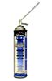
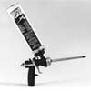
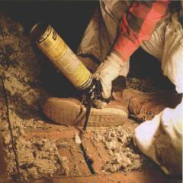
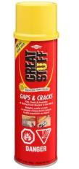
One-Part Spray Foam Options
Non-adjustable
canisters
Adjustable
gun-type applicators
7
GJA 2025 Version III
Notes:
Small, one-time use canisters are available in most hardware stores.
Spray patterns are not adjustable.
Larger canisters available through commercial suppliers can be fitted onto a gun-type applicator.
Properly maintained, the guns can be used repeatedly.
Spray patterns and bead thickness are adjustable.

Slide 8
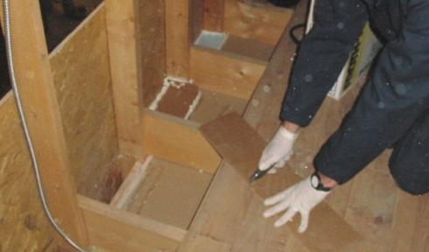
Air Sealing with One-Part Foam
Photo courtesy of the US Department of Energy
8
GJA 2025 Version III
Notes:
One-part foam can be used to fill small holes or with a combination of rigid materials to form a tight seal.
The installer is cutting and fitting cardboard into an open stud bay. He will seal the bay with a bead of one-part foam as shown in the bays to his right. The process takes about 1.5 minutes per bay.

Slide 9
One-Part Foam: Advantages and Disadvantages
One-Part Foam
ADVANTAGES
Quick and easy for small holes and gaps.
Creates an effective seal for small holes.
Lightweight and portable.
DISADVANTAGES
Set up time can exceed 2 hours.
Not cost effective for large jobs.
Freshly gunned product will not adhere on
overhead surfaces.
9
GJA 2025 Version III
Notes:
Advantages:
Quick and easy for small holes and gaps
Creates an effective seal for small holes
Lightweight and portable
Disadvantages:
Long curing time – The one-part foam can take over 2 hours to set. This can be problematic if foam is applied at the end of day and temperatures drop below the manufacturer’s specifications for proper set temperatures within the 2 hours.
It’s not cost-effective for large jobs.
Freshly gunned product will not adhere on overhead surfaces.

Slide 10
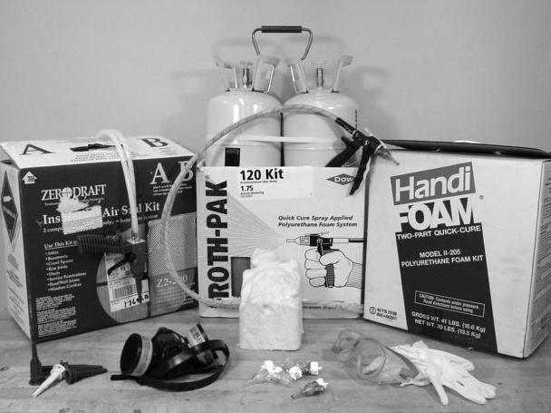
Two-Part Foam Kits
Photo courtesy of Dow Chemicals
10
GJA 2025 Version III
Notes:
Two-part foam is a foamed-in-place insulating air barrier designed for air leakage control in the building envelope.
A typical package includes two pressurized tanks consisting of different chemical components.
When mixed in the frothing chamber or tip and dispensed into the ambient air, closed cell polyurethane foam is produced.
The material expands to roughly three times the initial volume and sets up to a hard shell cure in less than 1 minute.
The kit also includes hose (available in different lengths) attached to a gun-type dispenser and several interchangeable standard and wide spray pattern tips.

Slide 11
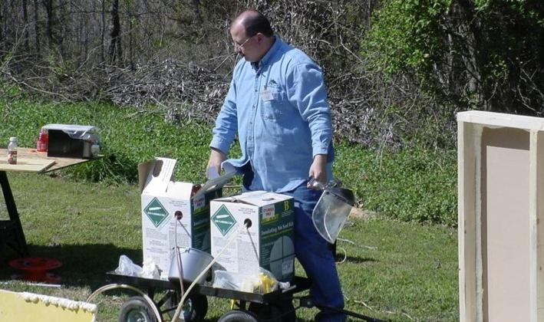
Two-Part Foam Kits
SPRAY FOAM INSULATION
11
Photo courtesy of the US Department of Energy
GJA 2025 Version III
Notes:
This is a photo of a 600-board-foot kit.
Two-part foam systems are designed as a “one-time-use-only” product. Tanks, hoses, and guns are disposed of when the tanks are empty.
Quantities are stated in board feet. A 200-board-foot package typically yields 16.5 cubic feet of coverage.
The large 600-board-foot kits of spray foam pictured here come in two metal tanks that look like propane tanks for a gas grill. Larger kits are often a better value in terms of cost per board foot of material. The weight of the larger system makes job site maneuverability more difficult, but longer hoses in combination with centrally located tanks may solve that problem.

Slide 12
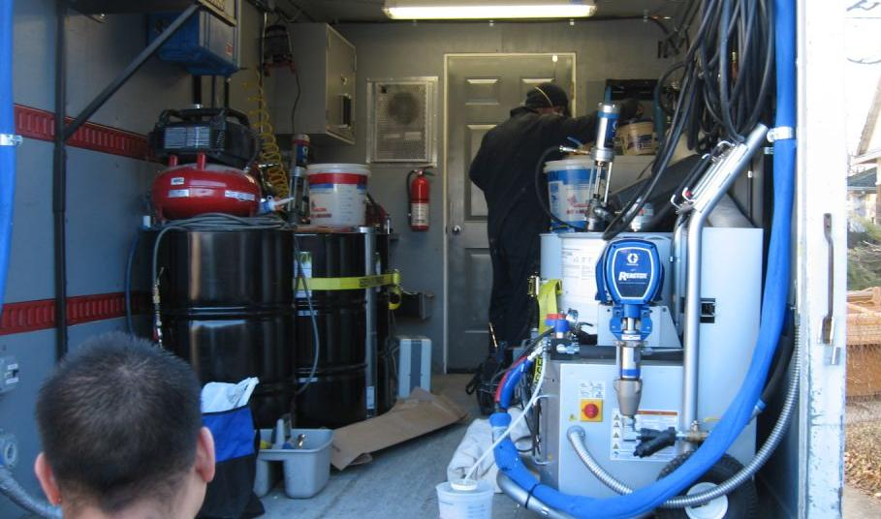
Truck Mounted Two-Part Foam Systems
12
Photo courtesy of the US Department of Energy
GJA 2025 Version III
Notes:
A dedicated vehicle for bulk spray foam application provides the best price per board foot.
Examples of bulk application include spraying under floors, exposed knee walls, and crawl space foundation walls.

Slide 13
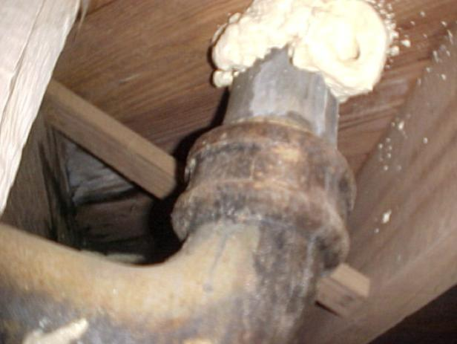
Sealing with Two-Part Foam
13
Photo courtesy of the US Department of Energy
GJA 2025 Version III
Notes:
Two-part foam seals irregularly sized gaps quickly and effectively. Two-part foam will fill up to a 3” gap with proper application. Larger openings require a backing material such as unfaced fiberglass.

Slide 14
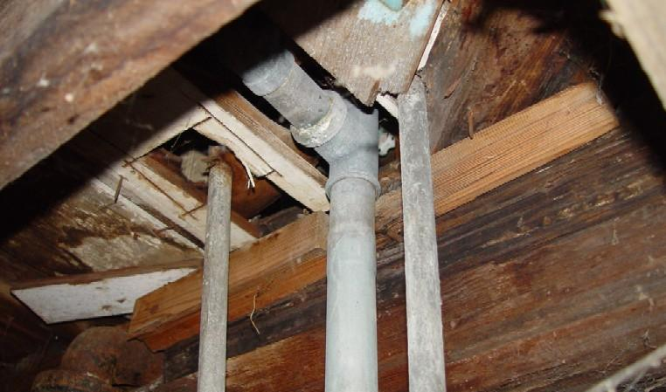
Sealing with Two-Part Foam
Photo courtesy of the US Department of Energy
14
GJA 2025 Version III
Notes:
Interior bypasses of all sizes penetrate the basement floor, creating serious air leakage pathways through the house.
Ask participants how they would seal a complicated hole like this.

Slide 15
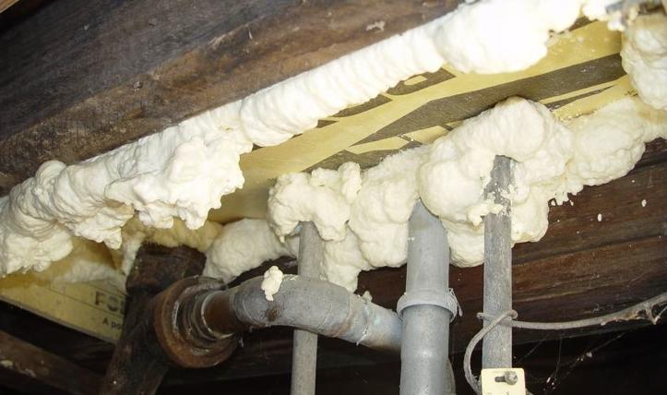
Sealing with Two-Part Foam
Photo courtesy of the US Department of Energy
15
GJA 2025 Version III
Notes:
Fitting insulation board into the large gaps and sealing edges with two-part foam is one of the easiest and most cost-effective air sealing techniques.
Roughly fit pieces of foam board around the pipes and attach to the ceiling with drywall screws.
Foam all gaps with two-part foam.

Slide 16
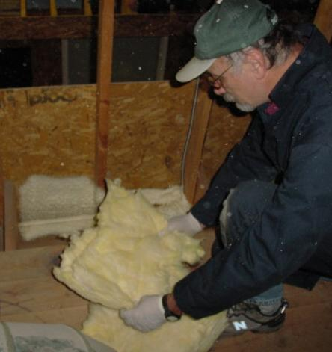
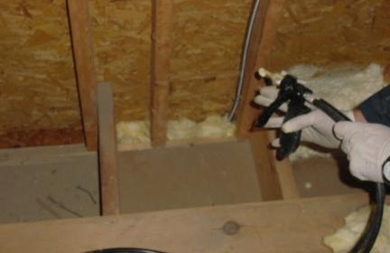
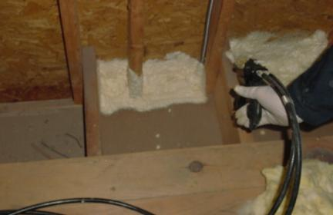
Foaming Attic Stud Bays
1
2
3
Photos courtesy of the US Department of Energy
16
GJA 2025 Version III
Notes:
Sealing attic stud bays with spray foam and fiberglass backer is quick and effective.
Tear off oversized chunks of fiberglass.
Stuff chunks into the bays.
Coat with a thin layer of two-part foam.
It takes about 20-30 seconds per bay, about one-third the time required to cut cardboard or other sealer and foam around the edges.
Attempting to foam bays without a backer requires more time and materials⎯at least two passes of foam, and waiting for the first layer to cure in between.

Slide 17
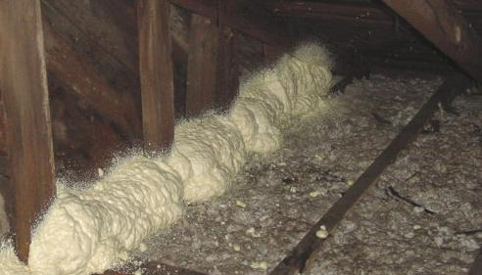
Foaming Attic Bypasses
Photo courtesy of the US Department of Energy
17
GJA 2025 Version III
Notes:
Fiberglass backer and two-part foam were used to seal attic open stud bays. Much more foam was applied here than necessary. It is bulging almost a foot out of the bays.
Foam is expensive. Don’t use more than required to get the job done.

Slide 18
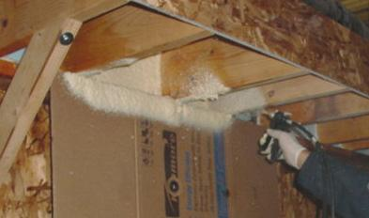
Foaming Band Joists
Photo courtesy of the US Department of Energy
18
GJA 2025 Version III
Notes:
This is a photo of band joist application in a lab setting.
A wide spray tip was used. Spraying closer to the target provides more control, but less coverage.
Practice will make installers quick and efficient with the various spray tips.
Here the installer is probably too far from the target, resulting in excessive overspray and a waste of material.
Be sure to seal the joint between the mudsill and foundation.

Slide 19
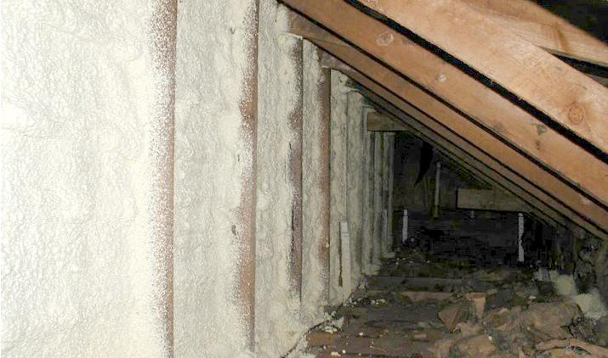
Insulating with Two-Part Foam
Photo courtesy of the US Department of Energy
19
GJA 2025 Version III
Notes:
This photo shows two-part foam application on the cold side of an attic knee wall in a 1.5-story Cape Cod.
The floor joists underneath the wall have already been sealed.
To gain the desired R-value, spray in successive layers, allowing each layer to fully cure before applying the next.
Chemical reactions during the cure cause temperatures within the product to rise, which is normal.
Applying too thickly in one pass may result in excessively high temperatures.

Slide 20
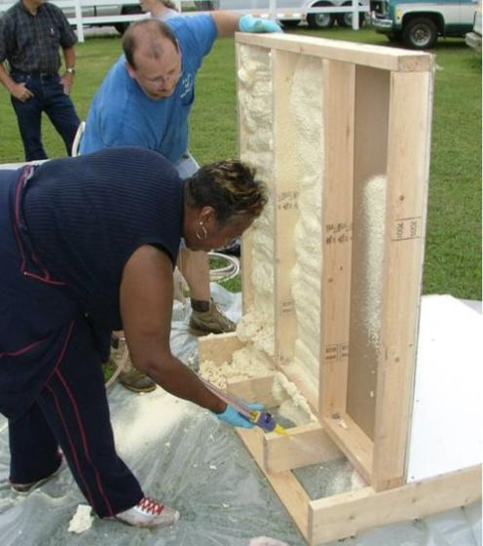
Knee Wall Prop
Knee wall prop used
to practice the correct application of spray foam.
Spray foam can be used to air seal and insulate the kneewall...
…or just air seal the
floor-joist cavities after they have been stuffed with batt insulation.
Photo courtesy of the US Department of Energy
20
GJA 2025 Version III
Notes:
Training workers on the proper use and application of two-part foam is important for effective application and for safety.
Q: What’s missing in this picture?
A: Respirators. Since they’re practicing outside, respirators are probably unnecessary, but in the field, protective equipment should always be worn.

Slide 21
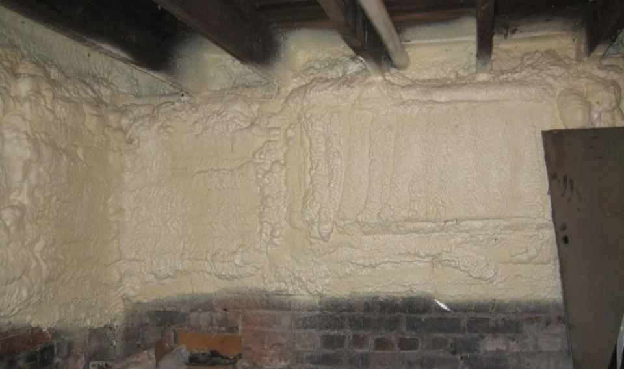
Basement Wall
SPRAY FOAM INSULATION
Photo courtesy of INCAP
Notes:
Two-part foam applied to a basement wall to within 2 feet of grade.
Two-part foam has an R-value or thermal resistance of about R-6 per inch; approximately R-9 for a 1.5-inch application.
Material Safety Data Sheets state that two-part foam requires a working temperature between 70 and 75 degrees to assure an adequate cure.
Experience among practitioners has shown that the product will not cure or adhere properly when the substrate is near or below freezing temperatures.

Slide 22
Two-Part Foam: Advantages and Disadvantages
Two-Part Foam
ADVANTAGES
  More thorough sealing
  Significantly reduced labor costs
  Motivates workers
  Good adhesion
  Quick cure time
DISADVANTAGES
Expensive; hazardous materials shipping fees
Easy to waste material
Restrictive dispensing temperatures
(around 75˚F recommended)
Specialized and expensive personal protection equipment required
22
GJA 2025 Version III
Notes:
Advantages:
More thorough sealing
Significantly reduced labor costs
Motivates workers
Good adhesion
Quick cure time
Speed is where two-part foam really shines. Attic air-sealing methods using cardboard and one-part foam can take three to four times as long as a two-part application.
Reduced time in unpleasant building cavities enhances crew health, comfort, and morale.
Disadvantages:
Expensive at up to $500 per kit, plus shipping and hazardous material fees for a 200-board-foot system
Easy to waste material
Restrictive dispensing temperatures (around 75°F recommended)
Specialized and expensive personal protection equipment required
Training is essential to assure economical and targeted use. There’s a tendency to overdo it and waste valuable product.
Though two-part foam kits are less expensive per board-foot of product than one-part foam, there is the added expense for safety training and equipment.

Slide 23
Safe Use of Spray Foam Insulation
Material Safety Data Sheet (MSDS)
Must have MSDS at job site whenever spray foam is used
  For following precautions for safe handling and use
  References emergency and first aid procedures
Use in well-ventilated area
Ventilation fans exhaust fumes and ensure cross-flow of fresh air
Wear personal protection equipment
Coveralls, rubber/latex gloves, eye protection
23
GJA 2025 Version III
Notes:
You must have an MSDS at the job site whenever spray foam is used.
Follow precautions for safe handling and use.
The MSDS lists emergency and first aid procedures.
Use in a well-ventilated area.
Provide ventilation fans to exhaust fumes and ensure cross-flow of fresh air.
Wear personal protection equipment.
Wear coveralls, rubber/latex gloves, and eye protection.

Slide 24
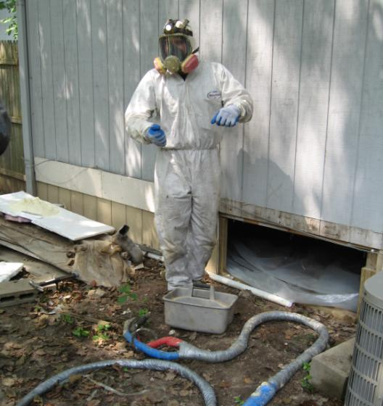
Respiratory Protection
SPRAY FOAM INSULATION
MSDS sheets state:
Atmospheric levels may not exceed exposure guideline
Use approved positive-pressure, supplied-air respirators
24
Photo courtesy of the US Department of Energy
GJA 2025 Version III
Notes:
Atmospheric levels should be maintained below the exposure guideline.
When atmospheric levels may exceed the exposure guideline, use an approved air-purifying respirator equipped with an organic vapor sorbent and particle filter.
When atmospheric levels may exceed the level for which an air-purifying respirator is effective, use positive-pressure, supplied-air respirators.
Without the use of a personal monitoring device, there is no way to determine whether atmospheric levels exceed the exposure guideline.
Be safe: wear a positive-pressure, supplied-air respirator as recommended in the MSDS.

Slide 25
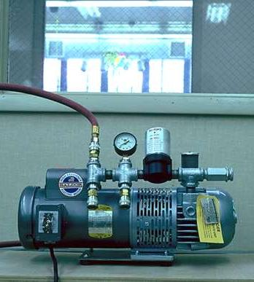
Respirators
Positive-Pressure, Supplied-Air Respirators
Designated air compressor should be located in an area with access to fresh air.
Photo courtesy of the US Department of Energy
25
GJA 2025 Version III
Notes:
Positive-pressure, supplied-air respirators have their own air compressor, which should be located in an area with access to fresh air.

Slide 26
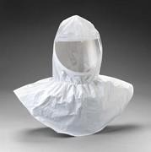
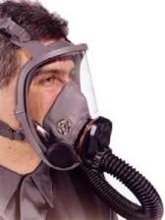
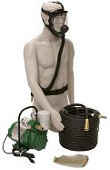
Respirators
SPRAY FOAM INSULATION
Positive-Pressure, Supplied-Air Respirators
Hood
Mask
Air hoses connecting mask/hood to air compressor can be cumbersome.
Equipment costs can run up to $1,000.
26
GJA 2025 Version III
Notes:
Positive-pressure, supplied-air respirators can use a mask or hood.
Tucking the hood into the suit or coveralls keeps installers a little cooler in hot attics as fresh air from outside cycles through.
Masks and hoods come with protective screens. When foam or scratches on the window degrade visibility, simply replace the protective screen.
Protective screens cost around 50 cents each. Hoods cost around $50 each.
The air hose connecting mask/hood to the air compressor can be cumbersome.
Equipment costs can run up to $1,000.
Eye and skin protection is a must. Disposable Tyvec suits and latex gloves are recommended.

Slide 27
Summary
Spray foam is used primarily to air seal.
Spray foam can be used to insulate crawl spaces and knee walls.
One-part spray foam is used for small jobs, too expensive
for big jobs.
Two-part spray foam adheres to vertical and overhead
horizontal surfaces.
Available in large kits and truck mounted systems for big jobs.
Proper ventilation and respirator equipment protects workers from harmful off-gases.
Foam cannot be left exposed in living areas.
27
GJA 2025 Version III
Notes:
Spray foam is used primarily to air seal.
Spray foam can be used to insulate crawl spaces and knee walls.
One-part spray foam is used for small jobs, but is too expensive for big jobs.
Two-part spray foam adheres to vertical and overhead horizontal surfaces.
Spray foam is available in large kits and truck-mounted systems for big jobs.
Proper ventilation and respirator equipment protects workers from harmful gases.
Foam cannot be left exposed in living areas.
Present this slide as an interactive discussion, soliciting personal examples from the trainees. Add your own personal examples and knowledge to supplement.

