Slide 1





Indoor Air Quality
WEATHERIZATION ENERGY AUDITOR SINGLE FAMILY
1
WEATHERIZATION ASSISTANCE PROGRAM STANDARDIZED CURRICULUM – August 2010
GJA 2024 Version III
Notes:
August 2010
1

Slide 2
Learning Objectives
Indoor air quality
By attending this session participants will:
Learn about the factors effecting IAQ.
Understand the role moisture plays in IAQ.
Learn about moisture movement.
Learn pollutant remediation techniques.
Understand the requirements of ASHRAE 62.1989
and ASHRAE 62.2 2007.
2
GJA 2024 Version III
Notes:
By attending this session, participants will:
Learn about the factors affecting IAQ.
Understand the role moisture plays in IAQ.
Learn about moisture movement.
Learn pollutant remediation techniques.
Understand the requirements of ASHRAE 62.1989 and ASHRAE 62.2-2007.
August 2010
2

Slide 3
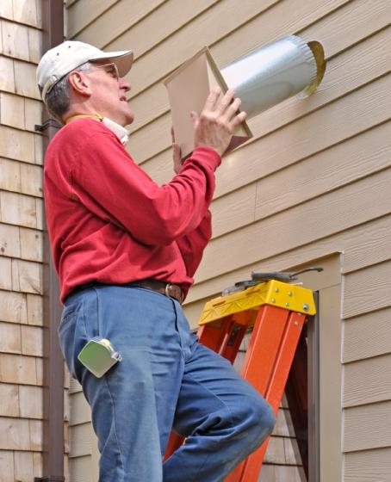
IAQ, Moisture and Ventilation
Moisture
Stored Toxic Materials
Carbon Monoxide (CO)
Radon
Sewer Gas
Other
Photo courtesy of The US Department of Energy
3
GJA 2024 Version III
Notes:
Many pollutants can be confined in a dwelling:
Moisture.
Stored toxic materials.
Carbon monoxide.
Radon.
Sewer gas.
Other.
While some moisture is necessary, too much moisture causes problems. Weatherization considers moisture a “sometimes” pollutant.
August 2010
3

Slide 4
Sources of Water Vapor
Source | Quarts per Day
Construction materials first year | 40
Standing water in basement | 30
Damp basement or crawlspace | 25
Greenhouse connected to house | 25
Humidifier - large | 20
Drying 1 cord of firewood | 16
Clothes dryer vented to inside | 13
Respiration/perspiration – 4 people | 4.7
Clothes washing | 2.1
Unvented gas range | 1.3
Cooking without lids | 1.0
Houseplants – average number | 0.5
Dish washing | 0.5
Floor mopping | 0.4
Showering/bathing | 0.3
4
GJA 2024 Version III
Notes:
Many seemingly innocent sources create significant water vapor in homes. Note from the table that building materials emit 40 quarts per day of moisture into a home the first year after the home is built. An unvented gas range contributes more to indoor moisture load than showering and bathing.
Have the class create a list of common household moisture sources. Rank them for importance.
Running an unvented kerosene or gas fired space heater – each gallon of fuel burned creates about 7.5 pints of water vapor.
Cooking a gas range without using a ducted range hood – each burner produces between 1 and 2 pints per hour.
Storing firewood indoors – a cord of green firewood creates about 3.5 pints of water per day.
Air drying clothes inside – each load of wash creates about 5 pints of water during drying.
Showering – a 10-minute shower creates about 1 pint of water.
Cooking without pot lids – about 1/6 pint per person per meal.
Washing floors – about 4 pints per room.
Watering plants – all the water is poured into house plants eventually evaporates into the room.
Pets – pets, and people, create about 1 pint of water per 50 lbs of body weight per day.
Hand washing dishes, including rinsing – about 1/3 pint per person per meal.
Faucet aerators – 0.02 pints per minute.
August 2010
4

Slide 5
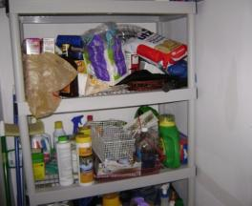
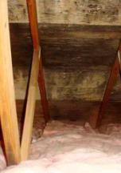
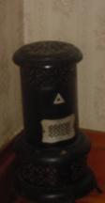
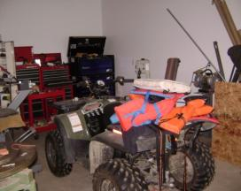
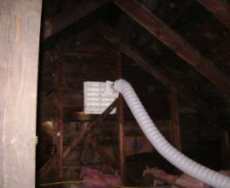
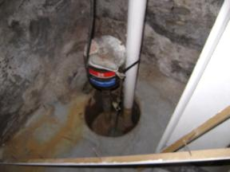
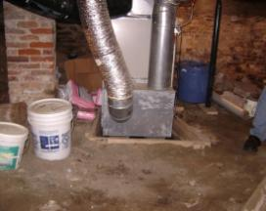
What Determines IAQ?
Indoor air quality
Photos courtesy of The US Department of Energy
5
GJA 2024 Version III
Notes:
The concentration of pollutants, such as:
Stored household chemicals.
Mold/mildew.
Unvented space heaters.
Vehicles and gas-powered equipment in attached garages.
Wet basements/crawl spaces, caused by:
Open sump holes.
No gutters/malfunctioning gutters.
Poor landscaping.
Exposed dirt floors.
Standing water.
Plumbing leaks.
Hobbyists – Off-gassing from model train glue, soldering, or particulates from woodworking.
CO and CO_{2.}
“Critters”.
Source strength vs. air change rate – Low levels of pollutants in a leaky home (one with a high ACH) are not as harmful to occupant health as low levels of pollutants in a very tight home.
Q: Do houses have to breathe?
A: No. People do. Houses have to be kept dry.
August 2010
5

Slide 6
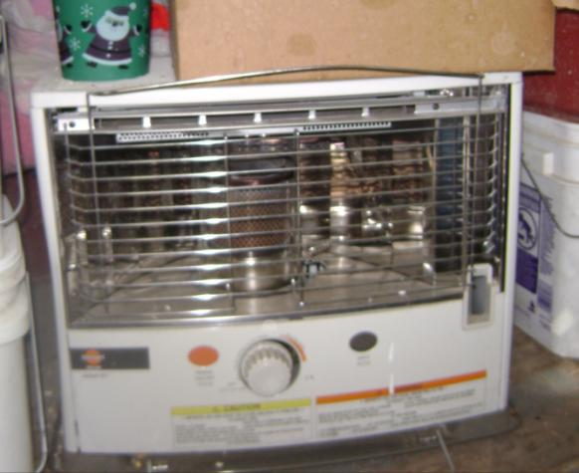
Pollutant Action Tree
Indoor air quality
Source
Eliminate
Encapsulate
Dilute
Driver
Eliminate
Weaken
Path
Eliminate
Block
Photo courtesy of The US Department of Energy
6
GJA 2024 Version III
Notes:
Pictured: an unvented space heater.
With any pollutant, elimination is preferred, encapsulation is acceptable, and dilution is a last resort.
Elimination: Removing the source of pollution. Examples: (1) Collecting all old paint cans or other old chemicals from the basement and disposing of them at the local municipal waste facility. (2) Installing gutters and downspouts to divert rain runoff away from a basement. (3) Removing the unvented space heater from the home.
Encapsulation: Containing the pollutant so it will not affect air quality. Examples: (1) Air sealing the ceiling over a tuck-under garage to prevent CO from entering the living space. (2) Pouring a concrete floor over a dirt crawl space to contain radon gas. (3) Installing a poly ground cover to contain moisture from the ground.
Dilution: Relying on adequate ventilation to reduce the concentration of pollutants to acceptable levels. Examples: (1) Unvented space heater operating instructions always say to keep windows open while the heater is in use to prevent pollutant buildup. (2) Running a kitchen range hood to exhaust combustion byproducts from a gas range while cooking pulls fresh air in elsewhere, diluting whatever pollutants remain.
An unvented heater can be very dangerous. Do not air seal or insulate a home unless the client agrees in writing not to use unvented combustion appliances as the primary heat source. See WPN 08-4 “Space Heater Policy” for more details.
Discuss “Walk Away” and/or Postponement of Services policy. This is covered in more detail in the “Deferral of Services” section of the Auditor training.
August 2010
6

Slide 7
IAQ and Relative Humidity
Relative Humidity and Indoor Air Quality Relationships
Decrease in bar width indicates decrease in effect
Bacteria
Viruses
Fungi
Dust Mites
Respiratory Infections
Allergic Rhinitis and Asthma
Clinical Interactions
Ozone Protection
Percent Relative Humidity | 0% | 10% | 20% | 30% | 40% | 50% | 60% | 70% | 80% | 90%
7
GJA 2024 Version III
Notes:
Keeping RH below 50% reduces or eliminates many common household problems.
Medical studies show most people⎯absent a medical condition⎯are healthiest and most comfortable between 30% and 50% RH.
Maintain 35% to 45% RH in heating climates.
Maintain 60% RH in cooling climates.
Stay above 20% and below 50% RH to avoid breakdown of immune systems, mold growth, dust-mite invasions, and viruses.
August 2010
7

Slide 8

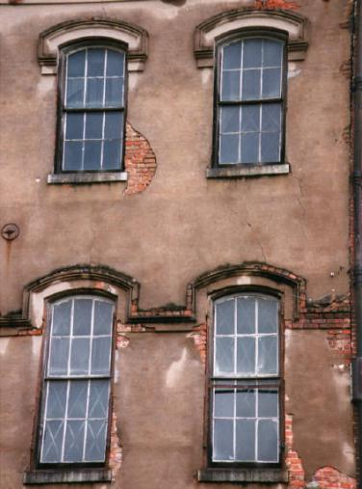

ASHRAE 62.1989
Photos courtesy of The US Department of Energy
8
GJA 2024 Version III
Notes:
ASHRAE 62.1 is an air quality standard meant for large commercial buildings, usually with forced ventilation.
The standard requires the greater of 15 CFM per person or 0.35 ACH, whichever is higher.
ASHRAE 62.1 was imposed on small residential buildings because it was the only building ventilation standard available.
In small buildings (defined as under three stories and having six or fewer units):
The person count equals the greater of the number of bedrooms plus one or the actual occupancy. There is a minimum of five persons. (This forces 75 CFM (5 people times 15 CFM) to be the absolute minimum ventilation rate.)
IAQ pollutants are to be dealt with at the source.
Ventilation may be provided by fans or operable windows.
Example: For a 1,150-square-foot, 3-bedroom home with 8’ ceilings, the required CFM will be the greater of the number of bedrooms plus one (with a minimum of five) = 5 x 15 CFM = 75 CFM or 0.35 ACH x (1,150 cu ft x 8’) = 0.35 x 9,200 cu ft = 3,220 CFH/60 minutes = 53.7 CFM.
This home requires 75 CFM.
August 2010
8

Slide 9
ASHRAE 62.2-2007 Table
Table 4.1a: Minimum Ventilation Air Requirements, CFM, New Buildings¹
Floor Area (ft²) | BEDROOMS
 | 0 - 1 | 2 - 3 | 4 - 5 | 6 - 7 | >7
< 1500 | 30 | 45 | 60 | 75 | 90
1501 – 3000 | 45 | 60 | 75 | 90 | 105
3001 – 4500 | 60 | 75 | 90 | 105 | 120
4501 – 6000 | 75 | 90 | 105 | 120 | 135
6001 – 7500 | 90 | 105 | 120 | 135 | 150
> 7500 | 105 | 120 | 135 | 150 | 165
45
¹ R.J. Karg of R.J. Karg, Associates
9
GJA 2024 Version III
Notes:
ASHRAE 62.2-2007 table applies to new construction.
Left column = conditioned floor area in square feet.
Right columns = number of bedrooms.
Read right from Floor Area and down from number of bedrooms to find the needed ventilation air in CFM.
Example: Find the floor area in the left column and the number of bedrooms in the top row. Reading right from the floor area column and down from the number of bedrooms for a 1,150-sq-ft, 3-bedroom home, the Minimum Ventilation Air Requirement would be 45 CFM.
Click to highlight row, column, and answer (45 CFM).
August 2010
9

Slide 10
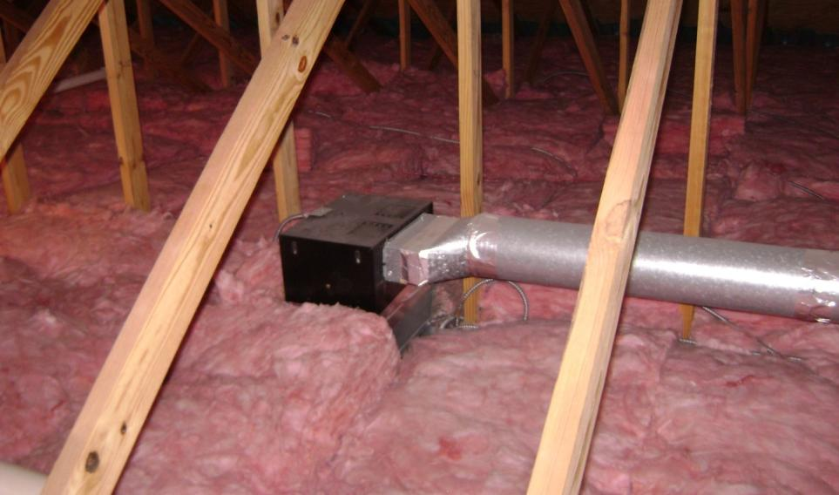
Installing Fans
Photo courtesy of The US Department of Energy
10
GJA 2024 Version III
Notes:
Use units with 1.5 sones or less.
Seal the fan housing to the ceiling.
Seal all duct joints.
Insulate the duct.
Slope duct to the exterior.
Run the duct to the gable end if possible.
If run to the soffit, block any soffit vent openings for 2 feet to either side of the vent hood.
Don’t go through the roof unless absolutely necessary.
August 2010
10

Slide 11
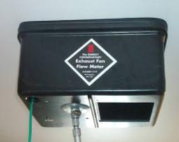
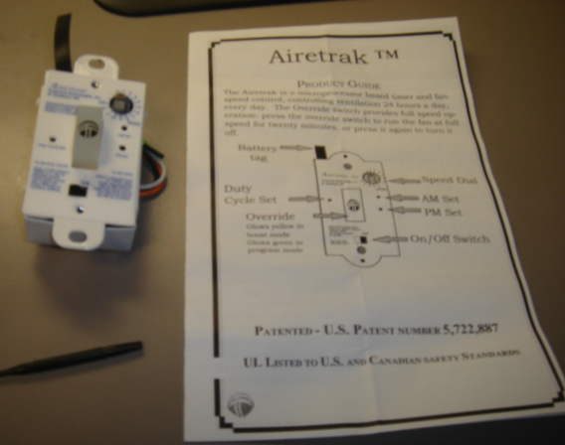
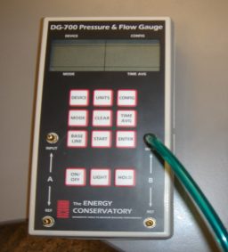
Upgrading ASHRAE 62.1
Installations to 62.2
Measure fan flow
Install Fan Control
11
GJA 2024 Version III
Notes:
The pictured control is a Tamarack Technologies Airtrak, available from most weatherization suppliers (e.g., EFI) for less than $90.
Using ASHRAE 62.2:
Cuts code-required CFM from 15/person, 5-person minimum to 7.5/person actual, no minimum.
Allows air sealing the home to the greatest extent possible.
Provides proper ventilation all the time under all conditions.
Cuts air-driven heat loss to an absolute minimum.
Requires measuring fan flow, as it’s a performance standard.
Requires automatic controls.
Generally has an incremental cost of the fan control switch − air inlets aren’t needed.
August 2010
11

Slide 12
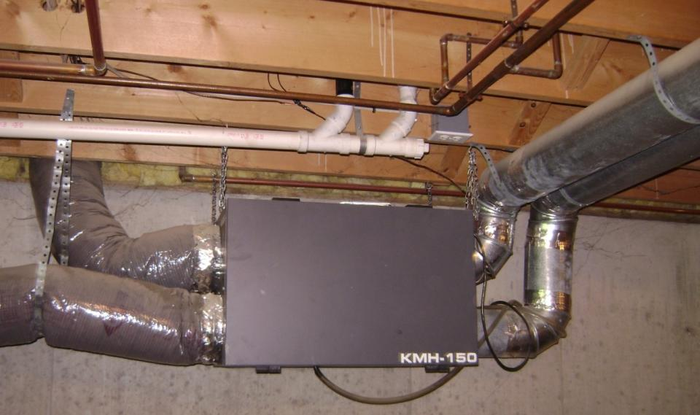
Air-to-Air Heat Exchanger
Photo courtesy of The US Department of Energy
12
GJA 2024 Version III
Notes:
It is a balanced system, where air is pumped in and out in equal amounts.
Entering air is passed by exiting air, scrubbing heat from it.
An air-to-air heat exchanger is generally considered “high-end,” but it may be appropriate in some client homes depending on the SIR.
The SIR is generally lower than for an exhaust-only vent system.
August 2010
12

Slide 13
Summary
IAQ depends on the pollutant source strength and the air change rate. Elimination at the source is preferable to confinement, which is preferable to dilution.
Many pollutants are present in the average home: The air change rate is a function of inside to outside pressure difference, hole size, and hole location.
A higher air change rate equals better IAQ, and usually higher space conditioning costs.
ASHRAE 62.1 and 62.2-(2004 or 2007)
Quality fans installed and used properly help ensure healthy IAQ.
13
GJA 2024 Version III
Notes:
IAQ depends on the pollutant source strength and the air change rate. Elimination at the source is preferable to confinement, which is preferable to dilution.
Many pollutants are present in the average home:
Radon.
CO.
Cleaning chemicals.
Fuels.
Moisture - Typically, excess moisture is the most significant of the common pollutants.
The air change rate is a function of inside to outside pressure difference, hole size, and hole location.
A higher air change rate equals better IAQ, and usually higher space conditioning costs.
ASHRAE 62.1 and 62.2-(2004 or 2007) guidelines are acceptable.
ASHRAE 62.1 is a large building IAQ standard presently allowed on single-family homes.
ASHRAE 62.2 is the specific small building IAQ standard.
Quality fans installed and used properly help ensure healthy IAQ.
August 2010
13

