Slide 1




WEATHERIZATION INSTALLER/TECHNICAN FUNDAMENTALS
Building Science Basics
1
GJA 2024 Version III
GJA 2025 Version III
WEATHERIZATION ASSISTANCE PROGRAM STANDARDIZED CURRICULUM – July 2012
Notes:
<number>
July 2012

Slide 2
Learning Objectives
  Understand the difference between thermal and air barriers.
  Know the proper location of thermal and air boundaries.
  Recognize the driving forces of air leakage.
  Understand the connection between air leakage, energy waste, and moisture problems.
  Understand how air ducts affect pressure balances within the home.
  Understand the principle behind the blower door as a tool for measuring air leakage.
2
GJA 2024 Version III
GJA 2025 Version III
Notes:
By attending this session, participants will:
Understand the difference between thermal and air boundaries.
Know the proper location of thermal and air barriers.
Recognize the driving forces of air leakage.
Understand the connection between air leakage, energy waste, and moisture problems.
Understand how air ducts affect pressure balances within the home.
Understand the principle behind the blower door as a tool for measuring air leakage.
July 2012
<number>

Slide 3
Comfort, Safety, and Efficiency
A comfortable, safe, and energy-efficient home requires:
  A fully insulated thermal envelope.
  A well-sealed air barrier.
  The thermal and air boundaries to be continuous and in contact with one another.
  Efficient, properly sized equipment to condition the living space and heat water.
  A well-designed and balanced distribution system.
  Healthy indoor air quality.
3
GJA 2024 Version III
GJA 2025 Version III
Notes:
Experience of the causes and effects of building failure has led to these basic tenets of weatherization.
A comfortable, safe, and energy-efficient home requires:
A fully insulated thermal envelope or thermal boundary.
A well-sealed air barrier – Since air carries heat and moisture, the condition of the air barrier plays a major role in the movement of heat and moisture through the building. It also affects the size of heating and cooling systems and indoor air quality (IAQ).
Continuous thermal and air boundaries that are in contact with one another – The motto is, “Seal tight, insulate right.”
Efficient, properly sized equipment to condition the living space and heat water – Bigger is not better. For example, oversized air conditioners make a house cold and clammy, and short cycle times produce problems down the road. Moisture in the air condenses on building surfaces, where it can cause mold and rot, instead of on the condenser coil. This course focuses on the top three bullets. To learn more about proper sizing of equipment, refer to Manual J.
A well-designed and balanced air distribution system.
Healthy IAQ is a key health and safety concern. We test for carbon monoxide (CO) levels, backdrafting, and mold and moisture to make sure we leave all homes safe for the residents.
<number>
July 2012

Slide 4
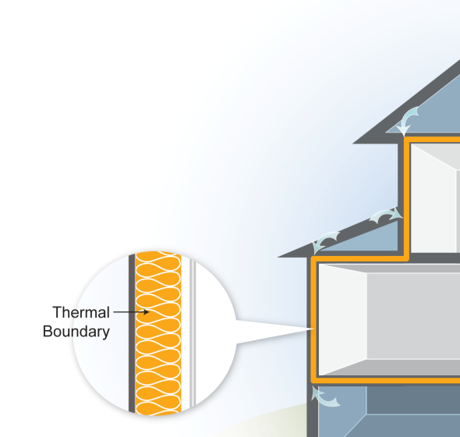
Thermal Boundary
The Thermal Boundary:
  Reduces heat flow between inside and outside.
  Easy to identify by presence of insulation.
  The location of insulation in relation to other building components is critical to its effectiveness.
  Even small areas of missing insulation are very important.
  Voids of 7% can reduce effective R-value by almost 50%.
4
GJA 2024 Version III
Notes:
The thermal boundary is the insulation.
The thermal boundary limits heat flow between inside and outside and is easy to identify by the presence of insulation.
The location of insulation in relation to other building components is critical to its effectiveness. When air passes through insulation, it takes heat and moisture with it.
Even small areas of missing insulation are critical to address.
Voids of 7% can reduce the effective R-value by almost 50%. The effective R-value in the attic of a 1,000-square-foot, single-story rambler insulated to R-38 falls to an effective R-value of only 19 when 70 square feet of insulation is pushed aside.
Common materials include fiberglass batts, blown-in cellulose, and vermiculite in some older homes. If the thermal and air boundaries are continuous and in contact with each other, air will not pass through the insulation.
It is quite common for cold air to bypass the insulation, not just in low-income homes, but in large new homes as well.
Q: What materials are both the thermal boundary and the air barrier?
A: Foam board, spray foam, and dense-pack cellulose insulation, properly installed, greatly reduce airflow.
<number>
July 2012

Slide 5
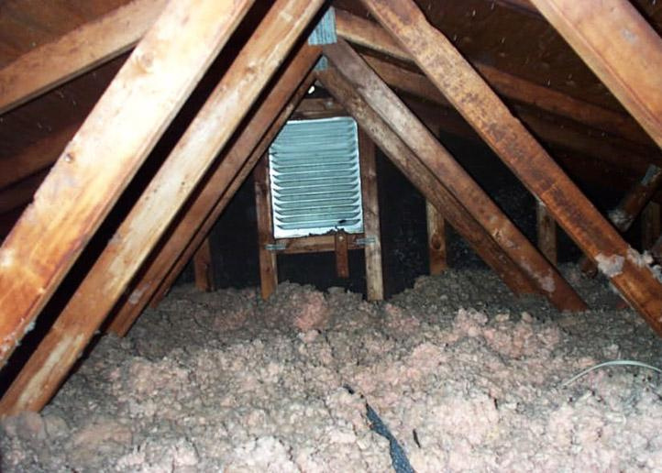
Photo courtesy of NRCERT
5
GJA 2024 Version III
Notes:
The thermal boundary is usually easy to identify.
Q: Where is the air barrier?
A: The air barrier cannot always be determined through visual inspection. Pressure diagnostics are the best way to determine the location and condition of air boundaries.
<number>
July 2012

Slide 6
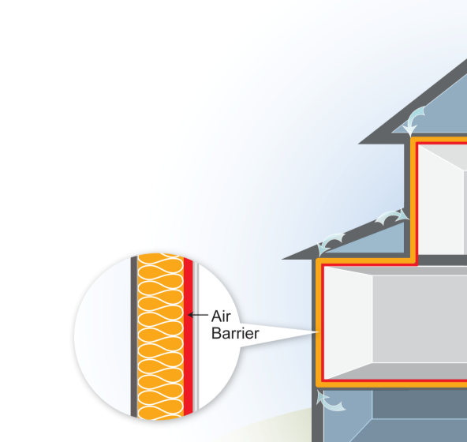
Air Barrier
The Air Barrier:
  Limits airflow between inside and outside.
  More difficult to identify.
  Not always where you think it is.
  Blower door is used to locate air barrier.
6
GJA 2024 Version III
Notes:
The air barrier:
Limits air flow between inside and outside, and the heat and moisture carried by that air.
Is more difficult to identify than thermal boundary, because it can be hard to see.
Is not always where you think it is.
The blower door is used to locate the air barrier. Pressure readings taken with the blower door running are used to locate air leakage and the air barrier.
Q: What is the air barrier in most homes?
A: Usually the interior drywall.
<number>
July 2012

Slide 7
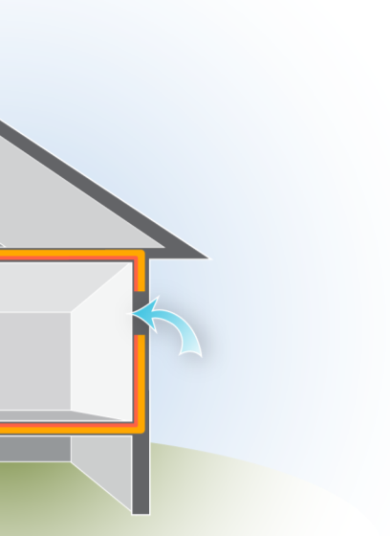
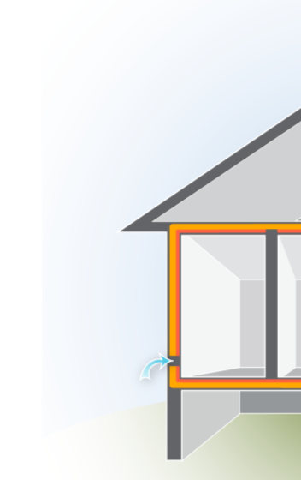
Air Leakage
Graphic developed for the US DOE WAP Standardized Curricula
Air Leakage requires:
      A hole.
      Pressure difference across that hole.
        The bigger the hole or higher
        the pressure difference, the
        more airflow.
        To reduce airflow, we can reduce the size of the hole or lower the pressure difference.
7
GJA 2024 Version III
Notes:
Holes in the air barrier wouldn’t matter without pressure differences.
Air leakage requires:
A hole.
Pressure difference across that hole.
The bigger the hole or higher the pressure difference, the higher the volume of air leakage.
To reduce airflow, reduce the size of the hole or lower the pressure difference. Holes and pressure differences usually go hand-in-hand.
<number>
July 2012

Slide 8
Air Leakage
  Airflow is measured in "cubic feet per minute" (CFM) or ft³/min
  1 CFM OUT = 1 CFM IN.
  Airflow takes the path of least resistance.
  Air moves from high- to low-pressure areas.
  Air usually moves from high- to low-temperature areas.
8
GJA 2024 Version III
Notes:
Airflow is measured in cubic feet per minute (CFM), also written as ft3/min. A cubic foot is a little larger than a basketball.
1 CFM out = 1 CFM in – The same volume of air that leaks out of a home also leaks into the home, often at a different location.
Airflow takes the path of least resistance – Air leakage leads to moisture issues when warm, relatively moist air leaks into colder areas and condenses on building surfaces.
Air moves from high- to low-pressure areas.
Air moves from high- to low-temperature areas.
Air leakage affects energy use because conditioned air leaks out and unconditioned air seeps in, increasing the total volume of air that must be cooled or heated to maintain comfortable indoor temperatures.
<number>
July 2012

Slide 9
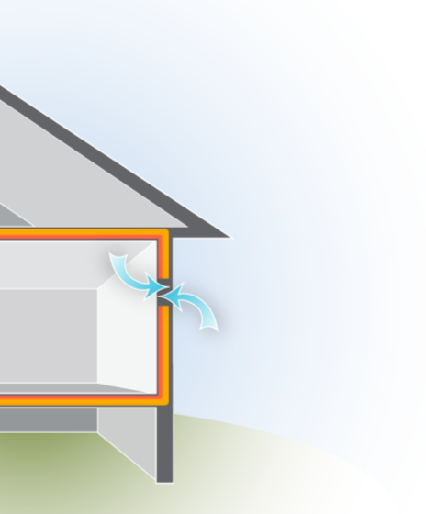
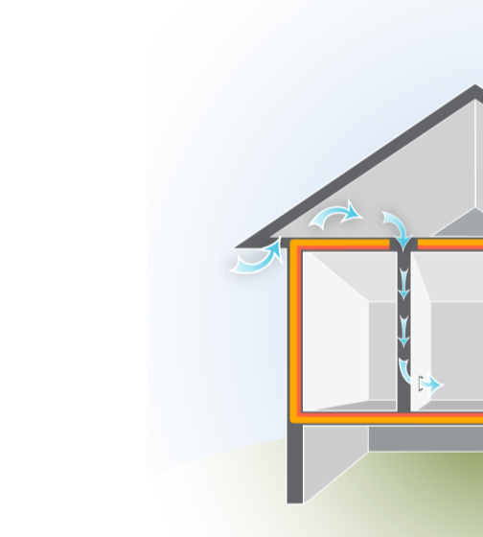
Air Leakage
Direct Leakage
Air enters and exits the thermal envelope at holes and cracks.
Indirect (hidden) Leaks
Enters, moves through building cavities and exits at a different location.
Graphic developed for the US DOE WAP Standardized Curricula
9
GJA 2024 Version III
Notes:
Direct leakage occurs at direct openings to the outdoors, and air leaks directly through the building envelope at this location – Direct leakage is common around doors and windows.
Indirect leakage enters at one location, moves through building cavities, and exits at a different location – Indirect leakage is common in older homes where interior walls have no top plates. Another typical example of indirect leakage is when a porch roof joins the side of a house. Often the siding is left off where the porch roof and house intersect. Cold air in the porch attic flows into the floor cavity of the home, and into wall cavities or soffits. This is revealed by a cold wall or floor in the winter. The blower door is used to track these leaks.
Q: What are some typical spots for direct leakage?
A: Dryer vents, around doors and windows, and any other place there are penetrations in the building envelope.
<number>
July 2012

Slide 10
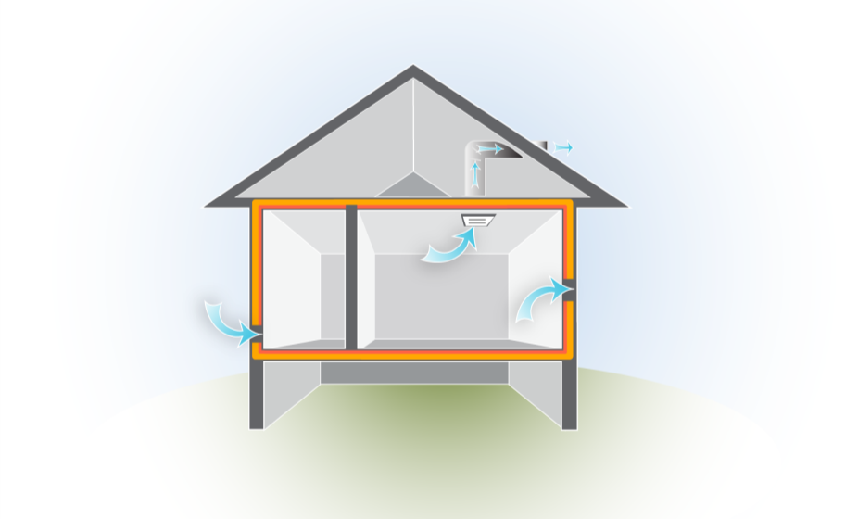
Air Leakage
Ventilation = Controlled air leakage
Infiltration =
Air leaking in
Exfiltration =
Air leaking out
Graphic developed for the US DOE WAP Standardized Curricula
10
GJA 2024 Version III
GJA 2025 Version III
WEATHERIZATION ASSISTANCE PROGRAM STANDARDIZED CURRICULUM – July 2012
Notes:
Infiltration is air leaking in.
Exfiltration is air leaking out.
Ventilation is controlled air leakage, i.e. air exchange.
Q: What are some common examples of each type of air leakage?
A: Here are three common examples:
Infiltration: Cold air coming in under a door in the winter.
Exfiltration: Warm air rushing up through recessed can lights into the attic in the winter.
Ventilation: Bathroom fan, hood fan, heat recovery ventilation (HRV).
Q: Is there anything odd about this illustration?
A: Would be unlikely to find exfiltration in a small room with mechanical exhaust ventilation. This is shown here to illustrate the terminology only,
<number>
July 2012

Slide 11
Air Leakage
Ventilation = Controlled air leakage
Infiltration =
Air leaking in
Exfiltration =
Air leaking out
Graphic developed for the US DOE WAP Standardized Curricula
11
GJA 2024 Version III
GJA 2025 Version III
WEATHERIZATION ASSISTANCE PROGRAM STANDARDIZED CURRICULUM – July 2012
Notes:
Infiltration is air leaking in.
Exfiltration is air leaking out.
Ventilation is controlled air leakage, i.e. air exchange.
Q: What are some common examples of each type of air leakage?
A: Here are three common examples:
Infiltration: Cold air coming in under a door in the winter.
Exfiltration: Warm air rushing up through recessed can lights into the attic in the winter.
Ventilation: Bathroom fan, hood fan, heat recovery ventilation (HRV).
Q: Is there anything odd about this illustration?
A: Would be unlikely to find exfiltration in a small room with mechanical exhaust ventilation. This is shown here to illustrate the terminology only,
<number>
July 2012

Slide 12
Air Leakage
Ventilation = Controlled air leakage
Infiltration =
Air leaking in
Exfiltration =
Air leaking out
Graphic developed for the US DOE WAP Standardized Curricula
12
GJA 2024 Version III
GJA 2025 Version III
WEATHERIZATION ASSISTANCE PROGRAM STANDARDIZED CURRICULUM – July 2012
Notes:
Infiltration is air leaking in.
Exfiltration is air leaking out.
Ventilation is controlled air leakage, i.e. air exchange.
Q: What are some common examples of each type of air leakage?
A: Here are three common examples:
Infiltration: Cold air coming in under a door in the winter.
Exfiltration: Warm air rushing up through recessed can lights into the attic in the winter.
Ventilation: Bathroom fan, hood fan, heat recovery ventilation (HRV).
Q: Is there anything odd about this illustration?
A: Would be unlikely to find exfiltration in a small room with mechanical exhaust ventilation. This is shown here to illustrate the terminology only,
<number>
July 2012

Slide 13
Driving Forces of Air Leakage
Driving Forces of Air Leakage
Temperature and pressure differences –
usually between inside and outside of house
The bigger the temperature or pressure difference,
the greater the air and heat flow
13
GJA 2024 Version III
GJA 2025 Version III
WEATHERIZATION ASSISTANCE PROGRAM STANDARDIZED CURRICULUM – July 2012
Notes:
Temperature and pressure differences drive air leakage.
The leakage we care about is usually between the inside and outside of the house. Air leakage within the conditioned space in a house is less important.
The bigger the temperature or pressure difference, the greater the air and heat flow. This is why measures that reduce heating demand are often more cost-effective than those that reduce cooling demand. The temperature difference between inside and outside in a very cold climate in winter is two to three times the difference between inside and outside in even the hottest climate in summer.
<number>
July 2012

Slide 14
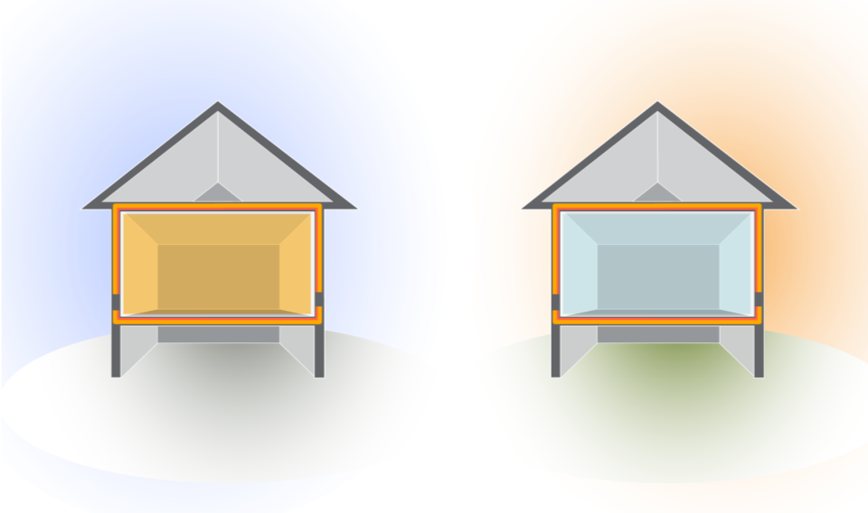
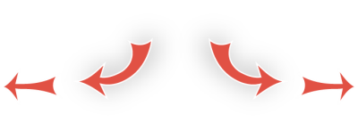

Air Leakage: Temperature
DeltaT = Temperature Difference
Winter
Summer
70
10
90
70
Delta T=60
Graphic developed for the US DOE WAP Standardized Curricula
Delta T=20
Air flow is from _____ to _____.
The higher deltaT, the ______ heat and air want
to escape or enter the building
14
GJA 2024 Version III
GJA 2025 Version III
WEATHERIZATION ASSISTANCE PROGRAM STANDARDIZED CURRICULUM – July 2012
<number>
Notes:
Delta T is the temperature difference.
Click ahead to reveal heat flow in winter versus summer.
Ask students to fill in the blanks before you click ahead.
Flow is from hot to cold.
The higher the Delta T, the more heat and air want to escape or enter the building.
The rate of heat and air transfer increases as the Delta T increases. The leakage rate of a home in the summer might be 40 CFMnatural, but increase to 120 CFMnatural in the winter with the increased Delta T.
Cost-effectiveness of cooling system replacements is less than for heating system replacements because of the smaller Delta T.
<number>
July 2012

Slide 15
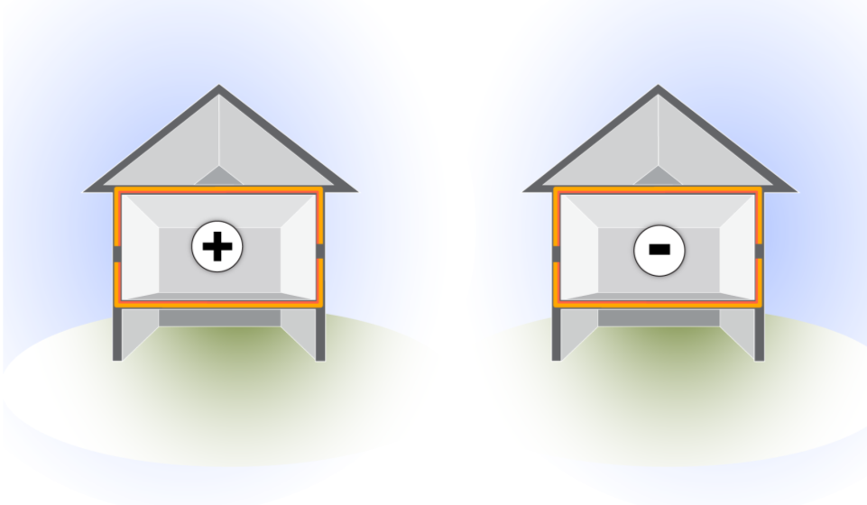


Air Leakage: Pressure
DeltaP = Pressure Difference
Graphic developed for the US DOE WAP Standardized Curricula
Positive
Negative
positive (high)
negative (low)
Flow is from ______________ to ______________ pressure.
For every CFM that _______, one CFM _______.
Flow takes the path of _______ resistance.
enters
exits
least
15
GJA 2024 Version III
GJA 2025 Version III
WEATHERIZATION ASSISTANCE PROGRAM STANDARDIZED CURRICULUM – July 2012
Notes:
Click ahead to reveal direction of air leakage.
Review terms infiltration and exfiltration.
Ask students to fill in the blanks before you click ahead.
Flow is from positive (high) to negative (low) pressure.
For every CFM that enters, one CFM exits.
Flow takes the path of least resistance – Air isn’t smart. Air goes where it is easiest to flow, not where you want it to flow.
Pressure acts on all sides of the home.
Q: What danger is associated with negative pressure in the home?
A: Backdraft.
<number>
July 2012

Slide 16
Air Leakage: Driving Forces
Types of Driving Forces
Wind
Heat – Stack effect, combustion
Fans – Exhaust fans, duct leaks, interior doors
16
GJA 2024 Version III
GJA 2025 Version III
Notes:
Pressure differences drive air leakage, but what causes pressure differences? The driving forces that induce temperature or pressure differences are:
Wind.
Heat – Stack effect is an example of heat producing a pressure difference. Combustion produces both temperature and pressure differences.
Fans – Exhaust fans, duct leaks, interior doors.
<number>
July 2012

Slide 17
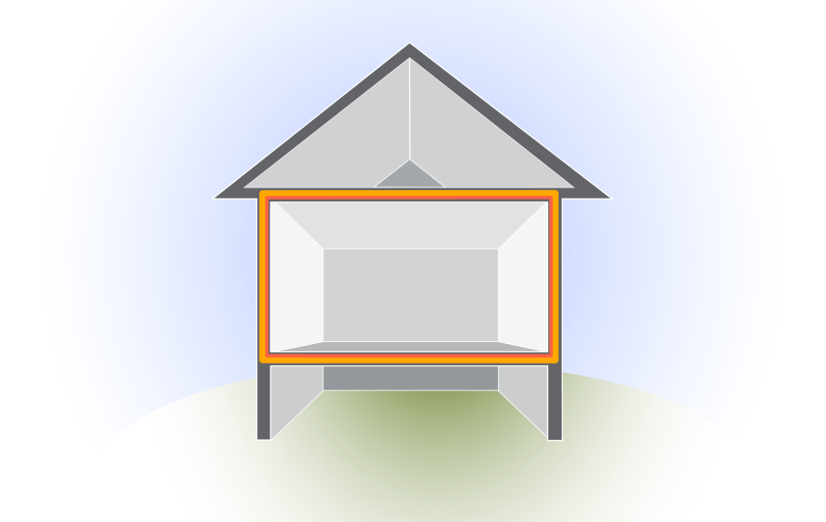

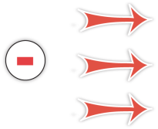
BUILDING SCIENCE BASICS
Driving Forces: Wind Effect
Wind creates a positive pressure on the windward side of the building . . .
Which creates a negative pressure
on the other sides
of the house
positive pressure
negative pressure
WIND DIRECTION
Graphic developed for the US DOE WAP Standardized Curricula
17
GJA 2024 Version III
GJA 2025 Version III
Notes:
Wind creates a positive pressure on the windward side of the building, which creates a negative pressure on the other sides of the house.
The leeward (protected) side of the house has negative pressure that sucks air out of the house. This is why during big storms, people will crack the windows open to equalize pressure and reduce the chances of windows blowing in or out.
During blower door tests, the hose taking external readings must be thrown clear of the wind path created by the blower door fan to avoid faulty readings due to the wind effect.
<number>
July 2012

Slide 18
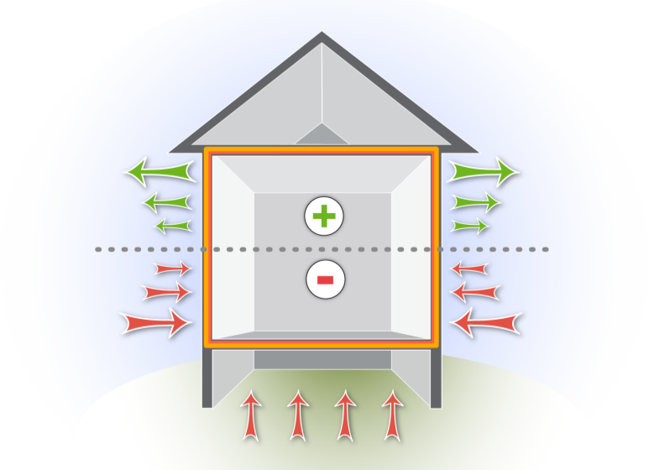
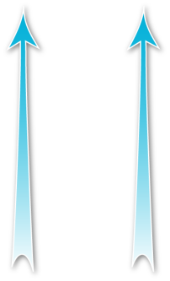

Driving Forces: Stack Effect
Stack Effect
Warmer air rises and escapes out of the top of the house. . .
pulling in outside air from low leaks.
positive pressure
Neutral pressure plane
negative pressure
Graphic developed for the US DOE WAP Standardized Curricula
18
GJA 2024 Version III
GJA 2025 Version III
Notes:
Warmer air rises and escapes out of the top of the house, which creates a suction that pulls in outside air at the bottom of the house.
Every CFM that escapes one place has to be replaced from somewhere.
Click to reveal airflow rising to top and entering through bottom.
Q: What is a useful version of stack effect?
A: Proper draft of a chimney.
<number>
July 2012

Slide 19

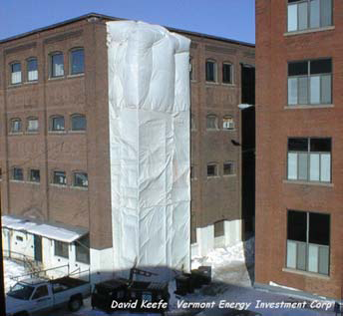






Stack Effect
Positive pressure
(with reference to outside)
Neutral pressure plane
Negative pressure
(with reference to outside)
Photo courtesy of David Keefe, Vermont Energy Investment Corp.
Notes:
Click to reveal the anatomy of the pressure on this building.
Air leakage in a building suffering from the stack effect is predictable.
Hot air rises, creating a negative pressure in the lower portion of the building. Negative pressure leads to infiltration, or air leaking into the building.
The neutral pressure plane is not located halfway up the building, but wherever the force of rising air is neutralized by limited leaks, or points of escape for the rising air.
Positive pressure in the top of the building causes exfiltration, or air leakage out of the building.
<number>
July 2012

Slide 20
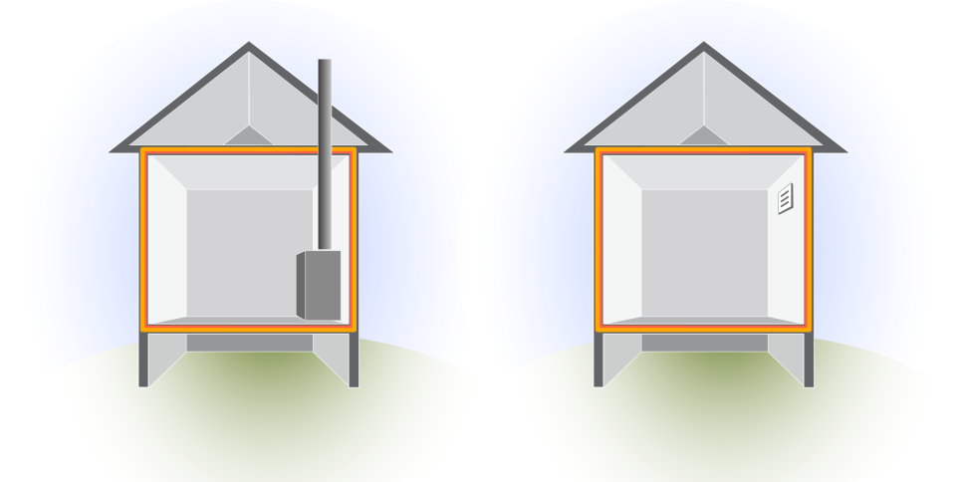

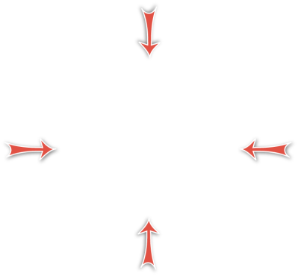


Driving Forces
Combustion Equipment & Exhaust Fans
Exhaust Fan
Negative
pressure
Graphic developed for the US DOE WAP Standardized Curricula
20
GJA 2024 Version III
GJA 2025 Version III
Notes:
Click to reveal the anatomy of depressurization in both situations.
Combustion appliances and exhaust fans can create negative pressure in the home. This pressure difference increases infiltration.
Combustion appliances that take their combustion air from inside the home.
For example, most 80+ furnaces and conventional gas water heaters, can create negative pressure in the home. In a tight home, this could result in unsafe levels of CO.
Direct-vented appliances that take combustion air directly from the outside.
For example, most 90+ furnaces don’t cause depressurization.
Exhaust fans also cause negative pressure.
<number>
July 2012

Slide 21
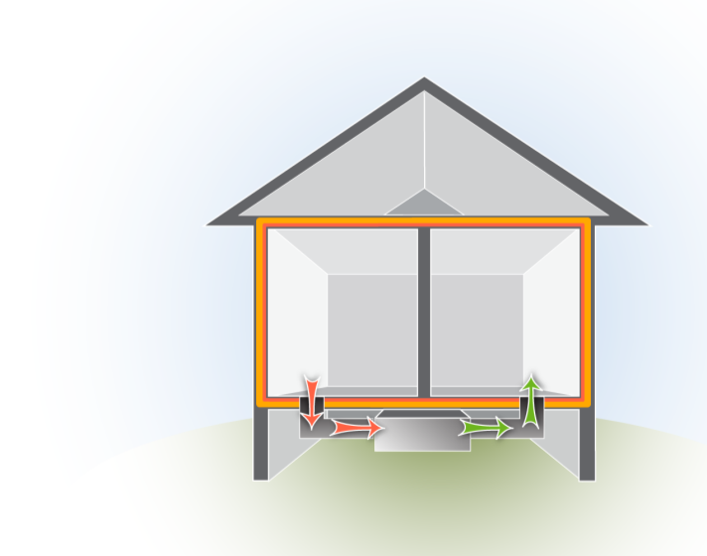
BUILDING SCIENCE BASICS
Driving Forces
Duct Leakage
Duct leaks are important because the air handler creates large pressures.
Duct leakage can create positive and negative pressures in different areas of the house.
All holes are not created equal!
Return
Supply
Graphic developed for the US DOE WAP Standardized Curricula
21
GJA 2024 Version III
GJA 2025 Version III
Notes:
Duct leakage can create positive and negative pressures in different areas of the house.
The pressures associated with duct leaks can be larger and more important because the driving force is stronger.
All holes are not created equal.
In this situation, when the door between the bedroom and main body of the home is open, pressure remains balanced throughout the home.
Q: What happens if you close the door to the bedroom in this situation?
Click ahead to reveal answer.
<number>
July 2012

Slide 22
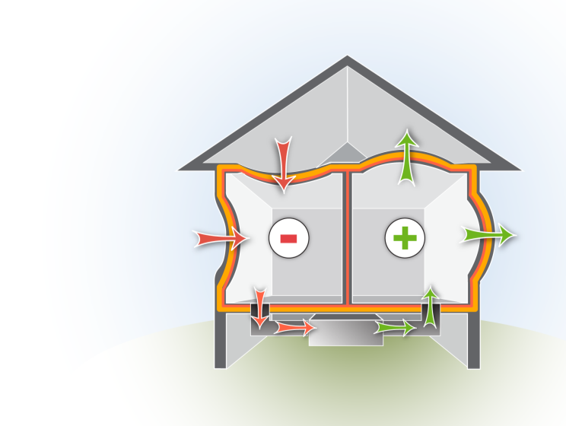
Driving Forces: Duct Leakage
Duct Leakage
Closed doors can cause positive pressure in rooms that have only supply vents.
This causes negative pressure where the return is located.
Return
Supply
Graphic developed for the US DOE WAP Standardized Curricula
22
GJA 2024 Version III
GJA 2025 Version III
<number>
Notes:
Closed doors that prevent supply air from getting back to a return vent cause positive pressures in those rooms with supply vents.
This situation starves the return for air, causing negative pressure in the zone where the return vent is located.
<number>
July 2012

Slide 23


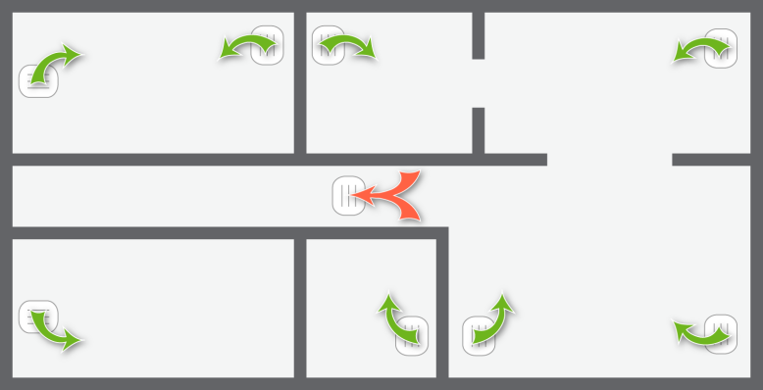


Driving Forces: Imbalances
Room Pressure Imbalances
Master
Bedroom
Utility Room
Kitchen
Whole-house
return in hallway
Living Room
Bedroom
Bath
Graphic developed for the US DOE WAP Standardized Curricula
23
GJA 2024 Version III
GJA 2025 Version III
Notes:
It is easy to predict pressure imbalances based on the locations of return and supply vents throughout a home, even without the use of a blower door.
Q: Which rooms of the house will have positive pressure and which will have negative, and will air leak into or out of those rooms?
A: Click to reveal answers in this order:
Master bedroom: positive, exfiltration.
Utility: negative, infiltration.
Kitchen: negative, infiltration.
Living room: negative, infiltration.
Bathroom: positive, exfiltration.
Bedroom: positive, exfiltration.
Q: What are some methods for balancing the pressure in this home?
A: Here are three:
Add returns in bedrooms and bathroom.
Undercut doors.
Add grates to the doors.
<number>
July 2012

Slide 24
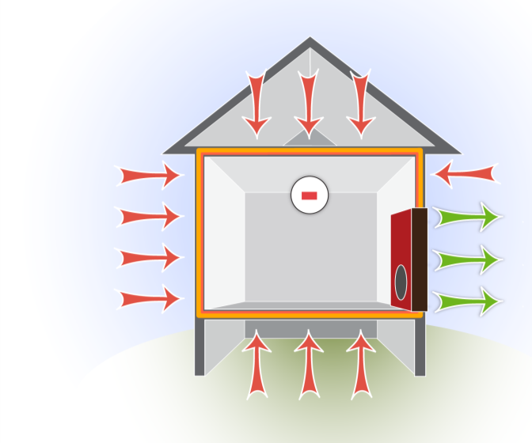
Controlled Driving Force
BUILDING SCIENCE BASICS
Use a Blower Door as a Controlled Driving Force
Using the blower door depressurizes the house, drawing air through all the holes between inside and outside.
Negative Pressure
Blower Door
Graphic developed for the US DOE WAP Standardized Curricula
24
GJA 2024 Version III
GJA 2025 Version III
Notes:
Using the blower door depressurizes the house, drawing air through all the holes between inside and outside.
Using the blower door as a driving force, air is sucked out of the house faster than it can be replaced. This creates a measurable pressure difference in order to perform diagnostics.
This is different from how the house behaves under normal conditions. Normally, air would be infiltrating through some of the holes and exfiltrating through others. With the blower door running, the home is depressurized so air infiltrates all the holes except the door
where the fan is set up.
<number>
July 2012

Slide 25
Summary
  Pressure and thermal boundaries should be continuous and in contact.
  Air carries heat and moisture.
  Air leakage requires a hole and pressure difference.
  Wind, heat, and fans drive pressure differences.
  Duct location and condition can cause room pressure imbalances.
  Blower door is a controlled driving force for quantifying air leakage.
25
GJA 2024 Version III
GJA 2025 Version III
Notes:
Pressure and thermal boundaries should be continuous and in contact with each other.
Air carries heat and moisture.
Air leakage requires a hole and pressure difference.
Wind, heat, and fans drive pressure differences.
Duct location and condition can cause room pressure imbalances.
The blower door is a controlled driving force for quantifying air leakage.
Present this slide as an interactive discussion, soliciting personal examples from the trainees. Add your own personal examples and knowledge to supplement.
<number>
July 2012

