Slide 1




WEATHERIZATION INSTALLER/TECHNICAN FUNDAMENTALS
At the Job Site
1
GJA 2024 Version III
GJA 2025 Version III
Notes:
1
July 2012

Slide 2
Learning Objectives
After this session, participants will be able to:
  Describe typical pre-existing conditions that should be reported to the crew leader.
  List which conditions require deferral on a dwelling.
  Describe a well-organized job site.
  Perform routine maintenance on typical tools.
  Describe basic power tool safety.
  Discuss the purpose of safety protocols, and list four elements of creating a safe work environment.
  Demonstrate how to protect the interior and exterior environment.
  List the steps of wrapping up the work day.
2
GJA 2024 Version III
GJA 2025 Version III
‹#› | WEATHERIZATION ASSISTANCE PROGRAM STANDARDIZED CURRICULUM – July 2012
eere.energy.gov
Notes:
After attending this session, participants will be able to:
Describe typical pre-existing conditions that should be reported to the crew leader.
List which conditions require deferral on a dwelling.
Describe a well-organized job site.
Perform routine maintenance on typical tools.
Describe basic power tool safety.
Discuss the purpose of safety protocols, and list four elements of creating a safe work environment.
Demonstrate how to protect the interior and exterior environment.
List the steps of wrapping up the work day.
2
July 2012

Slide 3
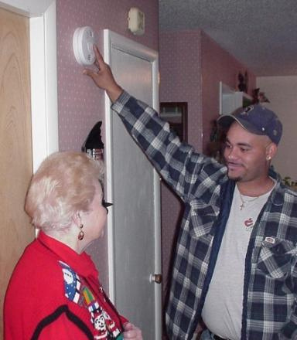
Arriving at the Job Site
Before you start…
  Always double check the address and make sure you are at the right house.
  Verify with the client that work may proceed.
  Decide where to park the truck for easy access, loading, and unloading.
3
GJA 2024 Version III
GJA 2025 Version III
‹#› | WEATHERIZATION ASSISTANCE PROGRAM STANDARDIZED CURRICULUM – July 2012
eere.energy.gov
Notes:
If you have prepared well before arriving at the job site by checking available materials against the work scope, it should be a smooth day’s work.
Before you get started pulling off siding, take a few precautions to make sure you don’t become one of those stories used to scare new hires.
Make sure you’re at the right house. Believe it or not, the wrong home has been weatherized before because someone forgot to double check the address, and the homeowner was elated at their good fortune!
Verify with the client that work may proceed. Weatherization is a very invasive process, so put the residents at ease by quickly reviewing what will be done.
Decide how to organize the job site for optimum safety and efficiency. Where should people park? Where best to unload equipment to make room in the truck during the day? On rainy days, you’ll want to make sure tools and materials aren’t being left out to be damaged.
3
July 2012

Slide 4
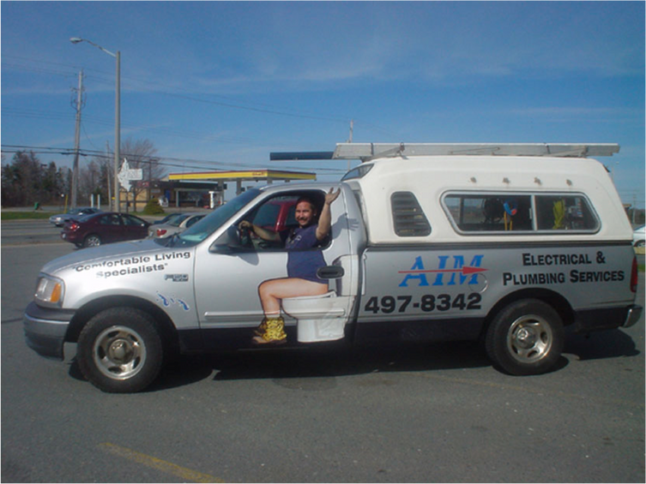
Use Designated Facilities
  Use designated restroom and wash-up facilities.
  Determine where breaks and lunch will be taken.
  If there are smokers on the crew, find out where they may smoke (not in the home).
  These tips are especially important when working in a lead environment.
Some crews are lucky enough to have their own portable restrooms. Otherwise, discuss with the resident which washroom facilities workers may use.
4
GJA 2024 Version III
GJA 2025 Version III
‹#› | WEATHERIZATION ASSISTANCE PROGRAM STANDARDIZED CURRICULUM – July 2012
eere.energy.gov
Notes:
While discussing the work with the resident, spend some time determining where the crew should take their breaks and fulfill other facilities needs.
Use designated restroom and wash-up facilities.
Determine where breaks and lunch will be taken.
If there are smokers on the crew, find out where they may smoke (not in the home).
This is especially important when working lead safe.
You should always be mindful of the resident’s preferences, but it is even more critical to designate wash-up and eating facilities when you are working in a lead environment to avoid contaminating the home unintentionally.
4
July 2012

Slide 5
Report Pre-existing Conditions
Before you get started, do a quick walk-through of the home to determine if there are any pre-existing conditions that must be noted.
Occasionally, you may discover conditions at the job site that were not noticed by the auditor or not mentioned in the work order.
We’ll look at a few examples of pre-existing conditions that should be brought to the attention of the crew leader and will share guidance on situations that may require deferral of the job until the situation can be improved.
5
GJA 2024 Version III
GJA 2025 Version III
‹#› | WEATHERIZATION ASSISTANCE PROGRAM STANDARDIZED CURRICULUM – July 2012
eere.energy.gov
Notes:
Though the auditor conducted a thorough assessment of the home prior to your arrival at the job site, the work of installing measures is far more invasive than a typical audit. This means that you may be the first person to access certain areas of the home in quite some time and may make some unfortunate discoveries.
The next few slides present some examples of pre-existing conditions that should be reported to the crew leader to determine appropriate actions and some guidance about the deferral policies in the Weatherization Assistance Program.
5
July 2012

Slide 6
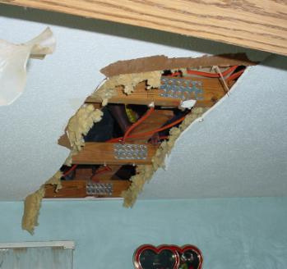
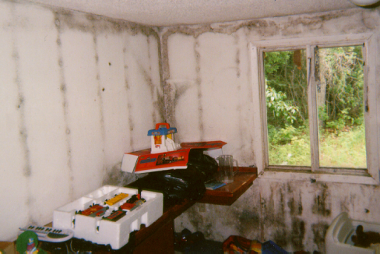
Report Pre-existing Conditions – Moisture
Auditors should determine causes
of moisture damage.
Photos courtesy of U.S. Department of Energy
Damaged ceilings may indicate moisture issues.
Mold on walls indicates serious moisture issues in the home. Determine underlying causes and mitigate before any air sealing.
6
GJA 2024 Version III
GJA 2025 Version III
‹#› | WEATHERIZATION ASSISTANCE PROGRAM STANDARDIZED CURRICULUM – July 2012
eere.energy.gov
Notes:
Photo of damaged ceiling and mold on walls.
Auditors should attempt to determine the underlying cause of mold problems.
Q: Should air sealing be recommended in a home where these kinds of conditions are observed?
A: Not until the underlying causes are resolved and the mold has been cleaned up.
If you find situations like this that aren’t mentioned in the work scope, notify the crew lead. The underlying cause of moisture damage must be addressed before repairs are made. The photo on the right would require deferral.
6
July 2012

Slide 7
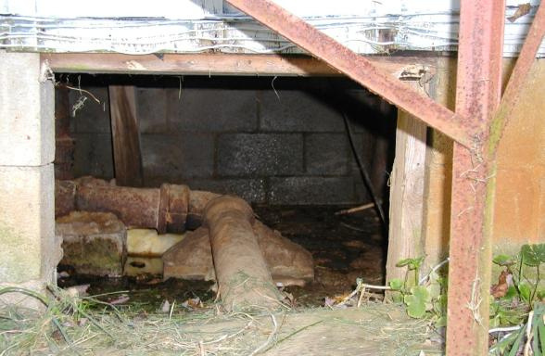
Foundations and Crawl Spaces
Situations like this can hinder weatherization work.
  Workers cannot access ducts, floor cavity.
  Occupant health and safety are impacted.
Wet crawl space
Photo courtesy of U.S. Department of Energy
7
GJA 2024 Version III
GJA 2025 Version III
Notes:
This is a photo of a wet crawl space without a door.
Situations like this can affect the health and safety of weatherization workers.
Even when the crawl space is clean and dry, accessibility guidelines apply. Check the local field guide. Typically, if there is less than 24” of vertical clearance, it may be considered inaccessible.
The term “confined space” is sometimes used and may even be defined in the State Field Guide for clarification about where workers are expected to go, and where they are not. The official OSHA definition is not helpful regarding specific dimensions and is generally inferred to mean an employee would be working with heavy machinery within the confined space.
According to OSHA’s definition, a confined space is:
Large enough for an employee to enter fully and perform assigned work;
Is not designed for continuous occupancy by the employee; and
Has a limited or restricted means of entry or exit.
7
July 2012

Slide 8
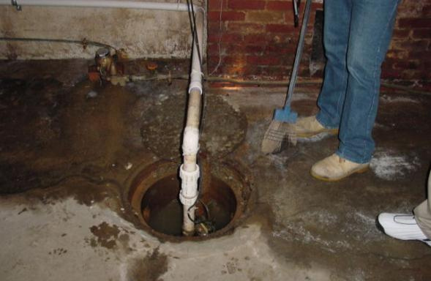
Basement
Situations like this can hinder weatherization work.
  Bulk moisture problems must be solved before weatherization work can begin.
Wet basement
Photo courtesy of PA Weatherization Training Center
8
GJA 2024 Version III
GJA 2025 Version III
‹#› | WEATHERIZATION ASSISTANCE PROGRAM STANDARDIZED CURRICULUM – July 2012
eere.energy.gov
Notes:
This is a photo of a wet basement floor with an open sump.
Bulk moisture problems like this will need to be fixed before weatherization work can begin.
8
July 2012

Slide 9
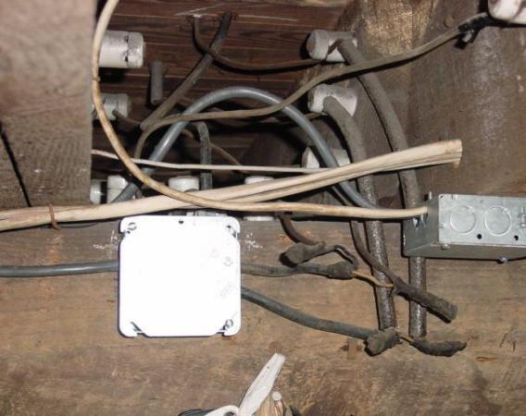
Electrical
Note the locations of these and any other electrical hazards:
  Knob and
  tube wiring
  Open wire splices
  Uncovered
  junction boxes
  Frayed wire, etc.
Most state codes prohibit insulation over knob and
tube wiring.
9
GJA 2024 Version III
GJA 2025 Version III
Notes:
This is a photo of knob and tube wiring.
The auditor should have noted the locations of these and other potential electrical hazards:
Knob and tube wiring
Open wire splices
Uncovered junction boxes
Frayed wire, etc.
If you discover electrical hazards and they aren’t noted on the work order, notify the crew chief to determine if a change order is required or if you can address the issue, continue work, and deal with the paperwork back at the office.
9
July 2012

Slide 10
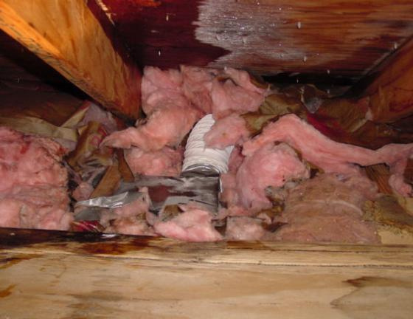
Ventilation Ducts
Note location and condition of exhaust ducts:
  Vented directly outside?
  Smooth or flex pipe?
  Moisture damage?
Photo courtesy of PA Weatherization Training Center
10
GJA 2024 Version III
GJA 2025 Version III
‹#› | WEATHERIZATION ASSISTANCE PROGRAM STANDARDIZED CURRICULUM – July 2012
eere.energy.gov
Notes:
This is a photo of disconnected duct from a kitchen ventilation fan and associated moisture on the roof sheathing.
All ventilation exhaust fans must be vented through the roof with smooth metal pipe. If you find a situation like the one shown here that is not on the work order, notify the crew’s leader. It should be vented to the outside and that will be much easier before you install insulation, rather than after.
10
July 2012

Slide 11
Deferral
When to walk away.
When to run away.
What to do about it.
11
GJA 2024 Version III
GJA 2025 Version III
Notes:
We never want to deny services to eligible clients, but there are some situations—if the client’s home is condemned, for instance—where weatherization money would be better spent elsewhere. In some cases, like if a rodent infestation is discovered in the attic, proceeding with weatherization work could put the crew in harm’s way.
Sometimes deferral of services may be left to the discretion of the subgrantee (the local community action agency), but in certain situations spending DOE’s money to weatherize the home is forbidden.
When to walk away – Weatherization services may be deferred in an otherwise eligible dwelling if certain situations or conditions apply.
When to run away – Other situations require the subgrantee defers services to the dwelling.
What to do about it – In either case, the same guidelines must be followed to inform the client that weatherization work will not be performed or that the work can only begin after certain conditions have been met.
The auditor is usually the first weatherization worker to visit the home and decides if it will be deferred or weatherized. However, installers may be the first to access certain areas of the home and may discover situations the auditor overlooked. Therefore, it’s important that you also recognize potential deferral situations and are able to explain the process to the client if you must.
11
July 2012

Slide 12
When to Walk Away
  Health and safety concerns
  Threatening animals
  Threatening clients
  Remodeling
  Refusal of measures
  Illegal activities
  Unusual situations
12
GJA 2024 Version III
GJA 2025 Version III
Notes:
In certain situations, weatherization services may be deferred; the decision is up to the subgrantee.
Unsanitary conditions or other health and safety concerns – If there are vermin or other immediate threats to the health and safety of weatherization workers, weatherization can be deferred.
Threatening animals – If there is a dangerous dog or other animal, weatherization workers may choose not to endure that threat. In this situation, corrective action can sometimes be offered as an alternative to deferral.
Threatening clients – If the client or resident is verbally or physically abusive, weatherization can be deferred.
Remodeling – If the dwelling is being remodeled or rehabilitated and the weatherization work is not coordinated with that effort, work can be deferred.
Refusal of measures – Sometimes clients refuse a certain weatherization measure. Perhaps they don’t want a refrigerator replacement, for example, because they don’t want to dispose of the old unit. Weatherization can be deferred as allowed by State policy.
Illegal activities – If the dwelling is host to illegal activities such as cultivation or distribution of illegal drugs, weatherization can be deferred.
Unusual situations – Situations may arise where auditors and installers are forced to defer services, but those situations could not possibly be written into regulations because they are so unusual. An example of an unusual situation is if the client has a respiratory ailment that is alleviated by the constant use of a humidifier. If the client can’t or won’t agree to discontinue use of a humidifier, air sealing and insulating may cause moisture problems in the home. Ultimately, any deferrals should be justified by the need to protect the health and safety of weatherization clients and workers, as the mission statement of the program to increase the energy efficiency of client homes.
12
July 2012

Slide 13
When to Run Away
  Already weatherized with DOE funds
  Vacant
  Demolition scheduled
  Condemned
  Structural problems
  Mobile home with poor supports
  Client/owner declines services
13
GJA 2024 Version III
GJA 2025 Version III
Notes:
A subgrantee must not weatherize a dwelling if any of the following conditions apply:
Already weatherized – If the dwelling was weatherized with DOE funds after September 30, 1994, it may not be re-weatherized with DOE funds.
Vacant – Do not weatherize vacant homes. An exception to this rule applies to multi-family dwellings. If at least 50% of the units in a duplex or four-unit building are occupied by eligible clients, the whole building may be weatherized. If at least 66% of the units in other multi-family buildings are eligible, the entire building may be weatherized.
Demolition scheduled – If demolition is scheduled within the next 12 months, it’s better to focus efforts elsewhere.
Condemned – No DOE money may be spent weatherizing a condemned building.
Structural problems – If there are serious structural problems, the cost of the incidental repairs will always outweigh the energy-savings opportunities.
Mobile home with poor supports – If the home is unsafe to live in, weatherization work cannot be done.
Client/owner declines services – The client/owner has the right to refuse weatherization services. This is a voluntary program.
13
July 2012

Slide 14
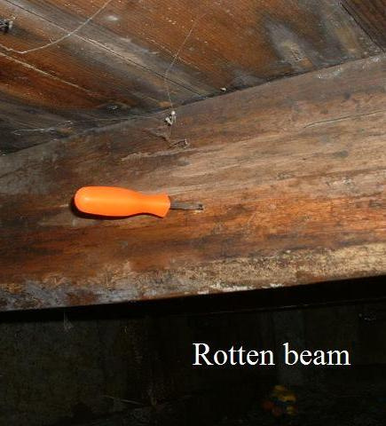
Walk or Run?
Unsound structure?
RUN
If the dwelling is structurally unsound, deferral of weatherization is required.
Photo Courtesy of The US Department of Energy
14
GJA 2024 Version III
GJA 2025 Version III
Notes:
The following four slides are intended to be interactive. The goal is for trainees to discern when deferral is at the discretion of the sub-grantee (i.e., walk away) versus when deferral is required (i.e., run away).
Click once to reveal the issue with the home.
Click again to reveal whether deferral is an option or is required by the program.
This screwdriver pushed easily through the floor beam in multiple locations, indicating severe structural weaknesses that could pose threats to residents and workers. If it’s an unsound structure, run.
14
July 2012

Slide 15
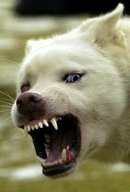
Walk or Run?
Threatening animal?
Walk
Deferral is up to the local agency when threatening animals are present.
15
GJA 2024 Version III
GJA 2025 Version III
Notes:
Click once to reveal the issue: threatening animal.
Q: Is deferral required by the program?
Click again to reveal the answer.
When threatening animals are present, you must decide whether work can proceed. If the animal poses a threat to the safety of weatherization workers, some action must be taken.
You may ask the client to put the threatening animal out of reach of the job site during work. If the client or the animal will not cooperate, you may defer services.
15
July 2012

Slide 16
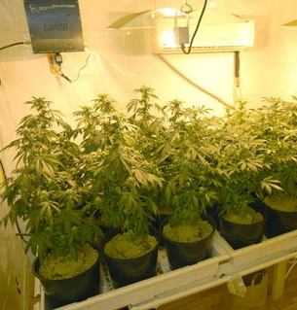
Walk or Run?
Illegal Activity?
Walk
Refusal of services is
up to the discretion of
the sub-grantee.
Photo Courtesy of The US Department of Energy
16
GJA 2024 Version III
GJA 2025 Version III
Notes:
Click once to reveal the issue: illegal activity.
Q. Is deferral required by the program?
Click again to reveal answer.
If an auditor discovers illegal activities going on at an eligible property, the sub-grantee may choose to refuse services.
16
July 2012

Slide 17
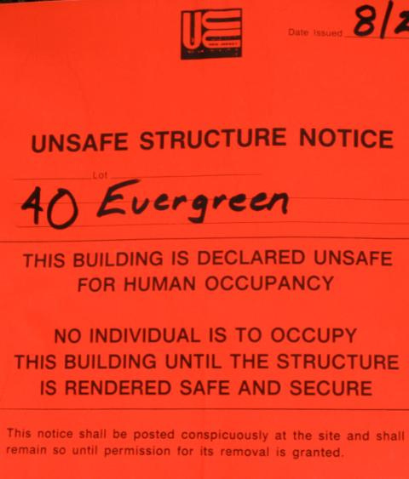
Walk or Run?
Condemned Structure?
Run.
DOE funds may not be
spent weatherizing
condemned structures.
17
GJA 2024 Version III
GJA 2025 Version III
Notes:
Click once to reveal the issue: condemned.
Q: Is deferral required by the program?
Click again to reveal answer.
A: Run away. DOE funds may not be spent weatherizing a condemned building.
17
July 2012

Slide 18
Deferral Policy Summary
Report pre-existing conditions that could put occupants and workers at risk to the crew leader to determine the course of action.
  Services may be deferred when:
    Animals or clients are threatening weatherization staff.
    Illegal activities are going on.
    The client refuses certain measures.
  Services must be deferred when:
    The dwelling is vacant, condemned, scheduled for demolition within 12 months, structurally unsafe, or has already been weatherized with DOE funds.
    The client/owner declines all weatherization services.
18
GJA 2024 Version III
GJA 2025 Version III
Notes:
Report pre-existing conditions that could put occupants and workers at risk.
Services may be deferred when:
Animals or clients are threatening weatherization staff.
Illegal activities are going on.
The client refuses certain measures.
Services must be deferred when:
The dwelling is vacant, condemned, scheduled for demolition within 12 months, structurally unsafe, or has already been weatherized with DOE funds.
The client/owner declines all weatherization services.
18
July 2012

Slide 19
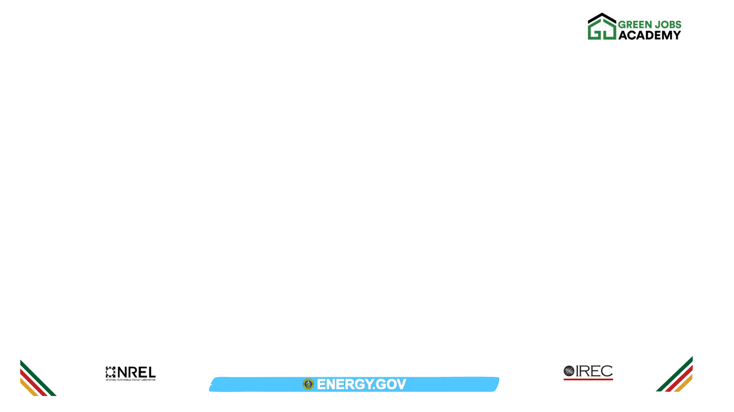
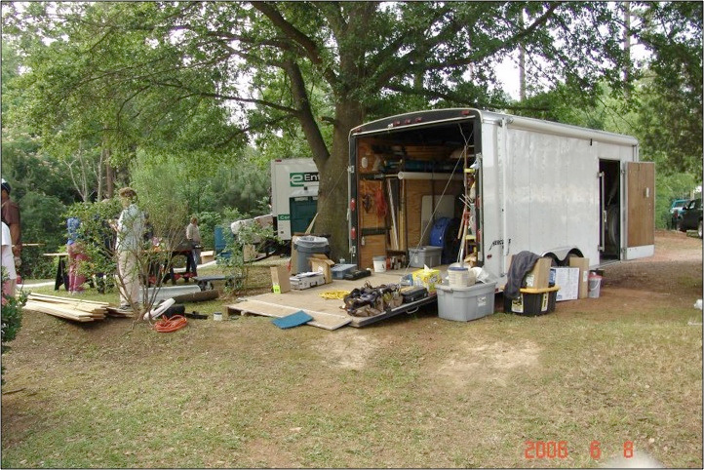
MATERIALS, TOOLS & EQUIPMENT
Photo courtesy of NRCERT
‹#› | WEATHERIZATION ASSISTANCE PROGRAM STANDARDIZED CURRICULUM – July 2012
eere.energy.gov
Notes:
A well-organized trailer and job-site helps work proceed smoothly. These materials can quickly be put in the protective plastic bins if a rain shower blows through. By organizing the most commonly used tools and materials in the same arrangement all the time, workers can quickly access what they need without blocking access to the inside of the trailer.
Note how the extension cord is neatly coiled when not in use. Avoid leaving tangles of cord or other equipment that could become a tripping hazard.
Throughout the day, return tools to a central area when they are no longer in use so they do not end up scattered throughout the house.
19
July 2012

Slide 20
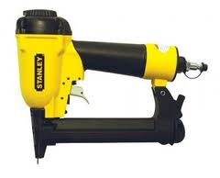

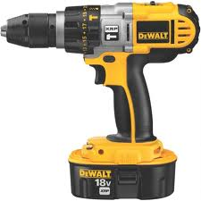
Basic Tool Maintenance
With proper maintenance, your tools will provide years of useful service.
Images courtesy of Bosch, DeWalt and Stanley
20
GJA 2024 Version III
GJA 2025 Version III
eere.energy.gov
Notes:
We discussed general maintenance of the large blowing equipment in the dense pack chapter, but even small power tools require maintenance to continue performing well.
Electric hand drill – Bits should always be sharp. Sharpen or replace when they get dull. When using for extended periods, let the motor cool down occasionally to avoid overheating. Keep air vents and motor clean by blasting some compressed air to clean it up. Coat metal surfaces with a light film of oil to keep them clean, and don’t forget to recharge the batteries.
Power sander – Prevent grime from coating internal mechanisms and causing the tool to overheat. Blow off dust with compressed air or a brush, and regularly clean the fan. Use the dust bag, and empty it often before it’s full to prevent dust from accumulating and obstructing the fan.
Jig saw – Always use sharp blades. If you notice burn marks on the cut, it’s time for a new blade. Let the blade reach maximum speed before engaging in the cut. Use faster speeds for softer materials, slower for harder. Blow through the air vent to clean out after use.
Pneumatic tools – Nail guns and other pneumatic tools require oil. Place a few drops of oil in the designated inlet (generally where the compressor hose hooks up, but check the instructions if in doubt) before each use.
20
July 2012

Slide 21
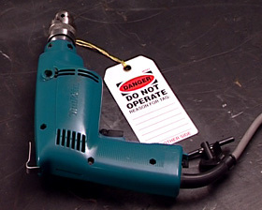
Basic Power Tool Safety
  Use double-insulated tools.
  Never carry by the cord.
  Disconnect when not in use and before servicing or changing accessories.
  Do not use in wet/damp conditions.
  Lock out/tag out.
Photo courtesy of CDX Online
This damaged drill has been tagged out.
21
GJA 2024 Version III
GJA 2025 Version III
Notes:
Basic power tool safety on-site will help avoid accidents. OSHA recommendations include:
Use double-insulated tools. Those are hand-held tools manufactured with non-metallic cases, so the user is insulated from electric wiring components. They reduce shock hazard, but shocks may still occur so follow the other safety guidelines mentioned here.
Never carry a tool by the cord or yank the cord to unplug it from an outlet. Also keep cords away from heat, oil, and sharp edges. Don’t lay tool or extension cords where they will be subjected to heavy traffic; or, if this is unavoidable, cover with a protective barrier to reduce wear and tear.
Disconnect power tools when they’re not in use and before servicing or changing accessories such as drill bits or saw blades.
Do not use in damp or wet locations unless they are approved for that use.
Lock out/tag out is a general term referring to safety policies and practices intended to reduce the risk of workers inadvertently using equipment that is unsafe. Lock out refers to physically locking tools down, either by locking them into a room or crate, or locking the piece of equipment itself so that it can not be operated. Tag out is often used on portable tools. Remove damaged portable tools, and tag them “Do Not Use.” These should be taken out of circulation until they can be repaired or disposed of and replaced.
21
July 2012

Slide 22
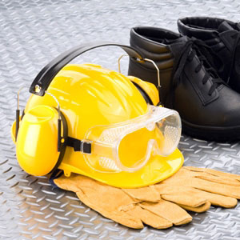
Creating Safe Jobsites
  Protect workers and residents.
  Use proper lighting and ventilation in work area.
  Mask work areas to prevent contamination and ease clean-up.
  Wear appropriate PPE.
  Lock out/tag out.
Photo courtesy of Constructionsafetyjobs.com
22
GJA 2024 Version III
GJA 2025 Version III
Notes:
Safety protocols are implemented to ensure the safety of the workers as well as the continued health and safety of the residents and visitors to the home being weatherized.
Basic safety protocols include:
Creating safe work environments with proper lighting and ventilation.
Masking the area to prevent contamination of the home interior or exterior when working with potentially harmful materials (this has the added benefit of making clean-up a snap).
Wearing proper personal protective equipment (PPE) at all times.
Working safely with electricity. Familiarize yourself with your workplace lock out/tag out procedures.
22
July 2012

Slide 23
Lighting and Ventilation
Lighting
  5 foot-candles
  Natural or with task lights
  OSHA 1926.26 and 1926.56
Ventilation
  Focus is workers’ safety
  Must not disperse unsafe substances into air
  MSDS
23
GJA 2024 Version III
GJA 2025 Version III
Notes:
Lighting
Recommended lighting level: 5 foot-candles
A foot-candle is equivalent to one lumen per square foot, lm/ft2
Can be natural or with task lights.
See OSHA 1926.26 and 1926.56.
Ventilation
Intended to maintain safe work environment for workers.
Must not disperse unsafe substances into air.
MSDS provides safe exposure levels and recommended PPE.
See OSHA 1926.55 and 1926.57 for exposure levels, if not on MSDS.
23
July 2012

Slide 24
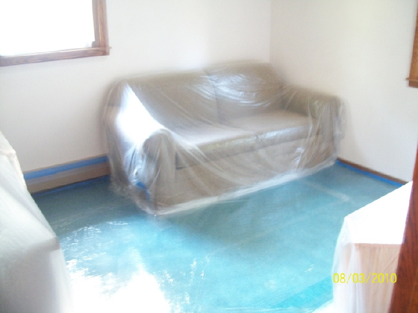
Use Protective Barriers
When you work on a job you must contain the work area to prevent the escape of dust and debris.
The goal of proper work area setup is to keep dust in the work area and non-workers out. Protective barriers should be used indoors and out.
Photo courtesy of epaleadservices.com
Protective barriers are required for lead-safe work but can be used in general to prevent property damage and ease clean-up.
24
GJA 2024 Version III
GJA 2025 Version III
Notes:
Apply plastic sheeting, construction paper, or drop cloths to the floor, ground or other applicable surfaces to protect the home or exterior from dust generated by the work.
When working outside, close doors and windows within 20 feet of the work area to prevent migration of dust and debris.
In environments where lead paint will be disturbed, prevent people and pets from entering the work area for their protection. Post warning signs and establish barriers around the work area with barrier tape, fencing, plastic barriers in doorways, etc.
24
July 2012

Slide 25
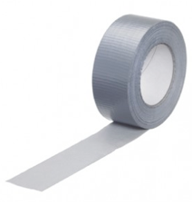
Protective Barriers: Supplies and Tools
Typical materials to restrict access and cover the floor/ground include:
  Signs
  Barrier tape, rope, or fencing
  Cones
  Heavy duty plastic sheeting
  Tape (masking, duct, or painter’s)
  Stapler
  Utility knife or scissors
  Rigid framing material for vertical containment
25
GJA 2024 Version III
GJA 2025 Version III
‹#› | WEATHERIZATION ASSISTANCE PROGRAM STANDARDIZED CURRICULUM – July 2012
eere.energy.gov
Notes:
Here are some typical supplies and tools you will need to set up the work area safely. These items are available in hardware, paint, or garden supply stores.
Purpose: To keep the dust in and people out of your work area.
You must post signs clearly defining the work area and warning occupants and other persons not involved in renovation activities to remain outside of the work area. These signs should be in the primary language of the occupants and should say: “Warning – Lead Work Area” and “Poison, No Smoking, or Eating.”
Also remember to keep pets out of the work area for their safety and to prevent them from tracking dust and debris throughout the home.
25
July 2012

Slide 26

Inside Jobs
Guidelines for lead-safe work can be adapted for use in less hazardous situations. Containing the mess reduces clean-up.
  Remove all objects from the work area.
  Cover all surfaces.
  Close windows and doors.
  Close and cover all ducts.
  Keep personnel and tools free of
  dust and debris.
26
GJA 2024 Version III
GJA 2025 Version III
Notes:
The following is an overview of lead-safe job site preparation but can and should be applied in any situation where the work will generate a lot of dust and debris. Furniture and electronics can be damaged by worksite dust, and removing or covering these objects will also speed clean-up at the end of the day.
Remove all objects from the work area, including furniture, rugs, and window coverings, or cover them with plastic sheeting with all seams and edges taped or otherwise sealed. Where lead safety is not an issue, drop cloths can be substituted for the plastic sheeting. These have the added benefit of being reusable.
Cover the floor surface, including installed carpet, with taped-down plastic sheeting in the work area six feet from the area of paint disturbance or a sufficient distance to contain the dust, whichever is greater. If a vertical containment system is employed, floor covering may stop at the vertical barrier, providing it is impermeable, extends from floor to ceiling, and is tightly sealed at floors, ceilings, and walls. Select the tape based on the materials. Duct tape works well on carpet but may damage wall finishes. Painters tape is more appropriate for painted surfaces.
Close windows and doors in the work area. Doors must be covered in plastic sheeting. When the work area boundary includes a door used to access the work area it must be covered in a way that allows workers to pass, but also confines dust and debris to the work area. One method is to cover the door with two layers of protective sheeting as described here:
Cut and secure one layer of sheeting to the perimeter of the door frame. Do not pull the sheeting taut. Rather, leave slack at the top and bottom of the door before taping or stapling.
Cut a vertical slit in the middle of the sheeting leaving 6” uncut at the top and bottom. Reinforce with tape.
Cut and secure a second layer of sheeting to the top of the door.
Close and cover all ducts opening in the work area with taped-down plastic sheeting. This is a good idea even when lead is not an issue, since it prevents dust and debris from being pulled into the air handling system and distributed throughout the home.
Ensure that all personnel, tools, and other items, including the exteriors of containers of waste, are free of dust and debris before leaving the work area.
26
July 2012

Slide 27
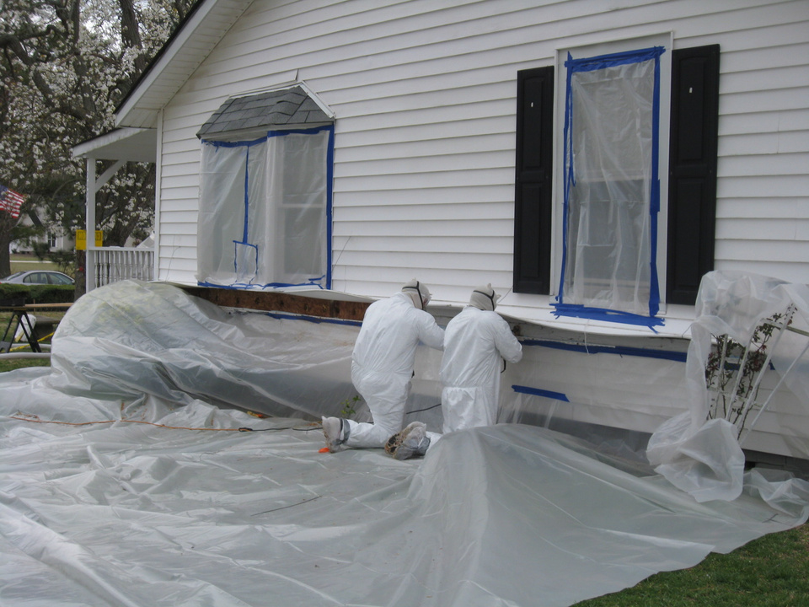
Outside Jobs
Photo courtesy of the US Department of Energy
Cover the ground with plastic 10 feet beyond work area.
27
GJA 2024 Version III
GJA 2025 Version III
‹#› | WEATHERIZATION ASSISTANCE PROGRAM STANDARDIZED CURRICULUM – July 2012
eere.energy.gov
Notes:
For lead-safe work, cover the ground with plastic sheeting or other disposable impermeable material extending 10 feet beyond the perimeter of surfaces undergoing renovation or a sufficient distance to collect falling paint debris, whichever is greater.
If the renovation will affect surfaces within 10 feet of the property line, then use vertical containment to prevent contamination of adjacent buildings and property.
Where lead paint or other hazardous materials are not an issue and the primary purpose of containment is to ease clean up, use your best judgment or refer to the local technical field guide.
Be mindful of landscape features such as shrubs and flower beds. Note how the shrubs are covered in the photo.
Close doors and windows within 20 feet of the work area.
Clean up accidental spills and report spills of hazardous material such as oil.
27
July 2012

Slide 28
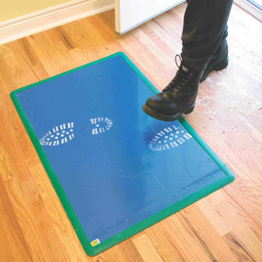
Dust Containment: Tools and Materials
  Wet-dry sandpaper, sanding sponge
  Misting bottle or pump sprayer
  Heavy plastic sheeting
  Utility knife or scissors
  Masking tape, duct tape, or painters’ tape
  High Efficiency Particulate Air (HEPA) vacuum
  Heavy duty plastic bags
  Tack pads (large, sticky pads that help remove dust), paper towels, or disposable wipes
Photo courtesy of ez-ier.com
Tack pads, also called tack mats, placed
where workers exit the work site prevent them tracking dust and debris on their shoes.
28
GJA 2024 Version III
GJA 2025 Version III
Notes:
These are examples of tools and materials to manage workplace dust.
28
July 2012

Slide 29
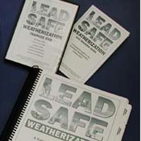
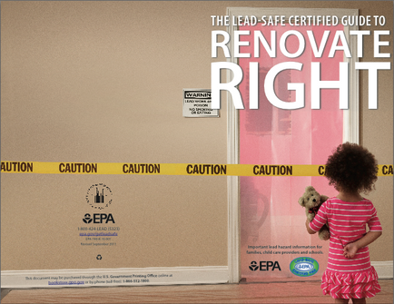
Lead Safe Work – Where to Learn More
LSW and RRP
  Lead-Safe weatherization (LSW) is specific to the Weatherization Assistance Program.
    www.waptac.org
  EPA renovation, repair and painting (RRP) rules apply to all jobs that disturb lead paint.
    www.epa.gov
Top image courtesy of Montana WTC. Bottom image courtesy of US EPA
29
GJA 2024 Version III
GJA 2025 Version III
Notes:
The rules surrounding working with lead paint can seem confusing, but it’s really pretty simple. LSW is required on all weatherization jobs on homes built prior to 1978. EPA RRP is not specific to weatherization and applies to all jobs that disturb a given amount of lead paint.
29
July 2012

Slide 30
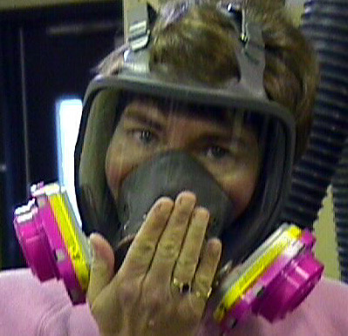
PPE
  Ensure you have the proper gear: safety glasses, hearing protection, protective clothing, and respirators.
  Ensure you have the proper fit: fit test for respirators.
  If in doubt, read the MSDS.
Photo courtesy of Environmental Health & Safety, Univ. of VA
Respirators should meet or exceed MSDS requirements and be assessed based on OSHA’s fit test guidelines.
30
GJA 2024 Version III
GJA 2025 Version III
Notes:
Ensure you have the proper gear: safety glasses, hearing protection, protective clothing, and respirators.
Ensure you have the proper fit: use a fit test for respirators.
If in doubt about what gear you need, refer to the MSDS. There is a section in every MSDS stating what the allowable exposure levels are and the ventilation and/or respirator types required for safe work.
30
July 2012

Slide 31
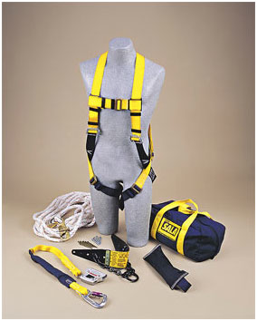
Fall Protection
Required by OSHA where workers could fall at least 6’ (or 10’ if working on scaffolding).
Options include:
  Personal Fall Arrest System (PFAS)
  Safety netting
  Guardrails/covers
Image courtesy of Kentuckiana Industrial Safety Training
A PFAS is often the most practical fall protection for weatherization work.
31
GJA 2024 Version III
GJA 2025 Version III
‹#› | WEATHERIZATION ASSISTANCE PROGRAM STANDARDIZED CURRICULUM – July 2012
eere.energy.gov
Notes:
Fall protection is required by OSHA where workers could fall at least 6’ (or 10’ if working on scaffolding). Remember, it isn’t just when working on ladders that you could fall 6 or more feet but also around open doors where there used to be a porch but isn’t anymore, or even on flat roofs where skylights or other potential openings are found.
Options for fall protection include:
Personal fall arrest system (PFAS) consisting of anchorage, lifeline (lanyard), and body harness – This is generally the most practical in weatherization work.
Safety netting – This is used largely on big building construction.
Guardrails/covers – This is used around openings like skylights or wall openings/ledges. Rails must be able to withstand a force of 200 lbs.
31
July 2012

Slide 32
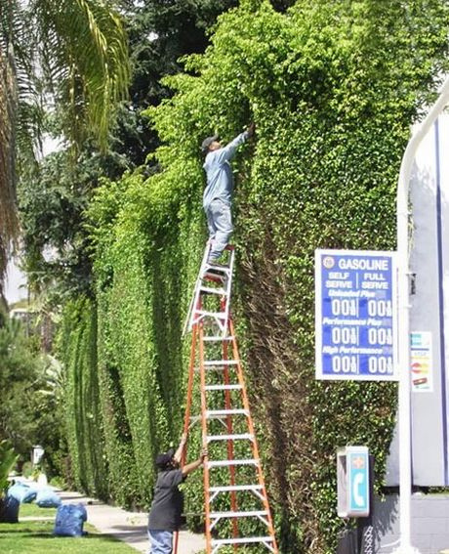
Ladders
  Use Ladders Safely
  Keep free of obstructions and slip hazards.
  Position the bottom ¼ of the working height away from surface.
  When accessing an upper level, ladder must extend 3’ above.
Photo courtesy of blog.safesourcing.com
32
GJA 2024 Version III
GJA 2025 Version III
Notes:
Use ladders as they were designed. Do not exceed weight limitations, and do not tie ladders together to achieve greater height unless they are specifically designed for such use.
Keep bottom of ladder free of obstructions and slip hazards. Do not place the ladder bottom on a slippery surface unless it has special slip-resistant feet.
Position bottom ¼ of the working height away from surface. When using non-self-supporting ladders, where it must be leaned up against the working surface, the safe working angle follows this guideline. For example, if a ladder is leaned up against a house so the upper part of the ladder meets the house 16’ in the air, the bottom of the ladder should be set at a 4’ horizontal distance away from that surface.
If accessing an upper level, the ladder must extend 3’ above that level. For example, if using a ladder to access a roof, the ladder must extend 3’ above the roof access point.
32
July 2012

Slide 33
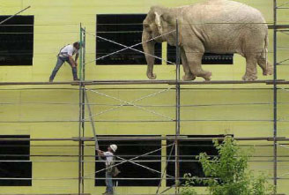
Scaffolding
  Some types: suspended, supported, and aerial lifts.
  If more than 10’ high, add guardrails and/or PFAS.
  Platforms must support weight+ and be at least 18” wide (12” for pump jacks).
  Do not move scaffolding while occupied.
Photo courtesy of elcosh.org
Scaffolding platforms must be capable of supporting their own weight plus 4x the maximum load. You never know what might happen.
33
GJA 2024 Version III
GJA 2025 Version III
Notes:
Types of scaffolding include suspended (typically used by window washers), and supported, the rigid kind most common in residential construction; and aerial lifts like cherry pickers.
If more than 10’ high, add guardrails and/or PFAS.
Platforms must support their weight plus four times the maximum load, and be at least 18” wide (12” for pump jacks). There may be no more than 1” wide gaps in the decking, and they must overlap 12” over supports unless they’re restrained to prevent movement.
Do not move scaffolding while occupied. OSHA allows moving occupied scaffolding under certain conditions, but it’s safer to avoid it wherever possible.
33
July 2012

Slide 34
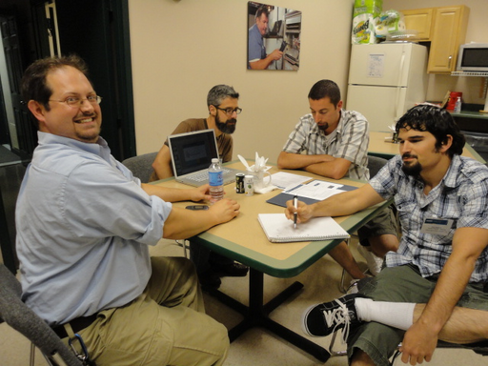
At the end of the day…
  Clean up job site.
  Remove protective barriers.
  Replace items moved during work day.
  Inventory tools and materials.
  Debrief with crew.
Photo Courtesy of The US Department of Energy
Debrief at the end of the work day to figure out what worked, what didn’t, and how to make things run smoother on the next job.
34
GJA 2024 Version III
GJA 2025 Version III
Notes:
Assuming the home wasn’t deferred and work continued on the home, the final part of the work day will be cleaning up and closing out. Wrapping up at the end of the work day goes smoothly on an organized job site with an organized truck/trailer.
Clean up the job site. Rake up spilled insulation from the lawn, gather empty caulk tubes and other materials, and generally make the area look at least as good as it did when you arrived.
Remove protective barriers. Follow precautions when working lead safe to prevent spilling the lead paint dust. Wrap disposable barriers dirty side in and bundle them into garbage bags while still in the work area. Don’t carry them through the house where they might spread dust and debris.
Replace items moved during work day. If furniture or other objects were moved to facilitate work, put them back when the job is over.
Inventory tools and materials. This should go quickly if everyone returned tools to a central area throughout the day as they were finished using them. Match the tools to the truck or trailer inventory sheet to make sure you haven’t left anything behind. Also take inventory of your materials. Did you use more insulation than planned? Determine what you might need to restock when you get back to the shop, or in preparation for the next days’ work. This should include fasteners, tool bits and blades, tools themselves if some were found to be unsafe, and any other materials you used at the job.
Debrief with crew. This can happen on the ride back or at the shop and is a useful tool for improving the effectiveness and efficiency of the crew over time. Discuss any client complaints that came up and how they were resolved. Share any compliments received from the homeowner related to the work done. Report what went smoothly and what was difficult, and get ideas of how to improve the work flow and safety on future jobs.
34
July 2012

Slide 35
Summary
  Pre-existing conditions like moisture issues, electrical hazards, and unvented exhaust fans that are not noted in the work order should be reported to the crew leader.
  If a dwelling has been weatherized already, is vacant, is condemned or scheduled for demolition, is structurally unsound, or if the client declines weatherization, it must be deferred.
  A well-organized job site keeps tools and materials at easy access and protected from the elements and includes designated facilities for washing up and breaks.
  Routine maintenance on your tools increases their working life and ensures on-going safety.
35
GJA 2024 Version III
GJA 2025 Version III
Notes:
Pre-existing conditions like moisture issues, electrical hazards, and unvented exhaust fans that are not noted in the work order should be reported to the crew leader.
If a dwelling has been weatherized already, is vacant, is condemned or scheduled for demolition, is structurally unsound, or if the client declines weatherization, it must be deferred.
A well-organized job site keeps tools and materials at easy access and protected from the elements, and includes designated facilities for washing up and breaks.
Routine maintenance on your tools increases their working life and ensures on-going safety.
Present this slide as an interactive discussion, soliciting personal examples from the trainees. Add your own personal examples and knowledge to supplement.
35
July 2012

Slide 36
  Use double-insulated tools, never carry them by the cord or use in wet conditions and follow lock out/tag out protocols.
  Safety protocols protect the workers and residents. A safe work environment masks areas to contain dust and debris, is well-lit and well-ventilated, and includes all necessary PPE for the work being performed.
  Protect the interior and exterior environment with masking to prevent contamination and ease clean-up at the end of the day.
  Clean up the job site, remove protective barriers, replace any household furnishings that were moved, inventory tools and materials, and debrief with the crew at the end of the work day.
36
GJA 2024 Version III
GJA 2025 Version III
Notes:
Use double-insulated tools, never carry them by the cord or use in wet conditions, and follow lock out/tag out protocols.
Safety protocols protect the workers and residents. A safe work environment masks areas to contain dust and debris, is well-lit and well-ventilated, and includes all necessary PPE for the work being performed.
Protect the interior and exterior environment with masking to prevent contamination and ease clean-up at the end of the day.
Clean up the job site, remove protective barriers, replace any household furnishings that were moved, inventory tools and materials, and debrief with the crew at the end of the work day.
Present this slide as an interactive discussion, soliciting personal examples from the trainees. Add your own personal examples and knowledge to supplement.
36
July 2012

