Slide 1




Zone Pressure Diagnostics
(ZPD)
WEATHERIZATION ENERGY AUDITOR SINGLE FAMILY
1
GJA 2024 Version III

Slide 2
Learning Objectives
Learn how to
Use a blower door and a pressure meter to:
  Identify and prioritize where to Airseal.
  Verify when Airsealing work is completed.
  Estimate the leakiness of surfaces that have attached exterior spaces, like an attic, basement, or garage.
Identify the value and limitations of Zone Pressure Diagnostics (ZPD).
2
GJA 2024 Version III
Notes:
By attending this session, participants will:
Gain an understanding of the powers and limitations of zone pressure diagnostics (ZPD).
Learn when it is best to use zone pressure diagnostics.
Practice using ZPD charts.

Slide 3
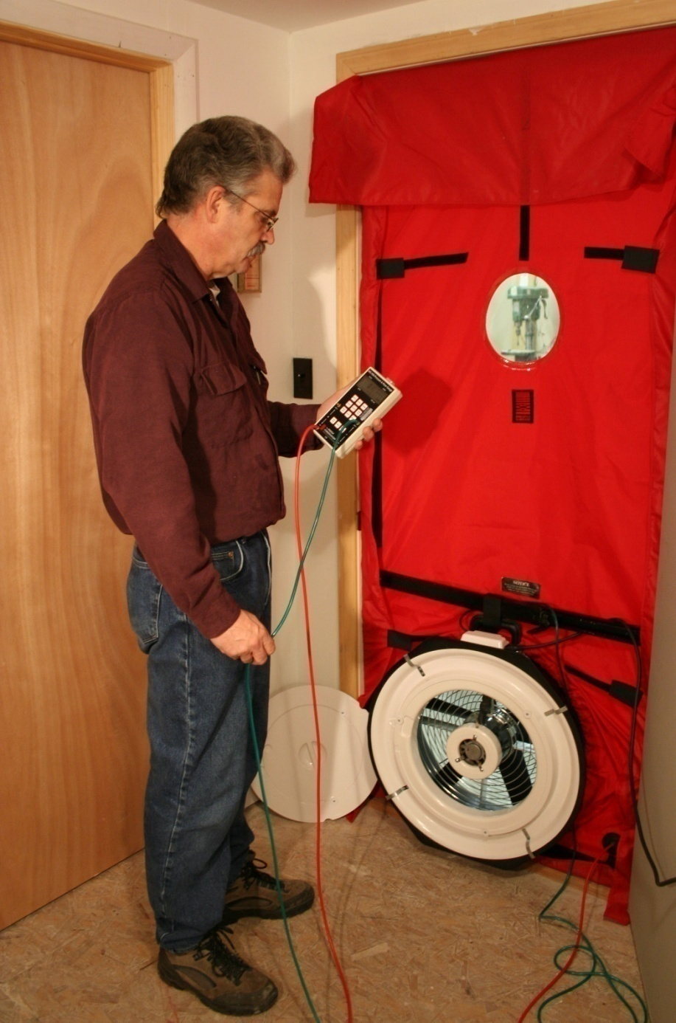
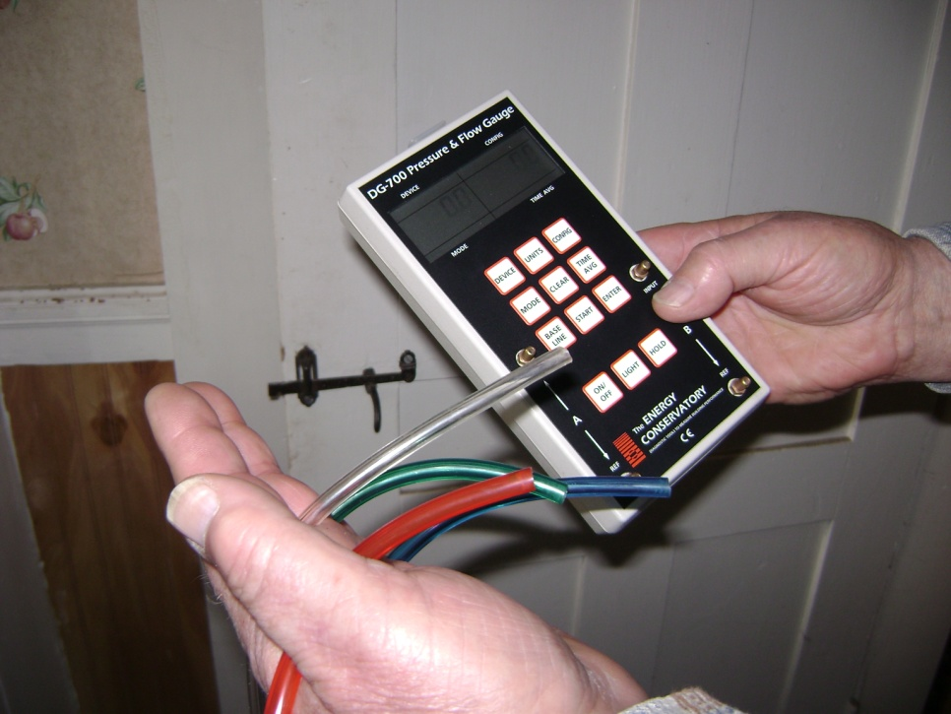
Necessary Equipment
Blower Door
at -50 pascals (pa)
Manometer and hoses
Chart to estimate the size of leaks
House-Zone | Zone-Outside
12 pa | 38 pa
25 | 25
37 | 13
41 | 9
45 | 5
48 | 2
49 | 1
3
Photos courtesy of the US Department of Energy
GJA 2024 Version III
Notes:
Blower door.
Manometer.
Various colored 50-ft. hoses.
Hoses run to appropriate zones allow you to remain near your blower door. This can be particularly important if you do not have a cruise control for the machine.
Colored hoses reduce confusion:
Blue = attic.
Green = outdoors.
Red = furnace room.
Clear = other.
Zone Pressure Diagnostics (ZPD) charts and ratio of pressure to leakage chart.

Slide 4

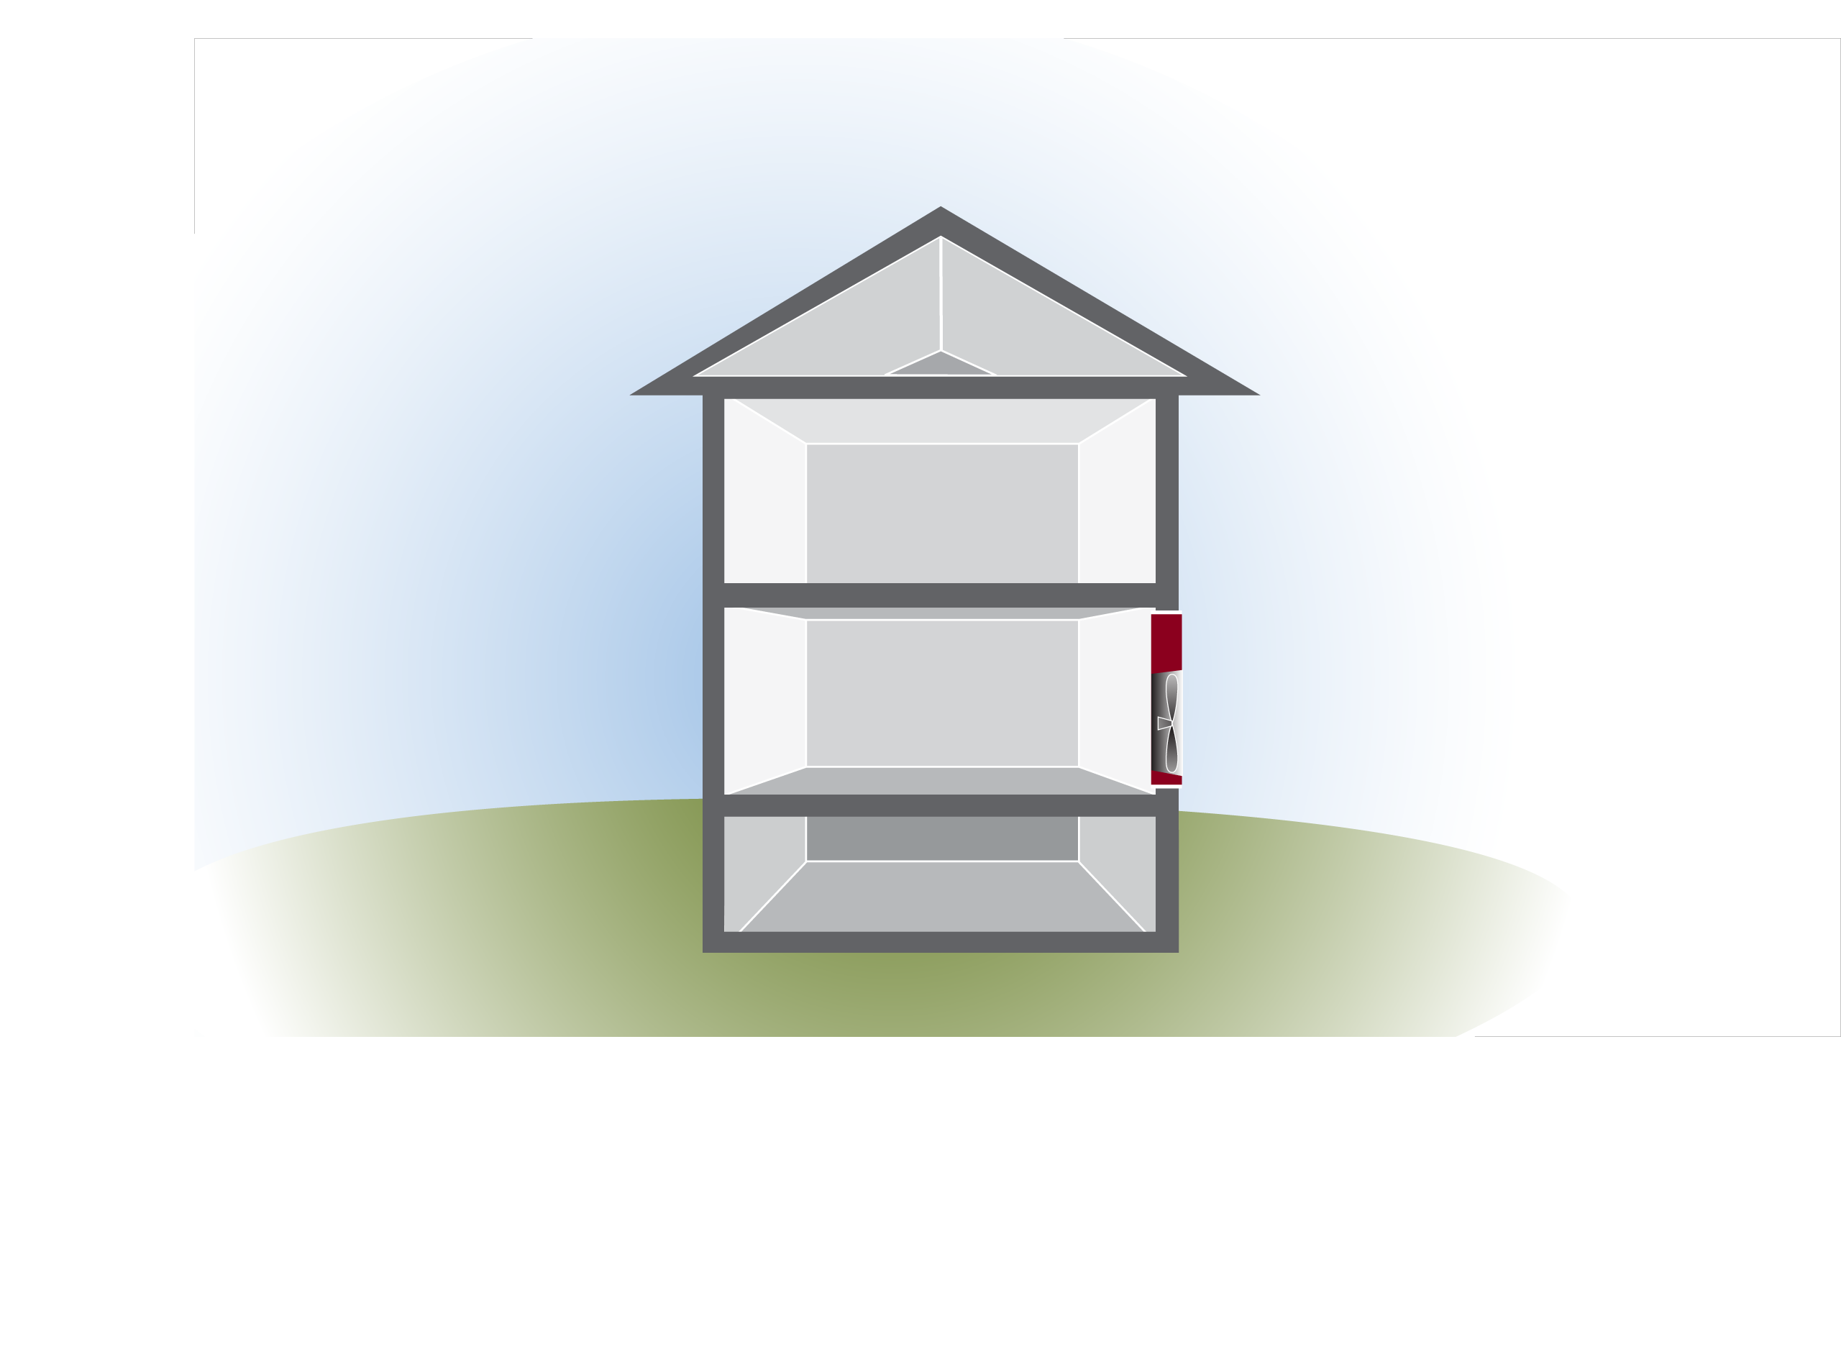
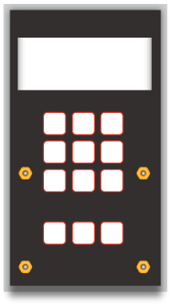
Zone Pressure Diagnostics (ZPD)
Outside
HOUSE: The Conditioned Space, or Thermal Envelope.
- Defined by Air Barrier
ZONE: Attached unconditioned space between the House and Outside.
- Acts as Pressure Buffer
Attic Zone
Air Barrier
House
-50
4
GJA 2024 Version III

Slide 5
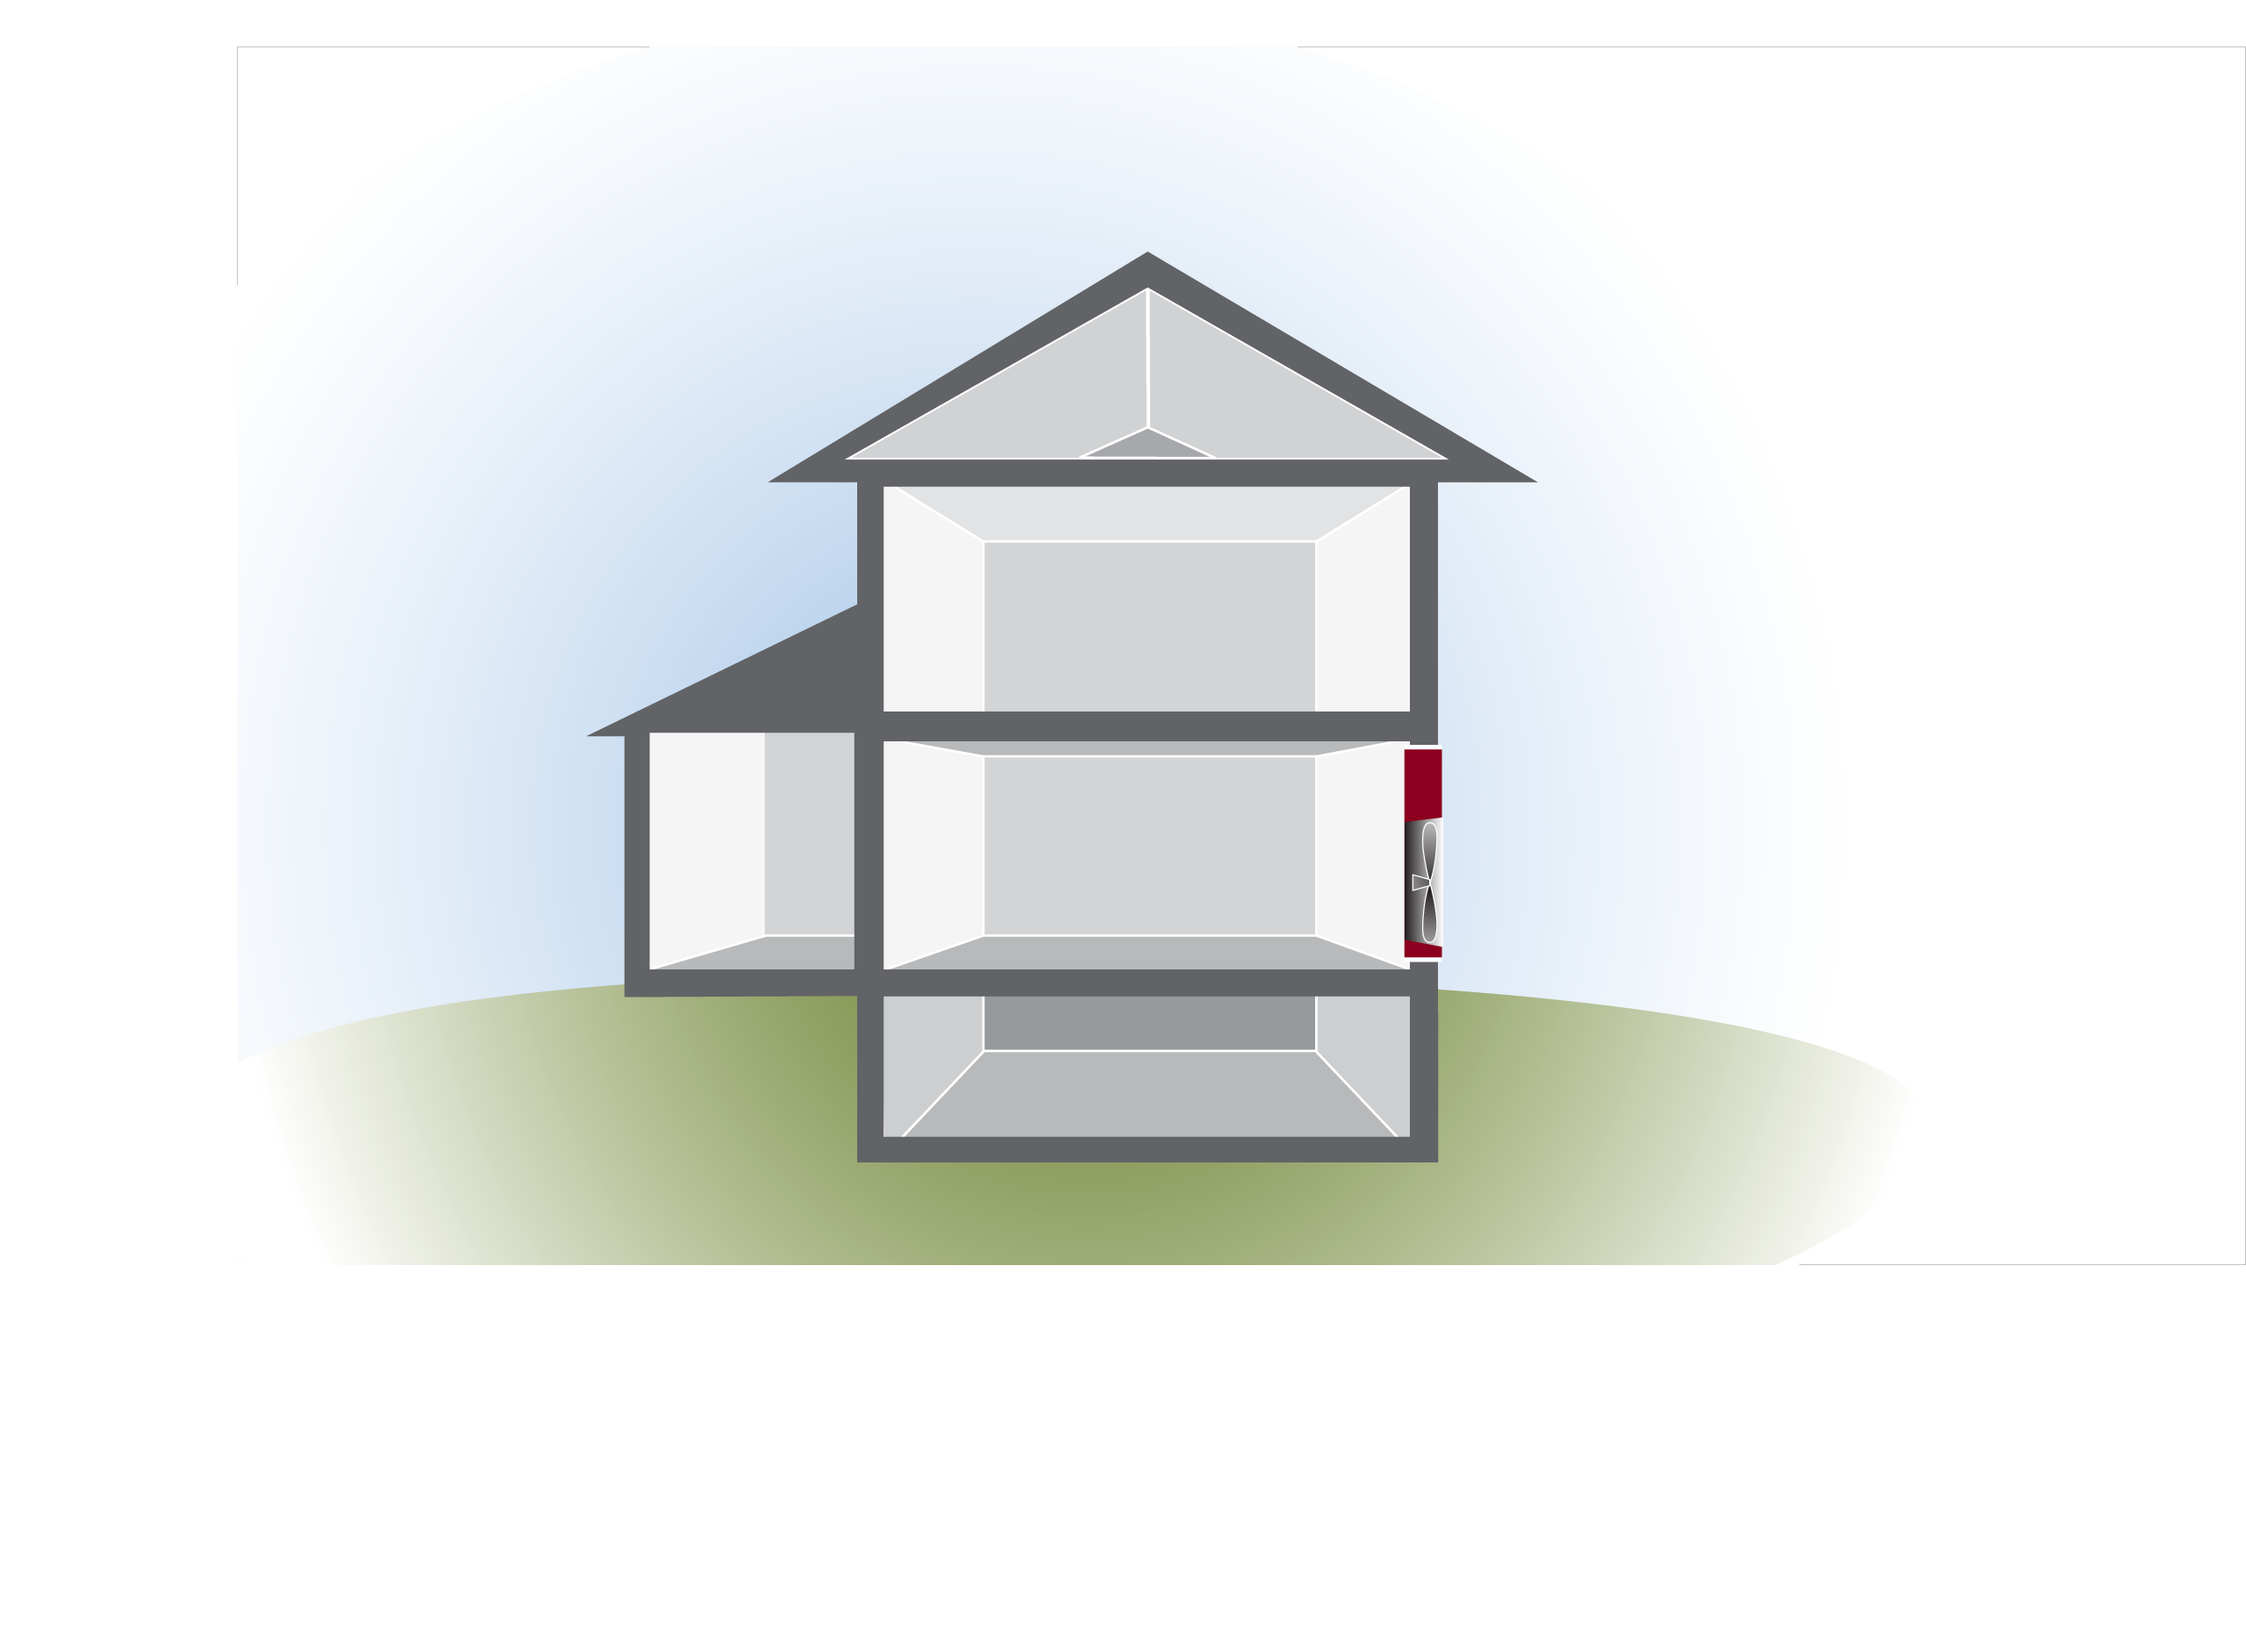
Identify some Zones
Outside
Attic Zone
Garage Attic
Zones have two Pressure Boundaries.
- House:Zone
- Zone:Outside
House
-50
Garage
Crawl Space
Basement
5
GJA 2024 Version III
Notes:
Zones form a second air barrier between the house and the outside.
They buffer the air pressure on the conditioned space.

Slide 6
ZPD PROCEDURE
Outside
25
Blower Door @50 pascals
Measure House:Zone
Pressures add up to 50.
  H:Z + Z:O = 50 pa
  25 + = 50
  See Chart to estimate Relative Leakiness for (H:Z) surface vs (Z:O).
Zone
25
House
25
-50
6
GJA 2024 Version III
Notes:
Always get blower door to 50 before ZPD measurements

Slide 7
Pressures determine the Relative Leakiness
Zone Pressures “Relative” Size of Leaks
House-Zone | Zone-Outside
12 | 38
25 | 25
37 | 13
41 | 9
45 | 5
48 | 2
49 | 1
House-Zone | Zone-Outside
2 | 1
1 | 1
1 | 2
1 | 3
1 | 4
1 | 8
1 | 13
RATIO
Attic :
floor
Roof
vents
Neither is a better air barrier. Same total area of leaks.
7
GJA 2024 Version III

Slide 8
ZPD Pressure and Leakage Area
Outside
5
Air flows through each surface, Attic and Roof, at the same rate (CFM)*.
Which surface has less total leakage area, Attic floor or Roof assembly?
Zone
45
House
-50
Attic Floor
See CHART
* Cubic feet of air per minute.
8
GJA 2024 Version III
Notes:
Air flow is the same at each surface.
It takes a lot more pressure to move equal CF through a small hole in the same amount of time as through a larger hole.

Slide 9
The Relative Size of Leaks
Zone Pressures Relative Size of Leaks
House-Zone | Zone-Outside
12 | 38
25 | 25
37 | 13
41 | 9
45 pa | 5 pa
48 | 2
49 | 1
House-Zone | Zone-Outside
2 | 1
1 | 1
1 | 2
1 | 3
1 | 4
1 | 8
1 | 13
Attic :
floor
Roof
vents
House:Zone is a better pressure boundary.
Attic floor is ¼ as leaky as the Roof.
9
GJA 2024 Version III

Slide 10
Airsealing Goals and ZPD
Outside
0
With Blower Door @50 pa
Air-tight Air Barrier: Keep out weather and contaminants.
House:Zone = 50 pa.
House:Interior cavities = 0 pa
No hidden leaks or Attic Bypasses (from attic to basement or crawl space).
Zone
50
Air Barrier
House
0
-50
10
GJA 2024 Version III

Slide 11
Interpreting House:Zone
Outside
House:Zone pressure
45-50 Outside (acceptable?)
30-45 Somewhat outside
20-30 Even
5-20 Somewhat inside
0-5 Inside (no air barrier)
Not useful when Zone:Outside surface is very leaky or tight! (more on that later)
See Chart for H:Z = 41 pa
Zone
41
Air Barrier
House
-50
11
GJA 2024 Version III
Notes:
When exterior surface is very leaky, pa will be misleadingly high.
Note a wall is at 50 and can be very leaky.
When exterior surface is very tight, the low pa is in relationship to very small total leakage area.
If it’s a garage, make a small opening of about 1 square foot and check the chart.

Slide 12
Ratio of Pressure to Leakage
Zone Pressures “Relative” Size of Leaks
House-Zone | Zone-Outside
12 | 38
25 | 25
37 | 13
41 | 9
45 | 5
48 | 2
49 | 1
House-Zone | Zone-Outside
2 | 1
1 | 1
1 | 2
1 | 3
1 | 4
1 | 8
1 | 13
Attic :
floor
Roof
vents
Where do you measure?
12
GJA 2024 Version III

Slide 13
Calculating Leakage Area at House:Zone
Outside
From previous Chart: the Attic floor is 1/3 as leaky as the Roof.
Measure Leaks to Outside!!
4x(1.0 sf) Roof vents = 4 sf
+10x(0.2 sf) Soffit vents = 2 sf
Total Roof leakage = 6 sf
6 x 1/3 = 2 sf of attic floor leakage to Airseal.
9
Attic
41
House
-50
13
GJA 2024 Version III
Notes:
The roof is 3 times as leaky, so divide the roof sf by 3 to get the attic leakage area.

Slide 14
Which surface is the Primary Pressure Boundary?
Outside
With Blower Door @50 pa
Primary Pressure Boundary
PPB 25 pa
or More Connected
MC 25 pa
H:Z + Z:O = 50 pa
PPB or MC?
1 : ? Ratio leaks
Attic
>
Garage Attic
48 pa
House
<
15 pa
Garage
-50
50 pa
Basement/Crawl
10 pa
14
GJA 2024 Version III
Notes:
It takes more pressure to move a cubic foot of air through a smaller hole in the same amount of time.

Slide 15
Goal for a GARAGE?
With Blower Door at 50 pa
Measure leaks to Outside!!
H:Z + Z:O = 50 pa
49 1 = 50
PPB MC PPB or MC?
1 13 Ratio Leaks
The GOAL: 50 pascals
Why? Contaminants!
Calculate with ratio to estimate leakage area at House:Garage.
House
Garage
-50
1 pa
H:Z=49 pa
15
GJA 2024 Version III
Notes:
PPB vs MC It takes more pressure to move a cubic foot of air through a smaller hole in the same amount of time.

Slide 16
Ratio of Pressure to Leakage
Zone Pressures “Relative” Size of Leaks
House-Zone | Zone-Outside
12 | 38
25 | 25
37 | 13
41 | 9
45 | 5
48 | 2
49 | 1
House-Zone | Zone-Outside
2 | 1
1 | 1
1 | 2
1 | 3
1 | 4
1 | 8
1 | 13
TO
House:Zone is a better pressure boundary. The Garage exterior is 13 times leakier.
16
GJA 2024 Version III
Notes:
Find the zone to house pressure in the far left column. Let’s use 37 for this example.
Read to the right to find the size relationship between the holes in the house to the zone air barrier and the holes in the zone to the exterior barrier.
Click to highlight with arrows. A Zone-to-house pressure difference of 35 Pa indicates the ratio of hole size zone-to-house is half that of the hole size zone-to-outside. So the zone is leakier (twice as connected) to the outdoors than to the house.
Q: If the pressure across the ceiling were 45 Pa, what would the relationship be?
Click to show the answer.
A: The total hole area in the ceiling would be a quarter of the total hole area in the roof.
The chart tells us nothing about the actual size of the holes, only the hole-size relationship.
If you know this relationship, a visual inspection of one surface will reveal the amount of hole in the other. (It’s rather subjective.) In this instance, seeing 2 sq. ft. of net free attic venting would indicate a ½ sq. ft. of total hole in the home’s ceiling.

Slide 17

Kneewall Attic @37 pa
Blower Door at 50 Pa,
House:Kneewall Attic pa
Zone:Outside ___ pa
Which is the Air Barrier, Kneewall, or Roof?
See Chart
37
37
KW
13
?
House
-50
17
GJA 2024 Version III
Notes:
Because the pressure between the house and attic is not 50 pascals (Pa), we know the ceiling and the roof both have holes through them.
If the roof were airtight, the pressure across the ceiling would be zero.
If the ceiling were airtight, the pressure would be 50 Pa
If the pressure across the surfaces were equal (25 Pa + 25 Pa), the holes would be equal sizes.
Each surface is resisting its share of the air pressure.
The CFM50 is moves through the roof and the ceiling at the same rate!
A higher pressure means less overall leakiness in that surface, either the ceiling or the roof.
Q: Is there a quantifiable relationship?
A: Yes, the pressure drop across each surface is directly proportional to the relative size of the holes in the surfaces.

Slide 18
Ratio of Pressure to Leakage
Zone Pressures “Relative” Size of Leaks
House-Zone | Zone-Outside
12 | 38
25 | 25
37 | 13
41 | 9
45 | 5
48 | 2
49 | 1
House-Zone | Zone-Outside
2 | 1
1 | 1
1 | 2
1 | 3
1 | 4
1 | 8
1 | 13
TO
Attic Kneewall is a better pressure boundary.
The Roof has twice the total leakage area.
18
GJA 2024 Version III
Notes:
Find the zone to house pressure in the far left column. Let’s use 37 for this example.
Read to the right to find the size relationship between the holes in the house to the zone air barrier and the holes in the zone to the exterior barrier.
Click to highlight with arrows. A Zone-to-house pressure difference of 35 Pa indicates the ratio of hole size zone-to-house is half that of the hole size zone-to-outside. So the zone is leakier (twice as connected) to the outdoors than to the house.
Q: If the pressure across the ceiling were 45 Pa, what would the relationship be?
Click to show the answer.
A: The total hole area in the ceiling would be a quarter of the total hole area in the roof.
The chart tells us nothing about the actual size of the holes, only the hole-size relationship.
If you know this relationship, a visual inspection of one surface will reveal the amount of hole in the other. (It’s rather subjective.) In this instance, seeing 2 sq. ft. of net free attic venting would indicate a ½ sq. ft. of total hole in the home’s ceiling.

Slide 19
Crawl Space: Outside @38 pa
With Blower Door at 50 Pa
Measure Crawl:Outside pressure ___ pa
Pressures between the house:crawl + crawl:outside add up to 50.
H:Z + Z:O = 50 pa
___ + ___ = 50 pa
Where’s the Air Barrier?
38
House
-50
38
12
38
Crawlspace Zone
19
GJA 2024 Version III
Notes:
Because the pressure between the house and attic is not 50 pascals (Pa), we know the ceiling and the roof both have holes through them.
If the roof were airtight, the pressure across the ceiling would be zero.
If the ceiling were airtight, the pressure would be 50 Pa
If the pressure across the surfaces were equal (25 Pa + 25 Pa), the holes would be equal sizes.
Each surface is resisting its share of the air pressure.
The CFM50 is moves through the roof and the ceiling at the same rate!
A higher pressure means less overall leakiness in that surface, either the ceiling or the roof.
Q: Is there a quantifiable relationship?
A: Yes, the pressure drop across each surface is directly proportional to the relative size of the holes in the surfaces.

Slide 20
Ratio of Pressure to Leakage
Zone Pressures “Relative” Size of Leaks
House-Zone | Zone-Outside
12 | 38
25 | 25
37 | 13
41 | 9
45 | 5
48 | 2
49 | 1
House-Zone | Zone-Outside
2 | 1
1 | 1
1 | 2
1 | 3
1 | 4
1 | 8
1 | 13
TO
Foundation is a primary pressure boundary.
The framed floor has twice the total leakage area.
20
GJA 2024 Version III
Notes:
Find the zone to house pressure in the far left column. Let’s use 37 for this example.
Read to the right to find the size relationship between the holes in the house to the zone air barrier and the holes in the zone to the exterior barrier.
Click to highlight with arrows. A Zone-to-house pressure difference of 35 Pa indicates the ratio of hole size zone-to-house is half that of the hole size zone-to-outside. So the zone is leakier (twice as connected) to the outdoors than to the house.
Q: If the pressure across the ceiling were 45 Pa, what would the relationship be?
Click to show the answer.
A: The total hole area in the ceiling would be a quarter of the total hole area in the roof.
The chart tells us nothing about the actual size of the holes, only the hole-size relationship.
If you know this relationship, a visual inspection of one surface will reveal the amount of hole in the other. (It’s rather subjective.) In this instance, seeing 2 sq. ft. of net free attic venting would indicate a ½ sq. ft. of total hole in the home’s ceiling.

Slide 21
House: Crawl via outside?
With Blower Door at 50 Pa
Can you do this?
What’s it measuring?
H:Z + Z:O = 50 pa
___ + ___ = 50 pa
    Where to put hose into the crawl space?
House
30
20
30
Crawlspace Zone
21
GJA 2024 Version III
Notes:
Because the pressure between the house and attic is not 50 pascals (Pa), we know the ceiling and the roof both have holes through them.
If the roof were airtight, the pressure across the ceiling would be zero.
If the ceiling were airtight, the pressure would be 50 Pa
If the pressure across the surfaces were equal (25 Pa + 25 Pa), the holes would be equal sizes.
Each surface is resisting its share of the air pressure.
The CFM50 is moves through the roof and the ceiling at the same rate!
A higher pressure means less overall leakiness in that surface, either the ceiling or the roof.
Q: Is there a quantifiable relationship?
A: Yes, the pressure drop across each surface is directly proportional to the relative size of the holes in the surfaces.

Slide 22
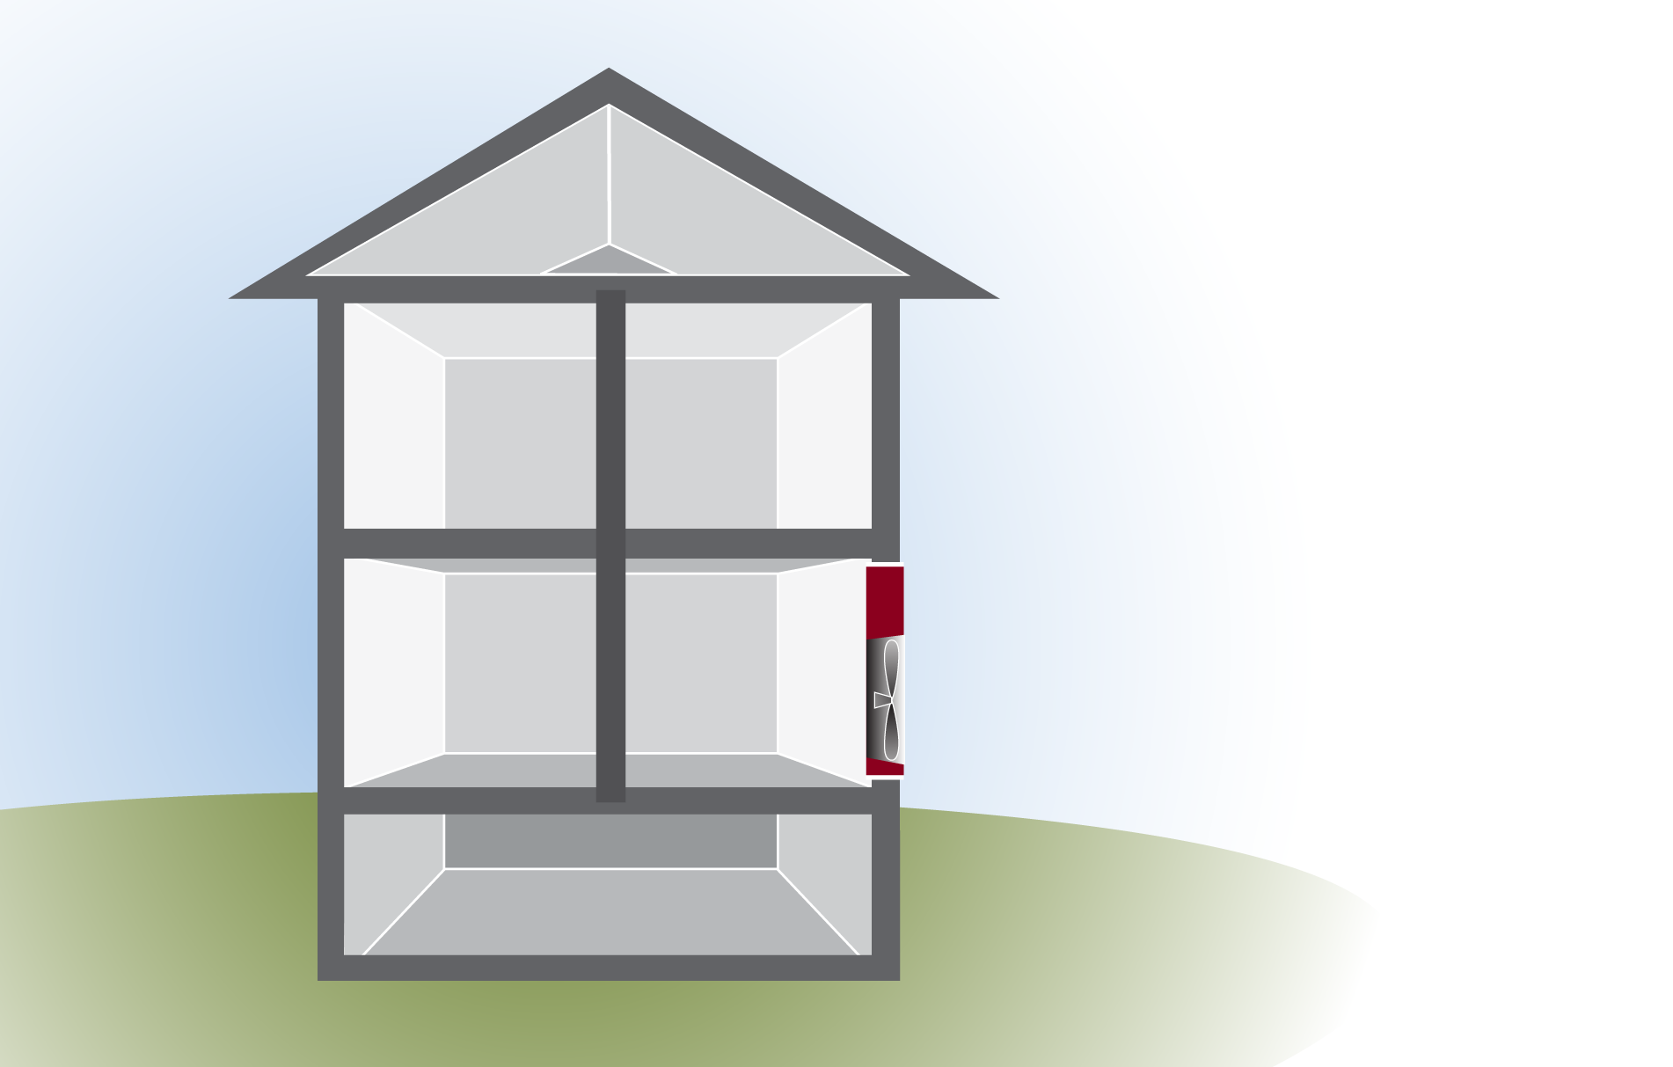
Testing Interior Cavities
Attic
0
What’s the Goal?
What does it mean when an interior cavity is 23 pa?
Where could leaks be located?
What can you do?
23
House
-50
Basement
22
GJA 2024 Version III
Notes:
Taking a few simple pressure measurements can reveal a great deal of information.
A reading of 25 Pa between the basement (zone) and the house indicates the hole area in the floor matches the hole area in the basement walls.
The relationship is 1:1; the total area of hole in the surfaces is the same. Each surface is resisting one-half of the pressure.
A reading of 41 Pa into the floor/ceiling cavity means either the cavity is more connected to the exterior than either the attic or the basement, or (more likely) the attic/basement connection is through interior walls. The walls further restrict the air movement, thereby increasing the pressure.

Slide 23
Attic Bypass Leaks
Attic Bypass: air pathways between the attic and any other Zone or interior cavity that’s connected to outside.
Look for chases: open wall cavities, chimney, plumbing, electrical, ducts, gas lines, floor cavities, etc.
23
GJA 2024 Version III

Slide 24
Attic Bypass Procedure
Attic
37
With Blower Door at 50 pa
House:Attic = pa
Open the Basement door.
House
37
25
-50
Basement
24
GJA 2024 Version III
Notes:
Taking a few simple pressure measurements can reveal a great deal of information.
A reading of 25 Pa between the basement (zone) and the house indicates the hole area in the floor matches the hole area in the basement walls.
The relationship is 1:1; the total area of hole in the surfaces is the same. Each surface is resisting one-half of the pressure.
A reading of 41 Pa into the floor/ceiling cavity means either the cavity is more connected to the exterior than either the attic or the basement, or (more likely) the attic/basement connection is through interior walls. The walls further restrict the air movement, thereby increasing the pressure.

Slide 25
Attic Bypass Procedure
House:Attic was 37 pa.
We opened Basement door.
Bring Blower Door to 50 pa.
  House:Bsmt goes to 0 pa
  Bsmt:Outside goes to 50 pa
House:Attic is dropped to 25 pa. Why?
What’s the GOAL?
Attic
25
House
0
-50
50
Basement
25
GJA 2024 Version III
Notes:
The basement reading goes to zero because we brought the basement inside the air barrier. The air barrier is now the basement walls rather than the house floor.
Q: What does the change in attic pressure when we open the basement door tell us?
A: It tells us the attic is somehow connected to the basement. The attic pressure went down because opening the basement door gave the attic air an easier path to the house, thereby reducing the pressure across the ceiling.
Q: What are likely places for these connections between basement and attic?
A: There are many possibilities:
Chimney chase
Plumbing vent stack chase
Pipe and wire penetrations
Dumbwaiter shafts
Dropped soffits
Wet walls – walls containing plumbing (between the kitchen and bath in newer homes)
Built-ins
and many others
The house CFM₅₀ (cubic feet of air per minute at 50 Pa pressure difference) will change, too.
Q: Why?
A: Opening the basement door removes the house floor from the picture. The tested surface⎯the air barrier⎯is now the basement wall rather than the house floor.
Q: Will the CFM₅₀ go up or down?
A: Up. A partial air barrier⎯the floor⎯has been removed, making the house leakier. The house is now 2,200 CFM₅₀.

Slide 26
Summary: Limits of ZPD
Can’t do without a blower door. Asbestos, etc.
Pressures not reliable in windy conditions.
Pressures show relative leakiness, not the size of leaks.
For very leaky buildings, start air sealing.
For very tight buildings, increase leakage at the zone: outside surface.
If roof vents are needed, consider installing first. Then the exterior leakage will be the same during pre & post-air sealing tests.
26
GJA 2024 Version III
Notes:
ZPD does not work well in an excessively leaky building.
The tested building must be tight enough for the blower door to create a 50 Pa pressure difference across the envelope under all test configurations.
You must be able to reach an actual 50 Pa pressure difference; using imputed numbers from can’t reach fifty (CRF) tables will not work.
ZPD requires having the ability to change the pressure over the tested surface in order to determine hole size.
ZPD does not work well under windy conditions.
ZPD can be time consuming. Use it only when the results will provide useful information. For example, if during the audit you observe holes that you will order sealed anyway, using ZPD to size them before they are sealed has no real value. After the work is done, verifying that the sealing worked with ZPD is worthwhile.

Slide 27
Summary: Benefits of ZPD
Helps prioritize where to air-seal first.
Identifies zones that don’t need work.
Verifies when air-sealing is completed.
You can calculate the total leakage area of the House:Zone surface.
Health & Safety: can verify that the living space is separated from a garage.
Reminders:
  A DeltaP of 0 means completely connected.
  A DeltaP of 50 means completely separated.
  A DeltaP of 25 means same size holes, but you have to go outside to estimate how big.
27
GJA 2024 Version III

Slide 28
Practice Questions?
What is the recommended blower door pressure for ZPD?
At CFM50, what do House:Zone and Zone:Outside add up to?
How do you identify the primary pressure boundary?
What is the goal ZPD pressure between house and attic?
Where do you typically look to size total leakage area?
What is the goal ZPD pressure between house and interior floor?
What is the goal ZPD pressure between house and garage?
In a ZPD test for Attic bypass leaks, should the house:attic drop?
If in an initial ZPD test, the house:attic pressure is 45 pa, does it mean that the attic was airsealed?
Where can you measure leakage area when trying to size the leakage between the house and garage.
28
GJA 2024 Version III

Slide 29
ZPD Lab Exercises
Test House:
Conduct ZPD for House: Attic
  With blower door at 50 pa, measure House: Attic pascals.
  Check the chart for relative leak sizes.
  Measure Roof vents and calculate sq ft leaks in the attic floor.
  Visually inspect from below and above.
Repeat ZPD for House: Garage
  If very tight, retest after creating some leakage at the zone: outside.
ZPD at an interior wall cavity. Interpret results.
House of Pressure:
Demonstrate ZPD for an Attic Bypass.

Slide 30
Ratio of Pressure to Leakage
Zone Pressure diagnostics
Zone Pressures “Relative” Size of Leaks
House-Zone | Zone-Outside
12 | 38
25 | 25
37 | 13
41 | 9
45 | 5
48 | 2
49 | 1
House-Zone | Zone-Outside
2 | 1
1 | 1
1 | 2
1 | 3
1 | 4
1 | 8
1 | 13
30
GJA 2024 Version III

Slide 31
Ratio of Pressure to Leakage
Zone Pressure diagnostics
Pressures “Relative” Size of Leaks
House-Zone | Zone-Outside
12 | 38
25 | 25
37 | 13
41 | 9
45 | 5
48 | 2
49 | 1
House-Zone | Zone-Outside
2 | 1
1 | 1
1/2 | 1
1/3 | 1
1/4 | 1
1/8 | 1
1/13 | 1
House-Zone | Zone-Outside
2 | 1
1 | 1
1 | 2
1 | 3
1 | 4
1 | 8
1 | 13
31
GJA 2024 Version III

