Slide 1
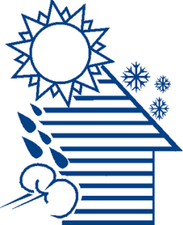



WEATHERIZATION ENERGY AUDITOR SINGLE FAMILY
House as a System
1
GJA 2024 Version III
Notes:
1.7.2013
1
August 2010
‹#›

Slide 2
Learning Objectives
By attending this session, participants will:
    Become aware of the potential for interaction among building components and mechanical systems.
    Understand how air sealing a home can negatively affect indoor air quality.
    Be able to recognize typical air leakage sites and know how to deal with them.
2
GJA 2024 Version III
‹#› | WEATHERIZATION ASSISTANCE PROGRAM STANDARDIZED CURRICULUM – August 2010
eere.energy.gov
Notes:
1.7.2013
2
August 2010
By attending this session, participants will:
Become aware of the potential for interaction among building components and mechanical systems.
Understand how air sealing a home can negatively affect indoor air quality.
Be able to recognize typical air leakage sites and know how they should be dealt with.
‹#›

Slide 3
House as a System
A house is a system of interdependent parts.
    The operation of one part affects many others.
    When they all work together, the house is comfortable, safe, efficient, and durable.
    A house will experience problems when its house parts don’t work together properly.
    Some obvious, some invisible.
    Some now, some years down the road.
3
GJA 2024 Version III
‹#› | WEATHERIZATION ASSISTANCE PROGRAM STANDARDIZED CURRICULUM – August 2010
eere.energy.gov
Notes:
1.7.2013
3
August 2010
A house is a system of interdependent parts: Mechanical and physical components.
The operation of one part affects many others.
When they all work together, the house is comfortable, safe, efficient, and durable.
Approaching the house as a system of interactive parts, the savings mount and we avoid creating health and safety issues.
Air sealing and insulating a home reduces the heating and cooling load. A replacement furnace in a sealed and insulated home can be smaller than the existing furnace. The initial price of the smaller unit is lower, and the long-term operating costs will be less.
A house will experience problems when its house parts don’t work together properly.
Some problems are obvious, some invisible.
Some problems appear now, some years down the road.
Building failures are symptoms of failures in the house as a system. As weatherization workers, we need to find the underlying problem, not just replace the rotted wood.
‹#›

Slide 4




House as a System
4
GJA 2024 Version III
‹#› | WEATHERIZATION ASSISTANCE PROGRAM STANDARDIZED CURRICULUM – August 2010
eere.energy.gov
Notes:
1.7.2013
4
August 2010
Click to highlight arrows pointing to various elements, as outlined in list below.
Buildings are systems. Everything in a building has the potential to interact with everything else:
Moisture through concrete, grading, landscaping, gutters, and downspouts.
Moisture from cooking, showering, and faucet aerators.
Air infiltration at windows and doors.
Air exfiltration at cathedral ceilings and recessed light fixtures, i.e., “can lights” or “pot lights.”
Garages and carbon monoxide.
Atmospheric combustion appliances.
Occupants and how they use the home.
The tighter the building, the stronger the interaction will be.
Codes that control trades practices were, for the most part, written when this potential was essentially insignificant. Consequently, individual tradesmen performing code-compliant work can create potentially harmful situations without realizing they have done so.
Example: Heating codes commonly ensure sufficient combustion air by requiring so many cubic feet of space per BTU/hr input of the appliance. These codes were established when basements were commonly rubble stone or granite slabs. Concrete is inherently tighter, but the codes haven’t changed to reflect that.
Energy auditors are the only people commonly trained in House as a System Science!
‹#›

Slide 5
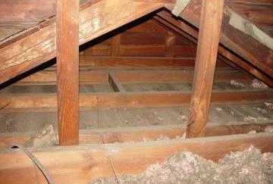
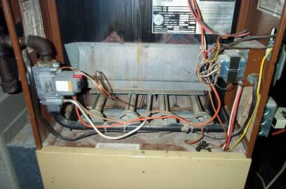
Examples - House as a System
An uninsulated attic ...
Makes the heating
and cooling system work harder than necessary.
5
GJA 2024 Version III
‹#› | WEATHERIZATION ASSISTANCE PROGRAM STANDARDIZED CURRICULUM – August 2010
eere.energy.gov
Notes:
1.7.2013
5
August 2010
An uninsulated attic or other failure in the thermal boundary or air barrier makes the heating and/or cooling system work harder.
‹#›

Slide 6
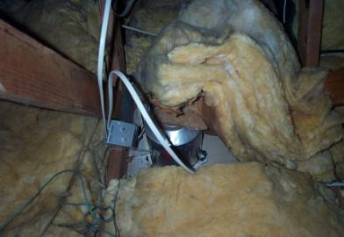
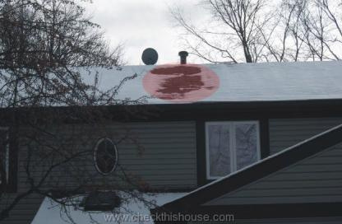
Examples – House as a System
Leaky recessed
lighting fixtures...
Increases heat loss/gain,
and can cause ice dams.
6
GJA 2024 Version III
‹#› | WEATHERIZATION ASSISTANCE PROGRAM STANDARDIZED CURRICULUM – August 2010
eere.energy.gov
Notes:
1.7.2013
6
August 2010
Leaky recessed light fixtures increase heat loss and gain, and can cause ice dams and moisture problems.
‹#›

Slide 7
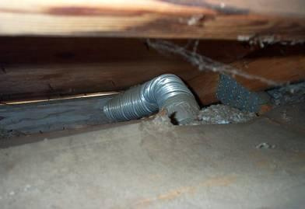
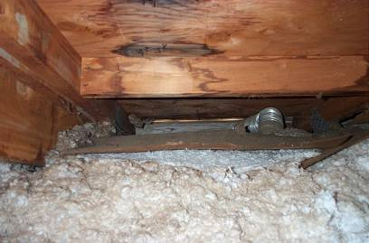
Examples – House as a System
This bathroom exhaust
fan does not exhaust to
outdoors – just to the soffit.
The moisture condenses on the roof deck and trusses causing damage.
7
GJA 2024 Version III
Notes:
1.7.2013
7
August 2010
Fans that exhaust into the attic or crawl space cause moisture to condense on the roof deck and trusses, weakening the structure. This problem could exist unnoticed for years, causing poor indoor air quality and expensive structural damage.
‹#›

Slide 8
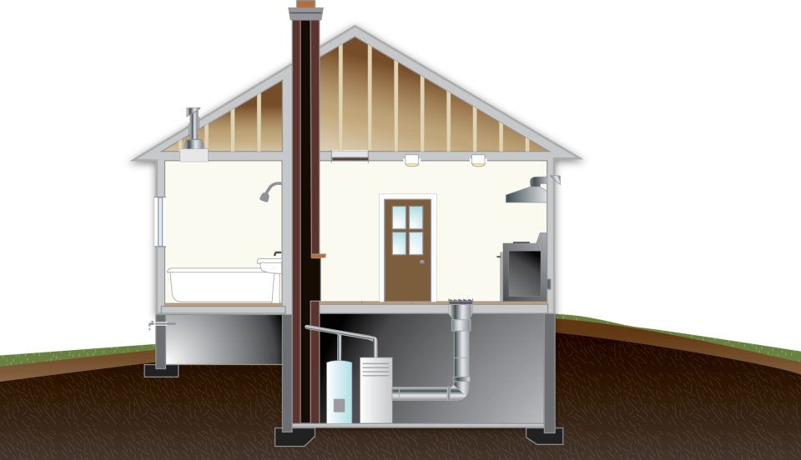

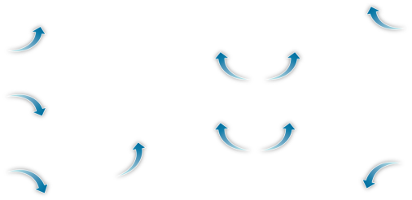
Ventilation & Air Change
Why seal
the leaks at all?
8
GJA 2024 Version III
Notes:
1.7.2013
August 2010
8
Click to reveal arrows indicating air leaking in, and again to reveal air leaking out.
Plugging the holes and then putting in fans is counterintuitive to most people.
The “old-timers” believed that “houses have to breathe,” so left them loose, but leaving houses leaky enough to provide good indoor air quality in spring and fall also leaves them drafty, which makes them expensive to heat in the winter and cool in the summer.
The first energy crisis inspired a wave of insulating without considering moisture build-up or IAQ. The results were odors, rot, and mold.
A house that is properly air sealed and mechanically vented has the correct amount of air exchange all the time. Heating properly air-sealed homes is also significantly cheaper than “letting the house breathe.”
The blue arrows represent infiltration, the red arrows, exfiltration. Because holes at the top and bottom are the ones most involved with the stack effect, sealing them is the first priority.
Intermediate-level holesthose around living space windows and doorsare more of a comfort issue than an energy conservation issue simply because the stack effect has little effect on them.
Wind-driven air leakage, which can occur at windows and doors, is mostly a function of building exposure. Unless the building is severely exposed to the wind, window and door leakage will have little effect on the air change rate. In homes with normal exposure, it is acceptable to only weatherstrip and air seal the windows and doors the homeowner complains about.
‹#›

Slide 9
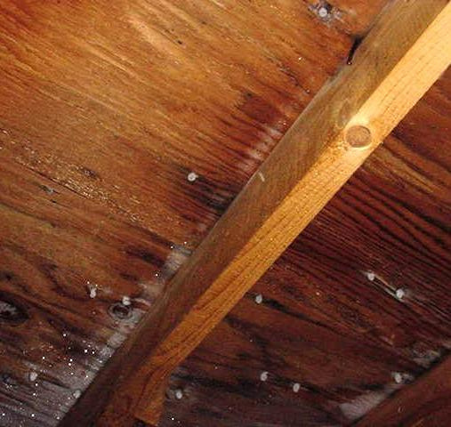
In the Attic…
House as a system
    2” x 6” rafters with plywood decking.
    White “dots”
    are frost on
    nail points.
Photo courtesy of The US Department of Energy
9
GJA 2024 Version III
Notes:
1.7.2013
9
August 2010
Small holes in the attic floorat pipes, wires, and the chimney chaseallow heated air from the living space to enter the attic.
The entering air will be relatively warm and wet compared to a cold attic in winter.
Moisture from the warm-wet air condenses on the first cold surface it contactstypically, the most northerly walls and the underside of the roof deck.
The water reacts to gravity, runs down to stain the ceiling, and looks like a roof leak.
‹#›

Slide 10
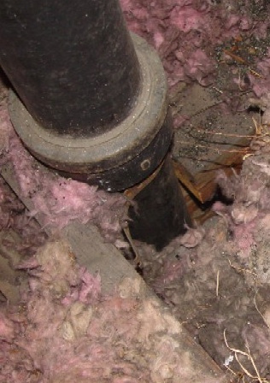
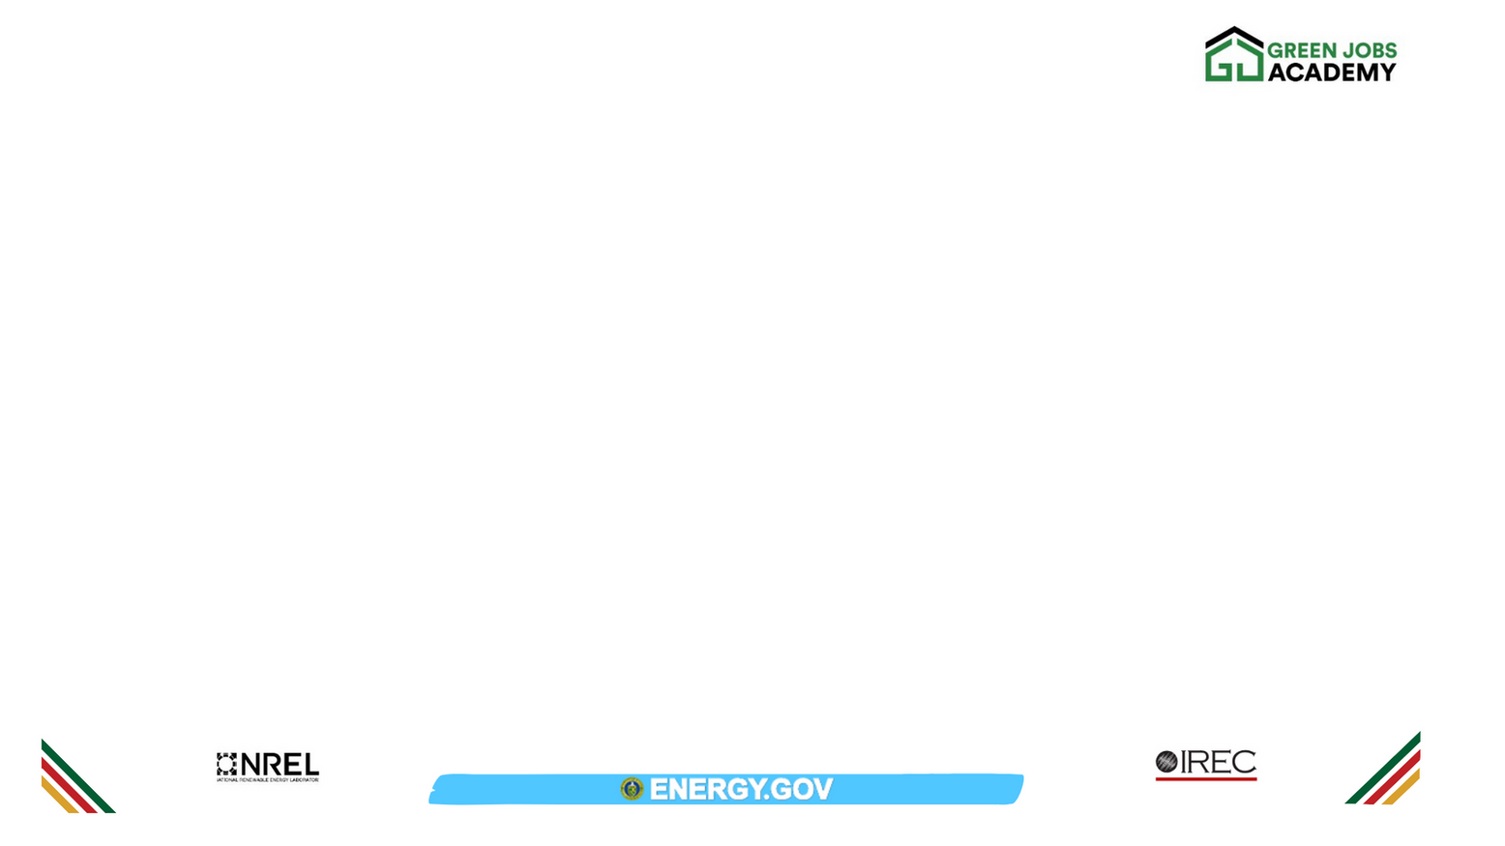

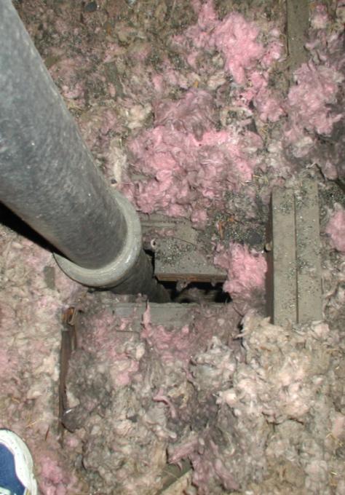
Plumbing pipe and dirty insulation are clues . . .
. . . that an attic bypass is allowing air flow through the insulation.
Photos courtesy of The US Department of Energy
‹#› | WEATHERIZATION ASSISTANCE PROGRAM STANDARDIZED CURRICULUM – August 2010
eere.energy.gov
Notes:
1.7.2013
August 2010
10
Pipe/Wire Bypasses
Dirty insulationparticularly fiberglasscan help you pinpoint air bypasses.
‹#›

Slide 11

Chimney Chases
Photo courtesy of The US Department of Energy
Notes:
1.7.2013
11
August 2010
Chimney chases are almost universally ignored during initial construction. There is little differentiation between new and old construction.
From an energy perspective, the area around the chimney is absolutely the worst place to have a vertical hole in a house.
It is the only hole that’s guaranteed to be a bypass between the basement and the attic. The chimney’s heat causes the air column around it to suck air from the basement and pressurize the attic.
Many a prematurely failed roof in heating climates is solely attributable to an unsealed chimney chase simply because the air pulled from the basement is often very humid. The resulting condensation on the underside of the roof deck can cause it to rot and load the underside of the shingles with moisture, causing them to expand and curl up at the ends. As the sun dries, the shingles contract back to their normal shape. The constant flexing causes premature shingle failure.
‹#›

Slide 12
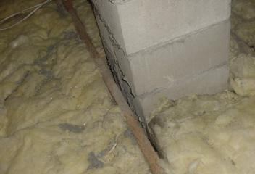
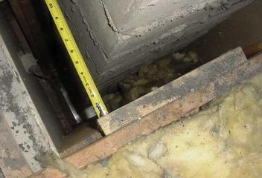
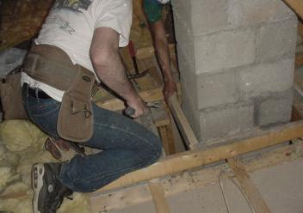
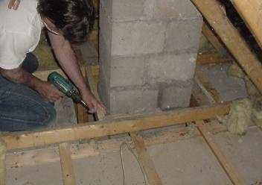
Treating the Chimney Chase
Photos courtesy of The US Department of Energy
12
GJA 2024 Version III
Notes:
1.7.2013
12
August 2010
Dirty fiberglass around the chimney points to an air leak from below.
Clearances are important. Fire code requires a 2” clearance from combustibles.
The air seal from the chimney to the ceiling below must be complete.
Note the “shine” below the tape to the left of the chimney in the upper right of the picture. That’s a light reflecting off the boiler smoke pipe in the basement.
‹#›

Slide 13
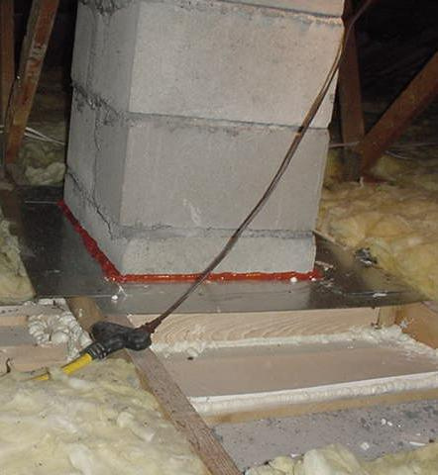
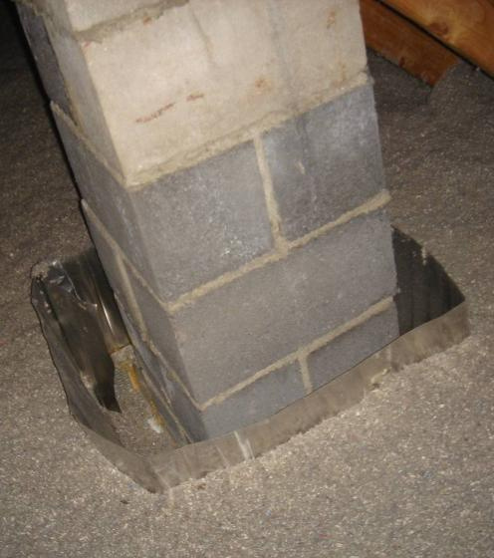
Sealed Chimney Bypass
Sealed chimney bypass…
with insulation barrier.
Photos courtesy of The US Department of Energy
13
GJA 2024 Version III
Notes:
1.7.2013
13
August 2010
The red line between the chimney and the metal air barrier is high-temperature caulk, which is required by code.
The underside of the metal is caulked to the ceiling framing.
Scrap pieces of drywall complete the air seal from new framing to the existing ceiling.
The last step is installing a metal dam to keep insulation at least 2” away from the chimney.
‹#›

Slide 14
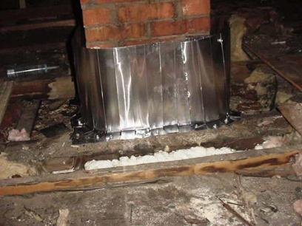
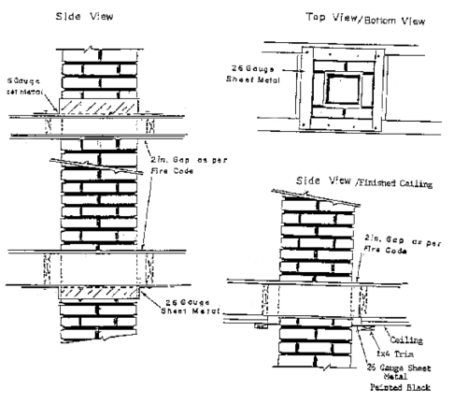
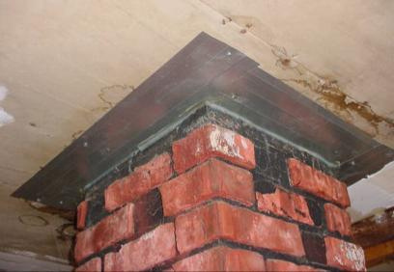
An Alternative Method
Detail for Sealing Thermal Bypass Around Chimney
14
GJA 2024 Version III
Notes:
1.7.2013
14
August 2010
Diagram from Maine’s DOE WAP Manual
With an exposed chimney, it is permissible to create the air seal in the living space at the ceiling if (1) it matches the general style and construction quality of the home, and 2) the homeowner agrees.
The insulation dam is still required in the attic.
‹#›

Slide 15
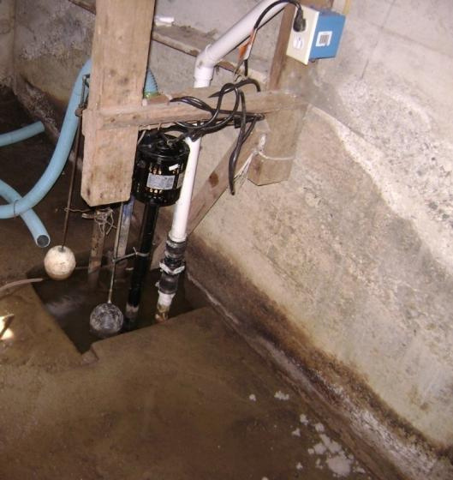
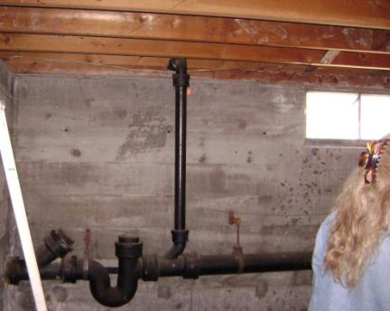
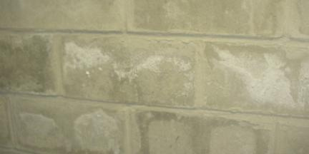
In the Basement
Photos courtesy of The US Department of Energy
Minor mold on floor stringers.
Spauling.
Mold on cement blocks.
High water mark.
Spauling on
cement blocks/
High standing water.
15
GJA 2024 Version III
Notes:
1.7.2013
15
August 2010
Notice the spauling (the white, chalk-like coating on the concrete caused by water picking up salts as it migrates through the concrete, then leaving them on the surface when it evaporates) as well as the high water mark and standing water. The sewer cleanout is plugged with a wood stopper. There is minor mold on the cement blocks and floor stringers
Q. Square foot for square foot, what evaporates more water vapor into the air: standing water or concrete without a vapor barrier?
A. Concrete, because it has more surface area.
Without a vapor retarder in, on, or below the concrete floor, ground moisture is constantly radiated into the basement.
Even with a vapor retarder, ground moisture will enter the basement through cracks and holes.
Soil gasses will enter with the moisture.
Mechanical appliances can produce airborne pollutants.
Many things stored in the basement can off-gas. Typically, we find detergents, paint, hobby chemicals, cleaning solvents, etc.
Dirt floors and crawl spaces are even more problematic.
Basements are typically well connected to the living space. Whatever is in the basement, occupants breathe in the living space.
Duct leaks can have many consequences:
The heat that leaks out of the ducts warms an area you don’t want heated.
Cold air is pulled into the heating system from the basement.
Heated air is forced out of the home.
Basement pollutants are delivered to the living space.
Remember: Whatever is in the basement, occupants breathe in the living space
‹#›

Slide 16
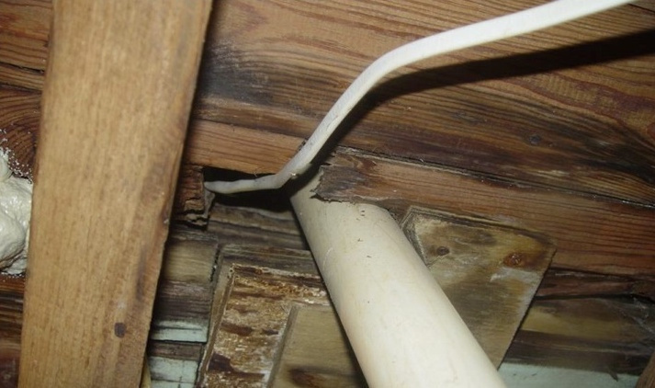
Plumbing and Wire Opening
Photos courtesy of The US Department of Energy
16
GJA 2024 Version III
Notes:
1.7.2013
16
August 2010
All types of holes give basement air free access into first-floor wall cavities. They will be connected in turn to upper floor cavities and the attic.
‹#›

Slide 17
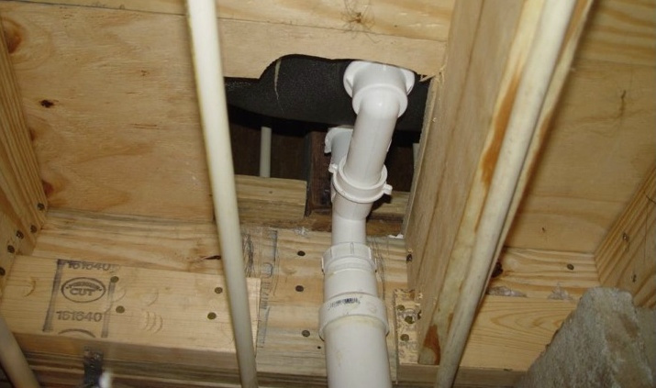
Under the Tub
Photos courtesy of The US Department of Energy
17
GJA 2024 Version III
Notes:
1.7.2013
17
August 2010
This opening under the tub looks innocent enough. It is almost certainly connected to vertical chases behind the tub/shower that are, in turn, connected to upper floor cavities and the attic.
‹#›

Slide 18
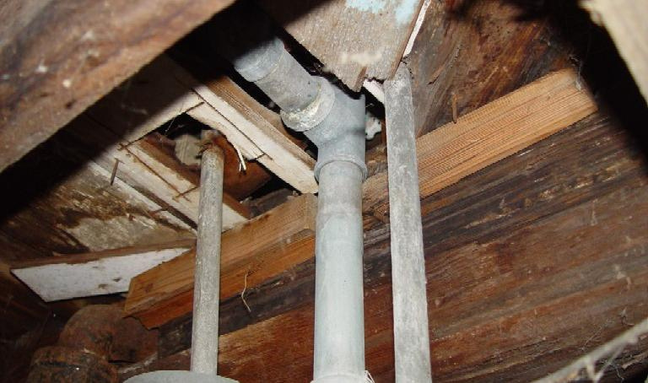
Another Tub
Photos courtesy of The US Department of Energy
18
GJA 2024 Version III
Notes:
1.7.2013
August 2010
18
This is a similar situation in an older home.
‹#›

Slide 19
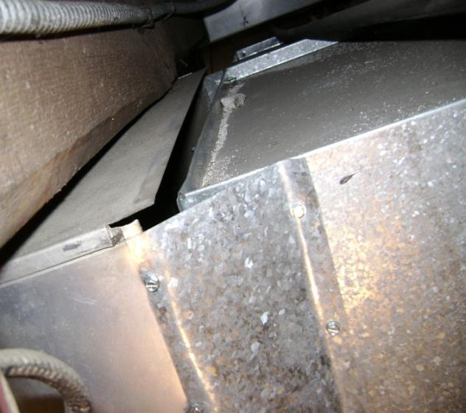
More in the Basement
House as a system
Top of connection between heat delivery plenum and main trunk.
Photos courtesy of The US Department of Energy
19
GJA 2024 Version III
Notes:
1.7.2013
19
August 2010
The installer couldn’t fit his arm into the space between the plenum and the ceiling so he didn’t bother finishing this job.
This situation pressurizes the basement, forcing air out along the sill. It can “power rot” the basement box sill assembly, while wasting significant energy.
The “cure” was drywall mesh tape, a good quality duct mastic such as RDC # 6, and a short stick.
‹#›

Slide 20
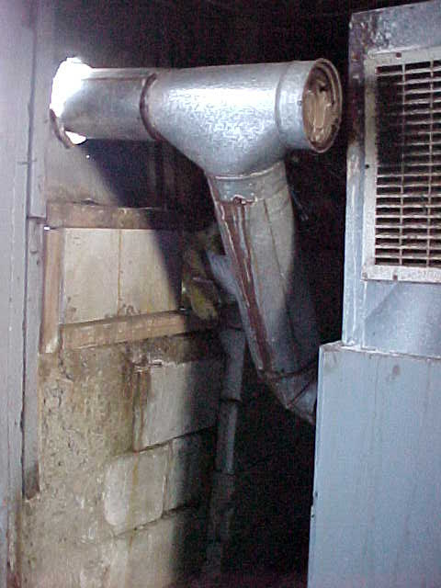

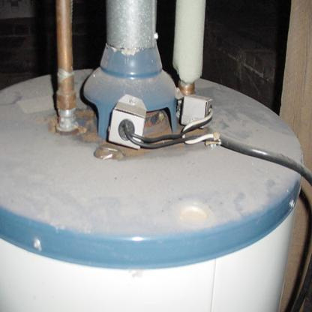
More in the Basement
Danger!
Grille cut into return plenum sucks on barometric damper.
Thermocouples shut off flame when backdrafting occurs, but real culprit is leaky return ductwork on furnace (not shown).
Photos courtesy of The US Department of Energy
20
GJA 2024 Version III
Notes:
1.7.2013
August 2010
20
The picture to the left shows a grille cut into the return plenum to prevent the duct from banging when the air handler started up. The air handler fan now sucks directly on the barometric damper. This house has, in effect, a power vent chimney. All combustion byproducts are being delivered to the occupants to breathe. THIS IS EXTREMELY DANGEROUS!
Even oil units can produce CO under these conditions. Oil combustion also produces aldehydestoxic byproducts of oil combustionand other pollutants.
On the right, we see the top of an atmospheric gas water heater. Because the vent system backdrafted repeatedly to the point of burning the paint off the water heater, someone installed thermocouples to shut down the gas flame whenever backdrafting occurred. The real culprit was leaky return ductwork on a warm air furnace (not pictured) sucking on the basement.
‹#›

Slide 21
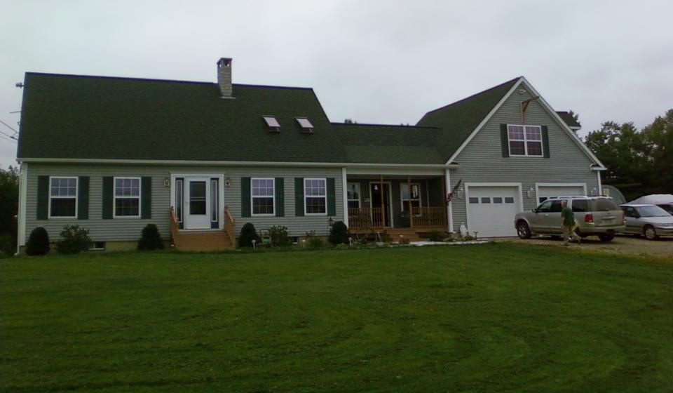

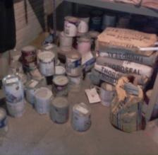
In the Garage
Photo courtesy of The US Department of Energy
21
GJA 2024 Version III
Notes:
1.7.2013
21
August 2010
Q. What are some pollutants typically stored in the garage?
Click to reveal selection of pollutants typically found in the garage.
The garage floor has the same moisture characteristics as the basement floor.
Garages are even more likely than basements to contain stored “off-gassers,” such as automobiles, lawn mowers, and other fossil-fueled machines.
Catalytic converters in cars emit low levels of CO for approximately four hours after the car is shut off!
Garages typically have a low “air-feed” (the lower edge of the overhead door) and high “relief” (pipe and wire penetrations near the ceiling). Or they are totally open to the living space attic. Anything breathable in the garage is soon inside the home.
It is extremely important to isolate the garage from the living space to the greatest degree possible to ensure that our weatherization activitiesparticularly measures that reduce the natural air change rate in the living spacedo not concentrate pollutants that previously escaped. A post-weatherization check of any isolation measures using pressure diagnostics is imperative!
‹#›

Slide 22
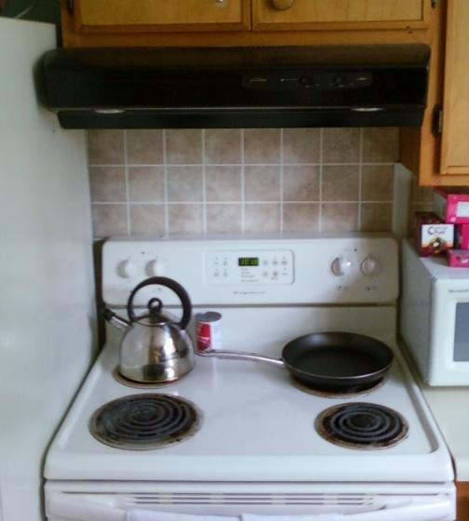
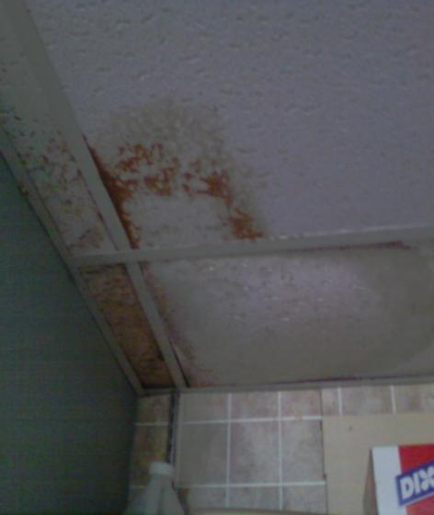
In the Kitchen and Bathroom
House as a system
22
GJA 2024 Version III
Notes:
1.7.2013
22
August 2010
Showering creates large amounts of airborne moisture.
….as does cooking without using pot lids.
Existing vent fans are typically underpowered and noisy.
Often, they’re not vented to the exterior.
When they are, the ducts often leak or restrict airflow.
Even a good fan does nothing if it isn’t used.
Remember when evaluating homes with gas ranges or cooktops that gas code requires they be vented to the building exterior through a hard-ducted vent hood. Recirculating models do not satisfy the code requirement. Always consider installing good quality CO detectors in homes with gas appliances.
With a properly functioning ventilation system, moisture and other pollutants are kept from entering the home. Any pollutantand moisture is considered a pollutant for the purposes of this discussioncreated in the home is transported safely outside through exhaust ventilation and ductwork. However, in many homes, the fans or ducts are loud, leaky, non-existent or otherwise not up to the job. Moisture created within the home condenses on cool building surfaces, both in the living space and in the attic, and causes mold, mildew, poor IAQ, and structural damage.
‹#›

Slide 23
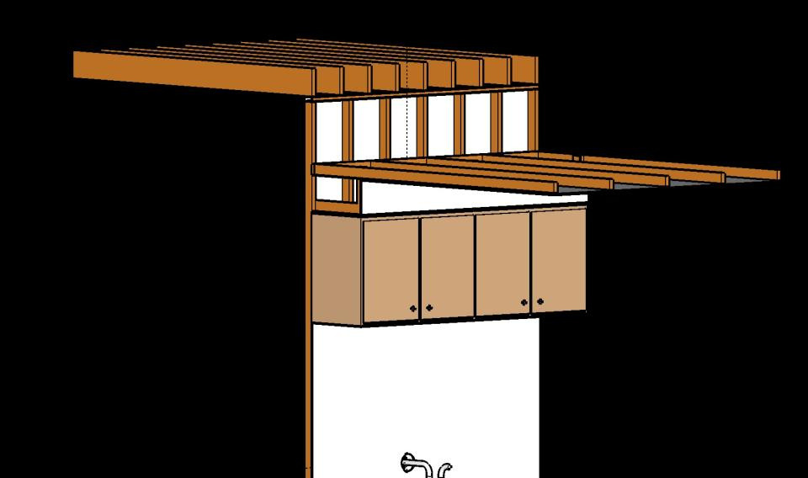
Dropped Soffits
Kitchen wall cabinets mounted under soffit or valance.
23
GJA 2024 Version III
Notes:
1.7.2013
August 2010
23
Ceiling drywall isn’t typically extended over cabinet dropped soffits.
Even if the attic is insulated, attic air has free access to the cavity, cooling the walls and cabinet.
‹#›

Slide 24
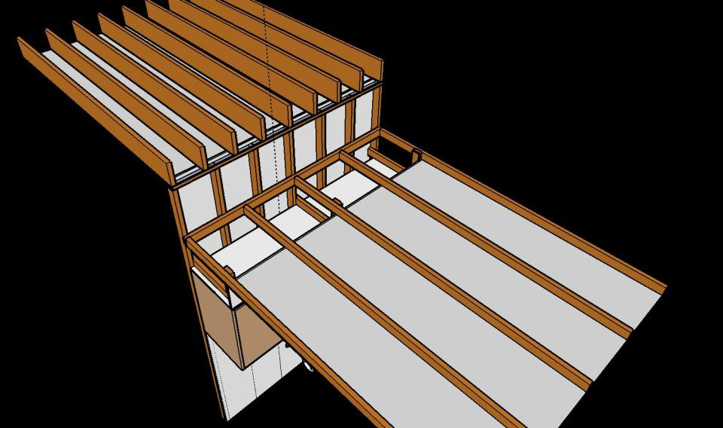

Dropped Soffits
If you see soffit-mounted cabinets, remember to investigate during attic inspection.
24
GJA 2024 Version III
Notes:
1.7.2013
August 2010
24
If you see soffit-mounted cabinets, remember to investigate during attic inspection.
‹#›

Slide 25
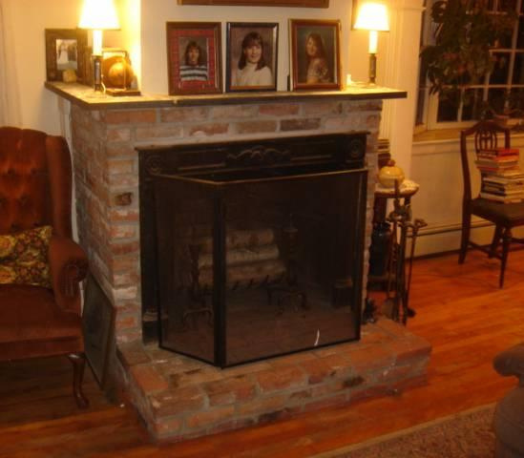
In the Living Room
Fireplaces “net cool” all but the smallest spaces.
25
GJA 2024 Version III
Notes:
1.7.2013
25
August 2010
An “open-burn” fireplace (one without glass doors) pulls so much heated air from the living space it actually may cool the surrounding space.
Of interest: Wing chairs and footstools were invented to shield people from the rush of air heading to open fireplaces in castles.
‹#›

Slide 26
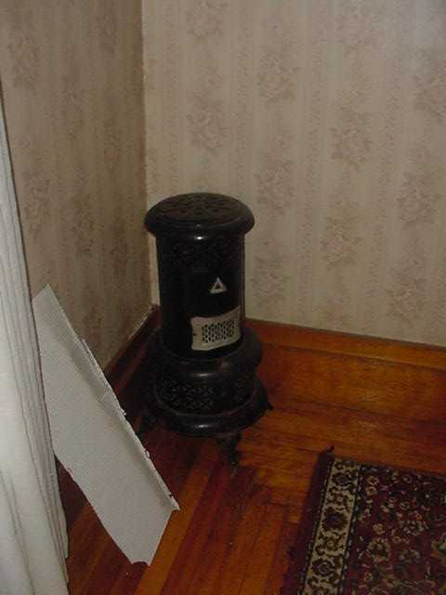
Unvented Space Heaters
And then there are
VENT FREE fireplaces!
& kerosene heaters
& homemade stuff.
26
GJA 2024 Version III
eere.energy.gov
Notes:
1.7.2013
26
August 2010
This is a photo of a kerosene wick burner heater, the predecessor of the Kerosun and other unvented space heaters.
Kerosene wick burner heaters are almost universally illegal because of their unhealthy emissions and because of the likelihood of fire. Vent-free gas fireplaces are illegal in many states because they tend to produce high levels of CO.
Instructions for vent-free fireplaces usually say to set the gas flame to blue with a yellow tip for low CO production. Further on, the instructions often say to close the air gate down for a more realistic yellow flame. A yellow flame indicates high CO production.
‹#›

Slide 27
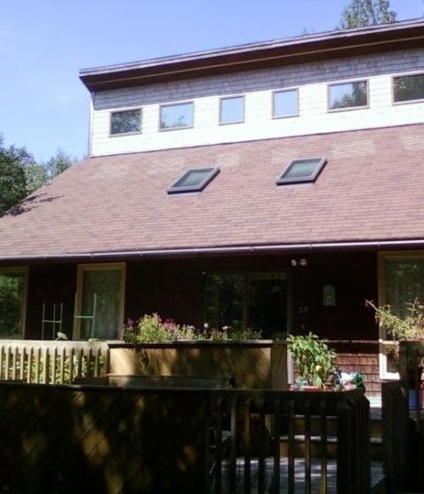
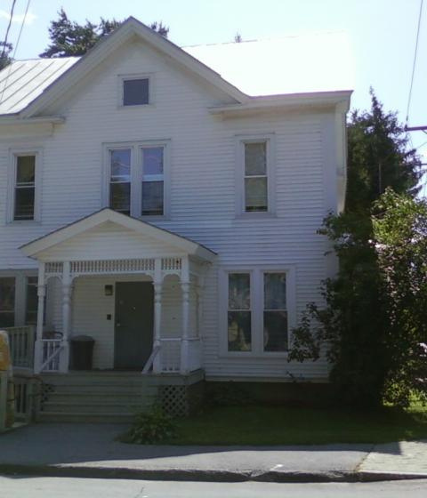
Outside
Trees & bushes against a building prevent wall assemblies from drying.
Cathedral ceilings invite moisture & mold problems. Roof windows or recessed lights will further complicate matters.
Photos courtesy of The US Department of Energy
27
GJA 2024 Version III
Notes:
1.7.2013
27
August 2010
The house as a system concept doesn’t stop at the walls. Factors outside the home that affect structural integrity and home performance include:
Roof leaks – Water leaking into the attic damages insulation, reducing the effective R-value and increasing heating and cooling bills.
Gutters (or lack of) – Poorly installed or clogged gutters can cause moisture to drip down exterior surfaces, infiltrating cracks and crevices. This can cause structural damage and reduce effective R-values of wall insulation.
Landscaping
Ground slope – Any landscaping that guides moisture toward the home, rather than away, is poor landscaping.
Vegetation
Good design: A deciduous tree planted on the south side of the house can shade it in summer, and allow low winter sun to warm the home during the heating season.
Bad design: Trees and bushes of any type that reduce air movement around the building retard drying of building components and can promote building rot.
Building design
Any building designlow slope or flat roof additions, abutting dormers, etc.that allows water to puddle or channels it toward other building components is a poor design.
‹#›

Slide 28
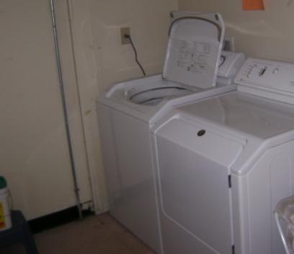
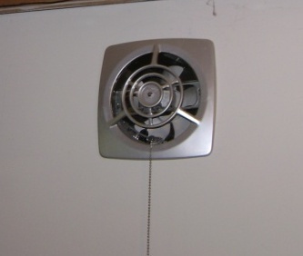
Mechanical Ventilation
All exhaust appliances “suck” on the house.
Photos courtesy of The US Department of Energy
28
GJA 2024 Version III
Notes:
1.7.2013
28
August 2010
Mechanical ventilation is essential in today’s homes to balance good indoor air quality and energy conservation. Homes left loose enough for moisture and odor control without using mechanical ventilation waste energy.
Types of mechanical ventilation include:
Bathroom and kitchen fans.
Clothes drier.
Central vacuum.
Whole-house ventilation.
Central heating and cooling systems.
Mechanical ventilation can pull moist exterior air into wall and ceiling assemblies in cooling environments. It may also cause backdrafting in any environment.
‹#›

Slide 29
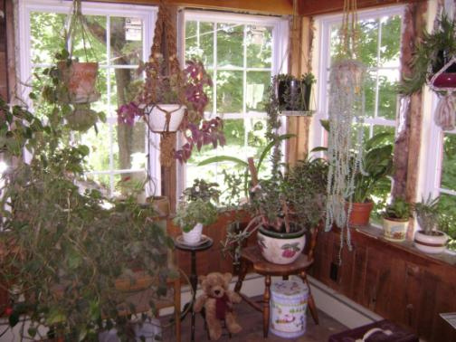
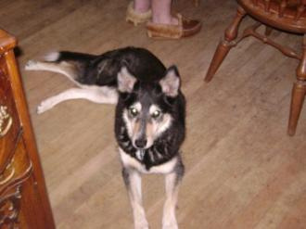
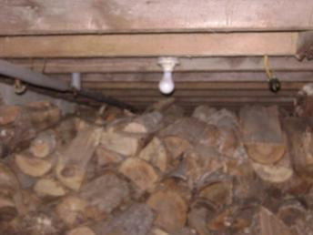
Occupant Behavior
Photos courtesy of The US Department of Energy
29
GJA 2024 Version III
Notes:
1.7.2013
29
August 2010
Occupant behavior is the most arbitrary factor in the IAQ and energy use of all homes. When you conduct the initial interview, find out how your clients use their home.
To protect IAQ, advise clients to avoid:
Storing firewood inside (or outdoors right next to the home).
Air drying clothes inside – even in the basement.
Having numerous plants.
Using chemicals indoors without adequate ventilation.
Using “energy conservation” gadgets such as a drier draft diverter which will dump wash chemicals into the home along with any reclaimed heat from the drier.
Energy use is affected by lifestyle:
Sleeping with windows open.
Under or over dressing.
Leaving any windows and doors open when the heat or A/C is on.
As an auditor, you must assess the impact of occupant behavior on your recommendations. It is extremely difficult to get someone to change a habit, and what makes sense to you may not make sense for your client.
‹#›

Slide 30
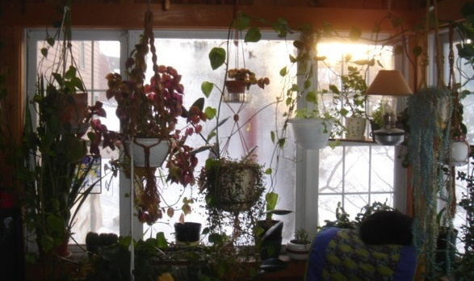
What’s Going On?
Heavy condensation on center window.
No condensation on side windows.
Why? What is the most likely
moisture source?
Photo courtesy of The US Department of Energy
30
GJA 2024 Version III
Notes:
1.7.2013
30
August 2010
Side windows are double glazed; the center window is single glazed.
Plant watering. All water poured into plant soil eventually evaporates into the room.
Evaporated water is condensing on the cold, single-paned center window.
‹#›

Slide 31
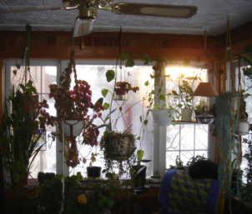
What Should Be Done?
    Add a storm window.
    Replace the entire window unit.
    Advise the homeowner to run
    the ceiling fan.
    Get rid of the plants.
It Depends!
31
GJA 2024 Version III
Notes:
1.7.2013
31
August 2010
Choices:
Add a storm window  Relatively inexpensive with fair return (improves existing R-1 to R-2).
Replace the window unit  More expensive with better return (R-1 to ≈ R-3.5).
Run the ceiling fan  No initial cost and will raise the glass temperature over dew point, but will increase heat loss through windows and use electricity.
Eliminate the plants  Free but interferes with client lifestyle and doesn’t reduce space heat consumption.
Any of the four will work.
In the private sector, the decision would rest on homeowner resources and motivations. With DOE funding, the auditor must make the best choice for each house, considering 1) the client, 2) the future use of the building, and 3) the SIR.
‹#›

Slide 32
Something to Think About
Houses:
    Are tighter.
    Have more exhaust appliances.
    Have “weaker” natural draft combustion appliances.
    Have less drying potential.
Diagram courtesy of John Tooley
32
GJA 2024 Version III
Notes:
1.7.2013
32
August 2010
This slide lists the four reasons why John Tooley, a leading building scientist, believes House as a System Science should dominate energy conservation retrofit decisions.
This slide and the next six were created using information from a presentation given by John Tooley in Portland, Maine.
‹#›

Slide 33
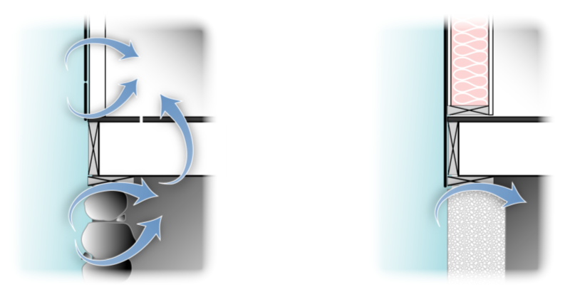


Today’s Houses Are Tighter
House as a system
OLD
Boarded exterior with lath & plaster interior walls.
NEW
Plywood
& drywall.
33
GJA 2024 Version III
Notes:
1.7.2013
33
August 2010
Plywood and drywall vs. boards and plaster.
Platform vs. balloon framing.
Concrete vs. granite slabs or rubble stone and brick.
Concrete vs. dirt floors.
Vinyl thermo pane windows vs. wood sash and storms.
Insulated doors vs. wooden doors.
Modern caulks.
‹#›

Slide 34
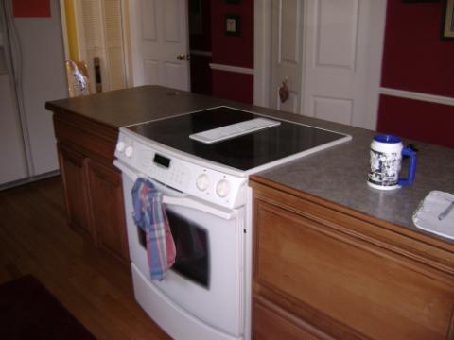


Today’s Houses Have More and Bigger Fans
34
GJA 2024 Version III
Notes:
1.7.2013
34
August 2010
More and stronger exhaust appliances.
400+ CFM Jenn-aire (upper left) vs. 50 CFM kitchen paddle fan hood (right).
Direct through-the-wall fan (below).
Clothes driers vs. drying rack or clothes line.
Central vacuum.
Air handlers.
Central AC.
Stronger furnace fans.
Whole house ventilation fans.
Bigger and more powerful fans in general.
‹#›

Slide 35









Today’s Houses Have Weaker
Draft Appliances
The weaker the draft (i.e., the higher the efficiency), the less air
moves through the heating system & therefore the house.
Air Tight Wood Stove
Kuma Stoves kumastoves.com
Open fireplaces
Glass doors reduce air loss
System 2000™ 90+%
High Mass drybase boiler 80%
Converted coal boiler 50%
35
GJA 2024 Version III
Notes:
1.7.2013
35
August 2010
Click to reveal the progression of appliances from open fireplaces to fireplaces with glass doors to air tight woodstove to coal boiler to 80% drybase boiler and finally to a 90%+ furnace. Ask students to name an appliance with weaker draft each step of the way.
Heating efficiency ratings are simply the percentage of consumed energy that goes up the chimney, i.e., as efficiency increases, less heat and air go up the chimney.
As we increase heating appliance efficiency, we reduce draft, which in turn moves less air through the building, reducing its drying capability.
The final step in efficiency improvement is a sealed combustion unit, which gets its combustion air from the outside and consequently does nothing to dry the building at all.
‹#›

Slide 36


Today’s Houses Have Less Drying Potential
The old house got wet in the summer
(humid) & dried in the winter (low humidity).
The new house gets just as wet but can’t dry; therefore poor IAQ and mold/mildew.
Older Home:
    Balloon-framed two-story home
    (lots of stack effect).
    Boards, plaster & lathe.
    No insulation.
    Construction style and materials inherently leaky.
Newer Home:
    Low (little stack effect).
    Plywood & drywall.
    Construction style and materials inherently tighter than older home.
36
GJA 2024 Version III
Notes:
1.7.2013
36
August 2010
Air moves readily through uninsulated walls and ceilings. Cavities filled with insulation slow or stop air movement.
Years ago, houses were designed to cycle wet to dry annually. That is, they got wet in humid times and dried out when the humidity dropped.
Energy savings measures generally interfere with this cycle and require moisture mitigation.
These circumstances led to the common belief that cellulose rots buildings. When cellulose first gained popularity after the first energy crisis, installers were not aware of the necessity for moisture control. The result was a large number of damaged buildings. We now know that moisture control is essential when insulating and air sealing buildings.
Modern homes generally spread out rather than up (think “ranch” vs. Victorian”), reducing the stack effect.
Better caulks and sealants, tighter construction details, and man-made materials all help keep moisture in.
‹#›

Slide 37





Lifestyle Changes
37
GJA 2024 Version III
Notes:
1.7.2013
37
August 2010
We’ve transformed from an agrarian society to an industrialized one, and from an active outdoor lifestyle to a sedentary indoor one.
Daily showers vs. weekly baths.
Water “sports” include hot tubs, multiple showerheads, saunas, and indoor pools.
‹#›

Slide 38
Summary
    We build very differently than we did as little as
    40 years ago.
    Economic pressure is driving the move to tighter
    houses with smaller margins of safety.
    The tighter a house is, the more influence individual components have on the others.
    All pollutants inside the pressure boundary will
    eventually be dispersed over the entire area.
    Altering a building or its mechanicals can have unexpected consequences.
38
GJA 2024 Version III
Notes:
1.7.2013
August 2010
38
We build very differently than we did as little as 40 years ago.
Economic pressure is driving the move to tighter houses with smaller margins of safety.
The tighter a house is, the more influence individual components have on the others.
All pollutants inside the pressure boundary will eventually be dispersed throughout the entire living area.
Altering a building or its mechanical system can have unexpected consequences.
‹#›

