Slide 1




CREW LEADER
Safe Work Practices
1
GJA 2025 Version III
Notes:
1.7.2013
<number>
‹#›

Slide 2
Learning Objectives
By attending this session, participants will be able to:
    Explain the purpose of OSHA regulations.
    Identify where to find DOE and EPA guidelines for working with lead, mold, asbestos and other health hazards.
    Describe which homes require lead-safe weatherization practices and certified renovators.
    Explain the importance of a materials safety data sheet (MSDS) and why it is important to keep nearby.
    (continued on next slide)
2
GJA 2025 Version III
Notes:
1.7.2013
By attending this session, participants will be able to:
Explain the purpose of OSHA regulations.
Identify where to find DOE and EPA guidelines for working with lead, mold, asbestos and other health hazards.
Describe which homes require lead-safe weatherization practices and certified renovators.
Explain the importance of a materials safety data sheet (MSDS) and why it is important to keep nearby.
<number>
‹#›

Slide 3
Learning Objectives
By attending this session, participants will be able to:
    Name typical personal protective equipment (PPE) and describe the functions.
    Explain the function and importance of using ground fault circuit interrupter (GFCI) equipment.
    Discuss simple workplace safety management methods.
    List which conditions require deferral on a dwelling.
3
GJA 2025 Version III
Notes:
1.7.2013
By attending this session, participants will be able to:
Name typical personal protective equipment (PPE) and describe the functions.
Explain the function and importance of using ground fault circuit interrupter (GFCI) equipment.
Discuss simple workplace safety management methods.
List which conditions require deferral on a dwelling.
<number>
‹#›

Slide 4
SAFE WORK PRACTICES
Crew Leader Requirements
Crew leads must be OSHA-30 certified and must demonstrate the ability to:
    Select, fit, and use the appropriate PPE for a
    particular task.
    Safely use basic hand and power tools.
    Use a basic first aid kit to treat common job-site injuries.
    Work lead safe.
    Identify serious mold conditions.
    Assess work area safety hazards.
4
GJA 2025 Version III
Notes:
1.7.2013
As of program year 2012, all crew leaders must attend and receive certification in an OSHA-30 course.*
Crew leads seeking the national crew lead certification must also demonstrate the ability to:
Select, fit, and use the appropriate PPE for a particular task.
Safely use basic hand and power tools.
Use a basic first aid kit to treat common job-site injuries.
Work lead safe.
Identify serious mold conditions.
Assess work area safety hazards.
Even if you’re not trying for the crew leader certification, these are all good skills to have.
Think of all of these things as prerequisites for the job.
Q: What are some examples of personal protective equipment you use on the job?
A: Hardhats, dust masks, and eye protection.
Q: What equipment is required to install dense-pack sidewall insulation in a lead-safe manner?
A: Six feet of plastic on the ground where you’re drilling, sprayer to mist the drill site, drill shroud, gloves, eye protection, and a dust mask.
*Described in Weatherization Program Notice 11-6 Health and Safety Guidance.
<number>
‹#›

Slide 5
SAFE WORK PRACTICES
Crew Leader Requirements
Know where to find critical information.
    U.S. Department of Energy (DOE) Weatherization Assistance Program regulations and policy
    Environmental Protection Agency (EPA) guidelines for asbestos, lead, mold, and other health hazards
    Material safety data sheets (MSDS)
5
GJA 2025 Version III
Notes:
1.7.2013
Crew leaders must possess a working knowledge of these critical sources of information and guidance:
U.S. Department of Energy (DOE) Weatherization Assistance Program regulations and policy.
The purpose of these regulations and policies is to keep weatherization workers and the families they serve safe and healthy.
Refer to www.waptac.org for the most up-to-date guidance. They maintain a full library.
Environmental Protection Agency (EPA) guidelines for asbestos, lead, mold, and other health hazards.
In homes built before 1978, lead-safe weatherization (LSW) practices are required to minimize the dangers of lead dust. An EPA certified renovator must be onsite during this work.
The EPA’s Healthy Indoor Environment Protocols for Home Energy Upgrades is a useful reference guide that covers a wide range of potentially harmful situations. It deals largely with occupant health. Worker safety is not addressed but the guide does include helpful references to relevant codes and standards for each of the hazards listed.
Material safety data sheets (MSDS).
Keep the MSDS for all materials in a designated spot in every truck. If something happens to an installer technician in the field, the emergency response team can provide assistance more quickly and effectively if they know the chemicals to which the worker has been exposed.
If you have an Internet connection in the classroom, pause the presentation and take some time showing the class where to find DOE guidance on the WAPTAC Website. Go to the “Rules and Guidance” tab and explore some of the more recent program guidance documents.
<number>
‹#›

Slide 6
OSHA Standards
SAFE WORK PRACTICES
Occupational Safety and Health Administration (OSHA) standards
    Ladder safety
    Fall protection
    Personal protective equipment (PPE)
    Respiratory protection
    Motor vehicles
    Power-operated hand tools
    Fire prevention
    Permit-required confined spaces
    Other worker-related OSHA standards
6
GJA 2025 Version III
Notes:
1.7.2013
Occupational Safety and Health Administration (OSHA) standards address:
Ladder safety.
Fall protection.
Personal protective equipment (PPE).
Respiratory protection.
Motor vehicles. Operate vehicles safely.
Power-operated hand tools.
Fire prevention.
Permit-required confined spaces.
Other worker-related OSHA standards.
The goal of OSHA regulations is to maintain worker safety and prevent the cycle of
complacency that many workers adopt after long periods with no accidents.
The Cycle:
People get into a routine and stop paying as much attention as they should.
Eventually, someone falls off a ladder or gets electrocuted.
Everyone gets scared and starts to take safety seriously for a while.
Nobody gets hurt for a long time.
People start to get careless again. The cycle repeats.
Ask students: Does everyone have a designated safety manager at his or her agency?
<number>
‹#›

Slide 7
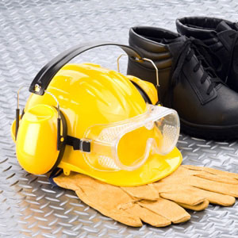
Creating Safe Job Sites
SAFE WORK PRACTICES
    Protect workers and residents.
    Use proper lighting and ventilation in work area.
    Mask work areas to prevent contamination and ease clean-up.
    Wear appropriate PPE.
    Lock out/tag out.
Photo courtesy of Constructionsafetyjobs.com
7
GJA 2025 Version III
Notes:
1.7.2013
Safety protocols are implemented to ensure the safety of the workers as well as the continued health and safety of the residents and visitors to the home being weatherized. It is generally the crew leader’s responsibility to oversee the safety of the job site.
Basic safety protocols include:
Creating safe work environments with proper lighting and ventilation.
Masking the area to prevent contamination of the home interior or exterior when working with potentially harmful materials (this has the added benefit of making clean-up a snap).
Wearing proper personal protective equipment (PPE) at all times.
Working safely with electricity. Familiarize yourself with your workplace lock out/tag out procedures.
<number>
‹#›

Slide 8
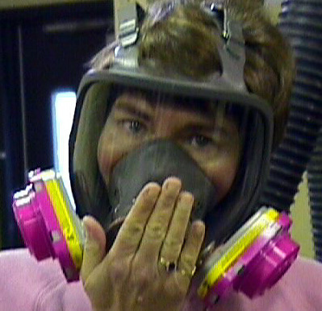
PPE
SAFE WORK PRACTICES
    Ensure you have the proper gear: safety glasses, hearing protection, protective clothing, and respirators.
    Ensure you have the proper fit: fit test for respirators.
    If in doubt about what gear you need, refer to the MSDS.
Respirators should meet or exceed MSDS requirements and be assessed based on OSHA’s fit test guidelines.
Photo courtesy of Environmental Health & Safety, Univ. of VA
8
GJA 2025 Version III
Notes:
1.7.2013
Ensure you have the proper gear: safety glasses, hearing protection, protective clothing, and respirators.
Ensure you have the proper fit. Use a fit test for respirators.
If in doubt about what gear you need, refer to the MSDS. There is a section in every MSDS stating what the allowable exposure levels are and the ventilation and/or respirator types required for safe work.
<number>
‹#›

Slide 9
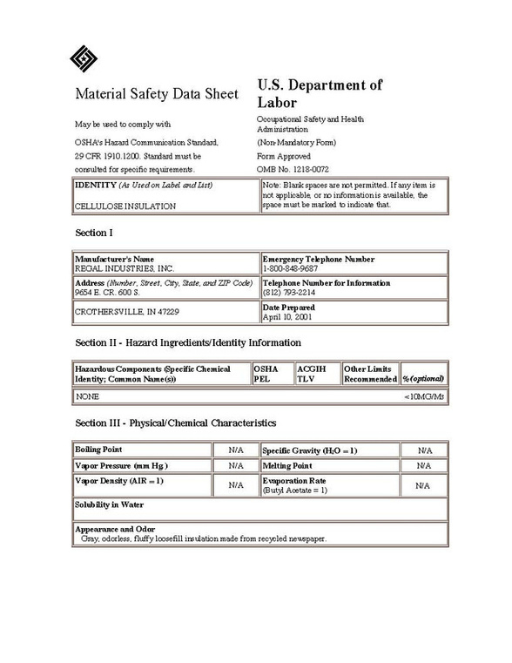
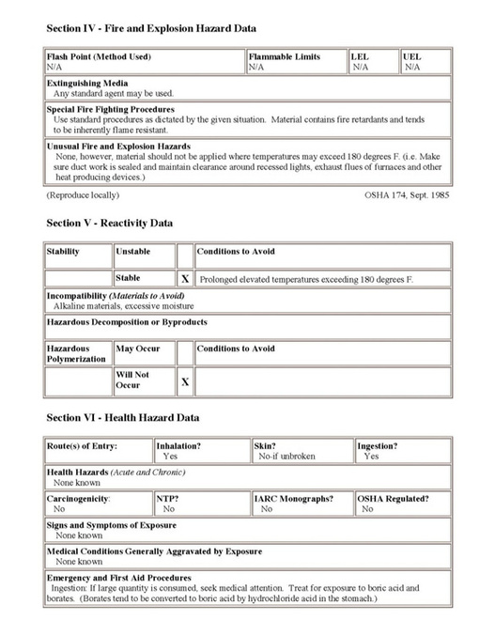
Material Safety Data Sheets
9
GJA 2025 Version III
Notes:
1.7.2013
Federal law requires that a material safety data sheet (MSDS) be present and easily accessible at the job site for every material used.
Get copies from your supplier or download them from the manufacturer’s website. Keep them, preferably in alphabetical order, in a safe place in your vehicle. They will be the first requested item if you are ever on the receiving end of an inspection by OSHA.
Crew leaders should be aware of MSDS when specifying chemical products for use by weatherization technicians.
<number>
‹#›

Slide 10
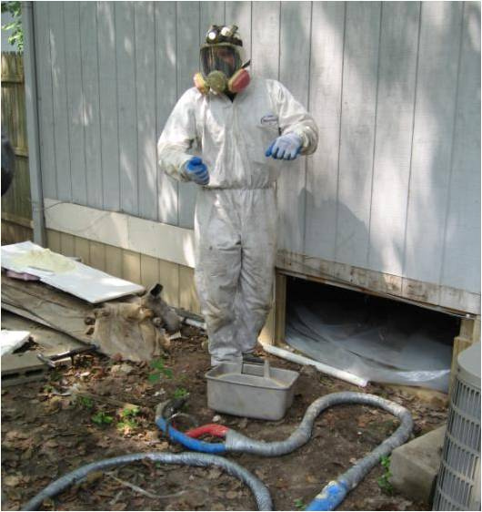
MSDS Requirements
MSDS generally requires the following information:
      Product and contact information of the manufacturer
      Hazardous ingredients
      Fire and explosion hazard data
      Reactivity data
      Health hazard data
      Emergency and first aid procedures
      Personal protective equipment
10
GJA 2025 Version III
Notes:
1.7.2013
MSDS generally require the following information:
Product and contact information of the manufacturer.
Hazard ingredients/identify information.
Fire and explosion hazard data.
Reactivity data.
Health hazard data.
Emergency and first aid procedures.
Personal protective equipment (PPE).
Hand out the MSDS sheets for two-part foam and point out hazards, first aid procedures, and PPE.
<number>
‹#›

Slide 11
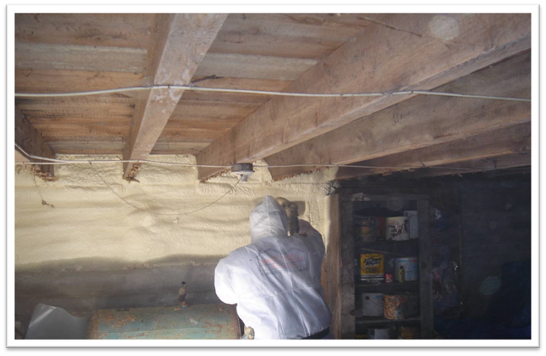
Protective Gear
A protective suit and positive pressure respirator keep this worker safe when applying two-part foam.
Photo courtesy of the US Department of Energy
11
GJA 2025 Version III
Notes:
1.7.2013
Personal protective gear is for your benefit.
Program-wide, senior weatherization workers stated that their major regret is paying the health penalty for “being tough” and not using disposable suits, respirators, etc.
<number>
‹#›

Slide 12
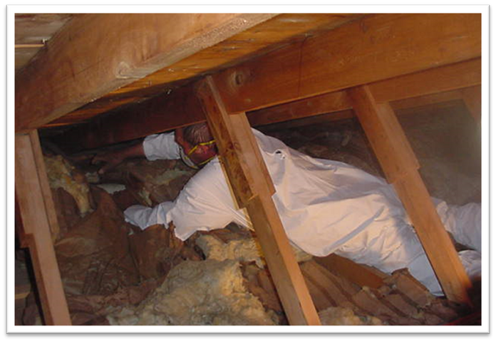
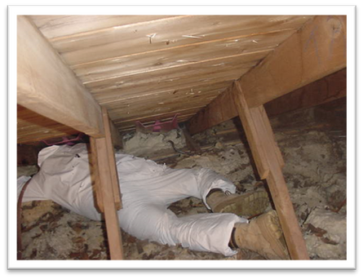
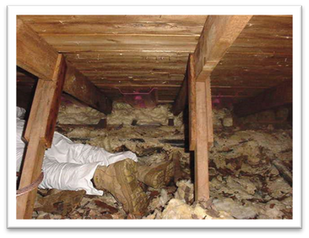
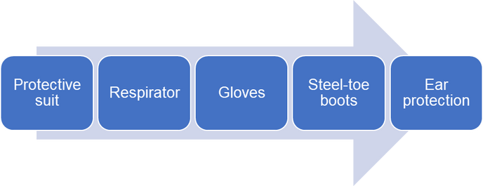
Protective Gear in Attics
12
GJA 2025 Version III
Notes:
1.7.2013
Insulation, particularly recycled fiberglass, can be an allergen. While a person may not react to insulation at first, he/she will react once a personal tolerance level is exceeded.
Protective suits protect workers’ skin from materials that may cause oversensitivity. They also protects workers’ families so allergens and toxins don’t come home with them.
Respirators protect the respiratory system from airborne pollutants and particulates that workers are exposed to through common weatherization installations. Cartridges should be matched to pollution sources according to the National Institute for Occupational Safety and Health (NIOSH). Positive pressure respirators provide outdoor air through a hood and hose.
Gloves protect hands.
Steel-toe boots protect workers’ feet.
Ear protection protects hearing.
<number>
‹#›

Slide 13
Lighting and Ventilation
Lighting
    Recommended lighting level: 5 foot-candles.
      A foot-candle is equivalent to one lumen per square foot, lm/ft².
    Natural or task lights.
    See OSHA 1926.26 and 1926.56.
Ventilation
    Intended to maintain safe work environment for workers.
    Must not disperse unsafe substances into air.
    MSDS provides safe exposure levels and recommended PPE.
    OSHA 1926.55 and 1926.57 list exposure levels.
13
GJA 2025 Version III
Notes:
1.7.2013
Lighting
Recommended lighting level according to OSHA: 5 foot-candles.
A foot-candle is equivalent to one lumen per square foot, lm/ft2.
Can be natural or with task lights.
See OSHA 1926.26 & 1926.56.
Ventilation
Intended to maintain safe work environment for workers.
Must not disperse unsafe substances into air – for example lead dust should not be ventilated without a collection strategy to ensure the dust is safely contained and will not contaminate the indoor or outdoor environment.
MSDS provides safe exposure levels and recommended PPE.
See OSHA 1926.55 and 1926.57 for exposure levels if not on MSDS.
<number>
‹#›

Slide 14
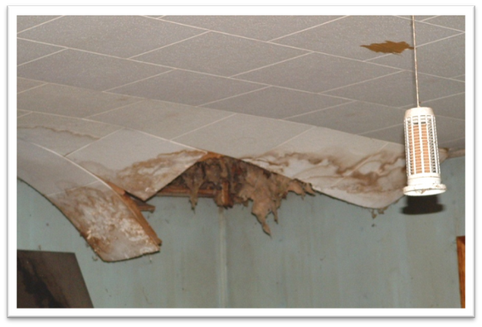
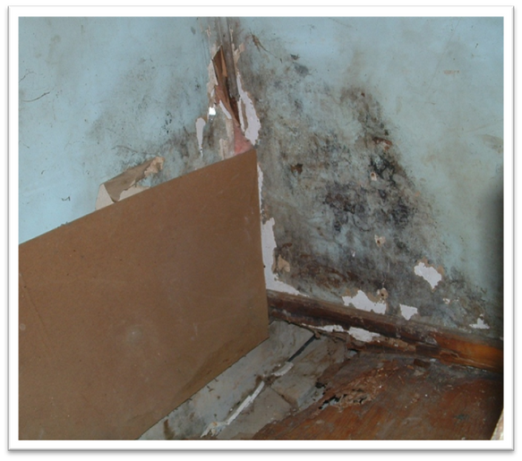
How Much Mold Is OK?
Photos courtesy of the US Department of Energy
14
GJA 2025 Version III
Notes:
1.7.2013
Mold is another toxic substance that affects people differently. Just because a person doesn’t react to a particular mold doesn’t mean he/she won’t react to another.
Always wear a proper respirator when working around any type of mold.
DOE guidance WPN 11-6 does not allow repair or remediation of mold with WAP money. If more than 10 sq. ft. of mold (specific allowances may vary; refer to the state technical field manual) is visible inside a dwelling, weatherization must be postponed until the mold is cleaned up or otherwise rendered harmless.
Complete a Deferral of Services notification and refer the mold situation to the proper funding source or program.
<number>
‹#›

Slide 15
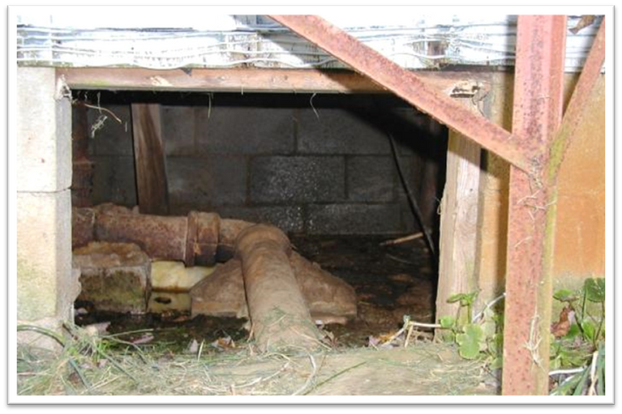

Foundations and Crawl Spaces
Situations like this can hinder weatherization work.
    Workers cannot access ducts, floor cavity.
    Occupants’ health and safety are impacted.
Wet crawl space
Photo courtesy of U.S. Department of Energy
15
GJA 2025 Version III
Notes:
1.7.2013
This is a photo of a wet crawl space without a door.
Situations like this can affect the health and safety of installers.
Even when the crawl space is clean and dry, accessibility guidelines apply. Check the local field guide. Typically, if there is less than 24” of vertical clearance, it may be considered inaccessible.
The term “confined space” is sometimes used and may even be defined in the state field guide for clarification about where workers are expected to go and where they are not. The OSHA definition is not helpful regarding specific dimensions and is generally inferred to mean an employee would be working with heavy machinery within the confined space.
According to OSHA’s definition, a confined space is:
Large enough for an employee to enter fully and perform assigned work;
Is not designed for continuous occupancy by the employee; and
Has a limited or restricted means of entry or exit.
<number>
‹#›

Slide 16
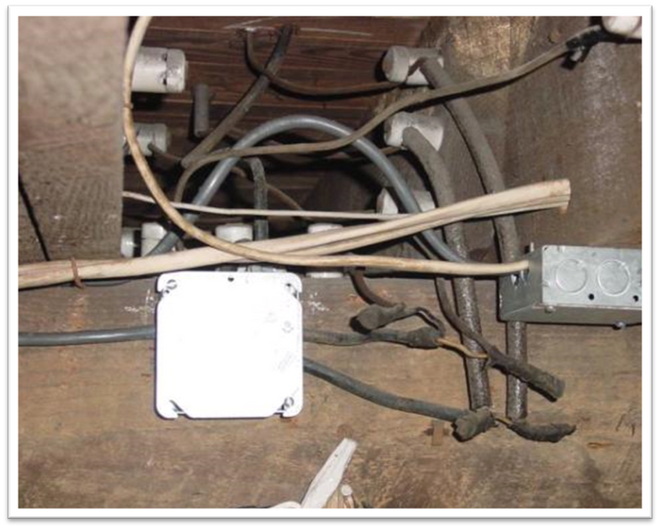
Electrical
Note the locations of these and any other electrical hazards:
    Knob and
    tube wiring
    Open wire splices
    Uncovered
    junction boxes
    Frayed wire, etc.
Most state codes prohibit insulation over knob and
tube wiring.
Photo courtesy of U.S. Department of Energy
16
GJA 2025 Version III
Notes:
1.7.2013
This is a photo of knob and tube wiring.
The auditor should have noted the locations of these and other potential electrical hazards:
Knob and tube wiring
Open wire splices
Uncovered junction boxes
Frayed wire, etc.
If you discover electrical hazards that aren’t noted on the work order, notify the energy auditor to determine if a change order is required or if you can address the issue, continue work and deal with the paperwork back at the office.
<number>
‹#›

Slide 17

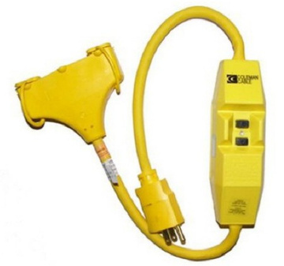
Ground Fault Circuit Interruption
This could save your life.
Photo courtesy of www.health.howstuffworks.com.
17
GJA 2025 Version III
Notes:
1.7.2013
Ensure that ground fault circuit interrupter (GFCI) equipment is on site and being used according to the manufacturer’s instructions. GFCI equipment protects you by shutting off the power supply if minute changes in electrical current are sensed.
Q: How much electricity do you think it takes to kill someone?
A: Just 75 milliamps. To put that in perspective, a small power drill uses 30 times that much electricity. Breakers are designed to go off at 15–20 amps. Those are made to protect the system, not workers. GFCI equipment is designed to protect you—it senses changes at the milliamp level. This equipment generally costs less than $100.
<number>
‹#›

Slide 18
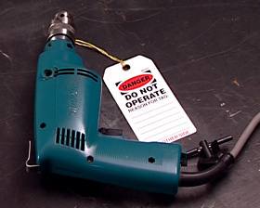
Basic Power Tool Safety
    Use double-insulated tools.
    Never carry by the cord.
    Disconnect when not in use and before servicing or changing accessories.
    Do not use in wet/damp conditions.
    Lock out/tag out.
This damaged drill has been tagged out.
Photo courtesy of CDX Online
18
GJA 2025 Version III
Notes:
1.7.2013
Basic power tool safety on site will help avoid accidents. OSHA recommendations include:
Use double-insulated tools. Those are hand-held tools manufactured with non-metallic cases so the user is insulated from electric wiring components. They reduce shock hazard, but shocks may still occur, so follow the other safety guidelines mentioned here.
Never carry a tool by the cord or yank the cord to unplug it from an outlet. Also keep cords away from heat, oil, and sharp edges. Don’t lay tool cords or extension cords where they will be subjected to heavy traffic; or, if this is unavoidable, cover with a protective barrier to reduce wear and tear.
Disconnect power tools when they’re not in use and before servicing or changing accessories such as drill bits or saw blades.
Do not use in damp or wet locations unless they are approved for that use.
Lock out/tag out is a general term referring to safety policies and practices intended to reduce the risk of workers inadvertently using equipment that is unsafe. Lock out refers to physically locking tools down, either by locking them into a room or crate or locking the piece of equipment itself so that it can not be operated. Tag out is often used on portable tools. Remove damaged portable tools, and tag them “Do Not Use.” These should be taken out of circulation until they can be repaired or disposed of and replaced.
<number>
‹#›

Slide 19
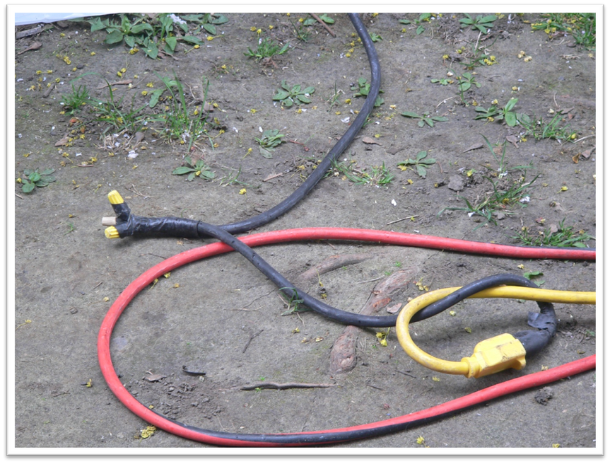
Unsafe Repair
SAFE WORK PRACTICES
Photo courtesy of the US Department of Energy
19
GJA 2025 Version III
Notes:
1.7.2013
Repair it right, or replace it.
If cords are worn or frayed, it’s safer to throw them out than to repair them.
When repairing grounded power tool cords, make sure that you replace like with like. Never break off the third prong of a grounded plug to make it fit into an outlet.
Repair it right, or replace it.
If cords are worn or frayed, it’s safer to throw them out than to repair them.
When repairing grounded power tool cords, make sure that you replace like with like. Never break off the third prong of a grounded plug to make it fit into an outlet.
<number>
‹#›

Slide 20
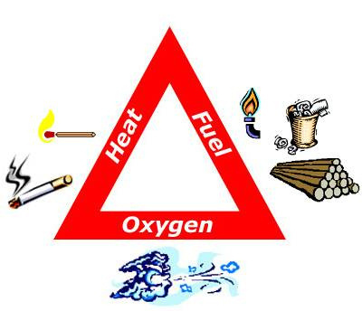
Fire Safety
    No smoking in or near a client’s home.
    Keep portable generators at a safe distance from structures.
    Have a fire extinguisher close by.
    Keep all combustibles away from heat sources.
Image courtesy of http://reslife.msu.edu/uapts/firesafety.html
20
GJA 2025 Version III
Notes:
1.7.2013
Fires are an ever present danger on job sites. Fire prevention on the job site is everyone’s responsibility, but the crew leader needs to be especially vigilant to assure that everyone on the crew is sharing in that responsibility.
Fires need a combination of heat, fuel, and oxygen to burn. If we assume that oxygen is always there, a spark and a fuel source is all it takes to start a fire. Accidents can and do occur but are usually a result of careless actions.
Some common sense preventative measures include:
Do not smoke in or near a client’s home.
Keep portable generators at a safe distance from structures.
Have a fire extinguisher close by.
Keep all combustibles away from heat sources. A can of pressurized foam sealant can and will explode into a fire ball if placed close to a heat source such as a wood stove or a gas heater.
Q: What are some hazardous fuels weatherization workers may have at the job site?
A: Gasoline, oil-soaked rags, two-part foam (if exposed to excessive heat, these pressurized containers can explode in a fire ball), and cleaning solvents.
<number>
‹#›

Slide 21
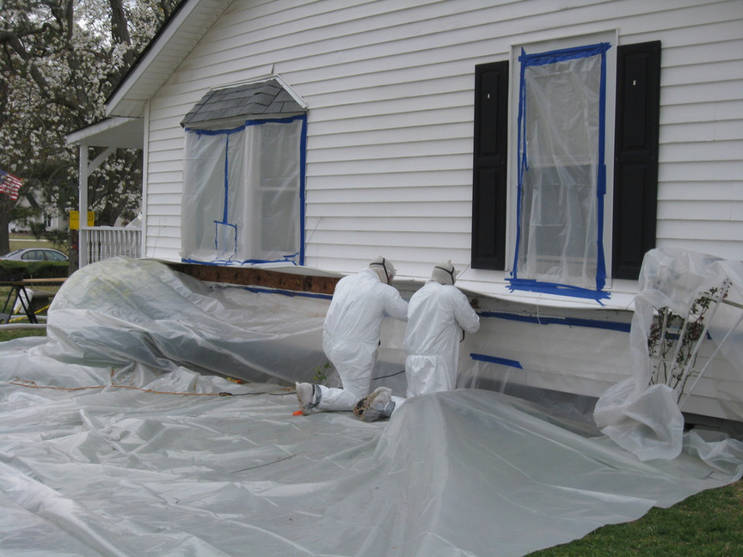
Outside Jobs
Photo courtesy of the US Department of Energy
Cover the ground with plastic 10 ft. beyond work area.
21
GJA 2025 Version III
Notes:
1.7.2013
For lead-safe work, cover the ground with plastic sheeting or other disposable impermeable material extending 10 ft. beyond the perimeter of surfaces undergoing renovation or a sufficient distance to collect falling paint debris—whichever is greater.
If the renovation will affect surfaces within 10 ft. of the property line, then use vertical containment to prevent contamination of adjacent buildings and property.
Where lead paint or other hazardous materials are not an issue and the primary purpose of containment is to ease clean up, use your best judgment or refer to the local technical field guide.
Be mindful of landscape features such as shrubs and flower beds. Note how the shrubs are covered in the photo.
Close doors and windows within 20 ft. of the work area.
Clean up accidental spills and report spills of hazardous material such as oil.
For more on general work area containment when lead is not an issue, refer students to the Maintaining Quality Control chapter of this curriculum.
<number>
‹#›

Slide 22
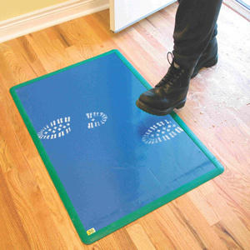
Dust Containment: Tools and Materials
    Wet-dry sandpaper, sanding sponge
    Misting bottle or pump sprayer
    Heavy plastic sheeting
    Utility knife or scissors
    Masking tape, duct tape, or painters’ tape
    High-efficiency particulate air (HEPA) vacuum
    Heavy duty plastic bags
    Tack pads (large, sticky pads that help remove dust), paper towels, or disposable wipes
Photo courtesy of ez-ier.com
Tack pads, also called tack mats, placed
where workers exit the work site prevent them tracking dust and debris on their shoes.
22
GJA 2025 Version III
Notes:
1.7.2013
These are examples of tools and materials to manage workplace dust.
Wet-dry sandpaper, sanding sponge
Misting bottle or pump sprayer
Heavy plastic sheeting
Utility knife or scissors
Masking tape, duct tape, or painters’ tape
High-efficiency particulate air (HEPA) vacuum
Heavy duty plastic bags
Tack pads (large, sticky pads that help remove dust), paper towels, or disposable wipes
<number>
‹#›

Slide 23
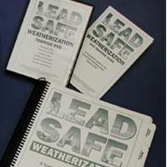
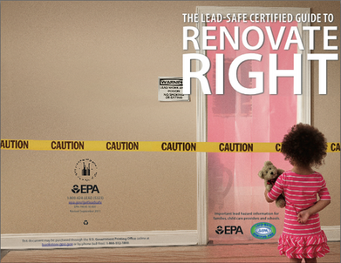
Lead-Safe Work – Where to Learn More
LSW and RRP
    Lead-safe weatherization (LSW) is specific to the Weatherization Assistance Program.
      www.waptac.org
    EPA renovation, repair and painting (RRP) rules apply to all jobs that disturb lead paint.
      www.epa.gov
Top image courtesy of Montana WTC. Bottom image courtesy of US EPA
23
GJA 2025 Version III
Notes:
1.7.2013
The rules surrounding working with lead paint can seem confusing, but it’s really pretty simple. LSW is required on all weatherization jobs on homes built prior to 1978. EPA RRP is not specific to weatherization and applies to all jobs that disturb a given amount of lead paint.
<number>
‹#›

Slide 24
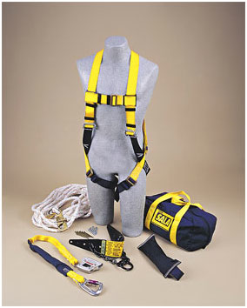
Fall Protection
Required by OSHA where workers could fall at least 6 ft. (or 10 ft. if working on scaffolding).
Options include:
    Personal fall arrest system (PFAS)
    Safety netting
    Guardrails/covers
Image courtesy of Kentuckiana Industrial Safety Training
A PFAS is often the most practical fall protection for weatherization work.
24
GJA 2025 Version III
Notes:
1.7.2013
Fall protection is required by OSHA where workers could fall at least 6 ft. (or 10 ft. if working on scaffolding). Remember, it isn’t just when working on ladders that you could fall 6 ft. or more but also around open doors where there used to be a porch but isn’t anymore or on flat roofs where skylights or other potential openings are found.
Options for fall protection include:
Personal fall arrest systems (PFAS) consisting of anchorage, lifeline (lanyard), and body harness – This is generally the most practical in weatherization work.
Safety netting – This is used largely on big building construction.
Guardrails/covers – This is used around openings like skylights or wall openings/ledges. Rails must be able to withstand a force of 200 lbs.
<number>
‹#›

Slide 25
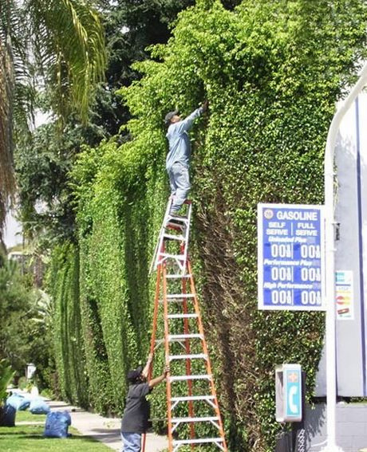
Ladders
One example of what not to do!
    Use ladders as they were designed.
    Keep bottom free of obstructions and slip hazards.
    Position bottom ¼ of the working height away from surface.
    If accessing upper level, ladder must extend 3 ft. above that level.
Photo courtesy of blog.safesourcing.com
25
GJA 2025 Version III
Notes:
1.7.2013
Use ladders as they were designed. Do not exceed weight limitations, and do not tie ladders together to achieve greater height unless they are specifically designed for such use.
Keep bottom of ladder free of obstructions and slip hazards. Do not place the ladder bottom on a slippery surface unless it has special slip-resistant feet.
Position the bottom of the ladder ¼ of the working height away from the surface when using non-self-supporting ladders (where it must be leaned up against the working surface). For example, if a ladder is leaned up against a house so the upper part of the ladder meets the house 16 ft. in the air, the bottom of the ladder should be set at a 4 ft. horizontal distance away from that surface.
If accessing an upper level, the ladder must extend 3 ft. above that level. For example, if using a ladder to access a roof, the ladder must extend 3 ft. above the roof access point.
<number>
‹#›

Slide 26
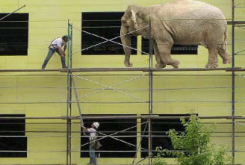
Scaffolding
    Types include suspended, supported, and aerial lifts.
    If more than 10 ft. high, add guardrails and/or PFAS.
    Platforms must support weight + 4x max load and be at least 18 in. wide (12 in. for pump jacks).
    Do not move scaffolding while occupied.
Photo courtesy of elcosh.org
Scaffolding platforms must be capable of supporting their weight plus 4x the maximum load.
You never know what might happen.
26
GJA 2025 Version III
Notes:
1.7.2013
Types of scaffolding include suspended (typically used by window washers), supported (the rigid kind most common in residential construction), and aerial lifts (cherry pickers).
If more than 10 ft. high, add guardrails and/or PFAS.
Platforms must support their weight plus four times the maximum load, and be at least 18 in. wide (12 in. for pump jacks). There may be no more than 1 in. wide gaps in the decking, and they must overlap 12 in. over supports unless they’re restrained to prevent movement.
Do not move scaffolding while occupied. OSHA allows moving occupied scaffolding under certain conditions, but it’s safer to avoid it wherever possible.
<number>
‹#›

Slide 27
Safe Work Practices Exercise
Safe Work Practices
(45 minutes)
27
GJA 2025 Version III
Notes:
1.7.2013
Refer to Lesson Plan and sample scenarios on the Class Exercise handout.
Allow at least 45 minutes of class time.
<number>
‹#›

Slide 28
Deferral
When to walk away.
When to run away.
What to do about it.
28
GJA 2025 Version III
Notes:
1.7.2013
We never want to deny services to eligible clients, but there are some situations—if the client’s home is condemned, for instance—where weatherization money would be better spent elsewhere. In some cases, like if a rodent infestation is discovered in the attic, proceeding with weatherization work could put the crew in harm’s way.
Sometimes deferral of services may be left to the discretion of the subgrantee (the local community action agency); but in certain situations, spending DOE’s money to weatherize the home is forbidden.
When to walk away – Weatherization services may be deferred in an otherwise eligible dwelling if certain situations or conditions apply.
When to run away – Other situations require the subgrantee to defer services to the dwelling.
What to do about it – In either case, the same guidelines must be followed to inform the client that weatherization work will not be performed or that the work can only begin after certain conditions have been met.
The auditor is usually the first weatherization worker to visit the home and decides if it will be deferred or weatherized. However, the crew may be the first to access certain areas of the home and may discover situations the auditor overlooked. Therefore, it’s important that you also recognize potential deferral situations and are able to explain the process to the client if you must.
<number>
‹#›

Slide 29
When to Walk Away
    Health and safety concerns
    Threatening animals
    Threatening clients
    Remodeling
    Refusal of measures
    Illegal activities
    Unusual situations
29
GJA 2025 Version III
Notes:
1.7.2013
In certain situations, weatherization services may be deferred; the decision is up to the subgrantee.
Unsanitary conditions or other health and safety concerns – If there are vermin or other immediate threats to the health and safety of weatherization workers, weatherization can be deferred.
Threatening animals – If there is a dangerous dog or other animal, weatherization workers may choose not to endure that threat. In this situation, corrective action can sometimes be offered as an alternative to deferral.
Threatening clients – If the client or resident is verbally or physically abusive, weatherization can be deferred.
Remodeling – If the dwelling is being remodeled or rehabilitated and the weatherization work is not coordinated with that effort, work can be deferred.
Refusal of measures – Sometimes clients refuse a certain weatherization measure. Perhaps they don’t want a refrigerator replacement, for example, because they don’t want to dispose of the old unit. Weatherization can be deferred as allowed by state policy.
Illegal activities – If the dwelling is host to illegal activities, such as cultivation or distribution of illegal drugs, weatherization can be deferred.
Unusual situations – Situations may arise where auditors and crews are forced to defer services, but those situations could not possibly be written into regulations because they are so unusual. An example of an unusual situation is if the client has a respiratory ailment that is alleviated by the constant use of a humidifier. If the client can’t or won’t agree to discontinue use of a humidifier, air sealing and insulating may cause moisture problems in the home. Ultimately, any deferrals should be justified by the need to protect the health and safety of weatherization clients and workers, keeping in mind the mission statement of the program to increase the energy efficiency of client homes.
<number>
‹#›

Slide 30
When to Run Away
    Already weatherized with DOE funds
    Vacant
    Demolition scheduled
    Condemned
    Structural problems
    Mobile home with poor supports
    Client/owner declines services
30
GJA 2025 Version III
Notes:
1.7.2013
A subgrantee must not weatherize a dwelling if any of the following conditions apply:
Already weatherized – If the dwelling was weatherized with DOE funds after September 30, 1994, it may not be re-weatherized with DOE funds.
Vacant – Do not weatherize vacant homes. An exception to this rule applies to multi-family dwellings. If at least 50% of the units in a duplex or four-unit building are occupied by eligible clients, the whole building may be weatherized. If at least 66% of the units in other multi-family buildings are eligible, the entire building may be weatherized.
Demolition scheduled – If demolition is scheduled within the next 12 months, it’s better to focus efforts elsewhere.
Condemned – No DOE money may be spent weatherizing a condemned building.
Structural problems – If there are serious structural problems, the cost of the incidental repairs will always outweigh the energy-savings opportunities.
Mobile home with poor supports – If the home is unsafe to live in, weatherization work cannot be done.
Client/owner declines services – The client/owner has the right to refuse weatherization services. This is a voluntary program.
<number>
‹#›

Slide 31
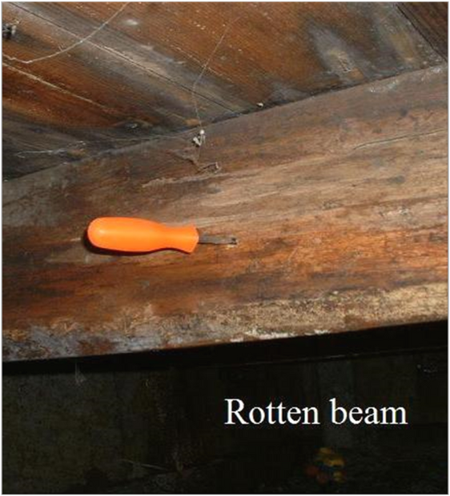
Walk or Run?
Unsound structure?
Run.
If the dwelling is structurally unsound, deferral of weatherization is required.
Photo Courtesy of The US Department of Energy
31
GJA 2025 Version III
Notes:
1.7.2013
The following four slides are intended to be interactive. The goal is for trainees to discern when deferral is at the discretion of the subgrantee (i.e., walk away) versus when deferral is required (i.e., run away).
Click once to reveal the issue with the home.
Click again to reveal whether deferral is an option or is required by the program.
This screwdriver pushed easily through the floor beam in multiple locations, indicating severe structural weaknesses that could pose threats to residents and workers. If it’s an unsound structure, run.
<number>
‹#›

Slide 32

Walk or Run?
Photo Courtesy of lawdogbite.com
Threatening animal?
Walk.
Deferral is up to the local agency when threatening animals are present.
32
GJA 2025 Version III
Notes:
1.7.2013
Click once to reveal the issue: threatening animal.
Q: Is deferral required by the program?
Click again to reveal the answer.
When threatening animals are present, you must decide whether work can proceed. If the animal poses a threat to the safety of weatherization workers, some action must be taken.
You may ask the client to put the threatening animal out of reach of the job site during work. If the client or the animal will not cooperate, you may defer services.
<number>
‹#›

Slide 33
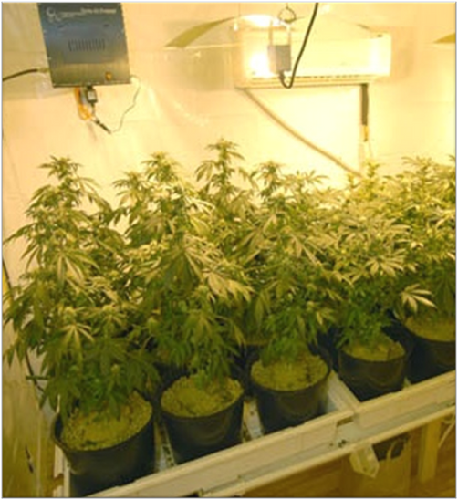
Walk or Run?
Illegal activity?
Walk.
Refusal of services is
up to the discretion of
the subgrantee.
Photo Courtesy of The US Department of Energy
33
GJA 2025 Version III
Notes:
1.7.2013
Click once to reveal the issue: illegal activity.
Q: Is deferral required by the program?
Click again to reveal answer.
If an auditor discovers illegal activities going on at an eligible property, the subgrantee may choose to refuse services.
<number>
‹#›

Slide 34
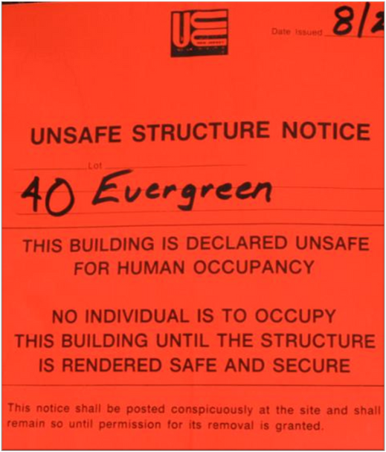
Walk or Run?
Condemned structure?
Run.
DOE funds may not be
spent weatherizing
condemned structures.
Image courtesy of the US Department of Energy
34
GJA 2025 Version III
Notes:
1.7.2013
Click once to reveal the issue: condemned.
Q: Is deferral required by the program?
Click again to reveal answer: Run away–DOE funds may not be spent weatherizing a condemned building.
<number>
‹#›

Slide 35
Deferral Policy Summary
Report to the crew leader any pre-existing conditions that could put occupants and workers at risk. The crew leader can then determine the correct course of action.
    Services may be deferred when:
      Animals or clients are threatening weatherization staff.
      Illegal activities are going on.
      The client refuses certain measures.
    Services must be deferred when:
      The dwelling is vacant, condemned, scheduled for demolition within 12 months, structurally unsafe, or has already been weatherized with DOE funds.
      The client/owner declines all weatherization services.
35
GJA 2025 Version III
Notes:
1.7.2013
Report to the crew leader any pre-existing conditions that could put occupants and workers at risk. The crew leader can then determine the correct course of action.
Services may be deferred when:
Animals or clients are threatening weatherization staff.
Illegal activities are going on.
The client refuses certain measures.
Services must be deferred when:
The dwelling is vacant, condemned, scheduled for demolition within 12 months, structurally unsafe, or has already been weatherized with DOE funds.
The client/owner declines all weatherization services.
<number>
‹#›

Slide 36
Summary
    OSHA regulations are designed to keep workers safe.
    Following EPA guidelines when dealing with hazardous materials protects the health of clients, installers, and their families.
    Keep the MSDS for commonly used materials on hand so emergency workers can react quickly and effectively in the case of an accident.
    Wear appropriate safety equipment to reduce risk
    of injury.
    Provide, maintain, and use personal protective equipment.
    Replace “like” with “like” when repairing power tool cords.
    Know and follow safety regulations.
36
GJA 2025 Version III
Notes:
1.7.2013
OSHA regulations are designed to keep workers safe.
Following EPA guidelines when dealing with hazardous materials protects the health of clients, installers, and their families.
Keep the MSDS for commonly used materials on hand so emergency workers can react quickly and effectively in the case of an accident.
Wear appropriate safety equipment to reduce the risk of injury.
Provide, maintain, and use personal protective equipment.
Replace “like” with “like” when repairing power tool cords.
Know and follow safety regulations.
Present this slide as an interactive discussion, soliciting personal examples from the trainees. Add your own personal examples and knowledge to supplement.
<number>
‹#›

