Slide 1




Zone Pressure Diagnostics
WEATHERIZATION ENERGY AUDITOR SINGLE FAMILY
1
GJA 2024 Version III

Slide 2
Learning Objectives
By attending this session, participants will:
Gain an understanding of the value and limitations of Zone Pressure Diagnostics (ZPD).
Learn when it is best to use zone pressure diagnostics.
Learn how to interpret pressure differences between the house and zone, and zone to outside.
Practice using a blower door, digital manometer and ZPD charts to estimate leakage rates and hole sizes.
2
GJA 2024 Version III
Notes:
By attending this session, participants will:
Gain an understanding of the powers and limitations of zone pressure diagnostics (ZPD).
Learn when it is best to use zone pressure diagnostics.
Practice using ZPD charts.

Slide 3
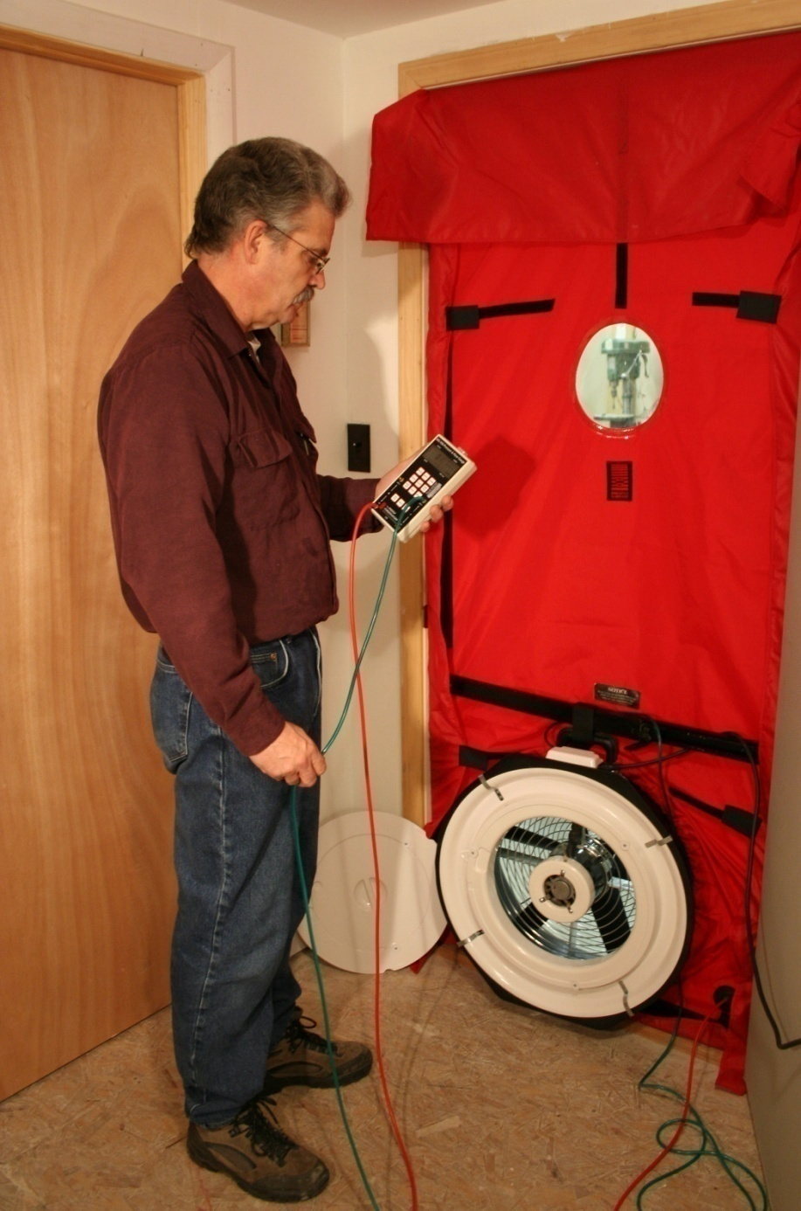
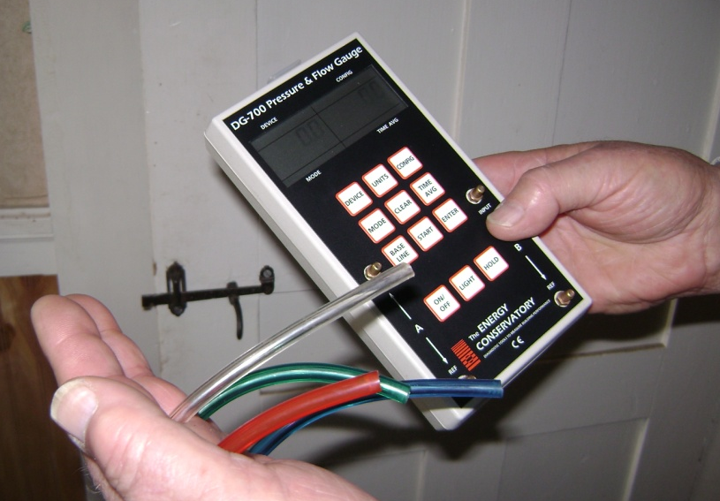
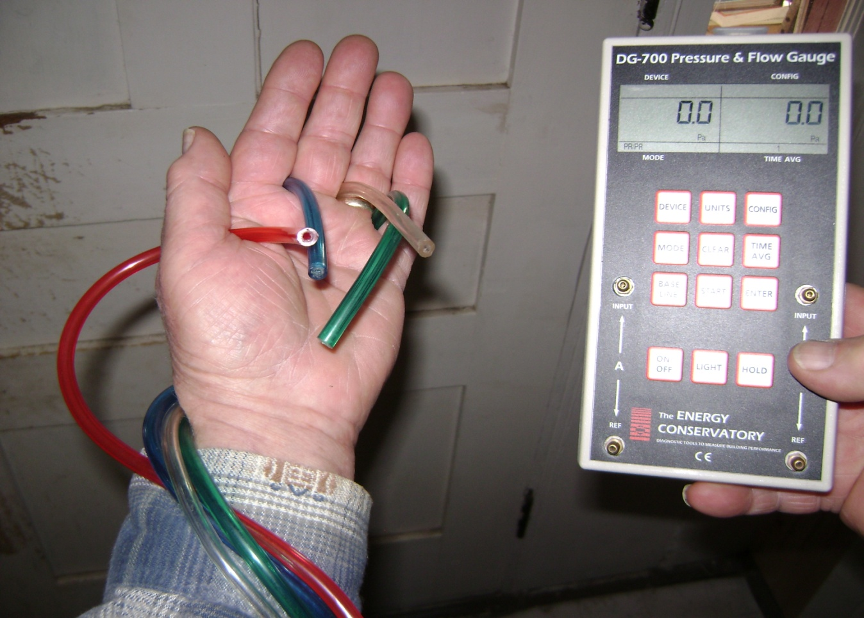
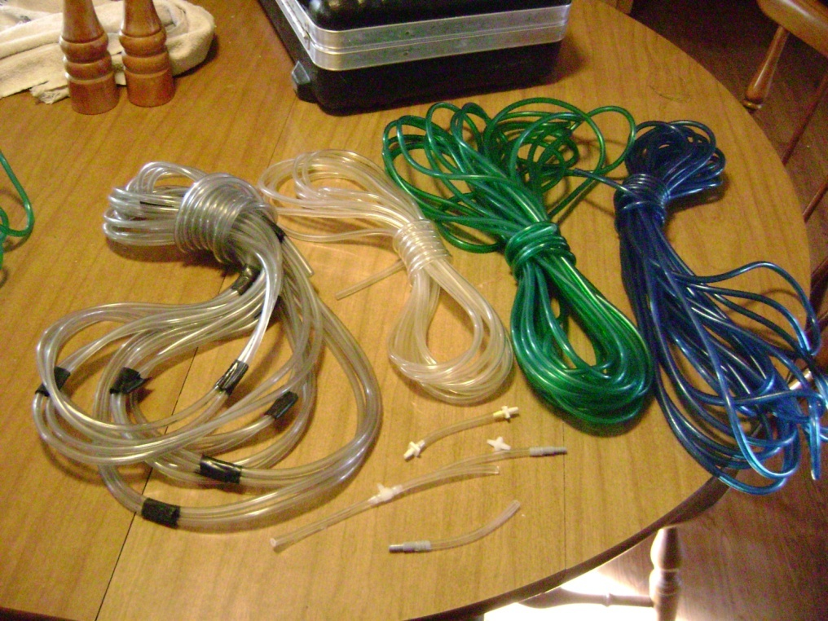
Necessary Equipment
Digital Manometer
Blower Door
ZPD charts
Open a door method
Flow method
For:
1. House to Zone
2. Zone to Outside
measurements
Pressure hoses
Photos courtesy of the US Department of Energy
3
GJA 2024 Version III
Notes:
Blower door.
Manometer.
Various colored 50-ft. hoses.
Hoses run to appropriate zones allow you to remain near your blower door. This can be particularly important if you do not have a cruise control for the machine.
Colored hoses reduce confusion:
Blue = attic.
Green = outdoors.
Red = furnace room.
Clear = other.
Zone Pressure Diagnostics (ZPD) charts and ratio of pressure to leakage chart.

Slide 4
ZPD: Practical Applications
Airseal using Blower door and Pressure gauge.
  Evaluate leakiness between conditioned spaces - HOUSE, unconditioned attached ZONEs, and OUTSIDE.
Determine relative leakiness.
  Higher pressure difference means smaller total hole size.
Prioritize air sealing activities.
  Quickly determine which surfaces are the leakiest.
Evaluate completed air sealing measures.
  Know when your airsealing crew is getting it right.
4
GJA 2024 Version III
Notes:
Use ZPD to:
Determine relative leakiness.
The higher the pressure the smaller the hole.
Prioritize air sealing activities.
Quickly determine which are the leakiest surfaces.
Evaluate completed air sealing measures.
Know if your crew does good work.

Slide 5
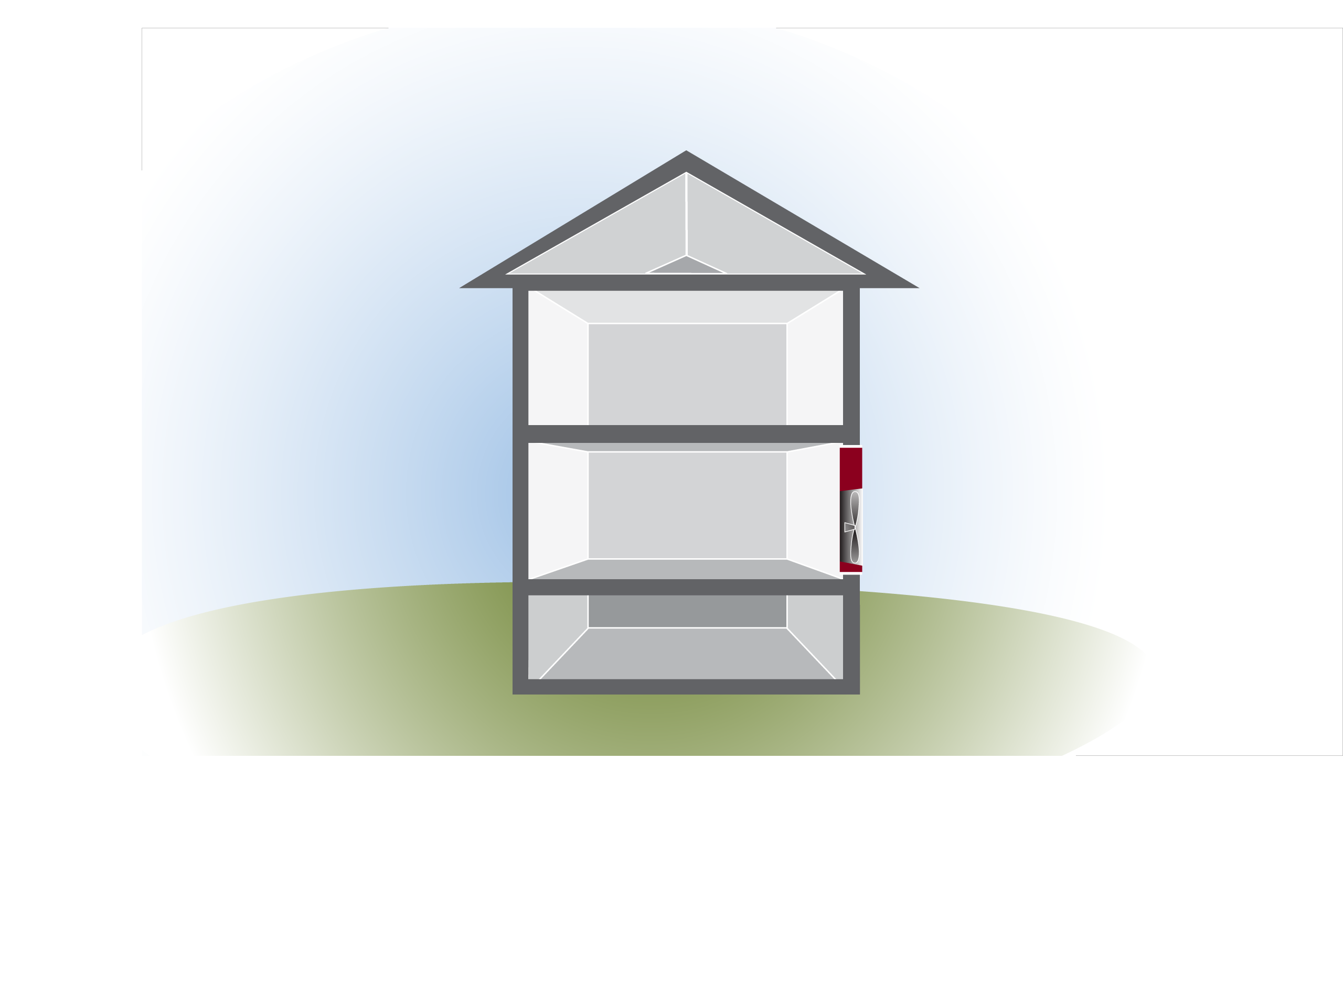
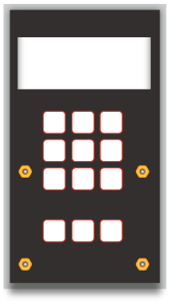
The House wrt Zones and Outside
Outside
THE HOUSE Pressures add up. If the house to outside is 50Pascals, then the pressures from house to zone and from zone to outside add up to 50Pa.
Attic Zone
House
50Pa
House
Basement Zone
5
GJA 2024 Version III
Notes:
Because the pressure between the house and attic is not 50 pascals (Pa), we know the ceiling and the roof both have holes through them.
If the roof were airtight, the pressure across the ceiling would be zero.
If the ceiling were airtight, the pressure would be 50 Pa
If the pressure across the surfaces were equal (25 Pa + 25 Pa), the holes would be equal sizes.
Each surface is resisting its share of the air pressure.
The higher the pressure, the smaller the hole. Therefore, we know the total area of the holes in the higher pressure (more resistant) surface is smaller than the total area of the holes in the lower pressure (less resistant) surface.
Q: Is there a quantifiable relationship?
A: Yes, the pressure drop across each surface is directly proportional to the relative size of the holes in the surfaces.

Slide 6
Relative Leakiness
1850 CFM50
Outside
Pressure: The house
to attic zone = 37Pa
Pressures add up: If the house to outside is 50Pa, then the attic zone to outside is 50Pa-37Pa.
What do the pressures tell us?
How Leaky is the ceiling in relation to the roof?
Attic Zone
? Pa
37Pa
House
50Pa
House
Basement Zone
6
GJA 2024 Version III
Notes:
Because the pressure between the house and attic is not 50 pascals (Pa), we know the ceiling and the roof both have holes through them.
If the roof were airtight, the pressure across the ceiling would be zero.
If the ceiling were airtight, the pressure would be 50 Pa
If the pressure across the surfaces were equal (25 Pa + 25 Pa), the holes would be equal sizes.
Each surface is resisting its share of the air pressure.
The higher the pressure, the smaller the hole. Therefore, we know the total area of the holes in the higher pressure (more resistant) surface is smaller than the total area of the holes in the lower pressure (less resistant) surface.
Q: Is there a quantifiable relationship?
A: Yes, the pressure drop across each surface is directly proportional to the relative size of the holes in the surfaces.

Slide 7
Ratio of Pressure to Leakage
Zone Pressures “Relative” Size of Leaks
House-Zone | Zone-Outside
12 | 38
25 | 25
37 | 13
41 | 9
45 | 5
48 | 2
49 | 1
House-Zone | Zone-Outside
2 | 1
1 | 1
1/2 | 1
1/3 | 1
1/4 | 1
1/8 | 1
1/13 | 1
TO
TO
7
GJA 2024 Version III
Notes:
Find the zone to house pressure in the far left column. Let’s use 37 for this example.
Read to the right to find the size relationship between the holes in the house to the zone air barrier and the holes in the zone to the exterior barrier.
Click to highlight with arrows. A Zone-to-house pressure difference of 35 Pa indicates the ratio of hole size zone-to-house is half that of the hole size zone-to-outside. So the zone is leakier (twice as connected) to the outdoors than to the house.
Q: If the pressure across the ceiling were 45 Pa, what would the relationship be?
Click to show the answer.
A: The total hole area in the ceiling would be a quarter of the total hole area in the roof.
The chart tells us nothing about the actual size of the holes, only the hole-size relationship.
If you know this relationship, a visual inspection of one surface will reveal the amount of hole in the other. (It’s rather subjective.) In this instance, seeing 2 sq. ft. of net free attic venting would indicate a ½ sq. ft. of total hole in the home’s ceiling.

Slide 8
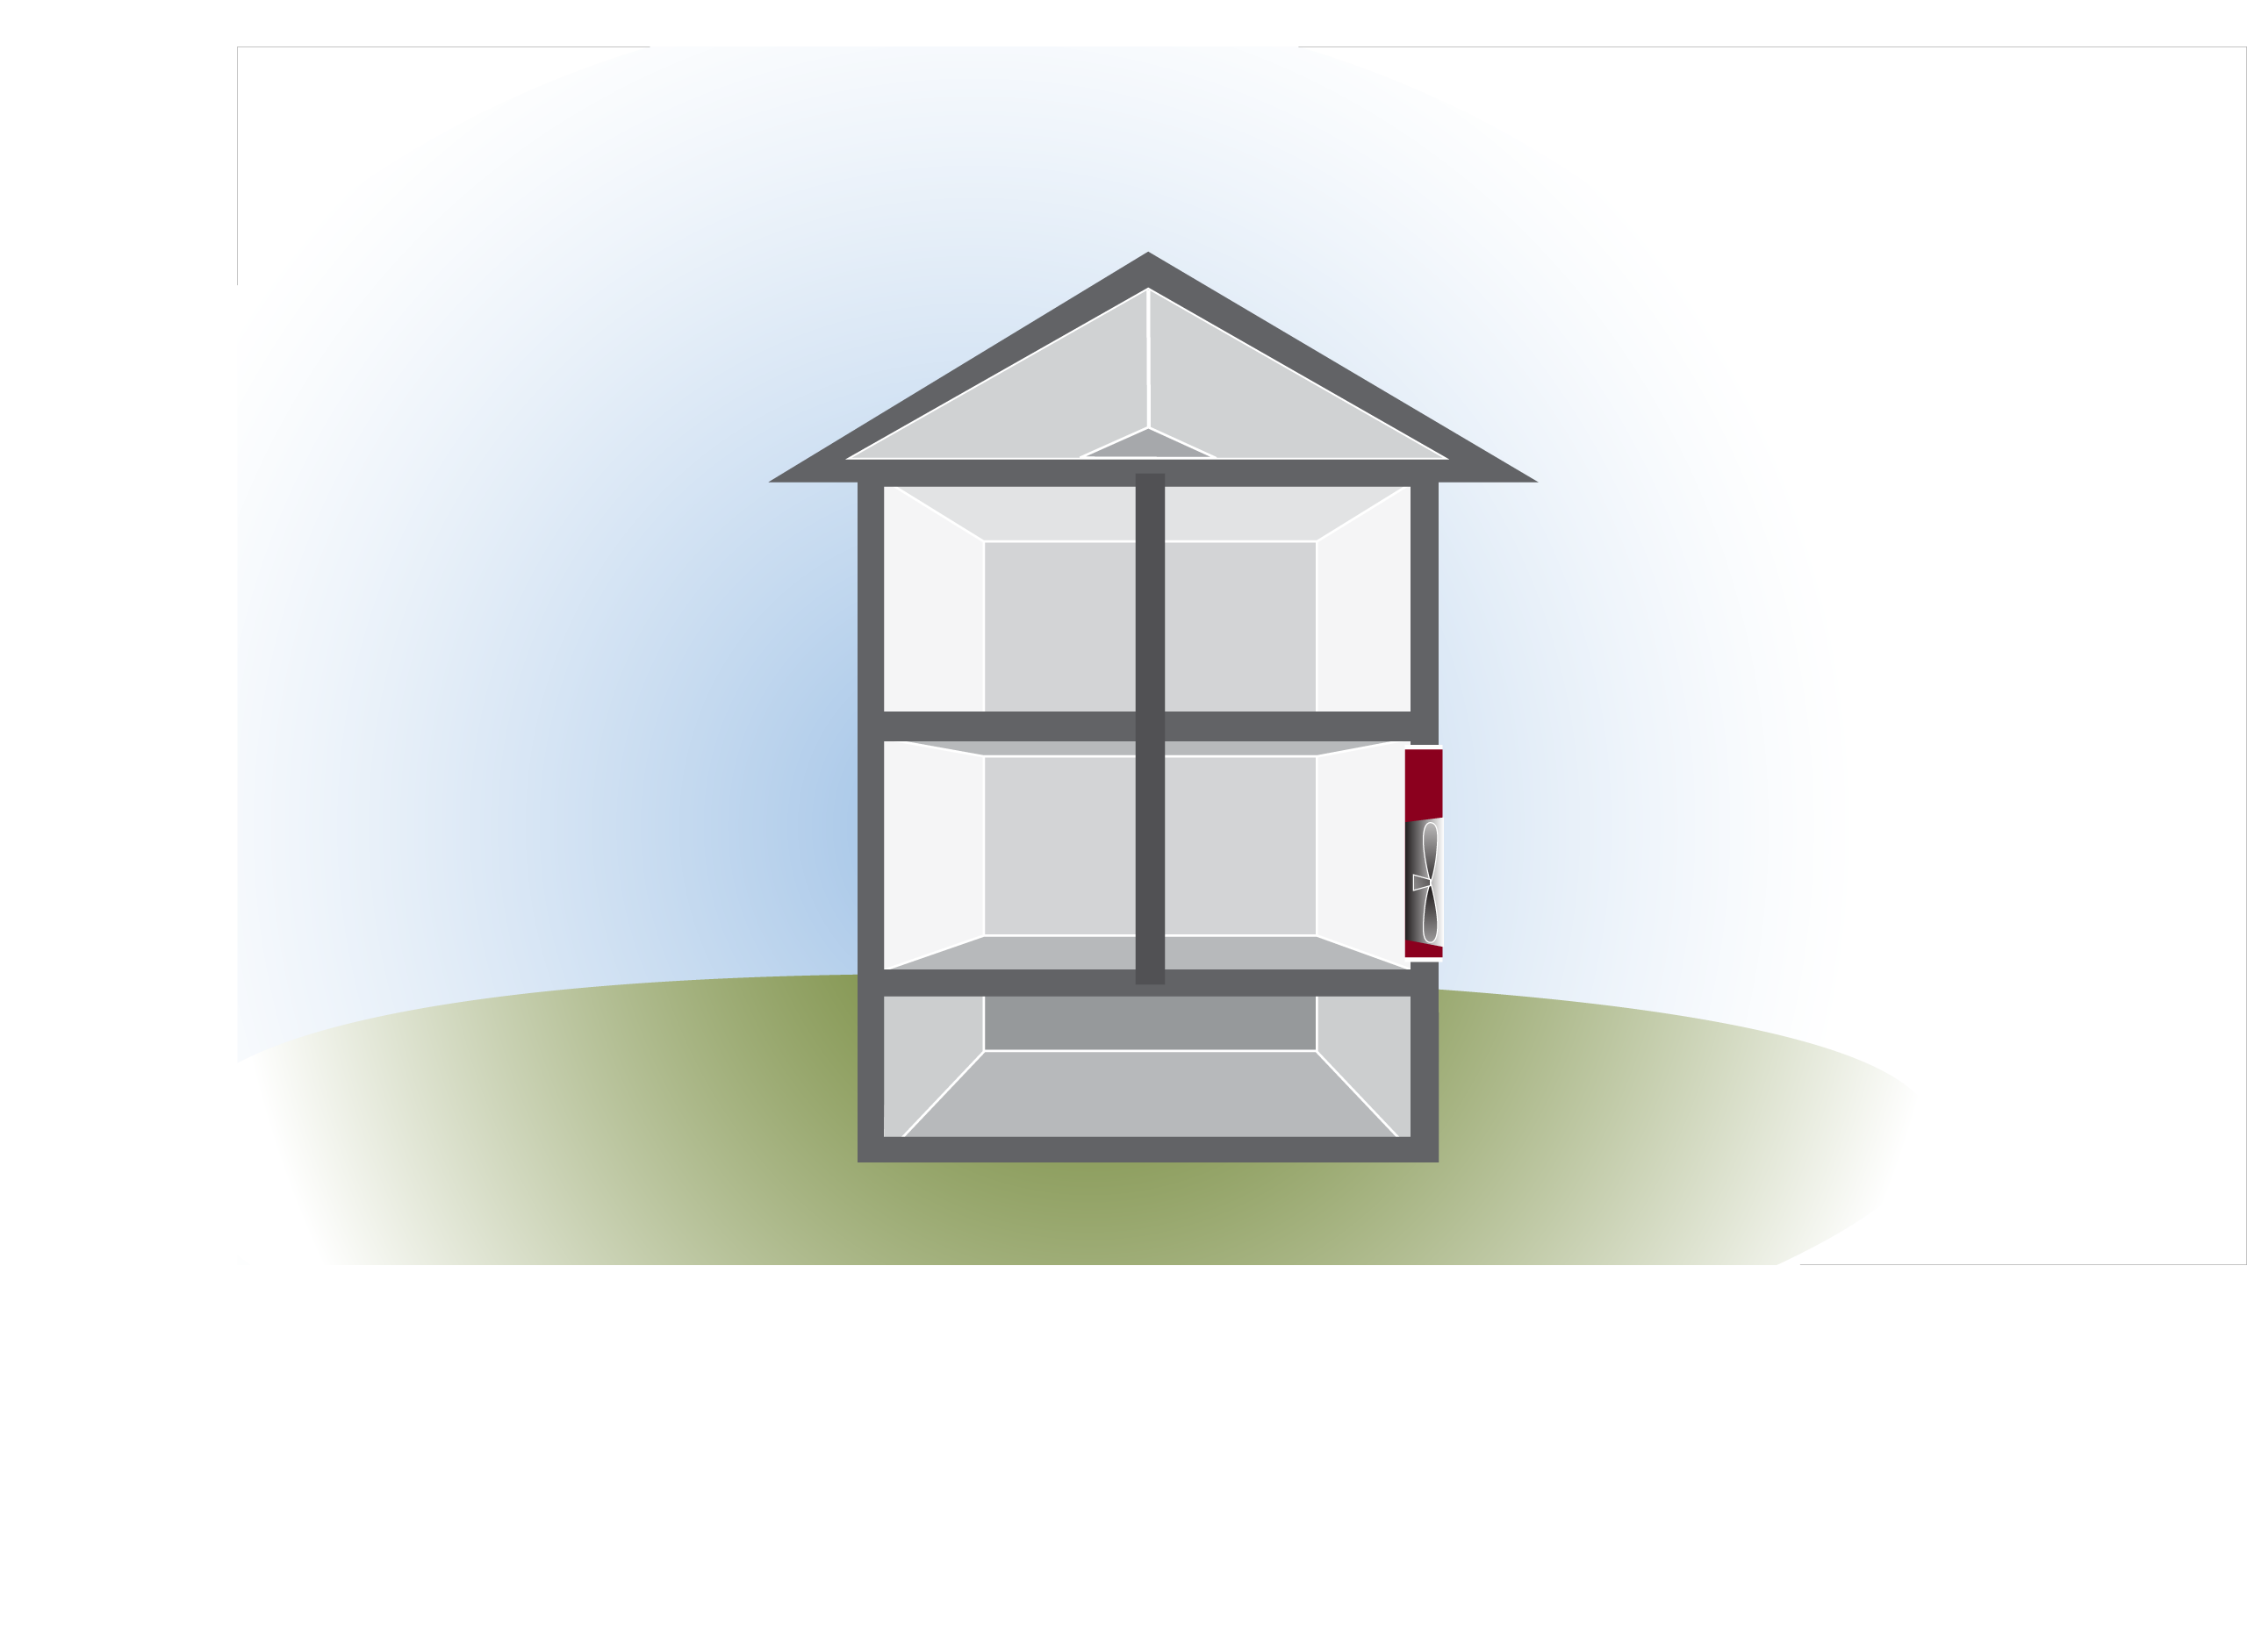
Probing Cavities
Let’s take our house, and put a probe in the basement zone.
Attic
41Pa
37Pa
What does 25Pa mean?
House
50Pa
25Pa
What does it mean if the upstairs floor cavity is 41Pa?
Basement
8
GJA 2024 Version III
Notes:
Taking a few simple pressure measurements can reveal a great deal of information.
A reading of 25 Pa between the basement (zone) and the house indicates the hole area in the floor matches the hole area in the basement walls.
The relationship is 1:1; the total area of hole in the surfaces is the same. Each surface is resisting one-half of the pressure.
A reading of 41 Pa into the floor/ceiling cavity means either the cavity is more connected to the exterior than either the attic or the basement, or (more likely) the attic/basement connection is through interior walls. The walls further restrict the air movement, thereby increasing the pressure.

Slide 9
Open a Door to Change Pressures
If we open the interior basement door, and put a probe in the attic, we might find that the attic has dropped to 25Pa. Why?
25Pa
50Pa
0Pa
The pressure between the house and basement is now zero.
House
Basement
9
GJA 2024 Version III
Notes:
The basement reading goes to zero because we brought the basement inside the air barrier. The air barrier is now the basement walls rather than the house floor.
Q: What does the change in attic pressure when we open the basement door tell us?
A: It tells us the attic is somehow connected to the basement. The attic pressure went down because opening the basement door gave the attic air an easier path to the house, thereby reducing the pressure across the ceiling.
Q: What are likely places for these connections between basement and attic?
A: There are many possibilities:
Chimney chase
Plumbing vent stack chase
Pipe and wire penetrations
Dumbwaiter shafts
Dropped soffits
Wet walls – walls containing plumbing (between the kitchen and bath in newer homes)
Built-ins
and many others
The house CFM₅₀ (cubic feet of air per minute at 50 Pa pressure difference) will change, too.
Q: Why?
A: Opening the basement door removes the house floor from the picture. The tested surface⎯the air barrier⎯is now the basement wall rather than the house floor.
Q: Will the CFM₅₀ go up or down?
A: Up. A partial air barrier⎯the floor⎯has been removed, making the house leakier. The house is now 2,200 CFM₅₀.

Slide 10
Can We Size The Holes?
Do the layers of walls and ceilings between inside and out affect pressures?
25Pa
50Pa
0Pa
Lets see how to use CFM50 and pressure changes to find airsealing and CFM50 goals.
10
GJA 2024 Version III
Notes:
The 50 Pa over the building envelope⎯like the temperature difference⎯is gradually reduced or partly contained by each layer of wall or ceiling between inside and outside.
If the pressure can be changed over one layer, creating a CFM₅₀ and pressure across each surface for each configuration, we can determine the size of the hole in each layer as well as the amount of air moving over the total path at 50 Pa! This also tells us how much CFM₅₀ reduction we can potentially achieve.
We need a chart or a computer.
Refer to the “ZPD Training Worksheet.”
Practitioners often laminate these charts so that they can write on them with an erasable grease pencil, allowing repeated use.

Slide 11
Here’s what we know
1850 CFM50
2200 CFM50
Why Higher CFM50?
> Basement leaky?
> More volume?
> Pressure?
50Pa
50Pa
25Pa
0Pa
25Pa
Basement door closed
50Pa
Basement door open
11
GJA 2024 Version III
Notes:
CFM₅₀ with the basement door closed = 1,850 CFM₅₀
Pressure across the house floor with the basement door closed (house at 50 Pa) = 25 Pa
CFM₅₀ with the basement door open = 2,200 CFM₅₀
Pressure across the house floor with the basement door open (house at 50 Pa) = 0 Pa

Slide 12
Open a Door Method #1 - from House to Zone
25Pa
1850
2200
350
350
2.76
966
97 sq”
350
2.76
966
97 sq”
350
1.76
616 62 sq”
> 616 CFM50 reduction from airsealing basement ceiling
12
GJA 2024 Version III
Notes:
Subtract the door closed CFM₅₀ from the door open CFM₅₀ (top row – calc chart).
Enter the result in the left side blanks of the next three rows.
Read down the far left column of the multiplier chart to find the proper multiplier row.
Read to the right to obtain the multipliers⎯interior, exterior, and total path.
Enter the multipliers in the appropriate row of the calculation chart.
Do the math!

Slide 13
What Do The Results Mean?
H-Z 350 x 2.76 = 966 CFM50 CFM50/10 = 96.6 sq.in. of holes in the floor.
Z-O 350 x 2.76 = 966 CFM50 CFM50/10 = 96.6 sq.in. of
holes in basement walls.
Total Path 350 x 1.76 = 616 CFM50 is the airsealing goal (61.6 sq.in.).
Attic
50Pa
House
50Pa
Basement
13
GJA 2024 Version III
Notes:
The CFM₅₀ for each surface is meaningless but dividing the number by 10 gives the approximate hole in square inches in the surface!
The total path number is the amount of the house CFM₅₀ attributable to losses through the zone. Here, of the 1,850 CFM₅₀ for the entire house, approximately 600 CFM₅₀ is coming through the basement.
If the crew seals every hole in either the house floor or the basement walls, the building CFM₅₀ will drop by approximately 600.

Slide 14
Between the House and Zone?
Outside
Only got a hatch?
With hatch closed, H-Z was 37Pa, and CFM50 = 1850.
Open the hatch - create at least 6Pa difference.
Get blower door back to 50Pa.
The CFM50 is now 2500 and the H-Z changed to 20Pa.
Note: H-Z change is 17 Pa.
Attic Zone
20Pa
House
50Pa
House
Basement or crawl
14
GJA 2024 Version III
Notes:
The attic hatch is often too small to drop the pressure across the ceiling to 0 Pa.
If opening the hatch creates a drop in pressure across the ceiling of at least 6 Pa and if the blower door can be brought back to 50 Pa with the hatch open, there is another method available to calculate the amount of the house’s total CFM₅₀ attributable to losses through the attic.

Slide 15
Flow Method #1: House to Zone (change more than 6Pa).
1850
2500
650
15
GJA 2024 Version III
Notes:
Find the hatch closed pressure in the far right column (click), and the hatch open pressure in the top row.
Click to highlight in the slide.
Follow to the intersection to find the multiplier (1.36).

Slide 16
Flow Method #1: House to Zone (change more than 6Pa).
1850
37Pa
2500
20Pa
650
1.36
884
> 884 CFM50 reduction from airsealing the attic flat
16
GJA 2024 Version III
Notes:
Enter the hatch closed CFM₅₀ in the top blank, the hatch closed pressure in the second blank, the hatch open CFM₅₀ in the third blank, and the hatch open pressure in the fourth blank.
Subtract the hatch closed CFM₅₀ from the hatch open CFM₅₀ and enter the result in the fifth blank.
Enter the chart multiplier in the sixth blank.
Multiply numbers in the fifth and sixth blanks and enter the result in the bottom blank.
This is the total path CFM₅₀ or the amount of the entire house CFM₅₀ that is attributable to the path. That is, of the 1,850 CFM₅₀ for the entire house, approximately 900 CFM₅₀ is coming through the attic.
If the crew seals every hole in either surface, the building CFM₅₀ will drop by approximately 900.
The flow method does not indicate the size of the holes in the tested surfaces.
How accurate are the results? The chart colors indicate degree of accuracy. Note the key in the upper right. (Click to bring in the green arrow.) The numbers in purple are accurate to within 15%.

Slide 17
What did we learn about the leakage in this house?
><
The total leakage between the house and outside is 1850 CFM50:
Of that
Leakage at Attic ≈ 884 CFM50
Leakage at Basement ≈ 616CFM50
Walls (remainder) ≈ 350 CFM50
Attic
Outside
House
50Pa
Basement
17
GJA 2024 Version III
Notes:
Of 1,850 CFM₅₀:
Through attic ≈ 900
Through basement ≈ 600
Walls (remainder) ≈ 350
Q: Does this house need new windows for air sealing?
A: No.
Q: Why not?
A: Air leakage through the walls⎯which include the windows and doors⎯is minimal.
Q: Where should we concentrate our air sealing activities?
A: The attic and then the basement.

Slide 18
Data Collection Procedure
Open a Door method: Two CFM50, One H-Z Pa
First CFM50, and House-Zone Pa.
Open door: House-Zone or Zone-Outside.
Final CFM50, the House-Zone Pa went to 0.
Use the correct chart: either H-Z or Z-O.
Flow method: Two CFM50, Two H-Z Pa
First CFM50, and House-Zone Pa.
Open hatch: House-Zone or Zone-Outside.
Final CFM50, and House-Zone Pa (>6Pa change).
Use the correct chart: either H-Z or Z-O.
18
GJA 2024 Version III
Notes:
By attending this session, participants will:
Gain an understanding of the powers and limitations of zone pressure diagnostics (ZPD).
Learn when it is best to use zone pressure diagnostics.
Practice using ZPD charts.

Slide 19
What if an unconditioned zone is accessible only from outside? For example, the bulkhead.
2000 CFM50
2500 CFM50
50Pa
50Pa
20Pa
50Pa
0Pa!
30Pa
Basement exterior door closed
Basement exterior door open
19
GJA 2024 Version III
Notes:
CFM₅₀ with the basement door closed = 1,850 CFM₅₀
Pressure across the house floor with the basement door closed (house at 50 Pa) = 25 Pa
CFM₅₀ with the basement door open = 2,200 CFM₅₀
Pressure across the house floor with the basement door open (house at 50 Pa) = 0 Pa

Slide 20
Open a Door Method #2 – from Zone to Outside
20Pa
2000
2500
500
20
GJA 2024 Version III
Notes:
Sometimes the only doorway opens to the exterior.
Use the “Open a Door (Zone Pressure - Series Leakage Diagnostics)” chart. The process and results are the same.

Slide 21
Open a Door Method #2 – from Zone to Outside
20Pa
2000
2500
500
500
2.23
1115
112 leakier
500
1.71
855
86 tighter
500
1.23
615 62 sq”
Can we get more than 615 CFM50?
21
GJA 2024 Version III
Notes:
Sometimes the only doorway opens to the exterior.
Use the “Open a Door (Zone Pressure - Series Leakage Diagnostics)” chart. The process and results are the same.

Slide 22
What if an unconditioned zone is only accessible from outside, and has a small opening? Crawl vent
1850 CFM50
1950 CFM50
50Pa
50Pa
30Pa
42Pa
20Pa
8Pa
Crawl exterior vent closed
Crawl exterior vent open
22
GJA 2024 Version III
Notes:
CFM₅₀ with the basement door closed = 1,850 CFM₅₀
Pressure across the house floor with the basement door closed (house at 50 Pa) = 25 Pa
CFM₅₀ with the basement door open = 2,200 CFM₅₀
Pressure across the house floor with the basement door open (house at 50 Pa) = 0 Pa

Slide 23
Flow Method 2: Make a small opening from Zone To Outside.
1850
1950
100
23
GJA 2024 Version III
Notes:
Sometimes the only doorway opens to the exterior.
Use the “Flow Method: Hole Added from Zone to Outside” chart. The process and results are the same.

Slide 24
Flow Method 2: Make a small opening from Zone To Outside.
1850
30Pa
1950
42Pa
100
4.09
409
24
GJA 2024 Version III
Notes:
Sometimes the only doorway opens to the exterior.
Use the “Flow Method: Hole Added from Zone to Outside” chart. The process and results are the same.

Slide 25
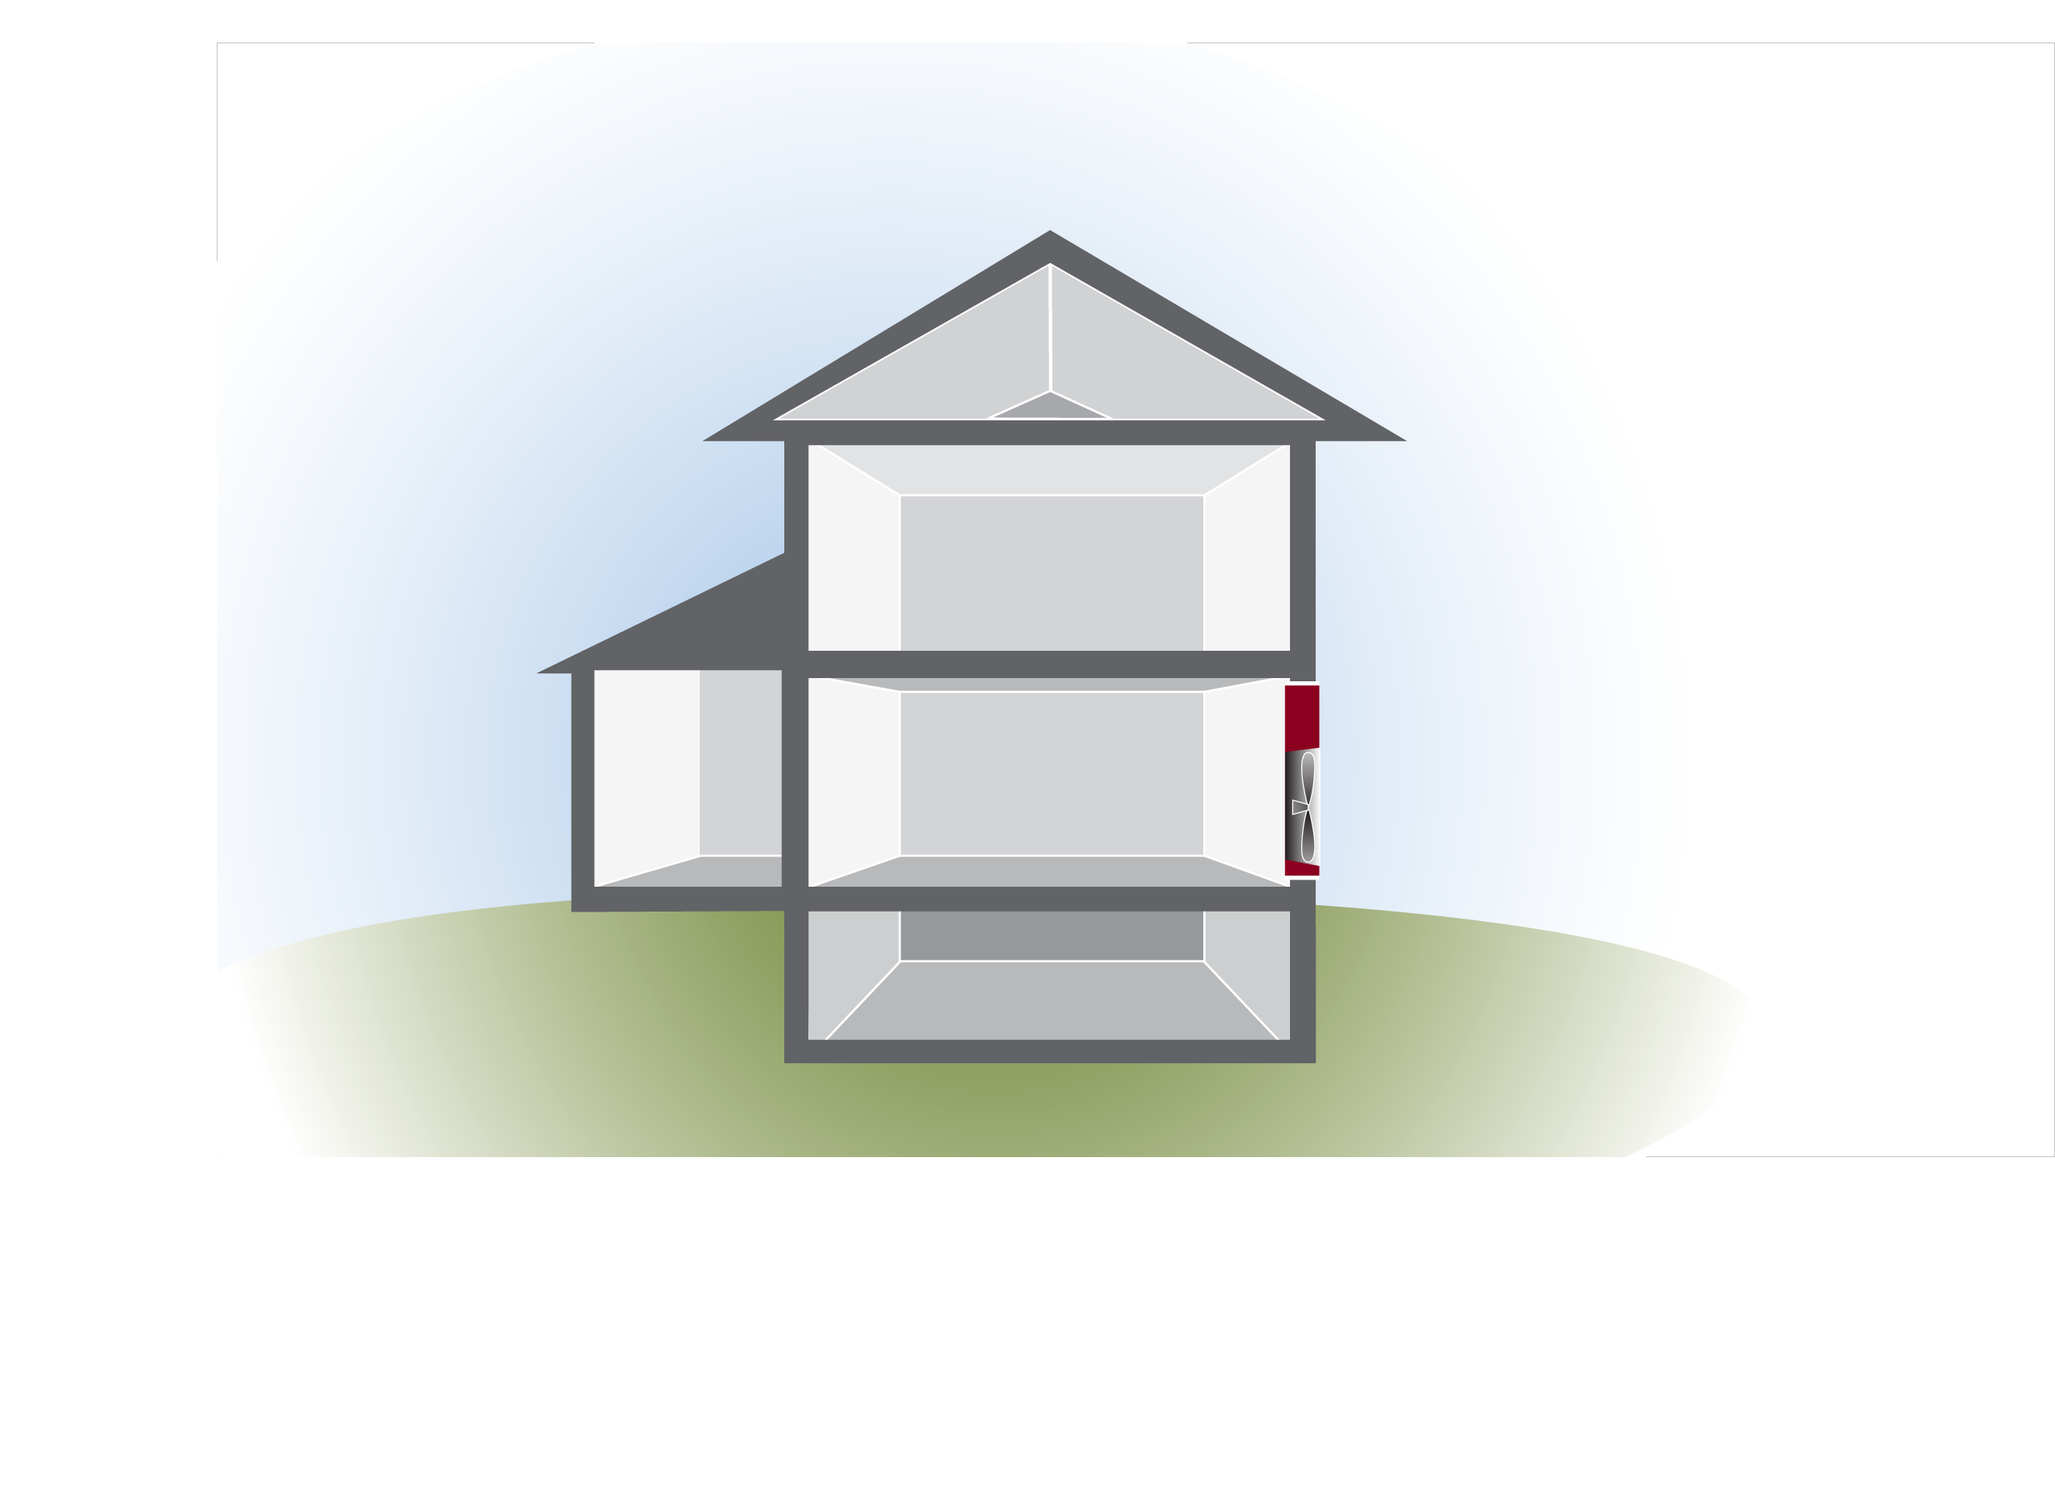
Use ZPD to Check Air Sealing
How about the garage?
Is the house wall properly airsealed?
What do we know about hole sizes?
Where else can you probe leakage here?
ZPD requires being able to change the pressure over a surface to determine its leakage and hole size.
50Pa
2 Pa
48Pa
25
GJA 2024 Version III
Notes:
In the pictured situation with the house at 50 Pa, the garage measures 48 Pa with reference to (WRT) the house.
Q: Can we assume the garage is properly air sealed from the house?
A: No, not without further observation/testing. All the pressure tells us is the relative size of the holes. If the garage door is open, the hole in the house/garage wall is huge.
Q: List other areas where pressure testing could be used to verify air sealing.
A: Chimney and pipe chases, attics from living space, dropped soffits over cabinets.

Slide 26
Ratio of Pressure to Leakage
Zone Pressures “Relative” Size of Leaks
House-Zone | Zone-Outside
12 | 38
25 | 25
37 | 13
41 | 9
45 | 5
48 | 2
49 | 1
House-Zone | Zone-Outside
2 | 1
1 | 1
1/2 | 1
1/3 | 1
1/4 | 1
1/8 | 1
1/13 | 1
26
GJA 2024 Version III
Notes:
Find the zone to house pressure in the far left column. Let’s use 37 for this example.
Read to the right to find the size relationship between the holes in the house to the zone air barrier and the holes in the zone to the exterior barrier.
Click to highlight with arrows. A Zone-to-house pressure difference of 35 Pa indicates the ratio of hole size zone-to-house is half that of the hole size zone-to-outside. So the zone is leakier (twice as connected) to the outdoors than to the house.
Q: If the pressure across the ceiling were 45 Pa, what would the relationship be?
Click to show the answer.
A: The total hole area in the ceiling would be a quarter of the total hole area in the roof.
The chart tells us nothing about the actual size of the holes, only the hole-size relationship.
If you know this relationship, a visual inspection of one surface will reveal the amount of hole in the other. (It’s rather subjective.) In this instance, seeing 2 sq. ft. of net free attic venting would indicate a ½ sq. ft. of total hole in the home’s ceiling.

Slide 27
Limitations of ZPD
Not great in excessively leaky buildings.
ZPD requires being able to change the pressure over the tested surface to determine hole size.
Not great in windy conditions.
May be time consuming.
Can’t use blower door on all buildings.
27
GJA 2024 Version III
Notes:
ZPD does not work well in an excessively leaky building.
The tested building must be tight enough for the blower door to create a 50 Pa pressure difference across the envelope under all test configurations.
You must be able to reach an actual 50 Pa pressure difference; using imputed numbers from can’t reach fifty (CRF) tables will not work.
ZPD requires having the ability to change the pressure over the tested surface in order to determine hole size.
ZPD does not work well under windy conditions.
ZPD can be time consuming. Use it only when the results will provide useful information. For example, if during the audit you observe holes that you will order sealed anyway, using ZPD to size them before they are sealed has no real value. After the work is done, verifying that the sealing worked with ZPD is worthwhile.

Slide 28
Value of ZPD
Determine relative leakiness of surfaces/zones.
Prioritize air sealing activities.
Useful to evaluate the completed air sealing job.
Now you aren’t air sealing blindly.
28
GJA 2024 Version III

Slide 29
Practice!
29
GJA 2024 Version III

Slide 30
Example 1
Which Method?
Open a Door – large opening from H-Z, or Z-Outside (0PA).
or
Flow – small opening from H-Z, or Z-Outside (over 6PA change).
Data: 2,050 CFM50. House in winter mode. H-G = 40PA.
2,550 CFM50 with house door to garage open. H-G = 0PA.
50Pa
Garage
40Pa
? Pa
30
GJA 2024 Version III
Notes:
In the pictured situation with the house at 50 Pa, the garage measures 48 Pa with reference to (WRT) the house.
Q: Can we assume the garage is properly air sealed from the house?
A: No, not without further observation/testing. All the pressure tells us is the relative size of the holes. If the garage door is open, the hole in the house/garage wall is huge.
Q: List other areas where pressure testing could be used to verify air sealing.
A: Chimney and pipe chases, attics from living space, dropped soffits over cabinets.

Slide 31
Open A Door Method #1–House to Zone
Zone Pressure diagnostics
40Pa
2050
2550
500
500
500
500
31
GJA 2024 Version III
Notes:
Hand out the two blank Open a Door charts. Read the four bullets below:
CFM₅₀ door closed = 2,050
Pressure zone WRT main house = 40 Pa
CFM₅₀ door open = 2,550
Pressure zone WRT main house = 0 Pa
Click to bring in the red arrow showing the correct row.
Allow time for the class to find and enter multipliers and do the math before clicking to the next slide.

Slide 32
Open A Door Method # 1 – House to Zone
Zone Pressure diagnostics
40Pa
2050
2550
500
500
0.63
315
31.5 sq”
500
1.54
770
77 sq”
500
0.54
270 CFM50
32
GJA 2024 Version III
Notes:
Discuss the students’ answers. Repeat the exercise with different numbers until students are comfortable with the process.

Slide 33
Example 2:
1200 CFM50
1850 CFM50
50Pa
45Pa
50Pa
18Pa
Crawl hatch
closed
Crawl hatch
open
33
GJA 2024 Version III
Notes:
CFM₅₀ with the basement door closed = 1,850 CFM₅₀
Pressure across the house floor with the basement door closed (house at 50 Pa) = 25 Pa
CFM₅₀ with the basement door open = 2,200 CFM₅₀
Pressure across the house floor with the basement door open (house at 50 Pa) = 0 Pa

Slide 34
Flow Method: House to Zone
1200
45Pa
1850
18Pa
650
34
GJA 2024 Version III
Notes:
Hand out blank Flow Method charts. Read the four bullets below:
CFM₅₀ door closed = 1,200
Pressure zone WRT main house = 45 Pa
CFM₅₀ door open = 1,850
Pressure zone WRT main house = 18 Pa
Allow time for the class to find and enter multipliers and do the math before clicking to show the arrows and multiplier. Be sure all students have the correct multiplier; if not, explain again. If so, click to the next slide.

Slide 35
Flow Method:
Hole – House to Zone
Zone Pressure diagnostics
1200
45Pa
1850
18Pa
650
0.43
280
35
GJA 2024 Version III
Notes:
Discuss the students’ answers.
Discuss the implications:
High pressure across the ceiling with the hatch closed indicates either a well vented attic or minimal holes in the ceiling. (The total ceiling hole area is much less than the total attic to exterior hole area.)
The 280 CFM₅₀ for the total path indicates that approximately one-quarter (280/1,200) of the building air leakage is through the attic.

Slide 36
Summary
ZBD is extremely useful to QUICKLY identify leaky surfaces and prioritize air sealing activities.
ZPD can help you determine the relative leakiness of a home and verify the effectiveness of completed air sealing work.
ZPD requires being able to change and measure pressures over selected surfaces to determine leakage and total hole size.
Leakage can be calculated using charts and a calculator, or a computer app.
ZPD does not work as well in extremely leaky homes or when it’s very windy.
36
GJA 2024 Version III
Notes:
ZPD can help you determine the relative leakiness of a home, prioritize air sealing activities, and evaluate completed air sealing measures.
ZPD requires a computer or charts to do the calculations.
The calculations can be time consuming, so use ZPD only when needed to prioritize or verify critical air sealing activities.
ZPD does not work well in extremely leaky homes or when it’s very windy.
ZPD requires being able to change the pressure over the tested surface to determine hole size.

