Slide 1




CREW LEADER
Effective Crew Management
1
WEATHERIZATION ASSISTANCE PROGRAM STANDARDIZED CURRICULUM – August 2012
GJA 2025 Version III
Notes:
1.7.2013
<number>
August 2012
‹#›

Slide 2
Learning Objectives
By attending this session, participants will be able to:
    List the basic leadership skills needed to effectively manage a crew.
    Summarize the steps in problem solving and the importance of problem-solving skills.
    Demonstrate how to schedule workdays for effective use of time and resources.
    Discuss tips for motivating a crew to work effectively as a team and enjoy doing it.
2
GJA 2025 Version III
Notes:
1.7.2013
By attending this session, participants will be able to:
List the basic leadership skills needed to effectively manage a crew.
Summarize the steps in problem solving and the importance of problem-solving skills.
Demonstrate how to schedule workdays for effective use of time and resources.
Discuss tips for motivating a crew to work effectively as a team and enjoy doing it.
<number>
August 2012
‹#›

Slide 3
Leadership Skills
Leadership skills include:
    Communication/people skills.
    Mentoring/teaching skills.
    Dealing with differences.
    Problem solving.
    Building enthusiasm for work within the team.
    Maintaining team spirit.
3
GJA 2025 Version III
Notes:
1.7.2013
A good crew leader should be a good installer, but a good crew leader must also be a good listener and teacher. Crew leaders must be patient and hardworking, organized, and able to think on their feet. In short, a good crew leader is a good overall leader.
Leadership skills include:
Communication/people skills.
Mentoring/teaching skills.
Dealing with differences.
Problem solving.
Building enthusiasm for work within the team.
Maintaining team spirit.
Q: Are there skills not listed here that help make a good leader?
Collect responses and make a list. Refer to these skills as they relate to topics throughout the presentation.
<number>
August 2012
‹#›

Slide 4
Communication Skills
Proper communication and people skills satisfy the basic needs of all employees.
    Need for respect
        Recognition
        Being heard
    Work/life balance
    Trusting environment
    Autonomy
    Fair compensation
4
GJA 2025 Version III
Notes:
1.7.2013
Proper communication and people skills satisfy the basic needs of all employees.
Need for respect – Everyone wants to be treated with respect. Showing respect is a way to honor differences and protect dignity.
Recognition – Good communication means being able to show appreciation for a job well done.
Being heard – Listening is a greater part of communication than talking. Effective listening helps you learn the motivations and frustrations of your crew.
Work/life balance – Everyone wants to live a balanced and pleasant life. Good communication makes the workday easier and often more fun.
Trusting environment – People work best when they are on a team they can trust. Communication is a big part of trust.
Autonomy – Don’t micro-manage your crew. When a manager tells workers not only what to do but exactly how to do it (e.g., which screwdriver to use, or which hand to use), it takes away their autonomy and creates resentment. Workers need to find their own rhythm of working as it fits within the crew’s rhythm as a team.
Fair compensation – People will work harder if they feel they are being fairly rewarded for their work. Compensation includes more than wages; it can include more flexible hours when needed, extra time off, training that will help them move up in the company, and more. A crew leader with good communication skills will know what motivates individual crew members and what makes them feel that they are being treated fairly.
<number>
August 2012
‹#›

Slide 5
Communication Exercise #1
Effective Listening Exercise
(10 Minutes)
5
GJA 2025 Version III
Notes:
1.7.2013
(Refer to the Lesson Plan for instructions.)
<number>
August 2012
‹#›

Slide 6

Communication Skills
Basics of Communication
Respect
Boundaries
Understanding
6
GJA 2025 Version III
Notes:
1.7.2013
These basics of communication apply to crew interaction as well as interactions with the client:
Basics of communication – More is said than what is spoken.
Respect – Show respect for people and their property.
Boundaries – Understand personal space.
Understanding – Communicate clearly, and be aware of communication barriers.
<number>
August 2012
‹#›

Slide 7

Communication 101
Communication of Feelings and Attitudes
Words (7%)
Body language (55%)
Tone of voice (38%)
Actions speak louder than words
7
GJA 2025 Version III
Notes:
1.7.2013
Our tone of voice, facial expressions, and body language express our feelings and attitudes much more than words.
Words – 7%
Tone – 38%
Body language – 55%
Actions speak louder than words.
<number>
August 2012
‹#›

Slide 8

Respect
Everyone wants to be respected. They want to be:
Listened to
Recognized for achievements
Fairly compensated
Listening to crew members is one way of showing respect while learning of problems before they become too big!
8
GJA 2025 Version III
Notes:
1.7.2013
Everyone wants to be respected. They want to be:
Listened to – Listening to what a person is saying is one of the best ways to show respect. Many people listen with a racing mind, thinking about what they will say when it is their turn to talk instead of really listening to what the other person is saying.
Recognized for achievements – If a crew member improves at a task over time, let him/her know that you’ve noticed.
Fairly compensated – People will work harder if they feel they are fairly compensated for their work. Compensation includes more than wages; it can include more flexible hours when needed, extra time off, training that will help them move up in the company, and more.
<number>
August 2012
‹#›

Slide 9

Boundaries
Personal Space
    Acceptable distance differs widely by culture
    Violating personal
    space is threatening
Image developed for the U.S. DOE WAP National Standardized Curricula
9
GJA 2025 Version III
Notes:
1.7.2013
Personal space – There are distinct zones of comfort based on the type of relationship. Americans are remarkably uniform in their comfort zones.
0 in. to 18 in. – Reserved for intimate and deeply personal relationships.
18 in. to 4 ft. – Personal conversations with friends, family, or associates.
4 ft. to 12 ft. – Formal interactions, like interviews or official meetings.
Acceptable distance differs widely by culture – Pay attention to your crew and clients when you are interacting with them. If they seem uncomfortable or continuously back away, give them some room.
Violating personal space is threatening – Imagine how it would feel if a stranger began poking around in your house. Invading personal space offends the same sense of personal boundaries. Keeping this in mind, you can act as a role model to the crew, showing them how to interact with the clients and how to behave in client homes to avoid causing discomfort.
<number>
August 2012
‹#›

Slide 10
Understanding Each Other
Includes understanding and being understood
Intention: Why are you trying to communicate?
      Getting Answers
      Education
      Know your audience: How do they communicate and learn?
      Use terms they will understand
      Find similarities, honor differences
      Barriers: Are there barriers to effective communication?
      Language
      Culture
      Poor Hearing or Sight
10
GJA 2025 Version III
Notes:
1.7.2013
Clear communication is key to a safe and productive job site.
Intention – Why are you trying to communicate?
Getting answers – Getting accurate answers means asking questions that can be understood. If there are a few different words for the same building component, make sure you are talking about the same thing. Be as clear as possible.
Education – When educating crew on the job, work with their individual learning styles whenever possible. Some people learn best by watching someone else perform a task, then trying it themselves. Others pick things up if you tell them the guidelines and leave them to figure it out on their own. As long as the work is up to program standards, cater to individual learning methods as much as possible.
Know your audience – How does your crew communicate and learn?
Use terms they will understand. A new crew coming from the building industry might use different terminology. For example, the part of the roof framing that some call a “purlin” is referred to as “skip sheathing” in certain regions.
Find similarities and honor differences. Find the qualities you can relate to, but don’t ignore differences.
Barriers – Are there barriers to effective communication?
Language – Do you speak the same language?
Culture – Cultural norms vary widely. The thumb-forefinger circle we use in the U.S. to indicate “A-Okay” is a vulgar sign in some parts of Europe, equivalent to flipping the middle finger here.
Poor hearing or sight – Sometimes it isn’t obvious that a person is losing hearing or sight. This can be a major barrier to communication if you don’t realize the cause of repeated questions and misunderstandings.
<number>
August 2012
‹#›

Slide 11
Communication Exercise #2
Communicating a Message Exercise
(20 Minutes)
11
GJA 2025 Version III
Notes:
1.7.2013
(Refer to the Lesson Plan for instructions.)
<number>
August 2012
‹#›

Slide 12
People Skills
What are “people skills”?
    Communication skills
    Tact
    Acceptance of differences
    Humor
    Curiosity
    Good listening skills
    Others?
12
GJA 2025 Version III
Notes:
1.7.2013
Q: What are “people skills”? (Before clicking ahead on this slide, have students define what they think is meant by the term “people skills.”)
A: Some acceptable answers are:
The ability to relate to others.
Getting along with others.
Being liked/admired by others.
Working well as part of a team.
Click to reveal the list of specific skills on the slide and have students list other things they think of. Keep a list on the board, a flip chart, or overhead.
Q: Can anyone name other things they consider to be people skills?
Keep a list of ideas. Ask participants what qualities they like in a person. Do these fall in the categories listed above?
Ask students to think about which of those skills they possess (their strengths) and which ones they could improve upon (their weaknesses).
<number>
August 2012
‹#›

Slide 13
Mentoring
A crew leader with good mentoring skills meets the basic needs of employees to grow and learn.
    Increase knowledge
    Gain valuable skills
    Explore and improve personal strengths
13
GJA 2025 Version III
Notes:
1.7.2013
A crew leader with good mentoring skills meets the basic needs of employees to grow and learn. Every employee wants to:
Increase knowledge – Knowing why we install the measures we do, why we do things in a specific order, and other reasons behind the work makes it easier for a crew to do a good job the first time and avoid re-work.
Gain valuable skills – Crew members are typically much more motivated to show up for work every day if they know they won’t be stuck doing the same task day in and day out. Letting crew try their hands at various tasks also allows them to find something they particularly enjoy doing.
Explore and improve personal strengths – Once a worker finds something he/she enjoys doing, it’s important to let him/her explore that aspect of the job. Today’s insulator might be tomorrow’s HVAC specialist.
<number>
August 2012
‹#›

Slide 14








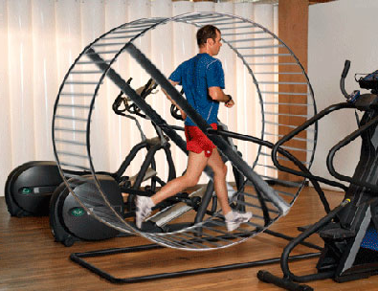

Importance of Mentoring
Without a mentor to improve their skills,
workers may feel like they’re running in place.
I’m working hard, but I’m not getting anywhere.
This is hard work, but I’m really going places!
Image source: www.forum.thefreedictionary.com
Image source: wallpapers.pixxsp.com
Without a mentor
With a mentor
14
GJA 2025 Version III
Notes:
1.7.2013
Without a mentor to improve their skills, workers may feel like they’re running in place.
Ask students if they agree or disagree.
<number>
‹#›

Slide 15
What Makes a Good Mentor?
    Trustworthiness
    Interested in others
    Advocacy for crew members
    Experience
    Seen as a role model
    Views the big picture
    Others?
15
GJA 2025 Version III
Notes:
1.7.2013
Click to reveal these traits in order:
Trustworthiness – Employees need to feel they can count on you to help them if there’s a problem, rather than criticizing them.
Interested in others – If you are interested in the progress of your employees, they will be, too.
Advocacy for crew members – The crew leader is often the liaison between the installers and management. Your crew should know you are fairly representing them and the work they do to the higher-ups.
Experience – A mentor is someone you can learn from.
Seen as a role model – The best leaders make those around them want to emulate their good habits. It’s also often easier to show people how to do something than to try to explain with words.
Views the big picture – Keeping the big picture in mind helps you avoid being caught unprepared and helps inform decisions you may need to make on the fly. It can take the sting out of those long, hard workdays when you remember the families your work is helping.
Others?
Q: Does anyone remember a mentor they’ve had, maybe from school or your first job? What was it about that person that you admired?
<number>
August 2012
‹#›

Slide 16
Mentoring Exercise #3
Mentoring Scenarios Exercise
(30 minutes)
16
GJA 2025 Version III
Notes:
1.7.2013
(Refer to the Lesson Plan and Mentoring Exercise Scenarios handout.)
<number>
August 2012
‹#›

Slide 17
Dealing with Differences
Honor differences
    Of opinion
    Of culture
    In general
Conflict resolution
    Acknowledge
    Discover root cause
    Solution
17
GJA 2025 Version III
Notes:
1.7.2013
Dealing with conflicts that arise on the job between crew members or between management and crew can be tricky. Honoring people’s differences and practicing the skills of conflict resolution make it a little easier.
Honor differences – Variety is the spice of life. We all have different backgrounds that make us who we are. A lot of conflict can be avoided by honoring all types of differences:
Of opinion.
Of culture.
In general.
Conflict resolution – Not all conflict is bad, but it’s almost always uncomfortable. Working through conflicts that arise on the job site can create a real sense of camaraderie. The steps for conflict resolution are:
Acknowledge – Admit that there is something going on, and address conflict as soon as you realize it’s there. Don’t let conflict simmer until it reaches a boiling point.
Discover the root cause – Often, what appears to be the problem may be the symptom of a deeper conflict. Talk to your crew individually to find out what is really causing tension.
Solution – Once you have found the root cause, determine a solution and try it out.
<number>
August 2012
‹#›

Slide 18
Problem Solving
    Identify the problem.
    Gather information.
    Consider your options.
    Implement the solution.
    Evaluate: Did it work?
18
GJA 2025 Version III
Notes:
1.7.2013
Problem solving uses the same basic principles as conflict resolution. The steps of all problem solving—whether it is a long-term, large-scale problem or an on-the-job, lightning decision—are:
Identify the problem.
Gather information.
Consider your options.
Implement the solution.
Evaluate: Did it work?
Problem-Solving Example:
Begin by identifying the problem. For example, if the crew arrives late to the job site because the engine of the crew truck overheats occasionally, is the problem that the crew is unmotivated or that the crew leader should have a vehicle maintenance schedule in place to avoid engine meltdown? Does the crew need a new truck? You can’t solve the problem until you know the root cause.
<number>
August 2012
‹#›

Slide 19
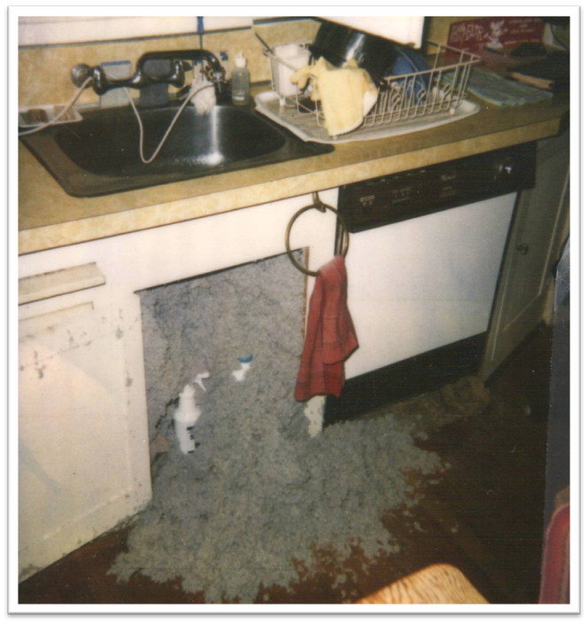
Identify the Problem
    Blower pressure too high?
    Weak original construction?
    Incomplete inspection prior to blow-in?
    Lack of checking?
Photo courtesy of Chris Clay, Building Performance Center
19
GJA 2025 Version III
Notes:
1.7.2013
Q: What is the problem in this situation?
A: It’s hard to tell without gathering more information. It could be any of the following:
Blower pressure too high?
Weak original construction?
Incomplete inspection prior to blow-in?
Lack of checking?
When identifying or defining the problem, it can be helpful to consider these questions:
What is the problem exactly?
Is it my problem?
Is this the real problem, or merely a symptom of a larger one?
If this is an old problem, what's wrong with the previous solution?
Does it need an immediate solution, or can it wait?
Is it likely to go away by itself?
Can I risk ignoring it?
<number>
August 2012
‹#›

Slide 20

Gather Information
    Who does it affect?
    What are the facts?
    Boundaries/limitations
    Opinions/assumptions
20
GJA 2025 Version III
Notes:
1.7.2013
Who does it affect?
What are the facts?
Boundaries/limitations – Are there boundaries/limitations to possible solutions? Money for new equipment? Vacation coming up?
Opinions/Assumptions – Do management priorities align with what you would recommend as the best solution for the crew? Are there assumptions you need to overcome or can’t possibly overcome?
<number>
August 2012
‹#›

Slide 21

Weigh the Options
    Brainstorm.
    Weigh the options. Are they:
      Practical?
      Ethical?
      Feasible?
      Flexible?
    What does your gut tell you?
21
GJA 2025 Version III
Notes:
1.7.2013
Brainstorm various solutions.
Weigh these options based on their suitability. Is the option:
Practical?
Ethical?
Feasible? Do you have the means to make it happen?
Flexible? Can you adapt to changes once you’ve put the solution in motion?
Finally, what does your gut tell you?
<number>
August 2012
‹#›

Slide 22
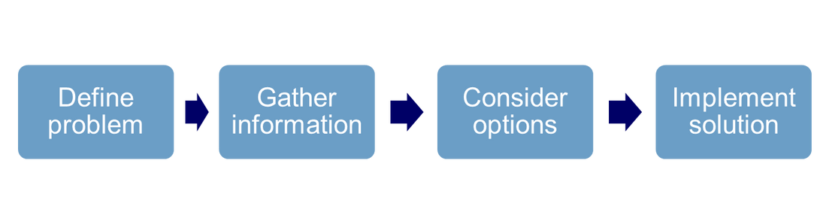
Problem-Solving Exercise #4
Problem-Solving Exercise
(30 minutes)
22
GJA 2025 Version III
Notes:
1.7.2013
(Refer to the Lesson Plan for instructions.)
Work through the process of problem solving while stressing that it is not a linear process. We are continually gathering more information, assessing the status, and adjusting solutions accordingly.
<number>
August 2012
‹#›

Slide 23

EFFECTIVE CREW MANAGEMENT
Measures of Success
    Did it work?
    Did you give it your best?
    Did your problem-solving efforts hit the nail on the head…
    Or leave elephant tracks?
Image source: www.huchhufflaw.com
23
GJA 2025 Version III
Notes:
1.7.2013
Evaluating your past efforts helps you improve. Measures of success are quite simple.
Did it work?
Did you give it your best?
<number>
August 2012
‹#›

Slide 24
Scheduling Work
Company Goals
    Adequate production
    Timely completion
    Quality work
Individual Goals
    Variety of tasks
    Autonomy
    Challenged
    Recognized/Appreciated
Make sure to align company and individual goals.
24
GJA 2025 Version III
Notes:
1.7.2013
When scheduling, the crew leader must meet the needs of the company while also considering the needs of the crew.
The company’s goals are usually:
Adequate production.
Timely completion.
Quality work.
Everyone is different, but most individuals thrive in working conditions in which:
There are a variety of tasks.
People feel they have autonomy.
People feel challenged.
Crew members receive recognition/appreciation for their work.
A good crew leader aligns company and individual goals.
<number>
August 2012
‹#›

Slide 25
Scheduling Exercise #5
Sample Work Order Scheduling Exercise
(30 minutes)
25
GJA 2025 Version III
Notes:
1.7.2013
(Refer to the Lesson Plan for instructions.)
<number>
August 2012
‹#›

Slide 26
Scheduling Exercise Discussion
Are you:
    Providing installers with variety and autonomy?
    Allowing for flexibility?
    Providing for real-time quality assurance?
26
GJA 2025 Version III
Notes:
1.7.2013
Did the resulting schedules:
Provide installers with variety and autonomy?
Allow for flexibility?
Provide for real-time quality assurance?
Have a class discussion about the challenges in achieving these three goals.
<number>
August 2012
‹#›

Slide 27
Build Enthusiasm for the Work
Mission of the Weatherization
Assistance Program
To reduce energy costs for low-income
families, particularly for the elderly, people
with disabilities, and people with children, while
ensuring their health and safety.
27
GJA 2025 Version III
Notes:
1.7.2013
Most people want to feel the work they are doing is meaningful (beyond bringing home a paycheck). Occasionally remind your crew of the mission of the WAP:
To reduce energy costs for low-income families, particularly for the elderly, people with disabilities, and people with children, while ensuring their health and safety.
This is part of keeping the big picture in mind.
<number>
August 2012
‹#›

Slide 28
Motivate Individuals and Team
How are your motivational skills?
Motivational Skills Quiz and Discussion
(45 minutes)
28
GJA 2025 Version III
Notes:
1.7.2013
(Refer to the Lesson Plan and Motivational Skills Quiz for instructions.)
Go to next slide for visual reminders while conducting the discussion part of this exercise.
<number>
August 2012
‹#›

Slide 29
Motivational Skills Discussion
Provide productive, challenging work
    Variety, autonomy, well organized, well equipped
    Set effective goals
    SMART, reasonably challenging expectations
    Understand individual motivations
    Knowing your crew, effective listening
    Provide rewards and recognition
    Encouragement, appreciation, fairness
29
GJA 2025 Version III
Notes:
1.7.2013
To motivate the crew, an effective crew leader should:
Provide productive, challenging work.
Variety, autonomy, well organized, well equipped.
Set effective goals.
SMART (SMART = Specific, Measurable, Attainable, Relevant, Time-bound), reasonably challenging expectations.
Understand individual motivations.
Knowing your crew, effective listening.
Provide rewards and recognition.
Encouragement, appreciation, fairness.
Refer to the Lesson Plan for guidance on leading the discussion.
<number>
August 2012
‹#›

Slide 30
Addressing Poor Performance
Performance = Motivation x Ability
Motivation
    Goals
    Assistance
    Feedback
Ability
    Providing Resources
    Training
    Reorganizing jobs
    Finding new job niche
    Releasing (last resort)
30
GJA 2025 Version III
Notes:
1.7.2013
When it comes to addressing poor performance on the job, understanding the factors influencing performance can help.
Performance = Motivation x Ability
Motivation requires:
Goals
Assistance
Feedback
If lack of motivation is the problem, solutions can include setting more effective goals, and providing additional assistance and feedback. Any time compensation can be directly linked to job performance, motivation will rarely be an issue.
If a lack of ability is the problem, there are many options:
Resources – Make sure the crew has the right tools for the job.
Training – Arrange for additional training on the specific tasks that need to be addressed.
Reorganize the job – Assign two workers instead of one, and assign tasks to the crew member that is best suited to the work. For example, if you would normally have one installer air seal the attic, but your crew member can’t make a proper can light cover, assign a second installer to address those kinds of specialty issues and to train the first installer if appropriate.
Find a new job niche – Determine what crew members are good at, and organize the workflow so they can contribute to the job effectively.
Release – As a last resort, it may be necessary to let an employee go.
<number>
August 2012
‹#›

Slide 31
Summary
    A good crew leader is a good installer but, more importantly, he/she is a good leader.
    Communicating, teaching, and problem solving are all part of the job.
    The first step to solving a problem is identifying the root cause.
    Provide variety, challenge, and autonomy at work.
    Create an organized, fair workplace and learn what motivates individuals to create an effective team.
31
GJA 2025 Version III
Notes:
1.7.2013
A good crew leader is a good installer, but more importantly, a good leader.
Communicating, teaching, and problem solving are all part of the job.
The first step to solving a problem is identifying the root cause. The last step is following up to determine if your solutions worked and considering why or why not.
Provide variety, challenge, and autonomy at work.
Create an organized, fair workplace and learn what motivates individuals to create an effective team.
Present this slide as an interactive discussion, soliciting personal examples from the trainees. Add your own personal examples and knowledge to supplement.
<number>
August 2012
‹#›

