Slide 1
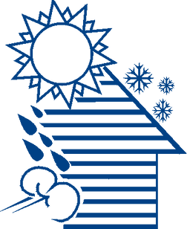


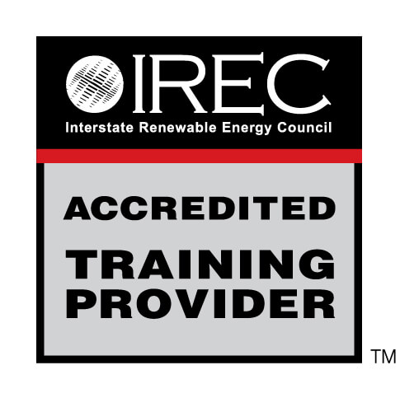
Electrical Safety in the Home
WEATHERIZATION INSTALLER/TECHNICIAN FUNDAMENTALS
1
GJA 2025 Version III
Notes:
<number>
July 2012

Slide 2
Learning Objectives
By attending this session, participants will be able to:
  Cite codes and rules related to electrical safety that affect weatherization activities.
  Define common electrical terminology.
  Identify common electrical safety hazards in homes.
  State practical solutions to electrical code issues and express when to notify the proper authority.
2
GJA 2025 Version III
Notes:
By attending this session, participants will be able to:
Cite codes and rules related to electrical safety that affect weatherization activities.
Define common electrical terminology.
Identify common electrical safety hazards in homes.
Learn about practical solutions to electrical code issues and notifying the proper authority.
Present this slide as an interactive discussion, soliciting personal examples from the trainees. Add your own personal examples and knowledge to supplement.
<number>
July 2012

Slide 3
The Danger
  An average of one person is electrocuted in the home every 36 hours.
  Electrical incidents are far more likely to be fatal than other types.
  There are four main types of electrical injuries:
    Electrocution (death due to electrical shock)
    Electrical shock
    Burns
    Falls
Courtesy of EFCOG Electrical Improvement Project
3
GJA 2025 Version III
Notes:
This module addresses OSHA’s General Industry electrical standards contained in 29 CFR 1910 Subpart S. OSHA also has electrical standards for construction and maritime, but recommends that employers in these industries follow the general industry electrical standards whenever possible for hazards that are not addressed by their industry-specific standards.
Suitability of electrical equipment for an identified purpose may be evidenced by listing or labeling by a nationally recognized testing laboratory which makes periodic inspections of equipment production and states that such equipment meets nationally recognized standards or tests to determine safe use in a specified manner.
The Lockout/Tagout (LOTO) standard, 29 CFR 1910.147, is not covered in this presentation. However, you can find information on the Lockout-Tagout Interactive Training Program under “OSHA Advisors” on the OSHA web site, www.osha.gov.
Electricity is one of the most common causes of fire in homes and workplaces. Explosions have also resulted from electrical sources.
<number>
July 2012

Slide 4
Electrical Terminology
  Current – the movement of electrical charge
  Resistance – opposition to current flow
  Voltage – a measure of electrical force
  Conductors – substances, such as metals, that have low resistance to electricity
  Insulators – substances, such as wood, rubber, glass, and bakelite, that have high resistance to electricity
  Grounding – a conductive connection to the earth which acts as a protective measure
Courtesy of EFCOG Electrical Improvement Project
4
GJA 2025 Version III
Notes:
Operating an electric switch is like turning on a water faucet. Behind the faucet or switch there must be a source of water or electricity with something to transport it and with a force to make it flow. In the case of water, the source is a reservoir or pumping station; the transportation is through pipes; and the force to make it flow is provided by a pump. For electricity, the source is the power generating station; current travels through electric conductors (wires); and the force to make it flow is voltage. Voltage is measured in volts and is provided by a generator.
Resistance
Dry skin has a fairly high resistance, but when moist, resistance drops radically, making it a good conductor.
Measured in ohms.
Use extra caution when working with electricity when water is present in the environment or on the skin. Pure water is a poor conductor, but small amounts of impurities, such as salt and acid (both are contained in perspiration), make water a good conductor.
Source: EFCOG Electrical Improvement Project
<number>
July 2012

Slide 5
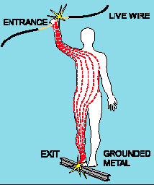
Electrical Shock
  Received when current passes through the body
  Severity of the shock depends on:
    Path of current through the body
    Amount of current flowing through the body
    Length of time the body is in the circuit
Graphic courtesy of EFCOG Electrical Improvement Project
5
GJA 2025 Version III
Notes:
A small current that passes through the trunk of the body (heart and lungs) is capable of causing severe injury or electrocution. Low voltages can be extremely dangerous because, all other factors being equal, the degree of injury increases the longer the body is in contact with the circuit.
Source: EFCOG Electrical Improvement Project
<number>
July 2012

Slide 6
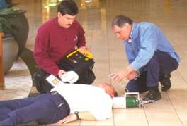
Dangers of Electrical Shock
  Even small currents are dangerous.
  Deadly if there is no defibrillator to use.
  It takes 30 times less current than a small power drill uses to stop your heart from working properly!
Defibrillator in use
Image courtesy of EFCOG Electrical Improvement Project
6
GJA 2025 Version III
Notes:
Currents greater than 75 mA* can cause rapid, ineffective heartbeat, also known as ventricular fibrillation.
This will cause death in a few minutes unless a defibrillator is used.
75 mA is not much current. A small power drill uses 30 times as much.
* mA = milliampere = 1/1,000 of an ampere
<number>
July 2012

Slide 7
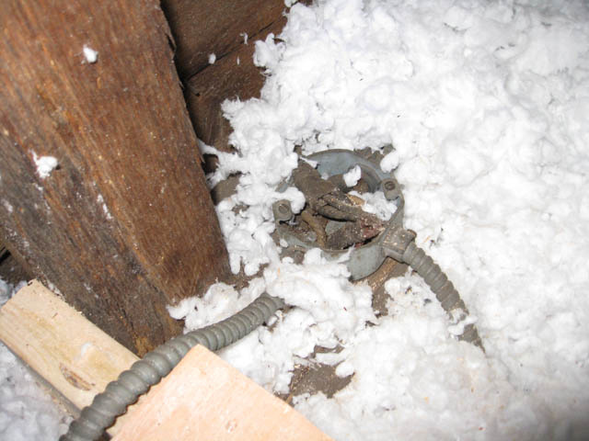
Recognizing Electrical Hazards
Photo courtesy of US Department of Energy
Open Junction Box
7
GJA 2025 Version III
Notes:
Protect all open junctions with code-compliant covers prior to installing insulation. Do not remove or open receptacle covers, switch plates, or covers of electrical equipment unless qualified and authorized.
<number>
July 2012

Slide 8
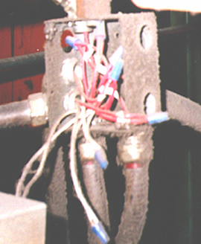
Recognizing Electrical Hazards
  Junction boxes, pull boxes, and fittings must have approved covers in place.
  Approved covers on boxes
  No missing knockouts
Image courtesy of EFCOG Electrical Improvement Project
Does this meet the requirements for safety?
8
GJA 2025 Version III
Notes:
Junction boxes, pull boxes, and fittings must have approved covers in place.
Unused openings in cabinets, boxes, and fittings must be closed (no missing knockouts).
This photo shows violations of these two requirements.
Report this situation to the crew chief.
Ask students what is wrong with the photo in the slide.
A: It is missing knockouts and an approved cover.
<number>
July 2012

Slide 9
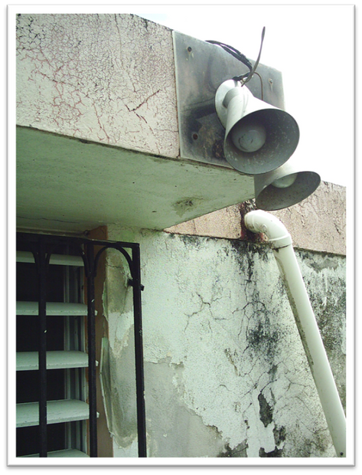
Recognizing Electrical Hazards
Wiring frayed and taped at outdoor fixture
Photo Courtesy of US Department of Energy
9
GJA 2025 Version III
Notes:
This wiring is frayed and taped at an outdoor fixture.
Q: Why is this a problem?
A: Frayed wire could cause a short circuit and lead to a fire.
<number>
July 2012

Slide 10
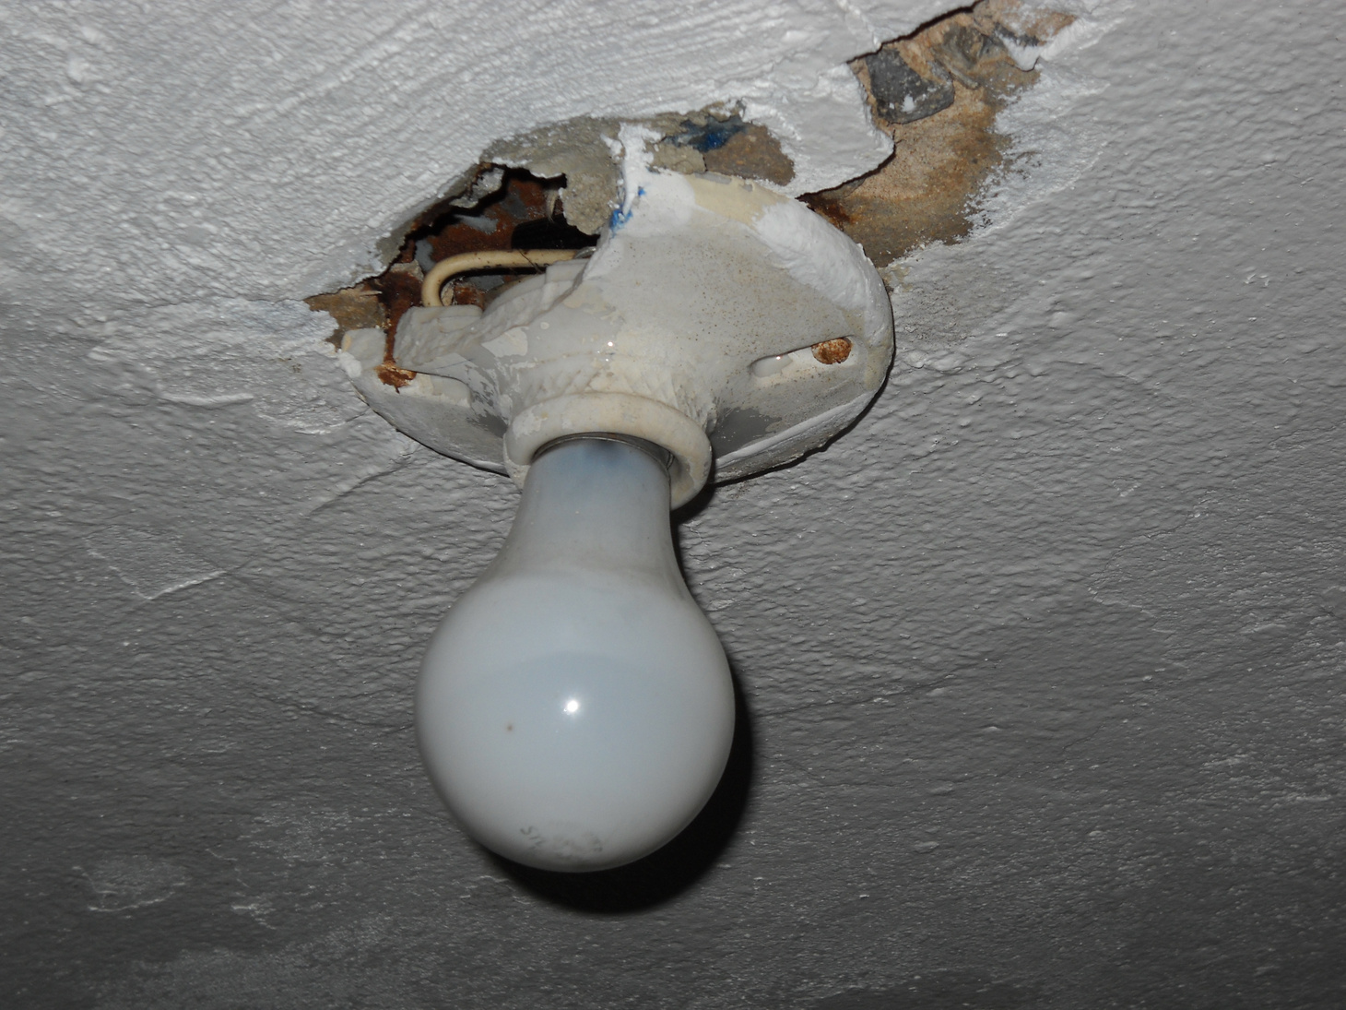
Recognizing Electrical Hazards
Damaged light fixture on attic ceiling
Photo Courtesy of US Department of Energy
10
GJA 2025 Version III
Notes:
This is a damaged light fixture in a ceiling.
Q: Why is this a problem?
A: An unsafe fixture may become a fire hazard if the exposed wiring comes in contact with newly installed attic insulation placed over it.
<number>
July 2012

Slide 11
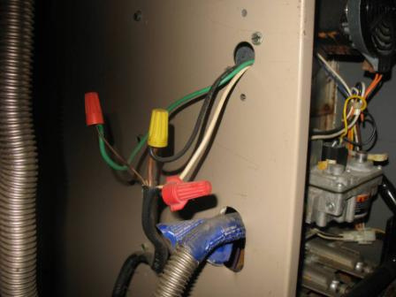
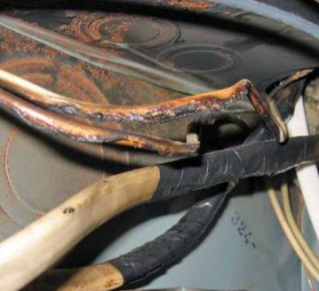
Recognize Electrical Hazards
Photos Courtesy of NRCERT
  Is insulation on wiring missing or deteriorated?
  Are wires properly clamped, connected, and enclosed?
11
GJA 2025 Version III
Notes:
Evaluate wiring safety.
Is insulation on wiring missing or deteriorated?
Are wires properly clamped, connected, and enclosed?
These are photos of deteriorated and dangerous wiring connections.
Exposed wiring connections such as those pictured here can be hazardous. Contact between the wiring leads will cause a short circuit.
Also note the sharp edge where the leads exit the furnace cabinet. Over time, vibrations may cause the wires to become frayed on this sharp edge and lead to a serious and even life-threatening short circuit.
These wires should be stabilized and enclosed in a code-compliant junction box.
<number>
July 2012

Slide 12
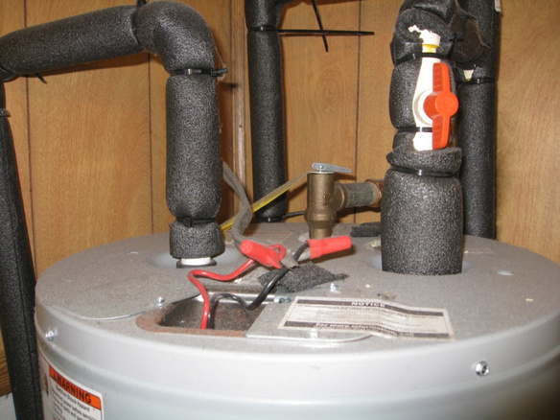
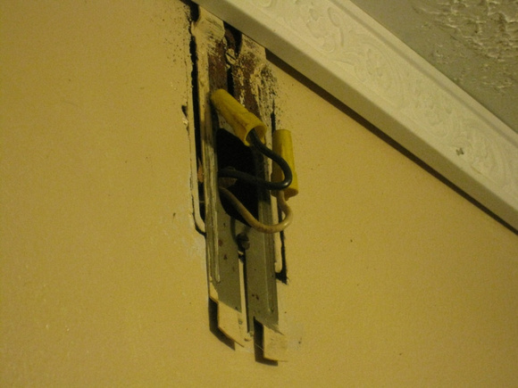
Identifying Electrical Hazards
Photos Courtesy of US Department of Energy
Open Wire Splices
12
GJA 2025 Version III
Notes:
According to the NEC, wire splices may not be left exposed and must be enclosed in a code-compliant junction box. Weatherization work may still continue where you won’t be covering the wires. Defer all repairs to a qualified electrician.
Assume all exposed wiring is energized until proven otherwise. STOP work, protect the area, and contact a supervisor if you encounter a dangerous situation.
Q: Name as many electrical hazards as possible.
A: Open Junction Box
Unused opening in cabinet, boxes, and fittings
Frayed or taped wires
Damaged light fixtures
Missing insulation or wiring
<number>
July 2012

Slide 13
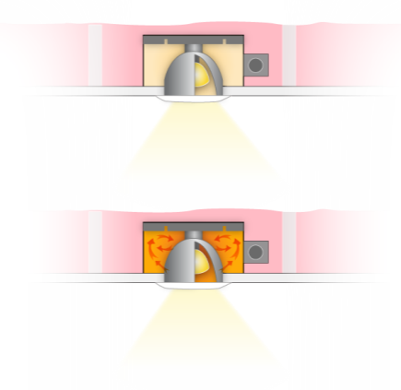
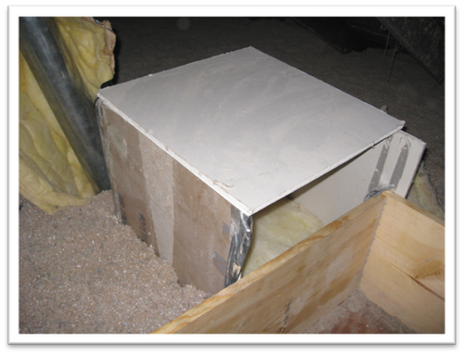
High Temperature Issues
Recessed Light Fixtures
Clearance to Combustibles
Photos courtesy of the US Department of Energy
IC Rated Fixture
Drywall box maintains appropriate clearances to heat producing recessed can lights
Non-IC Rated Fixture
13
GJA 2025 Version III
Notes:
IC rated recessed light fixtures can be completely covered with insulation.
If the fixtures aren’t IC rated, covering them with insulation can cause dangerous heat build-up in the fixture. In a best-case scenario, this will substantially shorten the life of every bulb that goes in that fixture. The worst-case scenario is fire.
<number>
July 2012

Slide 14
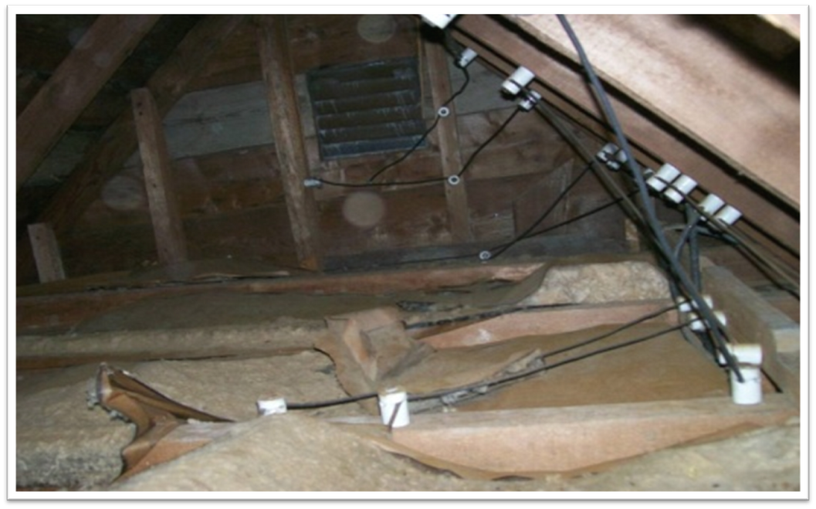
Insulating over Knob & Tube Wiring
Photo courtesy of the US Department of Energy
14
GJA 2025 Version III
Notes:
Knob and tube wiring is common in homes built before World War II. Properly installed and used as designed, it is extremely safe. Any problems typically arise either from circuit over-fusing and overloading or amateur modifications.
Weatherization measures contacting knob and tube wiring are affected by both code and rule.
The 2008 National Electric Code 314.29 requires that all wiring junction boxes remain accessible. This is easily achieved by flagging all boxes before insulating over them.
The 2008 National Electric Code 394.12 specifically forbids enveloping knob and tube wiring in thermal insulation. While it is a national code, it is enforced on the state or local level. Generally, one of the national building codesall of which reference the NEC for electrical requirementsis the basis for state and local code. Therefore, if there is a building code in effect, the NEC knob and tube ban is in effect unless the code has been amended locally.
DOE’s official position on this matter was stated on October 21, 1988, in DOE’s Knob and Tube Memorandum by Mary E. Fowler, then Chief of the Weatherization Assistance Program Branch: “…DOE-WAP policy on installation of thermal insulation around [knob and tube wiring] is that it is the state’s responsibility to ensure that such work be in conformance with the applicable codes in the jurisdiction where the work is being performed.”
DOE policy allows insulating around knob and tube wiring if the following conditions are satisfied:
All affected live knob and tube wiring is visually examined to see that it is in good condition and tested to see that the circuit voltage drop is less than 10%.
The circuit breaker or fuse controlling the circuit is matched to the wire gauge.
#14 wire = 15 amp fuse/circuit breaker.
#20 wire = 20 amp fuse/circuit breaker.
Correct amperage “S” type fuses are installed if the fuse panel has screw-in fuses.
Affected circuits in walls are evaluated, not just visible wiring in attics, etc.
A state weatherization program wishing to take advantage of the DOE policy must say it is doing so in its DOE state plan, and also determine that the activity is allowable under any applicable state and local code.
Applicable codes/rules:
2008 National Electric Code 314.29 and 394.12
DOE Knob and Tube Memorandum 1988
<number>
July 2012

Slide 15
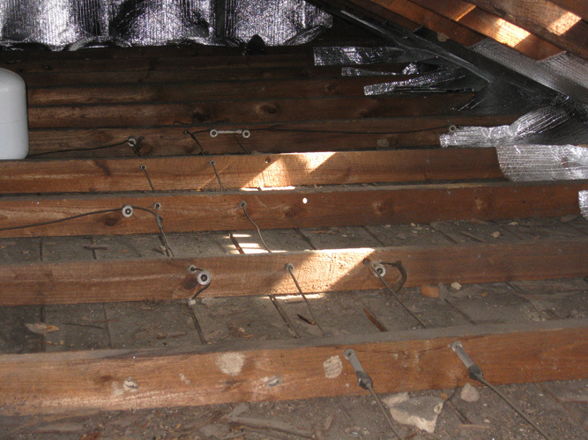
Knob and Tube Retrofits
Photo courtesy of the US Department of Energy
Extensive knob and tube wiring
15
GJA 2025 Version III
Notes:
Extensive live knob and tube wiring in attic may have a high replacement cost.
Q: Is extensive knob and tube wiring worth replacing?
A: It all depends on the SIR. The high cost of replacement may not meet the SIR criteria when rolled into the cost of all measures. In these cases, insulation should be deferred until the wiring is replaced by the homeowner or through another funding source.
<number>
July 2012

Slide 16
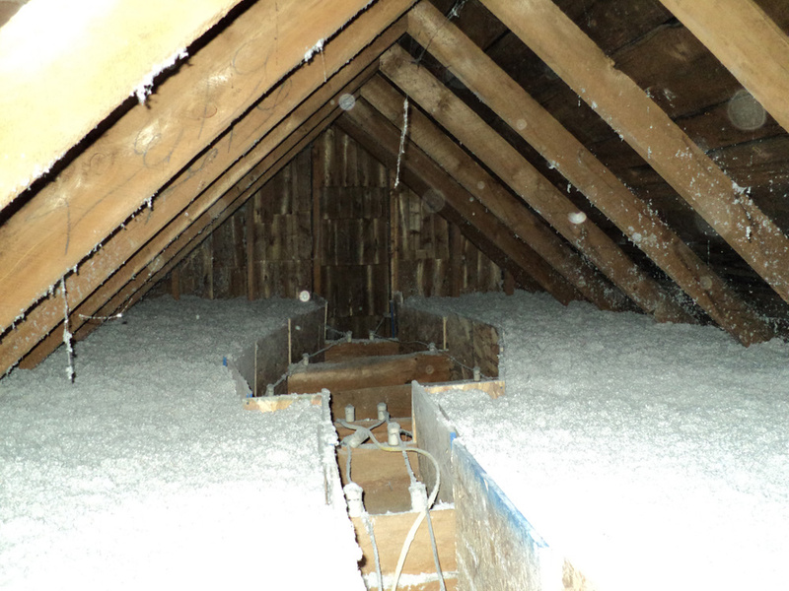
Knob and Tube Retrofits
Photo courtesy of the US Department of Energy
Damming around knob and tube wiring
16
GJA 2025 Version III
Notes:
Damming around knob and tube wiring is acceptable. In this photo, workers did a good job of damning, but it would likely have been less expensive to replace the knob and tube wiring with a new circuit. Then the new circuit could have been covered with insulation, creating a complete and uniform thermal boundary. In this case, damming around the old wiring will likely result in a significant energy penalty because of the insulation void.
<number>
July 2012

Slide 17
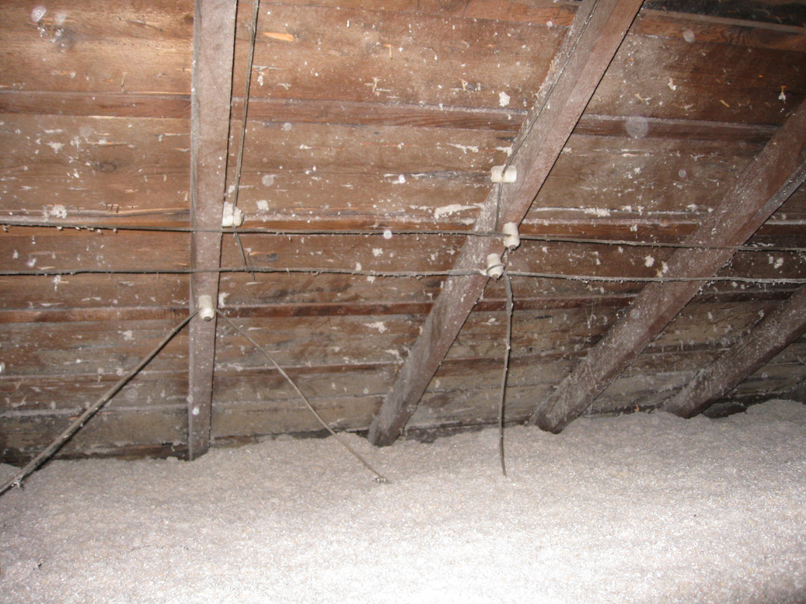
Encapsulating Knob and Tube Wiring
Encapsulated knob and tube wiring
Photo courtesy of the US Department of Energy
17
GJA 2025 Version III
Notes:
This illustrates a case where state code allows knob and tube wiring to be encapsulated with insulation if certain conditions are satisfied.
All affected live knob and tube wiring is visually examined to see that it is in good condition and tested to see that the circuit voltage drop is less than 10%.
Adequate over current protections (fuses or breakers) are in place.
Correct amperage “S” type fuses are installed if the fuse panel has screw-in fuses.
Affected circuits in walls are evaluated, not just visible wiring in attics, etc.
<number>
July 2012

Slide 18
Summary
  Codes and rules related to electrical safety include the IRC, NEC, and DOE Guidance.
  Common electrical safety hazards in homes include uncovered wiring splices, frayed wiring, and overloaded knob and tube wiring.
  Notify the proper authority and do not attempt electrical repairs unless qualified to do so.
18
GJA 2025 Version III
Notes:
Present this slide as an interactive discussion, soliciting personal examples from the trainees. Add your own personal examples and knowledge to supplement.
<number>
July 2012

