Slide 1



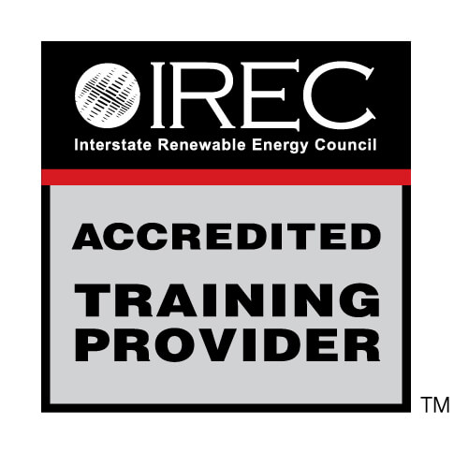
Introduction to Weatherization
QUALITY CONTROL INSPECTOR
1
GJA 2024 Version III

Slide 2
Learning Objectives
By attending this session, participants will be able to:
Discuss the historical perspective of the Weatherization Assistance Program (WAP).
Name characteristics of the client base served by the program.
Recognize that building science guides the selection of measures installed with program dollars.
Describe the principles of cost-effectiveness and the savings-to-investment ratio (SIR).
Recognize modern weatherization measures.
2
GJA 2024 Version III
Notes:
By attending this session, participants will be able to:
Discuss the historical perspective of the Weatherization Assistance Program (WAP).
Name characteristics of the client base served by the program.
Recognize that building science guides the selection of measures installed with program dollars.
Describe the principles of cost-effectiveness and the savings-to-investment ratio (SIR).
Recognize modern weatherization measures.

Slide 3
Mission
INTRODUCTION TO WEATHERIZATION
Mission of the Weatherization
Assistance Program
To reduce energy costs for low-income
families, particularly for the elderly, people
with disabilities, and people with children, while
ensuring their health and safety.
3
GJA 2024 Version III
Notes:
The legislative mission of the program is to reduce energy costs for low-income families, particularly for the elderly, people with disabilities, and people with children, while ensuring their health and safety (H&S).
The purpose of the program was changed in the law to include health and safety in the enabling legislation of 1990. Prior to that, health and safety was not implicitly mentioned.

Slide 4

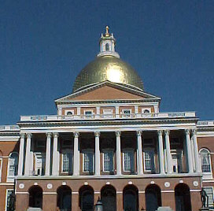
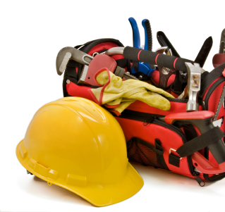
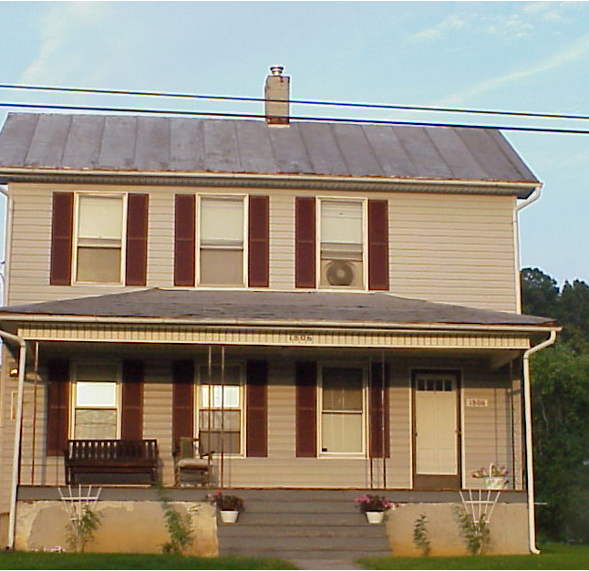
Organization
Organization: The Team Approach
U.S. Department of Energy Headquarters and the project management centers
(NETL and Golden)
50 state energy offices, the District
of Columbia, Native American tribal
organizations, and five territories
Over 900
local agencies
Low-income
households
4
GJA 2024 Version III
Notes:
The flow of dollars through the program:
The Federal government distributes funds to the U.S. Department of Energy (DOE), where the program is managed by the project management center (PMC).
Funds pass to each of the grantees: the 50 state offices, the District of Columbia, Native American tribal organizations, and the five territories.
Grantees distribute funds to over 900 local agencies nationwide according to approved budgets.
The money is used to install cost-effective, energy-saving measures in low-income households.
Lyndon Johnson’s “War on Poverty” laid the groundwork for the Weatherization Assistance Program (WAP) by creating the infrastructure of community action programs (CAPs) that now exist in every state. These CAPs often act as subgrantees. The War on Poverty included Head Start, the Low-Income Home Energy Assistance Program (LIHEAP), and after-school programs for children so parents could be part of the workforce.
CAPs have the right of first refusal to be a local weatherization agency. Only non-profits and local government agencies are allowed to act as subgrantees.

Slide 5
Weatherization Process
Wx Program Promotion and Client Recruitment
Wx Program Intake and Eligibility Determination
Applicant Selection and Preparation
Auditor Background Familiarization
Initial Site Visit – Auditor Conducts Energy Audit, H&S Testing,…
Work Scope Development
Work Scope Implementation/Installation
Contractor/Crew Final Inspection
Agency Final Inspection
Possible State and/or Federal Monitoring Visit
Client follow-up
5
GJA 2024 Version III
Notes:
This flow chart provides an overview of how a client home progresses through the weatherization process.
WAP promotion and client recruitment – This can be done through radio or other advertisements, posting notices at community centers, churches, and senior centers, through LIHEAP referrals, etc.
Intake and eligibility determination – This is usually done by designated administrative staff that verifies income eligibility and helps applicants fill in the necessary forms, as needed.
Applicant selection and preparation – Many agencies prioritize clients based on whether they are elderly, have disabilities, or have children in the home, energy use/energy burden, or some combination of these factors. This is also often where the client learns what they can expect from the weatherization process.
Auditor background familiarization – When possible, the auditor can review utility data and other relevant information before actually visiting the home.
Initial site visit/audit – The auditor collects site-specific information to enter into a software audit program or determine the applicability of a relevant priority list. In some cases, the auditor determines that the structure is unsound and defers services on the home.
Work scope development – Using the data collected onsite as well as local costs and savings related to various measures, the auditor develops a cost-effective list of measures to be installed in the home.
Work scope implementation/installation – Crews and contractors install measures listed in work order and notify the local agency of any new issues discovered during installation, sometimes adding energy savings or health and safety measures based on necessity.
Contractor/crew final inspection – Contractors and crews perform a final inspection on their work to ensure no measures were overlooked and that measures were installed in accordance with local technical and quality guidelines.
Agency final inspection – The local agency is responsible for checking each home.
Client follow-up – If clients call with questions, thanks, or complaints, agency staff members help tie up loose ends.
A certain percentage of the homes will be visited again by the state monitor, and a subset of those will be visited again by a federal DOE monitor.

Slide 6
Low-Income Households
Characteristics of Low-Income Households
More than 90% of low-income households have annual incomes less than $15,000.
More than 13% of these low-income households have annual incomes less than $2,000.
According to DOE’s Energy Information Administration (EIA), low-income households spend 14.4% of their annual income on energy, while other households only spend 3.3%.
The average energy expenditures in low-income households is $1,800 annually (as of 2010).
The elderly occupy 34% of low-income homes.
6
GJA 2024 Version III
Notes:
Facts:¹
More than 90% of low-income households have annual incomes less than $15,000.
More than 13% of these low-income households have annual incomes less than $2,000.
According to DOE’s Energy Information Administration (EIA), low-income households spend 14.4% of their annual income on energy, while other households only spend 3.3%.
The average energy expenditure in low-income households is $1,800 a year.
The elderly occupy 34% of low-income homes.
These statistics highlight the importance of our work and why the effectiveness of what we do is so important. Our goal is to reduce the energy burden on our clients. Energy burden refers to the percentage of a household’s income that must be used for energy bills. High energy burden means a high percentage of income is spent on energy bills. The energy burden for low-income households is over four times that of other households.
¹This data, provided by Joel Eisenberg of the Oak Ridge National Laboratory and Meg Power of Economic Opportunity Studies, is based on raw data from the Residential Energy Consumption survey conducted by EIA.
Source 1: ORNL/CON-493, ORNL/CON-484, EIA February 2008 Short-Term Energy Outlook
Source 2: ORNL/TM-2010/66, EIA February 2010 Short Term Energy Outlook

Slide 7
History
1976 to Early 1980s (First Generation)
Started in Maine as “Winterization”
Administered by the Community Services Administration
Later managed by the Federal Energy Administration
Volunteer labor
Low-cost measures
Little or no accountability
7
GJA 2024 Version III
Notes:
The Weatherization Assistance Program was created in 1976 after the first oil embargo and before DOE was formed. Local programs with the same goals had been in operation, but this was the formal beginning of a national program.
WAP started in Maine as “Winterization” − Maine’s program was used as a model for the national program.
It was originally administered by the Community Services Administration, then it was later managed by the Federal Energy Administration, a predecessor to DOE.
WAP used volunteer labor, who stapled plastic over windows.
WAP installed low-cost measures − there was very little insulation installation.
There was little or no production or financial accountability.

Slide 8
History
Early 1980s to Late 1980s (Second Generation)
Used volunteer labor from the Comprehensive Employment & Training Act under the Department of Labor
Often installed temporary measures
Little or no diagnostic technology
Project Retro-Tech – A paper energy audit allowed entry of the areas and R-values in the home to do very basic heat transfer calculations
Addressed the building envelope
WAP’s “Blow and go” – Program for attics that completed houses quickly, but with much less improvement than is common today
8
GJA 2024 Version III
Notes:
The program grew in the early 1980s.
The program used volunteer labor from the Comprehensive Employment and Training Act under the U.S. Department of Labor.
Often temporary measures were installed and used little or no diagnostic technology.
Project Retro-Tech − This paper energy audit allowed users to enter in the areas and R-values in the home and do very basic heat transfer calculations.
Addressed the building envelope.
The progam used “Blow and Go,” in which workers blew insulation into attics. It was a “quick and dirty” program that completed houses quickly, but with much less improvement to the home than is common today.

Slide 9
History
1990s (Third Generation)
Used paid professional labor
Addressed both building envelope and mechanical
heating systems
Diagnostic tools used in some states
Various components of program computerized
State and national evaluations conducted
Structured training and technical assistance provided
9
GJA 2024 Version III
Notes:
The program was evaluated in 1991 and it became clear that the cost-effectiveness of installed measures must be tracked. Measures expanded from shell work to heating and cooling systems.
The program was finally allowed to pay for labor. Groundbreaking states began using blower doors and created diagnostic techniques that have been refined over the years.
Structured training and technical assistance (T&TA) addressed the program’s shortcomings. There is now a feedback loop and accountability. When an inspector notices work in the field that is not up to state standards, training at a recognized facility can be required, or technical assistance will be sent to the local agencies to provide on-the-job training.
Used paid professional labor.
Addressed both building envelope and mechanical heating systems.
Diagnostic tools used in some states.
Various components of program computerized.
State and national evaluations conducted.
Structured training and technical assistance provided.

Slide 10
History
1990s to Present (Fourth Generation)
Measures are permanent and cost effective
Rental plans to ensure that weatherization benefits,
i.e., savings on utility bills, accrue to tenants, not landlords
Health and safety plans that establish protocols for energy-related health and safety measures, like relining chimneys or replacing faulty furnaces
Increased use of advanced diagnostic tools and energy audits
States leverage funds from other Federal programs and often through utilities to expand the reach of their WAP
Coordination with the U.S. Department of Housing and Urban Development’s (HUD) housing agencies make comprehensive rehabilitation and weatherization possible
10
GJA 2024 Version III
Notes:
Testing and diagnostics are refined and effective, and installation is often conducted by highly trained crews.
Weatherization measures are permanent and cost-effective.
States have rental plans to ensure that weatherization benefits, i.e., savings on utility bills, accrue to tenants, not landlords.
States have health and safety plans that establish protocols for energy-related health and safety measures, like relining chimneys or replacing faulty furnaces.
There is increased use of advanced diagnostic tools and energy audits.
Several states leverage funds from other Federal programs and often through utilities to expand the reach of their WAP.
Through coordination with the U.S. Department of Housing and Urban Development’s (HUD) housing agencies, comprehensive rehabilitation and weatherization are possible.

Slide 11
Measures
“Old School” Weatherization Measures
Many weatherization programs without strong management, turned into “doors and windows” programs that often included:
Replacing windows.
Adding storm windows.
Replacing doors.
Adding weather stripping.
Adding some attic insulation.
Caulking (by the case).
Doors and windows especially are highly visible and get much publicity, but typically they aren’t cost-effective. The measures that save the most energy – air sealing and adding insulation – are largely invisible.
11
GJA 2024 Version III
Notes:
Many weatherization programs without strong management turned into “doors and windows” programs that often included:
Replacing windows.
Adding storm windows.
Replacing doors.
Adding weatherstripping.
Adding some attic insulation.
Caulking (by the case).
Doors and windows especially are highly visible and get much publicity but typically they aren’t cost effective. The measures that save the most energy – air sealing and adding insulation – are largely invisible.

Slide 12
Measures
Modern Weatherization Measures
Blower door-directed
air sealing
Attic insulation
Dense-pack
sidewall insulation
Heating and cooling equipment repair and replacement
Duct sealing and modification
Electric base load measures:
  Compact fluorescent light bulbs (CFLs)
  Refrigerator replacement
  Water heater modification and replacement
12
GJA 2024 Version III
Notes:
The program has improved dramatically over the years. Modern measures provide cost-effective savings based on computerized energy audits. These are more than just shell measures.
Blower door-directed air sealing
Attic insulation
Dense-pack sidewall insulation
Heating and cooling equipment repair and replacement
Duct sealing and modification
Duct modification includes adding returns to provide the air-handling unit (AHU) with enough air, or reconnecting ducts in attics. Occasionally, a duct system is redesigned to use a trunk line. Generally, modifications are done to make sure that the returns are adequately sized and to replace the floor grills if they’ve been smashed shut.
Electric base load measures
Installation of compact fluorescent lamps (CFLs)
Refrigerator replacement
Water heater modification
Modern weatherization methods mean looking at the whole house – including the building shell, the mechanicals, and the base load – as a system.

Slide 13
Results
Almost 7 million homes have been weatherized to date with Federal and leveraged funds such as state and utility monies and fuel assistance program funds.
Energy savings averages 35% of consumption for a typical low-income home.
A favorable benefit-cost ratio of 1.8:1 exists.
The program supports tens of thousands of direct and indirect jobs nationwide.
13
GJA 2024 Version III
Notes:
A comprehensive national evaluation found that compared to utility-sponsored and local weatherization programs, DOE’s program was the most effective. The evaluation determined the program to be beneficial on many levels, from energy reduction to jobs creation.
More than 6.4 million homes have been weatherized to date with Federal and leveraged funds such as state and utility monies and fuel assistance program funds.
The average reduction in energy used for space heating is 35%.
This average reduction is extrapolated from natural gas reductions attributed to space heating; batch fuels like propane and fuel oil are difficult to impossible to monitor.
Favorable benefit-cost ratio of 1.8:1.
National evaluation resulted in three benefit-cost ratios. The lowest one (1.8:1) measures materials and labor spent at the house (denominator), against the projected energy savings over the life of the measures (numerator). This doesn’t include administrative costs. Other ratios include societal benefits and other non-energy benefits: indirect jobs, pollution reduction, improved health and productivity of those served, etc. Including societal benefits increases the benefit-cost ratio.
Supports tens of thousands of direct and indirect jobs nationwide; 52 direct jobs for every million dollars invested (before the Recovery Act). This number is changing dramatically with deployment of the American Recovery and Reinvestment Act (ARRA) funds.

Slide 14
Cost-Effectiveness
Cost-Effectiveness Requirements
An SIR of 1 or higher
Energy-related health and safety work not included in the SIR
No federally mandated upper limit for health and safety (H&S) funds
Higher requests for H&S budgets can encourage increased scrutiny of the state plan
SIR ≥ 1: The measure pays for itself over its lifetime
14
GJA 2024 Version III
Notes:
The success of the program is due to the hard work and dedication of its workers.
Two key principles guide the installation of measures: cost-effectiveness and the availability of health and safety funds.
Each individual weatherization material – and the package of weatherization materials installed – must be cost-effective.
Cost-effectiveness is measured by the savings-to-investment ratio (SIR), the amount of energy savings versus the cost to install a measure.
An SIR of 1 or higher means the savings earned over the lifetime of a given measure are greater than the full cost of installing that measure.
The SIR of each individual measure and of the package as a whole must be greater than or equal to 1.
Energy-related health and safety work is not included in the SIR.
There is no federally mandated upper limit for H&S funds. Each state designates this in its state plan.
Historically, states have set their upper limit around 6-7%. With an increase in the amount of lead-safe weatherization (LSW) and furnace replacements, that number has increased.
Requests for higher H&S budgets can encourage increased scrutiny of the state plan.

Slide 15
Cost-Effectiveness
States may include overhead costs in their cost-effectiveness requirements, but this limits the weatherization measures that can be
cost-effectively done to the house.
15
GJA 2024 Version III
Notes:
SIR greater than or equal to 1 means energy cost savings over the lifetime of the measure(s), discounted to present value, equal or exceed the cost of materials, installation, and on-site supervisory personnel.
For example, cost-effectiveness of a refrigerator replacement measures the present value of the energy savings over the lifetime of the appliance against the cost to purchase and install a new unit, as well as remove and decommission the old unit.
Present value accounts for the time value of money: $10 was worth more 15 years ago than it is today, and $10 spent today is probably worth more than $10 saved 15 years from now.
States may include overhead costs in their cost-effectiveness requirements, but this limits the weatherization measures that can be cost effectively done to the house.
Incidental repair costs must be included in the overall SIR.
Incidental repairs are those repairs necessary for the effective performance or preservation of weatherization materials. They may include adding framing or making limited roof repairs so attic insulation doesn’t get wet. Costs do not cover roof replacement.
A cold water leak in a mobile home is considered an incidental repair since it will keep the belly insulation dry, but repairing a toilet drain comes under H&S.
On a home needing significant repairs, the SIR for the entire package might be less than one, even though each measure has an SIR greater than one. For entire package calculations, the cost of incidental repairs enters the denominator. This puts a limit on the incidental repairs that can be done. H&S measures do not enter the cost-effectiveness equation.

Slide 16
Typical Savings & Payback
TYPICAL MEASURES INSTALLED | ENERGY SAVINGS | PAYBACK PERIOD
Virginia homes weatherized July 1988 to June 1989
• Caulking • Weatherstripping • Replacement windows • Storm windows • Attic insulation | Single family – Gas heat………...10% Single family – Electric heat………5% Mobile homes…………………….10% | 30 years 21 years 53 years
Virginia homes weatherized July 1989 to June 1990
• Advanced air sealing • Attic insulation • High-density wall insulation • Heating safety and efficiency improvements | Single family – Site built…………24% Mobile homes…………………….17% | 10 years 17 years
16
GJA 2024 Version III
Notes:
This study dispels the myths that windows and doors are the most cost-effective energy-savings measures. Air sealing and adding insulation save more energy and cost less, so they have a much quicker payback than doors and windows.
Virginia savings have increased even more since this study was done.

Slide 17
Summary
The mission of WAP is to reduce the energy bills of low- to moderate-income households.
Clients typically have a high energy burden.
Modern weatherization measures are based on principles of building science and cost-effectiveness.
There are limits on spending for incidental repairs,
but not for health and safety measures.
National evaluation in the early 1990s determined program is effective at energy use reduction and jobs creation.
17
GJA 2024 Version III
Notes:
The mission of WAP is to reduce the energy bills of low- to moderate-income households.
Clients typically have a high energy burden.
Modern weatherization measures are based on principles of building science and cost-effectiveness.
There are limits on spending for incidental repairs, but not for health and safety.
National evaluation in the early 1990s determined program is effective at energy use reduction and jobs creation.
Present this slide as an interactive discussion, soliciting personal examples from the trainees. Add your own personal examples and knowledge to supplement.

