Slide 1
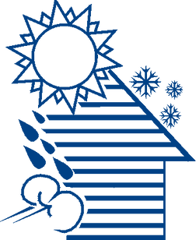


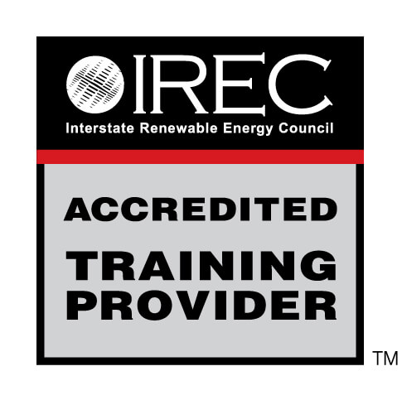
WEATHERIZATION INSTALLER/TECHNICAN FUNDAMENTALS
House as a System
1
GJA 2024 Version III
GJA 2025 Version III
Notes:
<number>
July 2012

Slide 2
Learning Objectives
  Understand the basic relationships of the components in a home.
  Learn that when you make changes it can create problems and damage in the future.
2
GJA 2024 Version III
GJA 2025 Version III
Notes:
By attending this session, participants will be able to:
Understand the basic interrelation of home components.
Understand that changes made now can create issues that emerge as damage years later.
<number>
July 2012

Slide 3
House as a System
A house is a system of interdependent parts.
  The operation of one part affects many others.
  When they all work together, the house is comfortable, safe, efficient, and durable.
  A house will experience problems when its
  house parts don’t work together properly.
  Some obvious, some invisible.
  Some now, some years later.
3
GJA 2024 Version III
GJA 2025 Version III
Notes:
A house is a system of interdependent parts, including mechanical and physical components.
The operation of one part affects many others.
When those components all work together, the house is comfortable, safe, efficient, and durable.
When approaching the house as a system of interactive parts, the savings mount and health and safety issues can be avoided.
Air sealing and insulating a home reduces the heating and cooling load. A replacement furnace in a sealed and insulated home can be smaller than the existing furnace. The initial price of the smaller unit is lower and the long-term operating costs will be less.
A house will experience problems when its parts don’t work together properly.
Some problems are obvious, and some are invisible.
Some problems appear now, and some appear years later.
Building failures are symptoms of failures in the house as a system. As weatherization workers, we need to find the underlying problem, not just replace the rotted wood.
<number>
July 2012

Slide 4
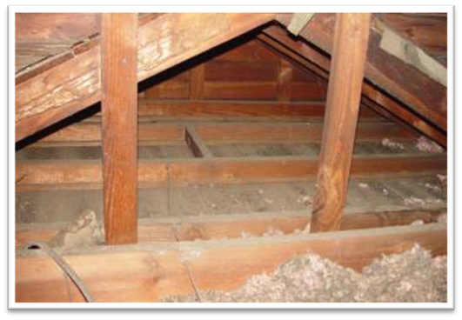
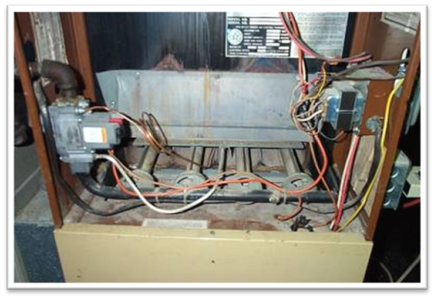
Examples
Photos courtesy of NRCERT
An uninsulated attic ...
… makes the heating and cooling systems run more.
4
GJA 2024 Version III
GJA 2025 Version III
Notes:
An uninsulated attic or other failure in the thermal boundary or air barrier makes the heating and/or cooling system work harder.
<number>
July 2012

Slide 5
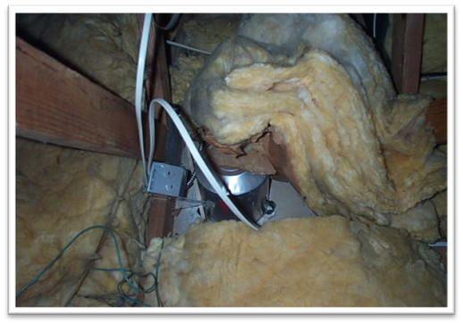
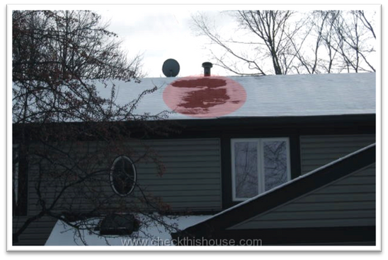
Examples
Photo courtesy of NRCERT
Photo courtesy of checkthishouse.com
Leaky recessed
lighting fixtures...
increases heat loss/gain,
and can cause ice dams and moisture problems.
5
GJA 2024 Version III
GJA 2025 Version III
Notes:
Leaky recessed lighting fixtures increase heat loss and gain, and can cause ice dams and moisture problems.
<number>
July 2012

Slide 6
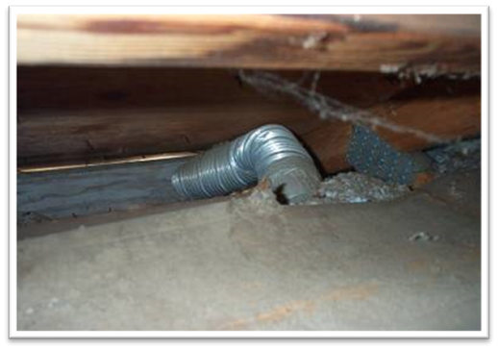
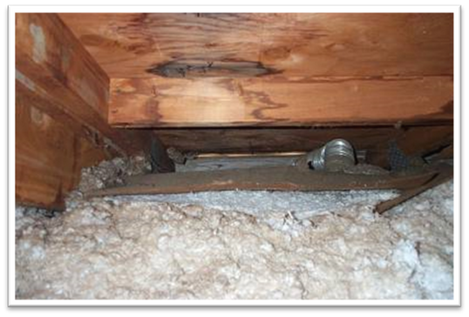
Examples
HOUSE AS A SYSTEM
Photos courtesy of NRCERT
This bathroom exhaust
fan does not exhaust to
outdoors – just to the soffit.
The moisture condenses on the roof deck and trusses causing damage.
6
GJA 2024 Version III
GJA 2025 Version III
Notes:
Fans that exhaust into the attic or crawl space cause moisture to condense on the roof deck and trusses, weakening the structure. This problem could exist unnoticed for years, causing poor indoor air quality (IAQ) and expensive structural damage.
<number>
July 2012

Slide 7
Summary
  Every house is a system of interdependent parts, including mechanical and physical components.
  Building failures are symptoms of larger issues.
  Weatherization changes some components but affects the entire house as a system.
7
GJA 2024 Version III
GJA 2025 Version III
Notes:
Every house is a system of interdependent parts, including mechanical and physical components.
Building failures are symptoms of larger issues.
Weatherization changes some components, but affects the entire house as a system.
Present this slide as an interactive discussion, soliciting personal examples from the trainees. Add your own personal examples and knowledge to supplement.
<number>
July 2012

