Slide 1
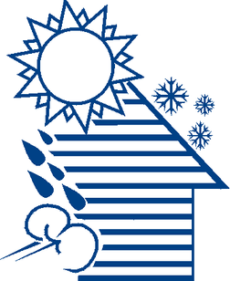



WEATHERIZATION INSTALLER/TECHNICIAN FUNDAMENTALS
Roofing, Flashing, and Attic Ventilation
1
GJA 2025 Version III
Notes:
July 2012
1

Slide 2
Learning Objectives
By attending this session, participants will be able to:
  Name required fall protection components.
  Identify and repair leak sources.
  Remove roofing systems.
  Insulate roof decks.
  Explain the purpose and principles of attic ventilation.
  Determine ventilation needs by code and practical alternatives.
  List ventilation options and guidelines.
  Install attic ventilation and repair roofing.
  Flash new penetrations.
2
GJA 2025 Version III
Notes:
By attending this session, participants will be able to:
Name required fall protection components.
Identify and repair leak sources.
Remove roofing systems.
Insulate roof decks.
Explain the purpose and principles of attic ventilation.
Determine ventilation needs by code and practical alternatives.
List ventilation options and guidelines.
Install attic ventilation and repair roofing.
Flash new penetrations.
Present this slide as an interactive discussion, soliciting personal examples from the trainees. Add your own personal examples and knowledge to supplement.
July 2012
2

Slide 3
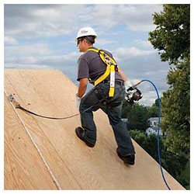
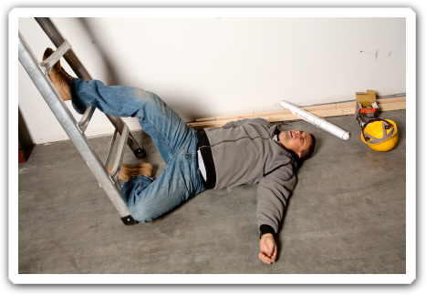
Fall Protection
Proper fall protection can mean the difference between this…
Image courtesy of lawlessgroup.com
Image courtesy of www.fallprotectionplans.com
3
GJA 2025 Version III
Notes:
Before working on any roofing project, you should be equipped with fall protection equipment. A crew chief or supervisor of the crew should have the appropriate OSHA training to develop and implement a workplace safety plan, including safe work practices for any workers going higher than 6 feet in the air.
Falling is the leading cause of disabling injury and fatality in the construction industry. Better to be safe than injured or dead.
July 2012
3

Slide 4
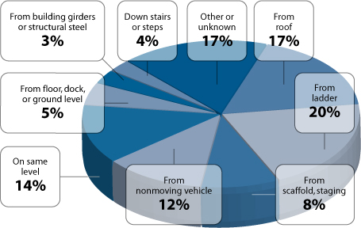
Where do we fall from?
Breakdown of fatal falls in 2009
Chart courtesy of U.S. Bureau of Labor Statistics, U.S. Department of Labor, 2010.
4
GJA 2025 Version III
Notes:
This chart shows the breakdown of the 645 fatal workplace falls in 2009.
More than a third of all those falls were from ladders or roofs.
July 2012
4

Slide 5
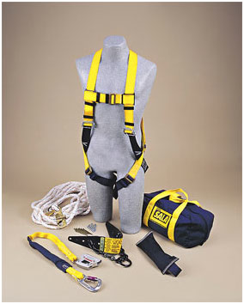
Personal Fall Arrest Systems
A personal fall arrest system (PFAS) must include these components:
  Anchorage
  Body Harness
  Connector/lanyard
  A PFAS may also include a deceleration device and/or lifeline.
Image courtesy of Kentuckiana Industrial Safety Training
5
GJA 2025 Version III
Notes:
A personal fall arrest system (PSAF) must include:
Anchorage – Provides a safe connection to an immovable surface. The function of the entire PSAF relies on the safe and proper installation of this device. Must be capable of supporting at least 5,000 lbs.
Body Harness – Distributes the weight of the fall over the thighs, pelvis, waist, chest, and shoulders. Body belts haven’t been allowed since 1998.
Connector/lanyard – This ties the anchorage and the body harness together. Snaphooks must be the locking type. Never use two snaphooks together unless they’re specifically designed for that.
A PFAS may also include a deceleration device and/or lifeline.
July 2012
5

Slide 6
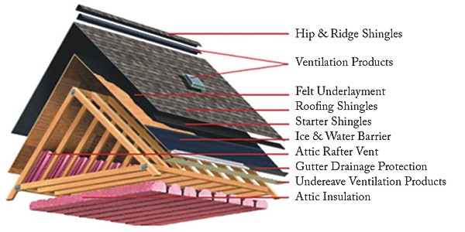
Typical Roofing System Components
Image courtesy of national-roofers.com
6
GJA 2025 Version III
Notes:
This illustration shows the components of a typical roofing system on site-built and modular homes.
Hip and Ridge Shingles – These curved shingles protect the peak.
Ventilation Products – Available in many different designs, which we’ll cover later in the presentation. Shown here are a ridge vent (top) and a standard roof vent (lower).
Felt Underlayment – Placed over the roof deck (also called sheathing) before shingles are installed.
Roofing Shingles – This layer is designed to withstand the elements and protect everything underneath it. Asphalt shingles are very common, but other materials may be common regionally, including clay, metal, and wood.
Starter Shingles – Installed on top of the drip edge/rake edge. A single row of shingles that are installed everywhere the roof ends.
Ice and Water Barrier – Just as the name implies, a durable layer to keep ice and water from damaging the home.
Attic Rafter Vent – Also called eave chutes or baffles, these keep soffit vents free of obstructions while still allowing thorough attic insulation.
Gutter Drainage Protection – Generally called a drip edge or a rake edge, this is typically a long, narrow piece of metal installed along all edges of the roof.
Undereave ventilation products – Sometimes called soffit vents, combined with a ridge vent they create a complete attic ventilation system.
Attic insulation – The thermal boundary of the home. Some homes are insulated at the roof deck, bringing the full attic into the conditioned space.
July 2012
6

Slide 7
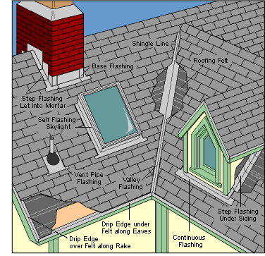
Creating a Drainage Plane
Note flashing locations at every edge.
Image courtesy of livingsmarter.org
7
GJA 2025 Version III
Notes:
According to buildingscience.com, drainage planes are “water repellent materials (building paper, house wrap, foam insulation, etc.) which are designed and constructed to drain water. They are interconnected with flashings, window and door openings, and other penetrations of the building enclosure to provide drainage of water to the exterior of the building. The materials that form the drainage plane overlap each other shingle fashion or are sealed so that water flow is downward and outward.”
This illustration shows roofing system components installed in a way that creates a complete, effective drainage plane. Note the flashing locations, how materials are overlapped in order to shed water consistently downward, and the special attention paid around any penetrations or edges.
If you must repair a roof leak, the first step is identifying the source. The majority of roof leaks happen at flashing, so look there before inspecting the field of shingles. If the source isn’t visibly obvious, with one worker on the roof and another in the attic, use running water to try to track it down. If that fails, begin removing shingles around the suspected source until you find signs, like discolored roofing felt or moldy sheathing, and trace those to the source.
Once the leak of the source has been discovered, repair it in a manner that creates a reliable and durable drainage plane. This is often achieved by reinstalling a piece of flashing or covering a penetration with a piece of metal, sliding it up under the shingles above, and securing in place with caulk (behind) and fasteners. Never rely solely on caulk or roofing cement to hold a repair in place. Roofs move a lot, and those materials will fail before the roof system as a whole. In some instances, especially in non-weatherized homes, the moisture source may not be a roof leak at all, but water escaping from the home into the attic and condensing on the cooler roof sheathing, then dripping down onto the ceiling.
July 2012
7

Slide 8
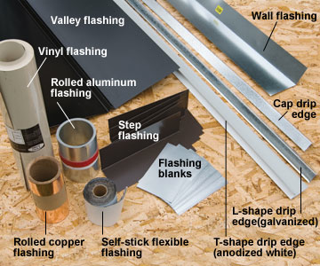
Flashing Materials
ROOFING, FLASHING aND ATTIC VENTILATION
Image courtesy of diyadvice.com
8
GJA 2025 Version III
Notes:
In weatherization, we won’t often be installing new roofing, but often are required to install or repair flashing where penetrations are made or roof leaks must be remedied. Here are some of the more common materials we use.
Aluminum – most common and will never rust.
Copper flashing – beautiful but expensive.
Vinyl flashing – easy to work with and does not crease as easily as metal flashings.
With a break, workers can fabricate flashings by bending metal strips or rolls, but preformed flashings for almost all situations are commercially available.
Valley flashing – for flashing valleys. Some have cleats, so you don’t need to drive nails through the flashing.
Drip edge comes in different styles:
T-shape – strong, will support roofing that overhangs the eaves.
L-shape – not as strong. Some builders use L-shape drip edge for the rake where strength is not an issue, and T-shape drip edge for the eaves.
Cap drip edge – for sealing multiple layers of roofing.
Step flashing – prebent pieces. You can also use blanks that you bend yourself. For counterflashing on chimneys, use blanks or cut pieces from a roll of flashing.
Self-stick flexible flashing – commonly used around windows and doors, but it can sometimes be used in difficult flashing situations, such as where a roof meets a wall.
Boot flashing (not shown) – vent pipe flashing with rubber gaskets that simply slides onto the pipes to provide a watertight seal. You can buy boot flashing with metal or plastic flanges.
Source – diyadvice.com
July 2012
8

Slide 9
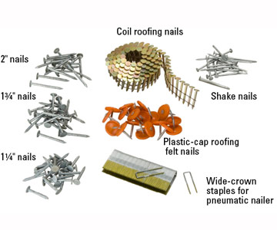
Common Fasteners
ROOFING, FLASHING aND ATTIC VENTILATION
Image courtesy of diyadvice.com
9
GJA 2025 Version III
Notes:
Fasteners must be long enough to penetrate the layers of roofing and completely poke through the sheathing. The required length will vary by application.
Galvanized nails are the most common choice for hand-nailing roofing.
Be sure to match metals when applying flashing. Use aluminum nails for attaching aluminum flashings, and copper nails for attaching copper flashings; if you mix metals, the nails or the flashing could corrode.
Nails with plastic caps are sometimes used to attach underlayment in high wind areas.
Nails with foam washers (not shown) are used on corrugated metal or plastic roofing. Always install through the peak of the corrugation to avoid leaks when water sits in the troughs.
Roofing nails are also available for power nailers, shown here in a coil.
Wide-crown staples are sometimes used with pneumatic nailers.
Nails for cedar shakes or shingles have thin shanks and small heads.
Source – diyadvice.com
July 2012
9

Slide 10
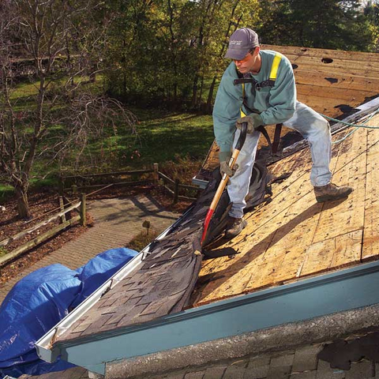
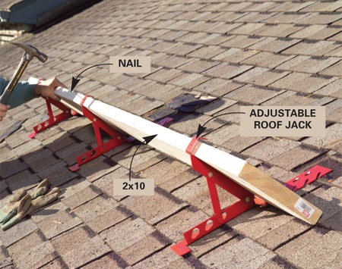
Removing Old Roofing
Install roof jacks to prevent debris from littering the area. Cover surrounding landscaping with tarps to ease cleanup.
Images courtesy of familyhandyman.com
10
GJA 2025 Version III
Notes:
Though uncommon in weatherization, if you do need to remove large areas of roofing, it is important to follow appropriate steps to avoid damaging underlayment and control debris throughout the project.
Install roof jacks to catch sliding debris and give workers a foothold on the roof.
Cover air conditioners and other mechanical systems with plywood to prevent clogging with debris.
Cover nearby landscaping with plastic or drop cloths to catch debris and ease cleanup.
For large jobs, begin at the peak and work downward. Those large jobs require a roofing fork or sometimes a snow shovel. For the smaller jobs typical in weatherization, removing a few shingles around a chimney for example, a small flat hand tool like a paint scraper used together with a flat prybar for loosening nails will be enough.
Evaluate flashing once it has been uncovered and remove if it needs to be replaced.
Sweep off the roof to prevent tripping, and cover with a waterproof layer before leaving for the day if the job can’t be completed in one day.
July 2012
10

Slide 11
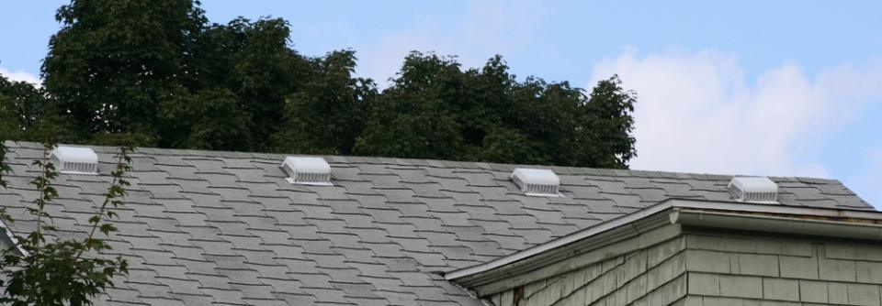
Purpose of Attic Ventilation
Photo courtesy of US Department of Energy
  Removes solar heat during hot weather.
  Removes moisture vapor during cold weather.
11
GJA 2025 Version III
Notes:
Attic insulation:
Removes solar heat during hot weather.
Removes moisture vapor during cold weather.
Anecdotal wisdom from the field indicates that less than 10 percent of homes in certain areas of the country have any type of roof ventilation. Many homes with roof vents have far fewer than required by code.
Q: If the purpose of attic ventilation is to remove moisture and solar heat, then why haven’t the majority of unvented roof systems failed? And why do certain roof systems fail regardless of whether they are vented or not?
A: Some of the causes of failure are obvious and can be resolved with attic ventilation. Other problems are more complex and require a broader approach. Attic ventilation is required and is therefore more closely related to code requirements than to building science.
July 2012
11

Slide 12
Common Misconceptions
  Attic ventilation always removes moisture
  vapor during cold weather.
  Attic ventilation will cure an attic moisture problem.
  The more attic ventilation, the better.
  Attic ventilation is not necessary.
12
GJA 2025 Version III
Notes:
Common misconceptions about attic ventilation include:
Attic ventilation always removes moisture vapor during cold weather.
Attic ventilation will cure an attic moisture problem.
The more attic ventilation, the better.
Attic ventilation is not necessary.
Some building scientists question the need for attic venting, particularly in cold climates where there is mounting evidence that attic ventilation may only worsen an existing attic moisture problem. On the other hand, codes require a certain amount of attic ventilation.
Raise these issues with participants in preparation for the slides that follow. Ask participants for examples from the field.
July 2012
12

Slide 13
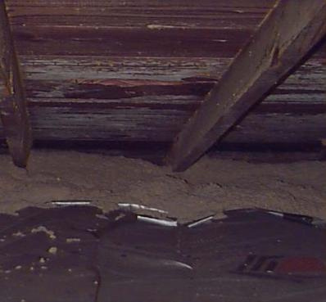
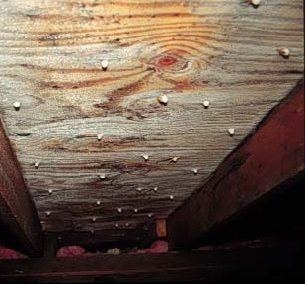
Post Wx Attic Moisture Problems
Mold on Sheathing
Frost on Sheathing
Photos courtesy of US Department of Energy
Both conditions occurred after attics were
insulated and vented, not before.
13
GJA 2025 Version III
Notes:
This photo shows mold and frost on sheathing after attic insulation and roof vents were installed.
In an uninsulated or unsealed attic, the house sufficiently warms the air to cause ventilation.
Insulation prevents the air in the attic from warming, thereby reducing its buoyancy and ability to vent.
The combination of high interior moisture sources and poor attic air sealing is one of the primary causes of roof failure in heating climates.
Attic vents have the potential to worsen an attic moisture problem. Venting provides openings that pull warm, moist air from the house through unsealed bypasses into the attic, where moisture can condense on cold surfaces. On very cold and still days, cold, dense air can sink into the attic space from the outside through the vents, cooling the attic surfaces even further. Additional venting is not the solution when attic air sealing and moisture mitigation would control moisture.
July 2012
13

Slide 14
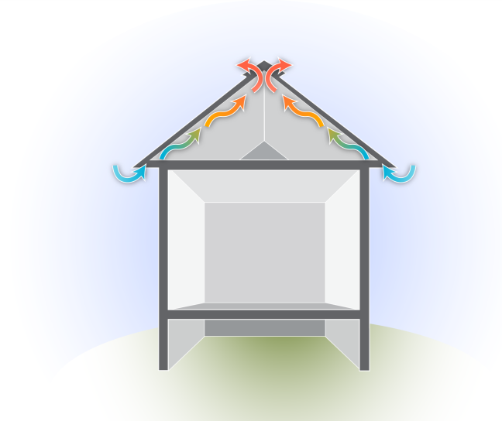
Passive Attic Venting: Convection
Ridge Vent
Outlet
(Heated Air)
How does it work?
Natural Convection
  Hot air rises,
  escapes high vents.
  Cooler air is pulled through soffit vents.
  Heat rises, escapes ridge vents.
Inlet
(Cool Air)
Graphic developed for the US DOE WAP Standardized Curricula
14
GJA 2025 Version III
Notes:
This graphic illustrates venting via natural convection.
Passive attic venting takes advantage of the natural buoyancy of air by providing inlets and outlets low and high on the roof. As air in the attic is warmed by solar radiation, it becomes lighter and rises, escaping through the higher vents. Cooler air is drawn in through eave vents as warmed air escapes. Venting is especially important in hot climates where attic temperatures can exceed 140F for long periods of time. Passive attic ventilation can significantly reduce cooling loads.
July 2012
14

Slide 15
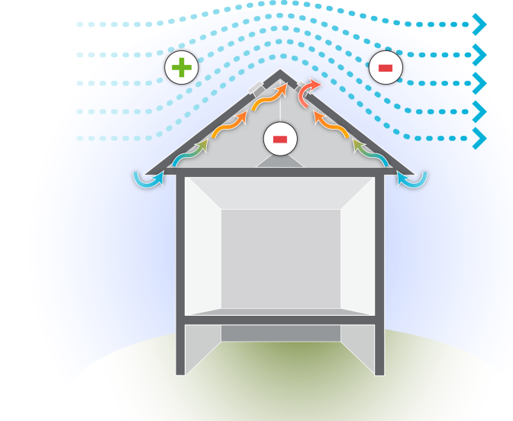
Passive Attic Venting: Wind
WIND
How does it work?
  Bernoulli Principle
  Positive pressure on windward side
  Negative pressure on leeward (protected) side
  Air is sucked out leeward vents
Graphic developed for the US DOE WAP Standardized Curricula
15
GJA 2025 Version III
Notes:
This graphic illustrates venting via wind effect.
Wind can also aid venting by creating positive pressure on the windward side of the roof and negative pressure on the leeward side. Air is exhausted from the attic by a phenomenon known as the “Bernoulli Principle,” where a sufficient air stream across an opening will create enough of a pressure difference to draw a liquid or gas (air) out of a vessel (attic space).
Demonstrate the Bernoulli principle with an old perfume bottle if possible or by puffing smoke into a bottle, then gently blowing across the opening, causing smoke to lift from the bottle. Or use chalk talk to illustrate the principle.
July 2012
15

Slide 16
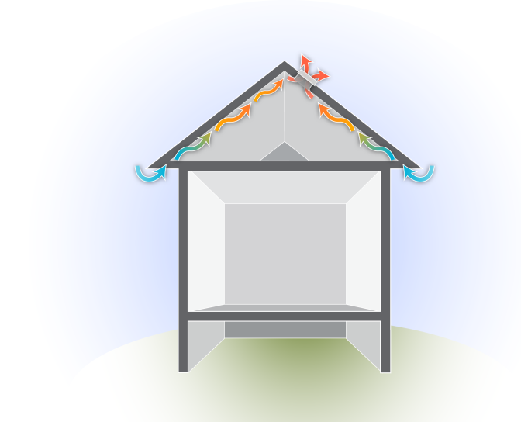
Power Venting
Fan-Powered Roof Vent
How does it work?
  Attic fan mounted in central hallway used in non-air-conditioned homes
  Roof vent (pictured) used
  in air-conditioned homes
  Neither is recommended
  as a weatherization measure.
  Potential for moisture condensation is high.
Graphic developed for the US DOE WAP Standardized Curricula
16
GJA 2025 Version III
Notes:
This graphic illustrates power venting.
Power ventilation is an active (non-mechanical) ventilation approach and can be accomplished in two ways.
In non-air-conditioned homes, temperatures may be controlled to some extent by the use of attic fans. An attic fan is usually mounted on the ceiling in a central hallway so that outside air is pulled through open windows and exhausted through the attic. The attic must have sufficient outlets to exhaust the air without creating high pressures against which the fan must operate.
Air-conditioned homes can use power attic ventilators with exhaust fans mounted through the roof or in the gable. The attic must have inlets for the ventilating air at opposite gable ends, or low-mounted roof vents if there is no roof overhang.
Power venting is generally not recommended as a weatherization measure because fans can draw warm humid air into the house, which may condense on cool surfaces in basements or crawl spaces.
Sufficient attic insulation and passive (non-mechanical) ventilation is a better alternative in most cases.
July 2012
16

Slide 17
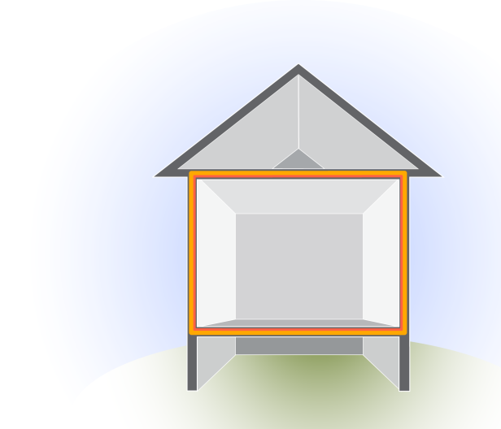
Code Issues
Thermal Boundary - Ceiling
Based on presence of ceiling vapor retarder
No vapor barrier: 1/150
One square foot of net free vent area per 150 square feet of attic.
Vapor barrier: 1/300
One square foot of net free vent area per 300 square feet of attic.
Graphic developed for the US DOE WAP Standardized Curricula
17
GJA 2025 Version III
Notes:
The amount of net free area (NFA) of vent required depends on the thermal boundary and vapor retarder.
When the ceiling is the thermal boundary, attic ventilation is required. Code requires using a 1/150 or 1/300 formula.
If the ceiling does not have a vapor retarder, use one sq. ft. of NFA per 150 sq. ft. of attic space (1/150).
If the ceiling does have a vapor retarder, less venting is required; use one sq. ft. of NFA per 300 sq. ft. of attic space (1/300).
Most code officials recognize a painted ceiling as a vapor retarder. Therefore, the 1/300 rule will likely apply in most cases.
NFA refers to the actual open area available to provide effective ventilation. For example, a 12” x 12” vent will provide somewhat less than 144 square inches of NFA because screens and louvers occupy some of the space.
Vents are rated by an R-value that relates to their NFA (not to be confused with insulation value). For example, an R-61 roof vent has an NFA of 61 square inches.
July 2012
17

Slide 18
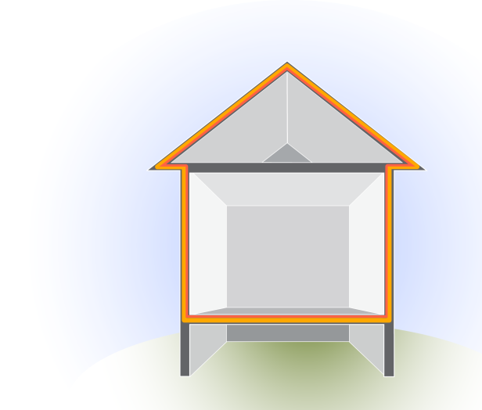
Code Issues
Thermal Boundary - Roof Deck
Attic ventilation is not required
when roof assembly is the thermal and pressure boundary.
Graphic developed for the US DOE WAP Standardized Curricula
18
.
.
.
.
.
GJA 2025 Version III
Notes:
When the roof deck is the thermal and pressure boundary, attic ventilation is not required nor recommended.
Finished attics or those containing HVAC equipment and duct systems are examples. The roof assembly in a finished attic should not be vented. Rather, it should be airtight and insulated with closed- or open-cell spray foam insulation.
July 2012
18

Slide 19
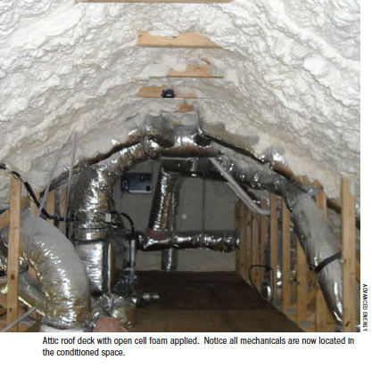
Insulating the Roof Deck
Insulating the roof deck brings the entire attic into the conditioned space. This is beneficial where ducts and pipes run through the attic. Shown here, spray foam has been applied to the roof deck. Rigid board and fiberglass are also used on roof decks.
Photo courtesy of Home Energy Magazine
19
GJA 2025 Version III
Notes:
In some situations, installers may be directed to insulate the roof deck instead of the attic floor. Spray foam, rigid board, and fiberglass (both batt and loose fill) can be used for this purpose.
This can be be very convenient if live knob and tube wiring is found on the floor of a knee-wall attic.
Insulating the roof deck brings the entire attic into the conditioned space. This can be very beneficial when ductwork and plumbing runs through the attic.
Q: What might be a negative result of insulating the roof deck?
A: More building volume to condition than if the building envelope didn’t include the attic. Also, roof leaks may take longer to show signs, causing more damage to the roof sheathing before they are discovered.
Where spray foam is applied to the roof deck, generally a ½-lb. foam with CO2 (instead of refrigerant) is used as the blowing agent. This foam is less dense, and allows water to penetrate. This way, roof leaks can be discovered and repaired before long-term damage is done to the roof deck or framing.
July 2012
19

Slide 20
Ground Rules and Specifications
  Vented attics should not communicate with the conditioned space.
    The ceiling air barrier must be continuous with no leakage.
    Specify appropriate attic sealing as part of the work scope.
  Specify that vents be placed low and high on roof.
  Specify eave chutes when soffit vents are present
  and loose fill insulation is needed.
  Specify that all mechanical ventilation ducts and
  plumbing stacks are vented directly to the outside.
20
GJA 2025 Version III
Notes:
Vented attics should not communicate with the conditioned space.
The ceiling air barrier must be continuous with no leakage.
Specify appropriate attic sealing as part of the work scope.
Specify that vents be placed low and high on the roof.
Specify eave chutes when soffit vents are present and loose fill insulation is needed.
Specify that all mechanical ventilation ducts and plumbing stacks be vented to the outside.
Air sealing specifications are an important part of attic retrofits, but are listed here to underscore their importance for attic ventilation.
July 2012
20

Slide 21
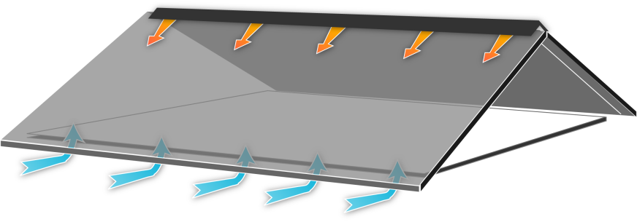
Venting Configurations
In a perfect world…
Continuous Ridge Vent
Continuous Eave Vent (Soffit Vents)
Graphic developed for the US DOE WAP Standardized Curricula
21
GJA 2025 Version III
Notes:
This graphic illustrates continuous soffit and ridge venting.
Continuous soffit and ridge venting is the best configuration because it allows for a good cross flow of ventilating air from low to high points in the roof assembly. However, this is best done during original construction. It would be impractical and costly to attempt to ventilate every roof this way.
Many vent types are available to accommodate different venting situations and roof configurations.
July 2012
21

Slide 22
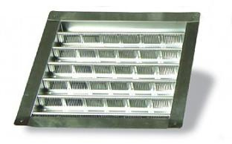
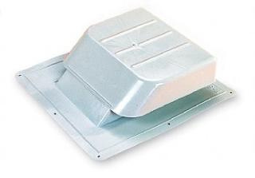
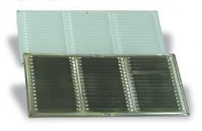
Vent Types
Gable Vent
Roof Vent
Images courtesy of J&R Products Inc.
Eave Vent
22
GJA 2025 Version III
Notes:
These are photos of gable, roof, and eave vents.
There are several types of passive attic vents. Gable and roof vents are the most commonly used in weatherization.
Gable vents are available in many sizes, in aluminum or acrylonitrile butadiene styrene (ABS) plastic, and are designed to be installed on gable ends. When installed on opposite gable ends, they allow for good cross flow across the length of an attic.
Roof vents are designed to be installed on pitched roofs and are available in aluminum and ABS plastic. Roof vents are rated by their net free area; an R-61 vent has an NFA of 61 sq. in.
Eave vents are used when there is sufficient soffit area and cross flow is required. They are difficult to install, and it takes a lot of them to have much effect.
July 2012
22

Slide 23
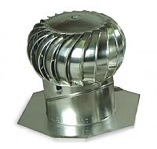
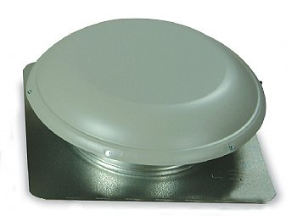
Vent Types
Turbine Vent
R-144 Mushroom Roof Vent
Images courtesy of J&R Products Inc.
23
GJA 2025 Version III
eere.energy.gov
Notes:
These are photos of turbine and large mushroom roof vents.
Turbine vents are rated to vent 600 sq. ft. when used with 300 sq. in. NFA of eave vents. A turbine vent has a galvanized adjustable base to fit most roof slopes. Because they are subject to mechanical failure and contribute to air leakage, turbine vents are not recommended in weatherization.
The large R-144 mushroom vent has more than twice the NFA as two R-61 roof vents. The opening is also large enough for an average-sized person to fit through when attic access through the roof deck is the only option.
July 2012
23

Slide 24
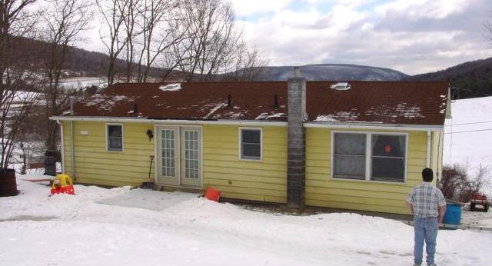
Vent Placement
Roof vents placed high on roof
Continuous Soffit Vent
Photo courtesy of PA WTC
24
GJA 2025 Version III
Notes:
This is a photo showing vents placed high on the roof.
Continuous soffit venting on both roof eaves provided the low vents, which allow for a good cross flow from low to high points within the attic space.
If no soffit venting is present, a combination of high and low roof vents is recommended.
July 2012
24

Slide 25
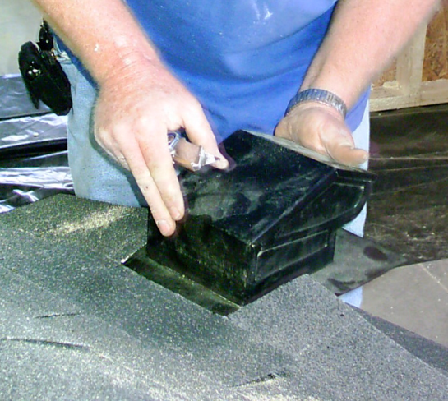
Vent Installation
  Cut hole to fit;
  test fit vent.
  Caulk edges of hole where flange will sit.
  Slide vent into place under shingles.
  Seal and nail.
Photo courtesy of the US Department of Energy
25
GJA 2025 Version III
Notes:
Installers should follow these guidelines. Specify details as needed:
Cut the appropriately sized hole and test-fit the vent. The flange is designed to slide under the roofing.
Once a proper fit is established, remove the vent and caulk a bead of roof cement under the shingles around the edges where the flange will sit.
Slide the vent into position, caulk with roof cement, and fasten through the roof deck with galvanized roofing nails.
Cover nail heads with roof cement. Nails should not be exposed.
July 2012
25

Slide 26
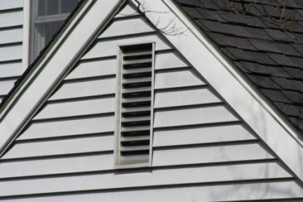
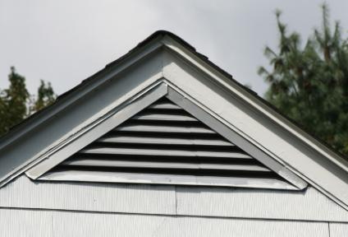
Vent Placement
Gable vents are attached similarly to roof vents.
Photos courtesy of the U.S. Department of Energy
26
GJA 2025 Version III
Notes:
These photos illustrate rectangular and triangular gable vents.
To install, cut an appropriately sized hole near the peak of each gable end. The vent is then caulked and fastened with galvanized nails or screws through the flange into the finished siding.
July 2012
26

Slide 27
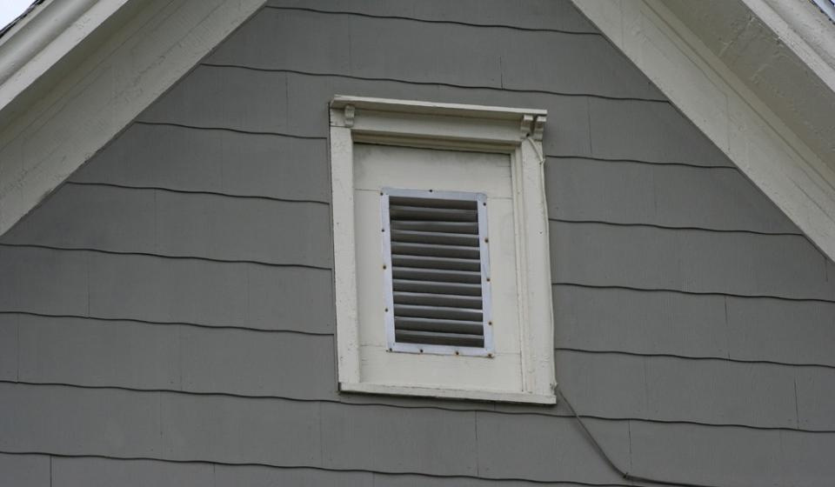
Attic Window Vent
Photo courtesy of the US Department of Energy
27
GJA 2025 Version III
Notes:
This photo illustrates the common practice of replacing an existing attic window with a plywood panel and standard rectangular gable vent.
Converting old attic windows to an attic vent saves the home from one more penetration.
July 2012
27

Slide 28
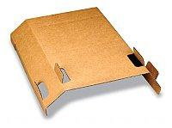
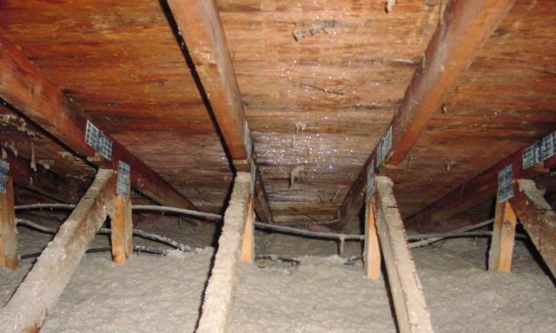
Eave Chutes
Eave Chute
Photo courtesy of PA WTC; Product photo by J&R Products, Inc.
28
GJA 2025 Version III
Notes:
This is a photo of installed eave chutes.
When soffit vents are part of the attic ventilation scheme, eave chutes should be installed before attic insulation is blown in.
Eave chutes maintain air space between the insulation blanket and the roof sheathing, and prevent insulation from clogging soffit vents.
Without eave chutes, installers may be tempted to scrimp on blown-in insulation around the edges to prevent blocking soffit vents. Specify chutes to maintain attic ventilation and encourage fast, effective attic insulation work.
July 2012
28

Slide 29
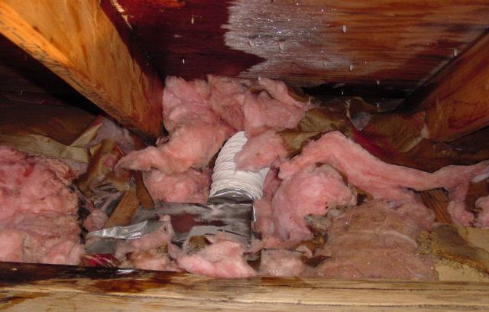
Mechanical Vent Terminations
Photo courtesy of PA WTC
29
GJA 2025 Version III
Notes:
This is a photo of a disconnected bathroom exhaust fan and resulting degradation of roof sheathing.
Specify that all mechanical vents be vented to the outside before attic vents or insulation is installed.
Vent terminations must prevent intrusion of moisture, materials, and animals into the vents.
July 2012
29

Slide 30
Summary
  Use proper fall protection when working on roofs.
  Leaks are most common at flashing. Re-create a quality drainage plain to repair.
  Attic ventilation is intended to remove solar heat during hot weather and water vapor during cold weather.
  Attic ventilation is required by code, but expert opinions vary on the actual value.
  Insulated roof decks bring the attic into the conditioned space and should not have attic venting.
  Any new penetrations through the roof must be properly flashed.
30
GJA 2025 Version III
Notes:
Use proper fall protection when working on roofs
Leaks are most common at flashing. Re-create a quality drainage plain to repair.
Attic ventilation is intended to remove solar heat during hot weather and water vapor during cold weather.
Attic ventilation is required by code, but expert opinions vary on the actual value.
Insulated roof decks bring the attic into the conditioned space and should not have attic venting.
Any new penetrations through the roof must be properly flashed.
Present this slide as an interactive discussion, soliciting personal examples from the trainees. Add your own personal examples and knowledge to supplement.
July 2012
30

