Slide 1




Mechanical Ventilation
WEATHERIZATION ENERGY AUDITOR SINGLE FAMILY
30
GJA 2024 Version III

Slide 2
Learning Objectives
By attending this session, participants will be able to:
Describe the importance of maintaining healthy Indoor Air Quality (IAQ) and the role of mechanical ventilation.
Recognize that a leaky home is not a substitute for proper ventilation.
Identify appropriate ASHRAE guidelines.
Calculate building volume.
Propose appropriate fan size based on static pressure.
Name the guidelines of proper duct installation.
30
GJA 2024 Version III
Notes:
By attending this session, participants will be able to:
Describe the importance of maintaining healthy IAQ and adequate combustion air, and the role of mechanical ventilation.
Recognize that leaving homes leaky is not proper ventilation.
Identify appropriate ASHRAE guidelines.
Calculate building volume.
Propose appropriate fan size based on static pressure.
Name the guidelines for proper duct installation.

Slide 3
Why is Ventilation Important?
Why is Ventilation Important?
Indoor Air Quality (IAQ)
Carbon Monoxide (CO) Levels
Adequate Combustion Air
3
GJA 2024 Version III
Notes:
Why is ventilation important? It helps ensure adequate Indoor air quality (IAQ), including the main safety concerns:
Carbon monoxide (CO) levels, and
Adequate combustion air.
Proper ventilation maintains healthy IAQ and helps ensure that combustion appliances have access to adequate combustion air.

Slide 4
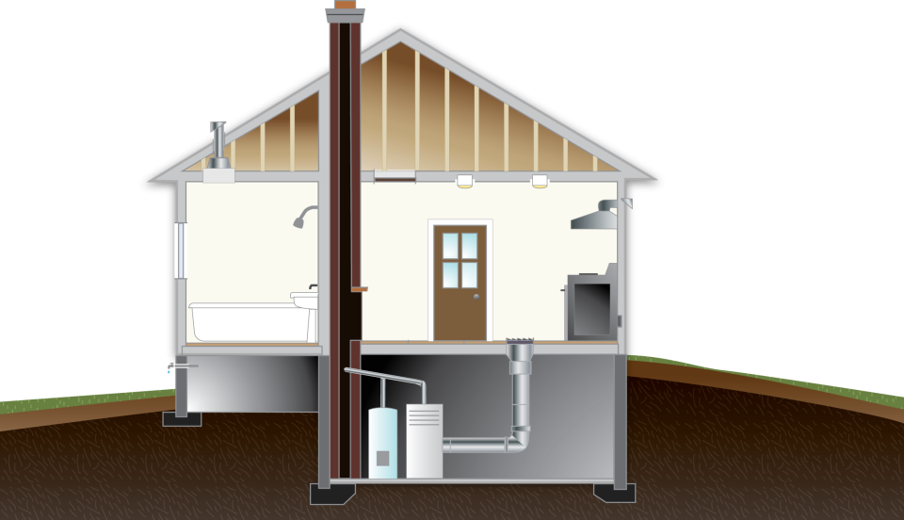
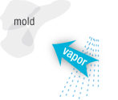


Why is Ventilation Important?
Graphic developed for the US Department of Energy
4
GJA 2024 Version III
Notes:
Many factors within the home can lead to poor IAQ, including:
Elevated levels of carbon monoxide from combustion appliances.
Off-gassing of commercial paints and building materials.
Moisture issues that can lead to mold or mildew.

Slide 5

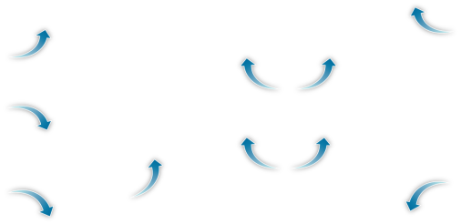
Ventilation:
Why Seal the Leaks at All?
MECHANICAL VENTILATION
Graphic developed for the US Department of Energy
5
GJA 2024 Version III
Notes:
Why don’t we just leave the house leaky?
No control over the air source − Air might be escaping through the attic and be pulled into the home from the musty crawl space under the home. This isn’t exactly fresh air.
No control over ventilation rate – In the absence of driving forces, such as a lack of wind on a calm day, ventilation levels may not be high enough to ensure healthy IAQ. And on days with excessively high driving forces, as in stack effect during sub-zero days, there may be far too much ventilation and associated energy loss.

Slide 6
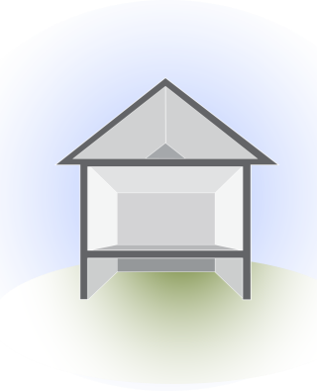
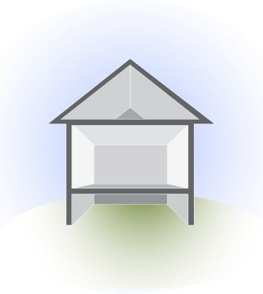
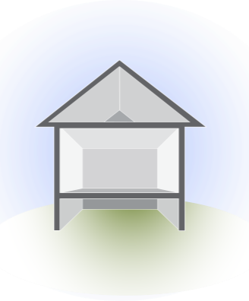

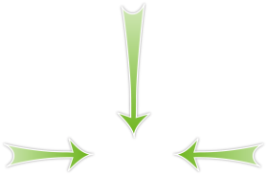
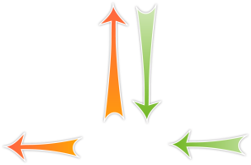
Goals of Ventilation
Stale Air Out
Fresh Air In
Neutral Pressure
Graphic developed for the US Department of Energy
6
GJA 2024 Version III
Notes:
The goals of ventilation are:
Get stale, polluted air out. Ducts must bring exhaust air all the way outside, not into the attic.
Get fresh air in. The intake should be outside, not in the garage or somewhere the air could be polluted before it enters the house.
Maintain close to neutral pressure in the home. Exhaust fans shouldn’t be so strong or out of balance with the home that they create a negative pressure in the home.

Slide 7
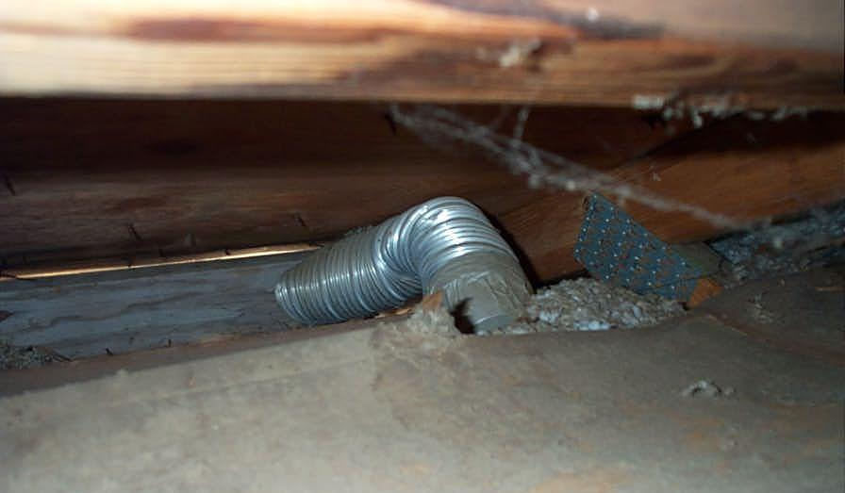
Goals of Ventilation
Is this getting the stale air out?
Photo courtesy of the US Department of Energy
7
GJA 2024 Version III
Notes:
Is this getting the stale air out?
This duct almost made it outside, but close only counts in horseshoes and hand grenades.

Slide 8
Motto of Weatherization
“Build Tight,
Ventilate Right”
8
GJA 2024 Version III
Notes:
“Build Tight, Ventilate Right”
This means we strive for a tight building envelope and then add ventilation as needed to provide adequate fresh air. This is the best way to ensure good IAQ without wasting energy.

Slide 9
Ventilation Strategies
Leave Homes Leaky
“Spot” exhaust ventilation at sources
Whole House exhaust ventilation (may have passive intake “trickle” vents)
Heat Recovery Ventilation - balanced system
9
GJA 2024 Version III
Notes:
Click to cross out “Leave homes leaky.” Click to check off each item in turn.
Leaving homes leaky is not a reliable way to ventilate a home.
Whole House Exhaust Ventilation Systems − These are not very common in Weatherization work due to the high labor and materials costs.
Heat Recovery Ventilation Systems (HRV)− Most common in cold climates, these are typically whole-house systems that have the added bonus of reclaiming some of the heat from exhaust air and passing that heat on to the intake air so less energy is needed to heat the home.
Spot Source Ventilation − Also called local ventilation, this is most common in Weatherization work. Spot source ventilation aims to remove pollutants at the source. Typical examples are kitchen exhaust fans and bathroom exhaust fans.

Slide 10
Converting from ACH to CFM
Mechanical exhaust fan flow (CFM) =
Room Volume (ft³) x Desired ACH ⎟ 60 min/hour
SPOT EXHAUST VENTILATION EXAMPLE
What size (CFM flow) exhaust fan will provide 8 ACH in a 12 ft x 7ft bathroom with 8 ft ceiling height.
Room Volume x 8 ACH / 60 min/hour CFM = FAN CFM
(12ft x 7ft x 8ft) x 8 ACH ⎟ 60
672 ft³ x 8 ACH ⎟ 60 = 90 CFM
10
GJA 2024 Version III
Notes:
Fans are rated in CFMs, but some guidelines are stated in ACH. How do you convert?
The math is simple.
For example, what size bathroom exhaust fan is needed to achieve the 8 ACH recommended by the Home Ventilation Institute?
Multiply the volume of the bathroom (the amount of air you need to ventilate) by the desired ACH, in this case 8, and divide by 60 to go from hours (in air changes per hour) to minutes (in cubic feet per minute).
(12 ft x 7 ft x 8 ft) x 8 ACH ÷ 60 minutes/hour
Work through the math as a class. Click to reveal the answer.
672 ft³ x 8 ACH ÷ 60 minutes/hour = 89.6 CFM
To reach the ventilation requirement, the fan must move 90 CFM.

Slide 11
Ventilation Terminology
Minimum ventilation rate (MVR) – historical use
Building tightness limit (BTL) – historical use
N-Factor – historical use
Air changes per hour (ACH)
Cubic feet per minute (CFM)
  Spot exhaust ventilation: kitchen, bathroom,
  Whole house ventilation
11
GJA 2024 Version III
Notes:
Below is important ventilation terminology.
Minimum ventilation rate (MVR)− This is the minimum amount of fresh air needed to maintain adequate indoor air quality in the home. MVR is based on the number of occupants and the size of the home and is measured in terms of cubic feet per minute or air changes per hour.
Building tightness limit − This is the limit, typically represented in terms of CFM₅₀, below which mechanical ventilation must be added to the home. Some programs have traditionally used BTL as a “line in the sand” below which they would not conduct any more air sealing regardless of the SIR for that measure. With the adoption of ASHRAE 62.2 in Program Year 2013, this is no longer an acceptable practice. Cost-effectiveness guides air sealing, and ASHRAE 62.2 requirements guide ventilation strategy.
Cubic feet per minute − Usually seen as CFM₅₀, cubic feet per minute of air movement due to 50 Pa house/outdoor pressure differentials created during blower door testing. CFM is the unit of measure most common for discussing airflow, air leakage, and fan flows.
Air changes per hour − Usually seen as ACH₅₀, the number of times the volume of air in a structure will change in 1 hour at the induced blower door house pressure of 50 Pa. ACH are used to put the standard CFM units of measure into context of the home (or room) size.
N-Factor - Used to convert readings taken at CFM₅₀ to CFM_{natural}, the amount of air leakage that occurs naturally. The N-factor depends on climate, building height, and shielding from wind. N ranges from 9.8 to 29.4 but typically averages about 20. A higher N-factor means the blower door is creating more exaggerated conditions. A lower N-factor means the blower door reading is closer to the natural leakiness of the home.
Q: What are appropriate levels of ventilation?
A: Click to next slide for discussion.

Slide 12


Ventilation Standards
ASHRAE 62.1
15 CFM/person total
0.35 ACH
Volume based on profile
ASHRAE 62.2-13
7.5 CFM/person mechanical
3 CFM/100 ft² floor area
Estimates house volume based on floor area
Top view
Graphic developed for the US Department of Energy
12
GJA 2024 Version III
Notes:
Both ASHRAE standards are based on building size and the number of occupants.
ASHRAE 62.1 – for multifamily buildings taller than three stories:
15 CFM/person total, under natural conditions
0.35 ACH – If there are 0.35 or more ACH, no additional ventilation is needed.
Volume based on profile – Calculations of the home area are based on a profile of the vertical area above grade.
ASHRAE 62.2 applies to all homes three-stories tall or less, including both single and multifamily:
7.5 CFM/person plus 1 CFM/100 ft² mechanical ventilation
Volume based on footprint – Calculations of the home area are based on a footprint of the horizontal area at grade.

Slide 13
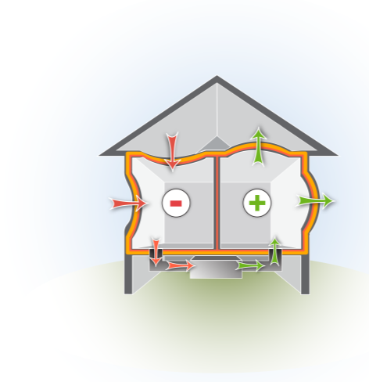
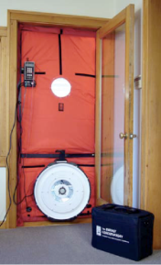
Measuring Ventilation
Tools for Measuring IAQ and Ventilation Rates
Images courtesy of the US Department of Energy
Worst case CAZ depressurization procedure
Blower door
Manometer
Combustion Analyzer
Exhaust fan flow hood
13
GJA 2024 Version III
Notes:
Common tools for measuring ventilation and IAQ include:
Blower door – Depressurize the house to -50 Pa with reference to outside and divide by an N-factor, typically around 20 to determine natural ventilation. A blower door reading of 1,600 CFM₅₀ equals around 80 CFM_{natural}.
CO tests – CO testing is one of the most important tests related to weatherization work because it saves lives. Test all combustion appliances and the ambient levels.
Combustion analysis/worst case depressurization – Ensure that there is enough combustion air to supply any atmospheric combustion appliances, even under worst-case conditions.

Slide 14



Measuring Building Volume
Exterior Measurements
Interior Measurements
Graphic developed for the US Department of Energy
14
GJA 2024 Version III
Notes:
As described by ASHRAE, interior measurements are used to determine the amount of air that needs to be ventilated. This is an important distinction, because auditors may have already used the exterior measurements to estimate insulation needs, but interior volumes may vary.
Click to reveal exterior, then interior measurements.
Story heights include the floor cavity. Building height includes only up to the air barrier of the building.
If heating equipment is located in the basement (even an unconditioned basement) and combustion air is drawn from there, it may make sense to include that space in the calculations.

Slide 15
Sample ASHRAE Calculations
MECHANICAL VENTILATION
ASHRAE 62.2-13
Whole House Ventilation Requirement (without exhaust fan or blower door credits) see RedCalc.com
Qtot = (0.03 x Conditioned Floor Area) +
(7.5 cfm x (#bedrooms+1))
Example:
Area of conditioned space = 1,600 sq ft
#Bedrooms = 3 (Use Occupants if more than Bdrms+1)
(0.03 x 1,600) + (7.5 x (3+1)
48 + 7.5 x 4 = 78 CFM
15
GJA 2024 Version III
Notes:
Auditors will typically use a spreadsheet or software to do these calculations, but it's good to know the reasoning behind the numbers that are generated by those tools.
These calculations determine what size fans are needed to maintain minimum ventilation requirements.
Sample situation:
5 people in a 3-bedroom 1,000-square-foot house with 8-ft ceilings
The home has already been weatherized and the installers did an excellent job. The final blower door test read 800 CFM₅₀.
The only mechanical ventilation in the house is a tiny kitchen exhaust fan that operates at 20 CFM.
The house is a well-shielded 1.5 story in Portland, ME.
Q: What is the required ventilation in this situation, and what (if anything) do you need to add to meet that requirement?
Walk through the next few slides with students, letting them make calculations as they appear in the presentations. Answers to the question above are shared on slides 18 and 19.

Slide 16
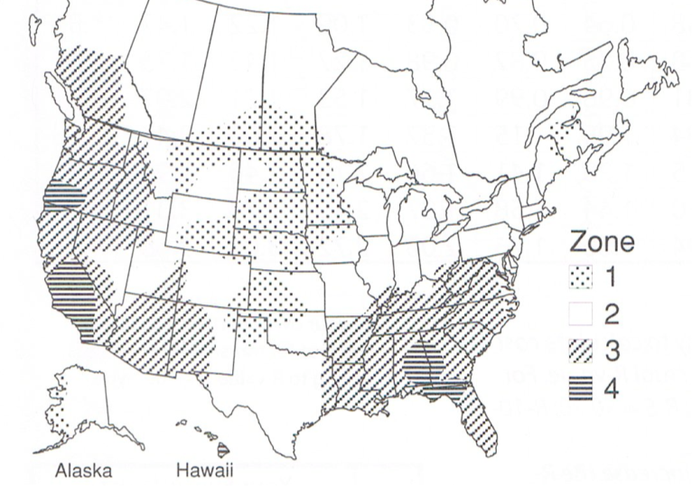
LBL Climate Zone Map
Graphic courtesy of Lawrence Berkeley National Laboratory.
16
GJA 2024 Version III
Notes:
Lawrence Berkeley Laboratories devised a way to estimate natural air-leakage based on CFM₅₀ readings from blower door tests.
Here is the map of climate zones developed by Lawrence Berkeley Labs to estimate the N-factor. For our sample calculations, the home is in climate zone 2.

Slide 17
N-Factors (historical reference)
Climate Zone | # of Stories > | 1 | 1.5 | 2 | 3
1 | Well-shielded | 18.6 | 16.7 | 14.9 | 13.0
 | Normal | 15.5 | 14.0 | 12.4 | 10.9
 | Exposed | 14.0 | 12.6 | 11.2 | 9.8
2 | Well-shielded | 22.2 | 20.0 | 17.8 | 15.5
 | Normal | 18.5 | 16.7 | 14.8 | 13.0
 | Exposed | 16.7 | 15.0 | 13.3 | 11.7
3 | Well-shielded | 25.8 | 23.2 | 20.6 | 18.1
 | Normal | 21.5 | 19.4 | 17.2 | 15.1
 | Exposed | 19.4 | 17.4 | 15.5 | 13.5
4 | Well-shielded | 29.4 | 26.5 | 23.5 | 20.6
 | Normal | 24.5 | 22.1 | 19.6 | 17.2
 | Exposed | 22.1 | 19.8 | 17.6 | 15.4
17
GJA 2024 Version III
Notes:
Using this table and the map of climate zones, we find the correct N-factor. Divide the blower door reading at CFM₅₀ by the appropriate N-factor to get the estimated CFM_{natural} of the home.
Q: What would change in our equation if the home was exposed?
A: The N-factor would be 15, instead of 20. Natural ventilation would be 53 (800/15) instead of 40 (800/20), so we would need to add less mechanical ventilation.

Slide 18
Static Pressure
Duct materials matter: rigid metal, “flex duct” (mylar with spiral wire), etc
Determine the equivalent “straight” duct length:
Measure straight duct lengths
See tables: elbows, corners, bends, kinks
Grills, end-caps
See tables for duct sizes that can provide sufficient cfm for the system
How do we end a trunk run?
18
GJA 2024 Version III
Notes:
Even when perfectly designed and installed, fans may not perform at their rated CFM because of static pressure.
Static pressure is the resistance from the inlet grill, duct runs, elbows, and outside termination that the fan must overcome to move air through the system.
Factors affecting static pressure include:
Length and material of ducts.
Bends, kinks, and elbows.
Grills and end-caps.

Slide 19
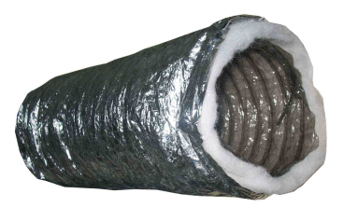
Air Flows More Easily…
through this…
than this
Photos courtesy of the US Dept. of Energy
19
GJA 2024 Version III
Notes:
Air flows more easily through smooth materials than rough.

Slide 20
Air Flows More Easily…
through this…
than this…
or this
Photos courtesy of Daniel Friedman and the US Department of Energy
20
GJA 2024 Version III
Notes:
Air flows more easily through smooth, broad angles than tight or constricted ducts.

Slide 21
Sample Static Pressure Calculation
Equivalent Duct Length (EDL)
 |  | DUCT DIAMETER
 |  | 4” | 6”
Duct | Smooth Metal | Same as measured duct length
Material | Metal-Flex | 1.25 x duct length | 1.5 x duct length
 | Mylar-Flex | 1.5 x duct length | 2 x duct length
Terminal | Wall Cap | 30 feet | 40 feet
Device | Roof Cap | 30 feet | 40 feet
Elbow | Adjustable | 15 feet | 20 feet
(12ft x 1.25_{material factor}) + 15ft_{elbow} + 30ft _{end-cap} =
60 ft. EDL
21
GJA 2024 Version III
Notes:
The equivalent duct length is one way to account for static pressure when sizing fans.
All manufacturers have performance curves for the fans they manufacture. They all provide tables to determine the actual fan size needed to overcome static losses and reach CFM requirements.
Taking the bathroom example where we converted ACH to CFM, the target is 8 ACH, which requires 90 CFM.
Work through the math as a class, then click to reveal the answer.
Assuming 12 ft of 4-inch flexible aluminum ductwork, one 90-degree elbow, and an end-cap, the EDL is 60 ft.
Here’s how:
The duct material: Flexible aluminum offers more air resistance than rigid, smooth metal ducts, so we multiply the length of the ducts (12 ft) by the factor of 1.25 to account for increased resistance.
12 x 1.25 = 15 ft EDL.
Pushing or pulling air through a 90-degree bend is harder than through straight ductwork. In this case, it’s as difficult as pushing or pulling air through 15 ft of straight ducts.
The end cap creates as much resistance as moving air through another 30 ft of straight ducts.
The result: 15 (EDL of material) + 15 (elbow) + 30 (end cap) = 60 ft EDL.

Slide 22
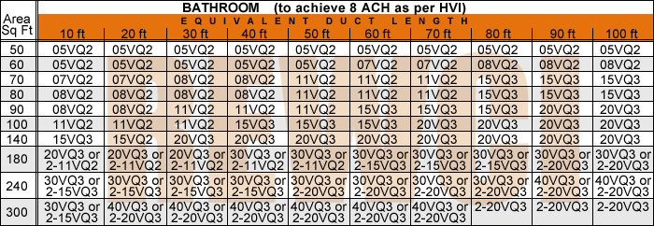
Fan Sizing Chart Using EDL
60 ft
90
15VQ3
Graphic developed for the US Department of Energy
22
GJA 2024 Version III
Notes:
Click to reveal arrows while explaining how to use the chart.
Use the fan-sizing chart from the manufacturer to determine which fan achieves the goal of 8 ACH.
Based on calculations in the last slide, a fan that can move 90 CFM is required.
This table indicates that to overcome the static pressure and achieve 8 ACH in a 90 ft² room (always round up) with a 60 ft EDL, the 15VQ3 150 CFM fan is required.

Slide 23
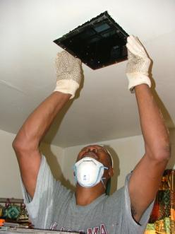

Meeting Ventilation Goals
MECHANICAL VENTILATION
Photos courtesy of the US Department of Energy
More than just installing a fan, it’s ensuring a safe and healthy environment
23
GJA 2024 Version III
Notes:
Meeting ventilation goals generally involves tuning or installing exhaust fans and sometimes adding fresh-air intake.
Ensuring proper ventilation makes the home safer and healthier for occupants.

Slide 24
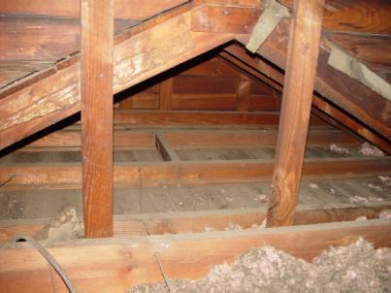
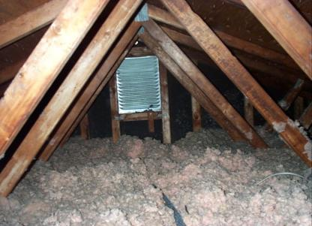
Timing Installation
Would you rather install equipment…
Photos courtesy of the US Department of Energy
here…
or here?
24
GJA 2024 Version III
Notes:
It’s much easier to install an exhaust fan and the ductwork before blowing the attic full of loose insulation.

Slide 25
Installation Guidelines
Exhaust flows directly outside.
Use short, straight, well-sealed ducts.
Use 2-3 feet straight pipe before an elbow.
Use long-radius elbows.
Use smooth materials.
Insulate in under-conditioned spaces.
Protect from animal and pests.
Follow manufacturer specs and installation instructions.
25
GJA 2024 Version III
Notes:
Below are some important installation guidelines.
Exhaust flows directly outside.
Use short, straight, well-sealed ducts.
Use 2–3 ft straight pipe before elbow.
Use long-radius elbows.
Use smooth materials.
Insulate ducts.
Keep animals out.
Follow manufacturer specs and installation instructions.
Ask students if they follow these guidelines. If not, why not?

Slide 26
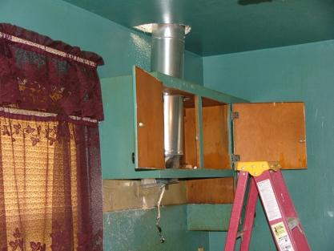
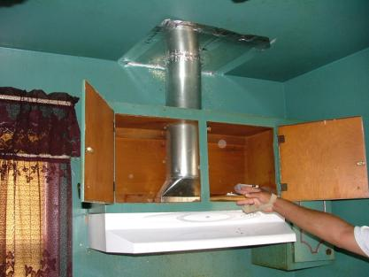
Installation Guidelines - Exhaust
Exhaust flows directly outside. Air seal penetrations.
Photos courtesy of the US Department of Energy
26
GJA 2024 Version III
Notes:
Exhaust flows directly outside.
This is a good hood fan installation.
The ducts are properly sized, smooth, and straight and flow directly outside.

Slide 27
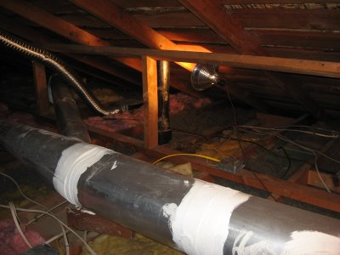
Installation Guidelines - Ducts
MECHANICAL VENTILATION
Short, straight, well-sealed ducts.
Photo courtesy of the US Department of Energy
27
GJA 2024 Version III
Notes:
Use short, straight, well-sealed ducts.
Q: Do you use duct tape for duct sealing?
A: No! Mastic.

Slide 28
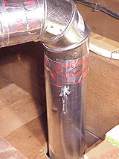
Installation Guidelines - Elbows
NEED 2 to 3 feet of straight pipe before first elbow
Photos courtesy of the US Department of Energy
28
GJA 2024 Version III
Notes:
Use 2–3 feet of straight pipe before the first bend.
This helps the air get up some speed before it’s hindered by bends.

Slide 29
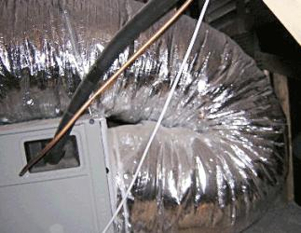
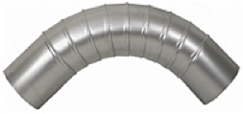
Installation Guidelines - Elbows
MECHANICAL VENTILATION
Long-Radius Elbows
VS
Image Source: http://isystemsweb.thomasnet.com/item/duct-and-components/machine-made-elbows/elmm11-45?&seo=110&bc=100%7C1015
29
GJA 2024 Version III
Notes:
Use long radius elbows.
It’s all about building easy pathways for air to follow.

Slide 30
Installation Guidelines - Materials
MECHANICAL VENTILATION
Smooth, Rigid Ducting Material
VS
Photos courtesy of the US Department of Energy
30
GJA 2024 Version III
Notes:
Use smooth, rigid ducting.
Ease of airflow
Easier to clean, stays clean longer

Slide 31
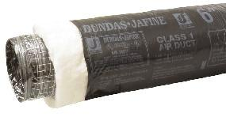
Installation Guidelines - Insulation
Insulate ducts running through unconditioned spaces.
Photo courtesy of the US Department of Energy
Insulated = no condensation, energy conservation
Uninsulated = Moisture damage and wasted energy
Image Source: Jones Property Inspections
http://www.jonespropertyinspections.com/images/Insulation%20inspection%20-%20torn%20&%20missing%20duct%20insulation,%20allowing%20condensation%20to%20drip%20in%20crawlspace%20(pools%20forming).jpg
31
GJA 2024 Version III
Notes:
Insulate ducts running through unconditioned spaces.
Insulate ducts running through unconditioned space to at least R-5 to save energy and prevent condensation.
Condensation forming on uninsulated ducts carrying air below the dew point can cause serious moisture damage to surrounding building materials.

Slide 32
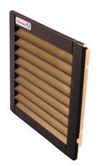
Installation Guidelines - Terminations
Duct terminations must keep animals out.
Photo courtesy of the US Department of Energy
Grilles keep animals out;
safer for them, safer for home
Bird’s nest being pulled from the ductwork
32
GJA 2024 Version III
Notes:
Duct terminations must keep animals out.
Ask students about various things they have found in ducts.

Slide 33
Summary
Proper ventilation maintains healthy IAQ and
adequate combustion air.
Leaving homes leaky is not proper ventilation.
Use appropriate ASHRAE guidelines.
Consider static pressure when sizing fans.
Install ducts properly: Mechanical connections, Metal elbows, Flex-duct best if straight only, fully stretched; Seal all joints and seams, insulate in unconditioned spaces (R-8 now), TERMINATE OUTSIDE.
33
GJA 2024 Version III
Notes:
Proper ventilation maintains healthy IAQ and adequate combustion air.
Leaving homes leaky is not proper ventilation.
Use appropriate ASHRAE guidelines.
Consider static pressure when sizing fans.
Install ducts properly.
Present this slide as an interactive discussion, soliciting personal examples from the trainees. Add your own personal examples and knowledge to supplement.

